Slide 1


Reasonable Adjustment
Digital Flag (RADF)
Universal Care Plan
Tricia Handley
Health Improvement Manager
Learning Disability & Autism Programme
NHSE London Region
Patriciahandley@nhs.net

Slide 2

Adi is 54 has a mild cognitive impairment
He recently had a stroke
Has type 2 diabetes
He lives alone
Supported district nurses for daily insulin
Carers 3 x daily to support activities daily living
Adi receives a health appt letter ……

Slide 3
Background – Reasonable Adjustment Digital Flag
Reasonable Adjustments not new - under Equality Act (2010 )
The RAD Flag is new(ish) National programme
Who does it apply to - all individuals under the Equality Act “have a physical or mental impairment that has a substantial and long-term adverse effect on the persons’ ability to carry out normal day-to-day activities” – suggested 17% - 20% people we see (national team) – very broad
What Organisations Does it apply to – all health and social care settings, including private establishments if they are treating NHS patients
Why- without specific adjustments being made, access care and treatment is not equitable for people who have a disability/long term impairments –Transformational for our most vulnerable and disempowered members of our population – challenge for system/staff
I

Slide 4
How Does it Work – Reasonable Adjustment Digital Flag
  Front line staff who come into contact with patients *need to (1) identify patients who RADF applies to - followed by the reasonable adjustments
  Flag can be added to record by a range of health and care staff in partnership patient - reviewed and updated as needed-
  IT suppliers Nationwide* are working with the National RADF team
  When the system goes live the RA’s will be seen wherever the patient presents across the country
  Full conformance Sept 30th 2026
  * NHS APP

Slide 5
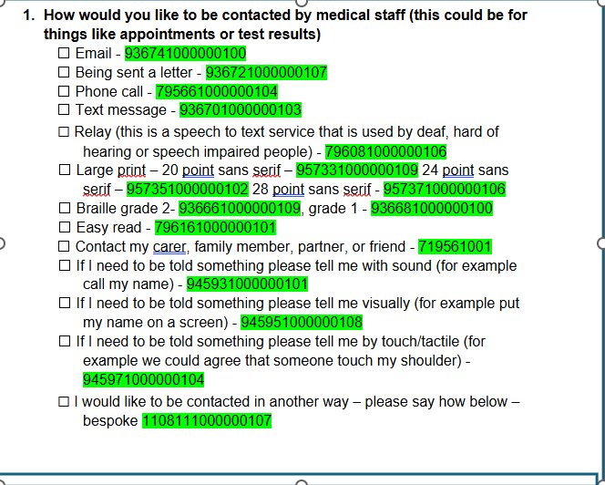
How Does it Work – Reasonable Adjustment Digital Flag
Flagging Reasonable Adjustments – everything I need to know - Futures
Notes:
This is part of a letter that can be sent out to patients Making RA is not new (doing things differently not new)

Slide 6
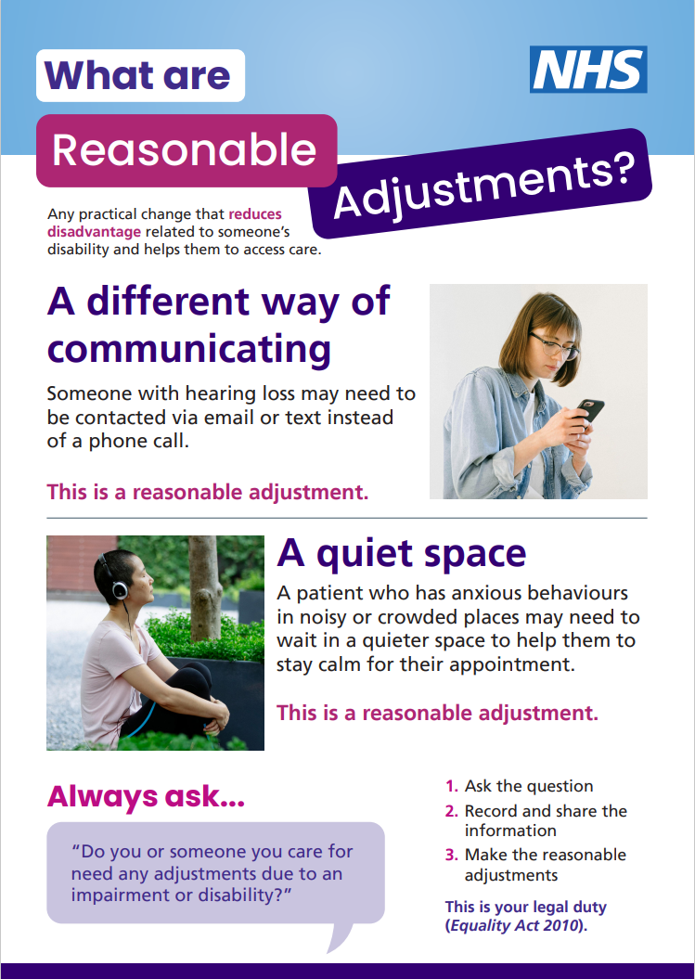
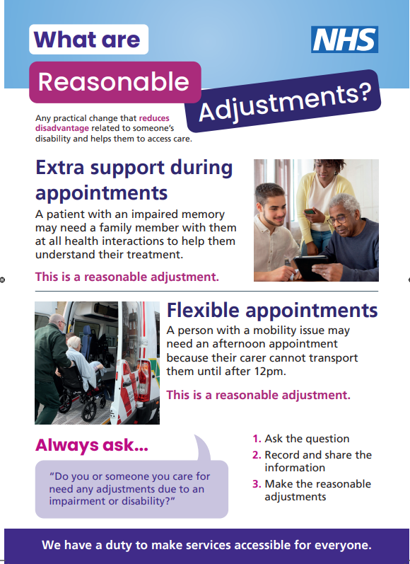
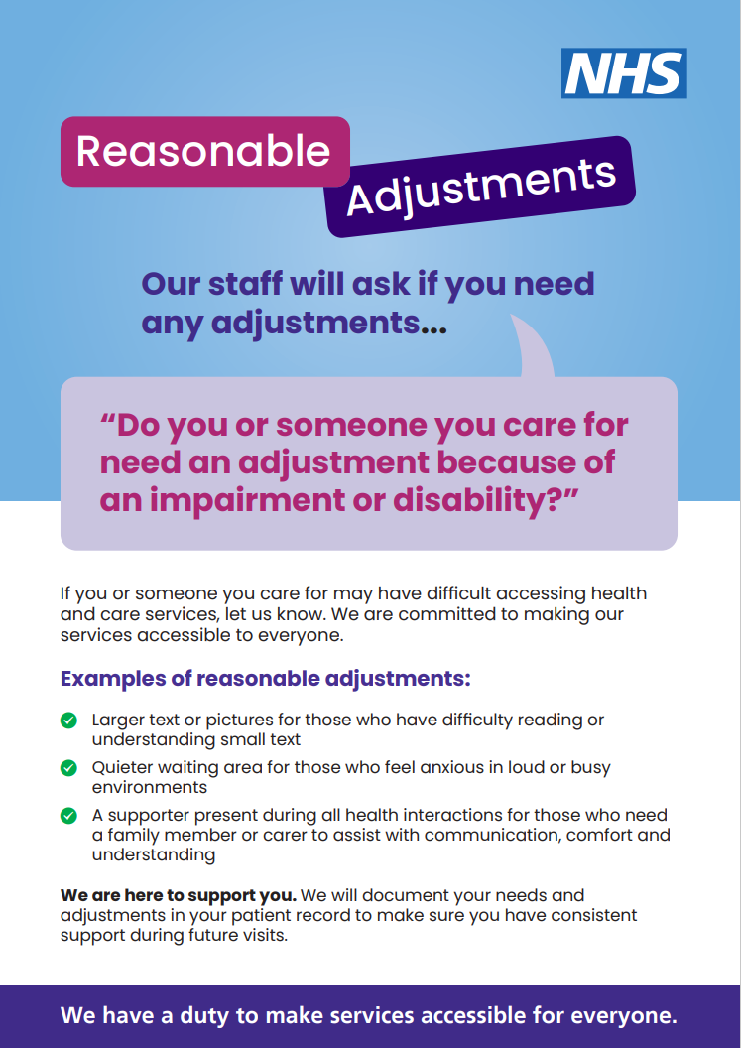
For Patients

Slide 7
Social Care – Reasonable Adjustment Digital Flag
Statutory social care
Voluntary and private
ASK ? Be armed knowledge – consider what reasonable adjustments those you support would benefit from – next health appointment – ask.

Slide 8
What is the Universal Care Plan - UCP
Since January ’25 the UCP is now a digital personalised care and support plan to enable Londoners share "what matters to me"
It can be accessed by health and social care staff across London and viewed by doctors, nurses, the ambulance service, NHS 111 and social care staff in L.A and independent sector.
It can be created by health and social care staff and input by all MDT – UCP is designed for collaboration
It is an ALL AGE care plan
Only complete what is needed – information shared in real time
It sits on NHS App - plan to be “Front door” of NHS

Slide 9
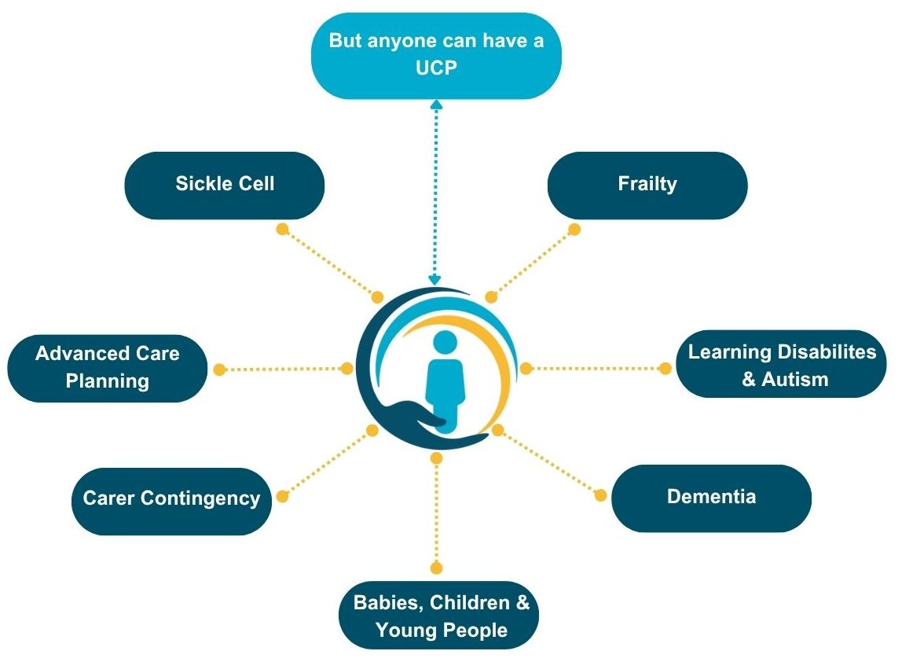
Who is the UCP for?
SF

Slide 10
Benefits of UCP
To the individual
To staff
To organisations
  Access to true personalised care planning
  Your care is coordinated across services
  Increased involvement in your care, through your wishes and preferences
  Your entire support network on the same page
  A single version of your care ‘truth’
  Improved care planning and quality of care tailored to your personal wishes, leading to better outcomes
  A care plan that is visible to everyone who cares for you means that you will not have to retell your story.
  Access to NHS plans of care and involvement in joint care planning for the person you care for, therefore achieving better care outcomes
  Easily accessible care plan via local EPR systems or the webpage, with the potential to edit plan data to reflect up to date information
  Ability to build relationships quicker with the person you're caring for
  Reduced crises through early access to support and information
  Improved reputation and rating (if applicable) through improved care delivered to patients
  Financial non-cash releasing benefits through getting the right care solution quicker, resulting in increased efficiency
  Reduced admissions of patients to hospital where that is not in line with their wishes
  Interoperability with other health and social care providers

Slide 11
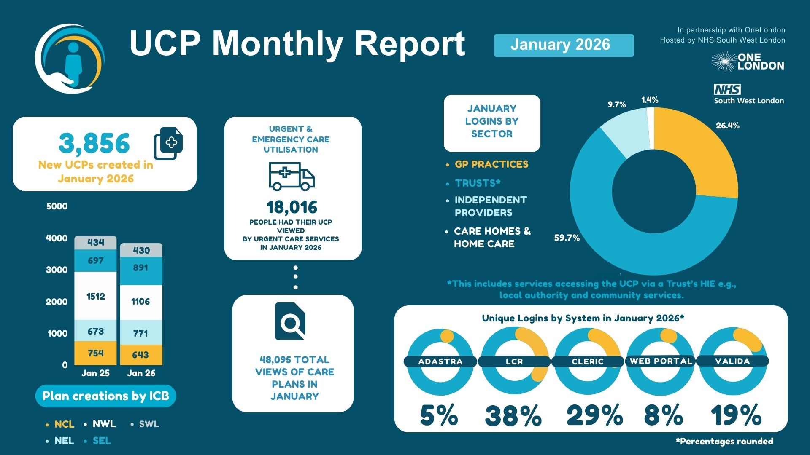
Notes:
Over 48,000 care plans were viewed in January – nearly 400 new plans created
If look at right of slide indep sector/ care homes home case totalled just over 10%
Ended 2025 with over 86,200 people who live or receive care in London with a UCP – now up to over 88,000
No on slide but figure show that in 2025 care homes accessed via UCP web portal grew by 75%.

Slide 12
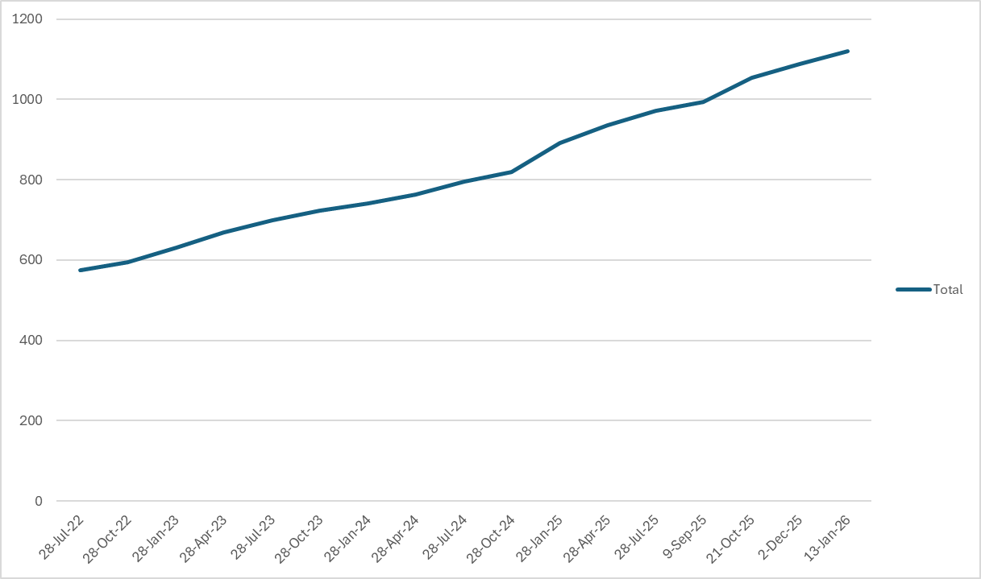
Londoners with a UCP with a learning disability and/or autistic people
As of 13th January 2026, there were 1120 Londoners with a learning disability and/or autistic people with a UCP

Slide 13
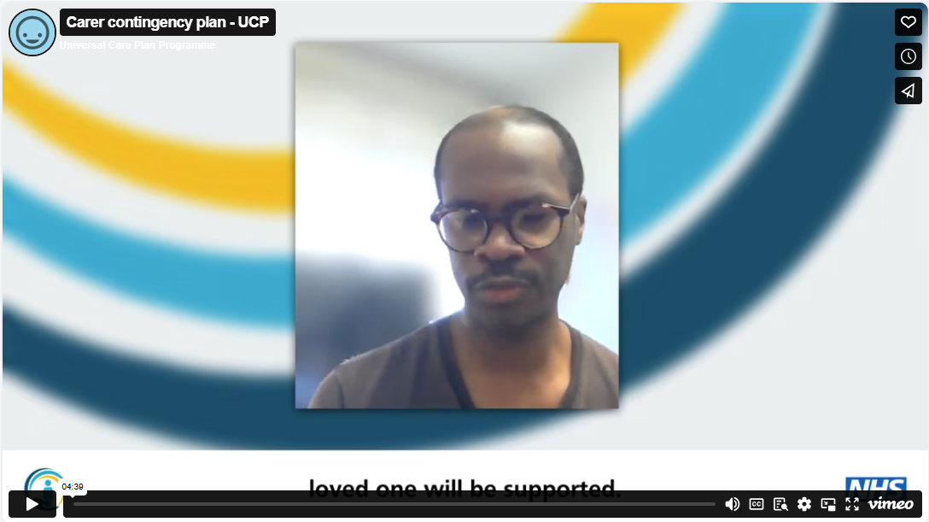

Carer Contingency Plan
If you support someone in their own home and they are cared for by a single parent, a Carer Contingency Plan can help to put at ease.
How to create:
https://ucp.onelondon.online/wp-content/uploads/2026/02/Carer-Contingency-Planning-in-the-Universal-Care-Plan-Guidance-V1.1.pdf
https://vimeo.com/1073172087/3155f452ef

Slide 14
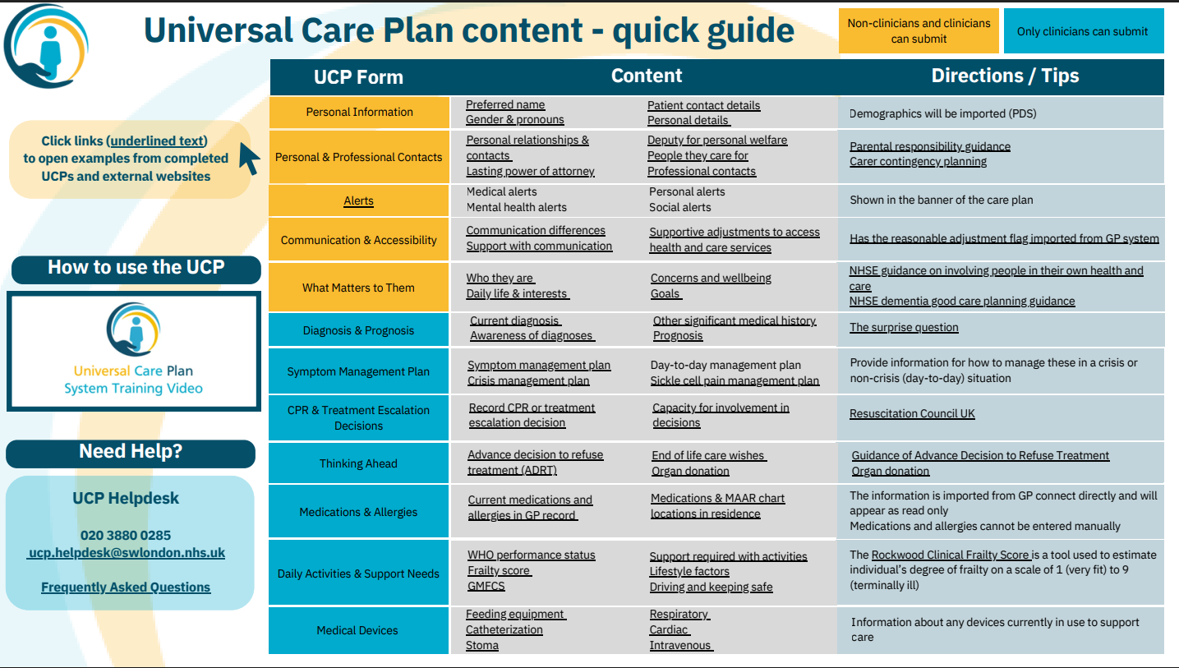
Updated Resources
Quick reference guide now includes clickable links to view examples of what a completed UCP may look like
Notes:
The plan has role based access –

Slide 15





UCP Access via the NHS App
Co-author of non-clinical forms
*some data fields within non-clinical forms are non editable but in a view state*
Always accessible
Viewable access to clinical forms
Person
NHS login
Ability to create and edit as per current Role based access.
Will be able to view when a person has updated the care plan.
Removal of ‘in progress’ option for non-clinical forms.
Health & care professional
EHR
SL
Notes:
The UCP sits on the NHS app – and late next month there will be a role out for patients to create there own plan – role based again so cant complete all but significant sections

Slide 16
How can I access the UCP?
Main route:
Web Portal Access | Universal Care Plan
Second route – London Care Record (HEI)

Slide 17
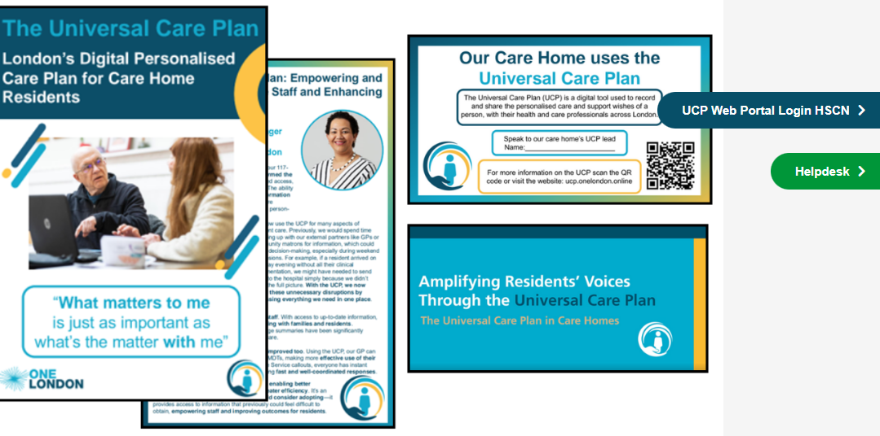
UCP Resources for Care Home Staff | Universal Care Plan

Slide 18
Adi is 54 has a mild cognitive impairment
He recently had a stroke
Has type 2 diabetes
He lives alone
Supported district nurses for daily insulin
Carers 3 x daily to support activities daily living
Adi receives a health appt letter ……

Slide 19

Universal Care Plan – Reasonable Adjustment Digital Flag
Thoughts

