Slide 1
Welcome to your registered manager network meeting
[Name | DD MM YYYY]

Slide 2


Size and structure report
Skills for Care has launched its annual ‘Size and structure of the adult social care sector and workforce in England’ report
Key findings include:
The report found that the adult social care sector has continued to grow between April 2024 and March 2025, despite a significant fall in the number of international recruits.
The new figures show that the vacancy rate for 2024/25 fell to 7%. This was a return to similar levels seen prior to 2021/22, when the rate had peaked at 10.5%. The number of filled posts grew by 3.4% to 1.6 million.
It’s now estimated that there are 1.47m people working in adult social care in England.
Take a look at the report
Notes:
https://www.skillsforcare.org.uk/Adult-Social-Care-Workforce-Data/Workforce-intelligence/publications/national-information/The-size-and-structure-of-the-adult-social-care-sector-and-workforce-in-England.aspx
The report draws upon the workforce intelligence that we collect in the Adult Social Care Workforce Data Set (ASC-WDS) and includes information relating to workforce supply and demand, such as recruitment and retention statistics, international recruitment and statistics on the wider economy.
The report found that the sector continued to grow in 2024/25. Encouragingly, it also shows that the vacancy rate has fallen to 7.0%, which is similar to levels seen prior to the Covid-19 pandemic.
Other key findings from the report include that:
the total number of adult social care posts was 1.71m in 2024/25 (an increase of 2.2% from 2023/24)
between 2023/24 and 2024/25 the number of posts that were filled (filled posts) increased by 3.4% to 1.60m (an increase of 52,000 filled posts)
an estimated 50,000 people arrived in the UK in 2024/25 and started direct care providing roles in the independent sector. This was a decrease of 55,000 from 2023/24, when the estimated number was 105,000.
The report also tells us that the sector faces long term recruitment and retention challenges. It is projected we will need around 470,000 new posts - an increase of 27% - by 2040 to keep up with the projected growth in the population over the age of 65.

Slide 3
State of the adult social care sector and workforce in England 2025 report
Available October 2025 – join us for a regional focus on our latest flagship data report
Thursday 23 October 2025 | 09:30 - 11:30 | Online
We’ll dig into the data across England and provide you with a comprehensive analysis of the adult social care workforce at a local level.
You’ll also have the opportunity to join a regional breakout room for a discussion on what the data is telling us in your area.
Register for the event

Slide 4
Adult Social Care Learning and Development Support Scheme (LDSS)
Funding for training is available for you and your workforce
The LDSS scheme supports adult social care employers to invest in learning and development for their staff, by providing a financial contribution towards the costs of training. Up-to-date information, including guidance for employers and a list of courses and qualifications eligible for funding can be found on the Government website
The LDSS will continue to be administered by NHSBSA via the online claims service
Webinar: Making the most of funding for training in 2025–26
We were recently joined by DHSC and NHSBSA to share key information about accessing funding for staff training through the LDSS in 2025-26.
Find out more and watch the recorded webinar
FAQs available
Notes:
NEW: FAQs available on Skills for Care’s website, co-produced with DHSC and NHSBSA
https://www.gov.uk/government/collections/adult-social-care-learning-and-development-support-scheme
https://www.skillsforcare.org.uk/Funding/Learning-and-development-funding-for-adult-social-care.aspx#Webinar
Employers must have an up-to-date ASC-WDS account – SEE NEXT SLIDE
Staff recruited overseas are eligible for the LDSS funding, as long as they are legally employed in England and have a NI number.
The LDSS is open to claims for eligible training courses and qualifications that have been paid for in financial year 2025 to 2026, as well as those paid for in financial year 2024 to 2025. Regardless of the financial year in which the training course or qualification was paid for, a 3-month claims window applies:
for training courses - claims must be submitted within 3 months of course completion.
for qualifications - an initial ‘qualification start’ claim must be submitted within 3 months of the qualification being paid for and started (whichever is the later date) and the ‘qualification completion’ claim must be submitted within 3 months of qualification completion
If you have questions or concerns regarding the timeframes to claim, or any other query relating to the LDSS, please get in touch with our team at asclearninganddevelopmentsupport@nhsbsa.nhs.uk.
LDSS will accept applications for courses and qualifications that are delivered internally
A step-by-step guide on how to claim funding is available on the Skills for Care website. https://www.skillsforcare.org.uk/Funding/Learning-and-development-funding-for-adult-social-care.aspx

Slide 5
Adult Social Care Workforce Data Set (ASC-WDS)
ASC-WDS is a free online service which helps you to manage your team and provides crucial information to decision makers
Benefits to your business
Become eligible to claim LDSS funding for your staff
Safe and free storage of staff records
Manage training records
Benchmark your workplace
Access the ASC-WDS Benefits Bundle
Make your voice heard!
Find out more: www.skillsforcare.org.uk/ascwds
Notes:
The Adult Social Care Workforce Data Set (ASC-WDS) is a data collection service, commissioned and funded by the Department of Health and Social Care. It is the leading source of intelligence for the adult social care workforce.
You can gain access to funding for training your staff the Learning and Development Support Scheme (LDSS). You need an ASC-WDS account to be eligible to claim funding. These funds have saved care providers thousands of pounds.
The system provides safe and free storage of staff records and can help you to manage your training records - get expiry alerts when training is due to expire, define mandatory training for different job roles. It’s basically a free learning management system.
You can benchmark your workplace against other providers in your area, for metrics like pay or turnover. You can even filter to see only Good and Outstanding providers near you.
You’ll also get our ASC-WDS Benefits Bundle for discounts and special offers from Skills for Care.

Slide 6
Quality Assured Care Learning Service
A key part of selecting the right learning and development for your organisation is finding the right training provider and course/qualification
Skills for Care is delivering DHSC’s Quality Assured Care Learning Service (QACLS). This service will help you find high-quality learning and is intended to be a route to funding through the DHSC’s Learning and Development Support Scheme (LDSS).
On our website, you can access a spreadsheet of all the training providers, courses and accredited qualifications that been quality assured through the new QACLS. Find out more about the QA service for training providers.
The Oliver McGowan Mandatory Training (Oliver’s Training) on Learning Disability and Autism is quality assured through the QACLS. Funding to support Oliver’s Training will be made available to the adult social care sector in Autumn 2025 through the LDSS, separate to the overall existing LDSS funding already available for other training and qualifications. Further details will follow in due course.
Notes:
Webpage: https://www.skillsforcare.org.uk/Developing-your-workforce/Quality-assurance/Quality-Assured-Care-Learning-Service.aspx
Spreadsheet: https://www.skillsforcare.org.uk/Developing-your-workforce/Quality-assurance/Quality-assured-training-and-courses.aspx
Where there are learning providers who've been through the QA process these must be used in 25-26 in order to claim LDSS
Oliver’s Training
On 19 June 2025, the Oliver’s Training draft Code of Practice was published by DHSC. The purpose of the code is to explain what is meant by training that is ‘appropriate to the person’s role’ and to provide guidance on how to ensure all staff receive such training.
DHSC will be providing funding to support rollout of the Oliver’s Training to the adult social care sector as part of the Learning and Development Support Scheme (LDSS). This funding will be specific to Oliver’s Training, separate to the overall existing LDSS funding already available for other training and qualifications. Training completed between April 2025 and March 2026 will be eligible for reimbursement.
Further details will be provided in due course.

Slide 7
Integration and Integrated Care Systems (ICSs)
Why get involved in your ICS and how?
Ensure that social care is at the heart of decision making
Promote the importance and understanding of social care
Access any available funding and development opportunities
Inform the development of systems and processes
Help to make the sector an attractive career option
Demonstrate to regulators you work in partnership
Have you heard of or are you involved in your ICS (at system, place or neighbourhood level)? If so, how?
www.skillsforcare.org.uk/Integration
Notes:
INTEGRATION AND ICSs
Integrated care is about people only having to tell their story once to get the high-quality care and support that means they can live the lives they want. It presents the opportunity for joint working across service providers to ensure person-centred care, where choice and control is based on what matters to the person drawing on care and support.
Joining up care leads to better outcomes for people. When local partners – the NHS, councils, care providers, voluntary sector and others – work together, they can create better services based on local need.
The Health and Social Care Act 2022 provided the legislative framework for health and care organisations to work together and deliver joined up care. Integrated Care Systems (ICSs) have been set up to make this happen. Their (ICSs) aim is to improve health and care services – with a focus on prevention, better outcomes and reducing health inequalities.
On the Skills for Care website, we have a more comprehensive explanation about integration and a short animation about ICSs as well as examples of where integration across sectors is already working well. You'll find examples of how leaders of social care organisations are involved with their ICS and innovative ideas for making integrated ways of working a success.
https://www.skillsforcare.org.uk/Support-for-leaders-and-managers/Integration/Integration.aspx
WHY GET INVOLVED?
We would like to encourage social care employers to engage with their ICS this could be through its local placed-based partnership or at neighbourhood level.
There are different ways providers can get involved – listed here are some examples how to get involved in place-based systems. This will be different for every ICS. (NOTE TO LMs: Use your local knowledge when providing examples. And it may just be by being a member of this network and feeding in through Skills for Care).
joining the main local placed-based partnership as an individual
joining the main local placed-based partnership as a group, such as a local care association or registered manger, deputy manager or nominated individual network
joining one of the sub-groups or ‘neighbourhoods’ of the place-based partnership as an individual or network
finding out who to connect with who is already engaged with the place-based partnership in an area, seeking to be kept informed of opportunities and developments.

Slide 8
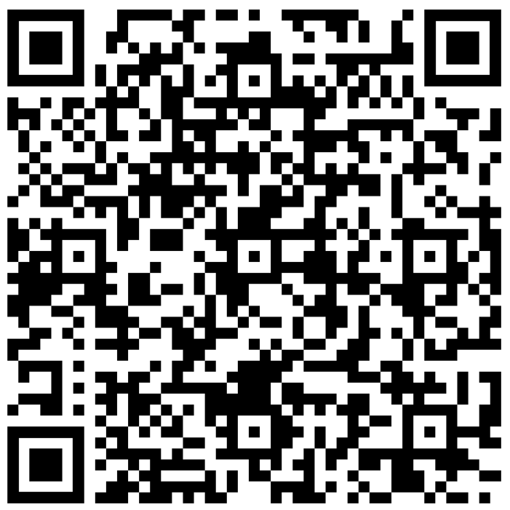
New placement strategy for social care nursing
Skills for Care is proud to launch the first-ever national placement strategy for social care nursing
Developed in collaboration with the Council of Deans of Health, it aims to position social care as a placement of choice for all student nurses and nursing associates.
It offers care providers and higher education institutions recommendations for how to deliver high-quality, consistent placement experiences. Read the strategy and see how you can get involved
Nursing placement strategy event
Wednesday 10 September 2025 | 13:00 – 15:00 | Online
Join our online event which aims to bring together local social care providers, universities and colleges in the same region to explore how the recommendations of the strategy can be implemented.
You’ll have the opportunity to participate in regional breakout groups, Q&A session and panel questions with stakeholders involved in nursing education and care provision.
Find out more and book now
Notes:
https://www.skillsforcare.org.uk/Regulated-professions/Nursing/Pre-registration/Student-nurses-and-nursing-associates.aspx

Slide 9
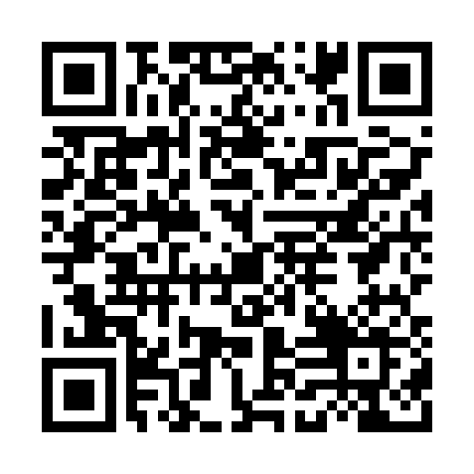
What would you like to see in a business skills programme?
Survey for managers
Last year Skills for Care carried out extensive engagement activity to identify gaps in training provision and priorities. As a result of this work business skills for managers in adult social care was identified as a key priority.
To help support the development of this, we would like to identify the most important topics you would like included in a business skills programme as well as how it should be structured and delivered.
Please could you complete our very short survey to share your views.
https://online1.snapsurveys.com/SfCBusinessSkills25
Notes:
Locality Managers - Please allow 5 mins for the survey to be completed within the meeting.
CLOSES ON 12 SEPTEMBER 2025

Slide 10
Upcoming events, seminars and programmes

Slide 11
New RM webinars…
Getting stronger – how digital can work for you
Thursday 18 September | 10:00 – 11:00
This one-hour webinar is designed to support frontline managers to harness and integrate digital technology in their service. Join us to learn about the training available to upskill yourself and your workforce and how to access the right training opportunities to use digital, data and technology effectively and ethically. Register now
AI – Starting small, growing smarter
Thursday 25 September | 10:00 – 11:00
In partnership with The Outstanding Society, this webinar is designed to support frontline managers to take their first steps into the world of artificial intelligence (AI). Focusing on low-risk, practical ways to get started, explore how AI can support everyday tasks, reduce admin pressures, and improve decision-making — without the need for technical expertise or major investment. Register now
Notes:
https://www.skillsforcare.org.uk/news-and-events/Events/September/RM-webinar-Getting-stronger-how-digital-can-work-for-you.aspx
https://www.skillsforcare.org.uk/news-and-events/Events/September/RM-webinar-AI-Starting-small-growing-smarter.aspx

Slide 12
Webinar: Overview of the mandatory training requirement on learning disability and autism: What you need to know about the Code of Practice
Thursday 13 November 2025 | 14:30 – 16:00
We will share an overview of the Oliver McGowan Code of Practice, which sets out how Care Quality Commission (CQC) registered providers can meet the statutory training on learning disability and autism appropriate to their staffs’ roles.
We will be joined by the Department of Health and Social Care and CQC, where we will explain what the Code of Practice covers, provide an overview of Oliver’s Training, detail what support is available and describe how the CQC will use the Code of Practice and considering compliance with the learning disability and autism training requirement.
Register your place here.
Notes:
https://www.skillsforcare.org.uk/news-and-events/Events/September/Overview-of-the-mandatory-training-requirement-on-learning-disability-and-autism.aspx

Slide 13
Preparing for change: exploring the Mental Health Act reforms
Wednesday 22 October 2025 | 10:00 - 16:00 | Manchester
At this in-person event, we’ll explore how we expect the reforms will affect autistic people, people who have a learning disability, and their families, and the communities and the services that support them.
We’ll hear from people who have experience of the Mental Health Act in their lives. There will be opportunities to explore how the reforms are likely to affect your work and to network with colleagues to get ready for the changes.
Book now

Slide 14
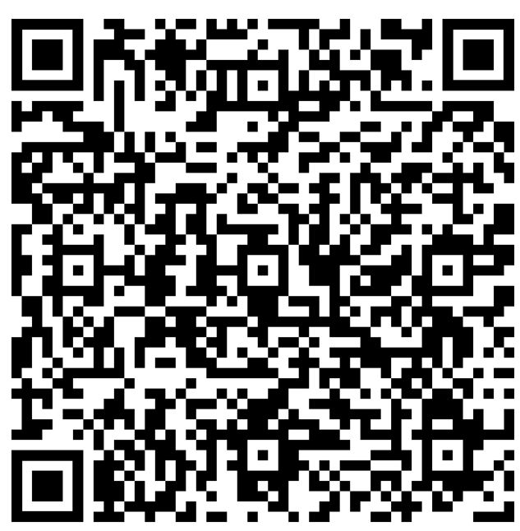
Are you involved in delegated healthcare activities?
Book your place at one of our regional roadshow events today!
Starting 3 September 2025 – Finishing 30 September 2025
Locations: Coventry | Taunton | York | London | Colchester | Warrington
We’ll be traveling to each region bringing together people involved in delegated healthcare to explore how to promote safe and personalised. Through interactive discussions, and collaborative planning, guided by the Skills for Care delegated healthcare activities guiding principles you’ll have the opportunity to: connect with peers and share real-life experiences explore best practice and to overcome common challenges contribute to national insight and improvement receive a certificate of attendance for CPD.
Spaces are limited – secure your place today!
https://bit.ly/DHAroadshow

Slide 15
Workforce planning: An overview of our resources for adult social care providers
Join our free webinar for an overview of Skills for Care’s operational workforce planning resources for adult social care providers.
The session will:
provide an overview of workforce planning
explore Skills for Care’s free workforce planning resources
share best practice examples
introduce Skills for Care’s costed workforce planning seminars.
Monday 22 September 2025 | 13:00 – 14:00 | Online
Book via: bit.ly/OPWorkforcePlanningWebinar2025
Notes:
Direct link to book: https://www.skillsforcare.org.uk/news-and-events/Events/September/Workforce-planning-An-overview-of-our-resources-for-adult-social-care-providers.aspx
Overview
Join us for an overview of our free operational workforce planning resources. Discover how they can support you with workforce stability, reducing staff shortages and turnover, and ensuring continuity of care.
The session will:
provide an overview of workforce planning
explore Skills for Care’s free workforce planning resources
share best practice examples
introduce Skills for Care’s costed workforce planning seminars
There will be an opportunity to ask any questions you may have during the session.
Who should attend?
Leaders and managers in adult social care services, including registered managers, and people, HR and workforce planning leads.

Slide 16
New preceptorship package to strengthen social care nursing workforce
Preceptorship programmes are a vital part of the support required to recruit and retain registered nurses and nursing associates who are new to the NMC register.
Join us for these free sessions where you’ll pick up practical guidance and resources to run a successful preceptorship programme.
Preceptorship lead workshop – for experienced nursing staff looking to lead on preceptorship | September, October and November dates available | 11:30 – 13:00
New to role preceptor workshop - preceptorship role in practice | September, October and November dates available | three-hour workshop
Notes:
Preceptorship programmes are a vital part of the support required to recruit and retain registered nurses and nursing associates who are new to the NMC register.
Nursing preceptorship is a structured period of support and development for newly registered nurses and nursing associates as they transition into their professional roles.
It is designed to smooth the transition into the workforce, promote safe, effective, and confident practice and foster a sense of belonging and professional identity. Newly qualified nursing staff are called ‘preceptees’ and are supported by more experienced nursing staff who act as ‘preceptors’.
Our preceptorship series is designed to enable organisations to put a programme of preceptorship in place and utilise the existing knowledge and skills of their experienced nursing staff who can provide preceptorship leadership and act as preceptors for newly qualified staff.
Sessions available
The sessions are free. Booking is required. Certificates of attendance will be available.
Introduction to preceptorship webinar aimed at organisations who are interested in introducing preceptorship programmes for newly qualified nursing staff. This session is suitable for registered managers or learning and development leads. Speakers include Wendy Fowler (Education Advisor) from the NMC.
The session took place on 3 September 2025. It was recorded and will be made available on the preceptorship webpage in due course.
https://www.skillsforcare.org.uk/Regulated-professions/Nursing/Preceptorship.aspx
Preceptorship lead workshop is aimed at nursing staff working in social care who have 12 months+ experience and are keen to take a leadership role in relation to preceptorship in their organisation.
This session will give them confidence and tools to be the lead for their organisation.
If attending the lead workshop, they must also attend the new-to-role preceptor workshop below.
29 September, 21 October, 26 November - only need to attend one.
Limited spaces
https://www.skillsforcare.org.uk/news-and-events/Events/September/Preceptorship-lead-workshop-Embedding-and-championing-preceptorship-September.aspx
New-to-role preceptor workshop is aimed at nursing staff working in social care who have 12 months+ experience or who have completed a period of preceptorship themselves.
This session provides guidance and support on the role of the preceptor and its function in supporting preceptees within their organisation.
30 September, 22 October, 27 November – only need to attend one
Limited spaces
https://www.skillsforcare.org.uk/news-and-events/Events/September/New-to-role-preceptors-workshop-preceptor-role-in-practice.aspx

Slide 17
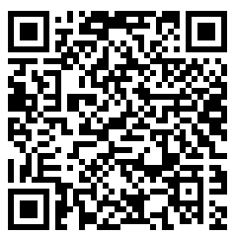
Join our dedicated forums and networks
exclusively for nursing workforce leaders and nurses
Nursing Workforce forum
Tuesday 16 September| 14:00 - 15.30 | Online
This forum is for nursing workforce leaders in social care wanting to hear about practice innovation, CPD and career opportunities, how to contribute to national policy development, and networking with other providers and stakeholders.
Nursing Education forum
Wednesday 17 September | 14:00 - 15.30 | Online
Are you invested in increasing social care opportunities within nursing education and practice learning? In this forum you can influence from a care provider perspective, ensuring our future nursing graduates have a positive and rewarding experience of social care.
Social Care Network for Students and Early Career Nursing
We’ve launched this network in partnership with the Council of Deans of Health. If you’re a care provider hosting students or an employer of newly qualified nurses and nursing associates, please encourage them to get involved. It is a great opportunity for peer support and hearing from others to understand local and national nursing policies.
If you’re interested in joining any of our forums or networks,
Find out more and complete the expression of interest form.
www.skillsforcare.org.uk/JoinTheNursingCommunity

Slide 18
Join our new Global Majority Nursing network
For registered nurses and nursing associates from a diverse background working in social care
Monday 22 September | 10:00 - 12.00 | Online
This network aims to provide registered nurses and nursing associates with a place to address the challenges faced by the workforce and focus on supporting the sector to ensure there are opportunities for strategic leadership in nursing.
They’ll have the opportunity to:
take part in breakout group discussions
network and share experiences
explore opportunities to access leadership development
access training on dealing with difficult situations.
Please share this opportunity with registered nurses and nursing associates from a diverse background. www.skillsforcare.org.uk/JoinTheNursingCommunity

Slide 19
Further support and resources
For registered managers and frontline managers

Slide 20
Webinars to support your service
Our registered manager webinars cover a wide range of topics to support you and your service.
They are delivered to a live audience and recorded for further viewing. The webinars are between 30-60 minutes long and are supported with resources and additional information.
Our new recorded webinars include:
New managers: What resources and support is available | Watch now
Discover how we can support you in recruiting and developing your staff, explore support available to help you effectively lead your organisation and identify ways to further your own development.
Managing risk: Good and best practice approaches for CQC regulated providers | Watch now
Explore how residential, homecare, and learning disability/autism services manage risk in their day-to-day operations. It focuses on key areas such as managing risky behaviours, supporting people with fluctuating capacity, and respecting unwise decisions, while providing practical strategies for involving people in decisions about their own safe care.
Notes:
https://www.skillsforcare.org.uk/Rmwebinars
https://www.skillsforcare.org.uk/Support-for-leaders-and-managers/Support-for-registered-managers/Registered-manager-webinars/Managing-a-service.aspx#NewmanagersWhatresourcesandsupportisavailable
https://www.skillsforcare.org.uk/Support-for-leaders-and-managers/Support-for-registered-managers/Registered-manager-webinars/Care-topics.aspx#ManagingriskGoodandbestpracticeapproachesforCQCregulatedproviders

Slide 21

Registered manager membership
Skills for Care is the award-winning membership organisation for registered managers.
Through membership, we support managers to develop best practice and knowledge, keep up-to-date with sector developments and share ideas with peers.
Membership benefits include:
printed copy of our ‘Social care manager’s handbook’
monthly newsletter including practical information and guidance
access to Good and Outstanding care guide: Single Assessment Framework version and 34 Quality Statement recommendation checklists
exclusive annual resource when you renew your membership
the chance to train to become a mentor or receive mentoring.
…plus much more
Become a member for £35 per year.
Find out more about our award-winning registered manager membership
Notes:
https://www.skillsforcare.org.uk/membership
Become a member for £35 per year

Slide 22

Developing new managers and deputies – a guide to effective succession planning
This guide provides practical steps to identify, develop, and retain future leaders in adult social care.
As part of our registered manager membership, managers renewing their membership from 1 April 2025 – 31 March 2026 will receive an exclusive printed copy of this new guide.
The development of future managers is more important than ever, and this guide provides insight into practical ways to succession plan across different sizes and types of adult social care services.
The guide includes practical tools such as checklists, interview templates, and scenario-based assessments to help adult social care providers develop effective succession planning strategies.
Download the guide now
Notes:
https://www.skillsforcare.org.uk/membership
https://www.skillsforcare.org.uk/resources/documents/Support-for-leaders-and-managers/Developing-leaders-and-managers/Developing-leaders-and-managers-guide/Developing-new-managers-and-deputies-guide.pdf
With 10,000 registered managers due to retire in the next 15 years, succession planning is key to ensuring that your service continues to provide well-led, consistent quality care, both today and in the future.
This will be available to buy on the bookshop shortly and will amend the slide when this is live

Slide 23

Good and outstanding care guide – Single Assessment Framework edition
Our updated Good and Outstanding care guide has been co-produced with The Outstanding Society and covers the new CQC inspection model
Aimed at frontline managers and those supporting regulated services, it helps regulated providers to prepare evidence to meet the CQC’s 34 Quality Statements.
An electronic version of this latest edition is available to all our registered manager members as part of their membership.
Become a member for £35 a year

Slide 24

The care exchange
Our podcast series which celebrates managers in social care is celebrating over 25,000 downloads!
Listen to real conversations with social care managers from across the sector
Our podcasts are hosted by locality managers Pia Rathje-Burton and Wendy Adams. Hear real-life insights into being a manager in social care including best practices, experiences and top tips which will inspire your own approach to being a registered manager.
New episode: I’m a CQC expert – by accident
Hear from Louie Werth who is a CQC and feedback expert! He chats about how to prepare your staff in giving feedback to the CQC, how feedback will improve your service and the one question that the CQC will ask everyone. We also talk about creating good surveys and improving the wellbeing of your workforce.
www.skillsforcare.org.uk/careexchange
Notes:
https://www.skillsforcare.org.uk/careexchange
https://www.skillsforcare.org.uk/Support-for-leaders-and-managers/Support-for-registered-managers/The-care-exchange/The-care-exchange-Series-5.aspx

Slide 25

Social care managers Facebook group
Staying connected with each other and sharing advice, experiences and guidance is vital.
Our Facebook group is open to all registered managers and front-line managers in similar roles.
Join this growing group of managers who are using it every day to:
network with peers and connect one another’s services
discuss issues affecting them and their service, and share advice and experience with other managers
provide support and ideas to like-minded colleagues across England.
Find out more and join the group
Notes:
https://www.skillsforcare.org.uk/Support-for-leaders-and-managers/Support-for-registered-managers/Social-care-managers-Facebook-group.aspx
Join this group of managers to stay connected with each other and share advice, experiences and guidance

Slide 26
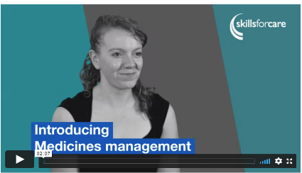
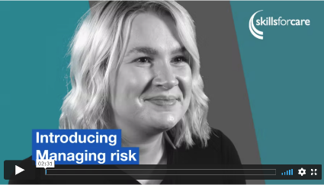
Support for the CQC Assessment Framework – Inspection toolkit
Recommendations, practical examples, advice and resources to support your CQC assessments
Ensure your service is prepared by exploring recommendations, practical examples and resources covering the 34 Quality Statements in our inspection toolkit.
Notes:
Inspection toolkit
https://www.skillsforcare.org.uk/Support-for-leaders-and-managers/Good-and-outstanding-care/Inspection-toolkit.aspx

Slide 27
CQC seminars and eLearning
Learn how to meet or exceed CQC expectations or recover from falling below CQC standards with our seminars and eLearning modules.
Whether you are preparing for your first assessment, striving to deliver outstanding care or needing to improve, we can help with our full-day seminars which cost £250 + VAT:
Being prepared for CQC assessment | Tuesday 16 September | Book now
Delivering outstanding care | New dates coming soon…
Improving your CQC rating | Tuesday 9 September | Book now
You can also look at our range of eLearning modules to help you understand what is expected of your service and how you can best evidence these expectations. Each module costs £40 (which can be claimed back through LDSS).
Notes:
Seminars
Being prepared for CQC assessment: Tuesday 16 September or Wednesday 22 October | 10:00 - 15:30 | https://www.skillsforcare.org.uk/news-and-events/Events/Ongoing/Being-prepared-for-CQC-assessment-seminar.aspx
Improving your CQC rating | Tuesday 9 September
Delivering outstanding care | new dates coming soon
Cost £250 + VAT
10% discount available for ASC-WDS account holders.
Payment can be made by invoice or credit card.
Modules
eLearning module: https://www.skillsforcare.org.uk/Support-for-leaders-and-managers/Good-and-outstanding-care/eLearning.aspx
Modules costs £40
Adult social care providers can claim back the full cost of purchasing each module via the new Adult Social Care Learning and Development Support Scheme (LDSS).

Slide 28
Evidencing CQC safe and effective staffing through workforce planning
Join our seminar to meet CQC standards around safe and effective staffing through workforce planning.
The seminar will help you:
define workforce planning and its importance
utilise data to inform staffing decisions
align staffing with CQC standards
develop priorities based on workforce challenges
leave with at least 20% of the initial workforce plan developed.
Wednesday 8 October| 09:30 – 15:00 | £250 + VAT | Book now
Notes:
https://www.skillsforcare.org.uk/news-and-events/Events/Ongoing/Evidencing-CQC-safe-and-effective-staffing-through-workforce-planning.aspx
Key Benefits:
Enhanced compliance with CQC requirements
Gain insights into aligning workforce planning practices with CQC’s expectations for safe, effective staffing and robust governance.
Improved recruitment and retention
Address the underlying factors impacting recruitment and retention, resulting in a more stable and sustainable workforce.
Financial and operational efficiency
By maintaining optimal staffing levels, organisations can experience significant cost savings by reducing turnover, minimising overtime costs, and enhancing service continuity.
Evidence-based decision making
Equip managers with the tools to make informed staffing decisions using real-time workforce data, leading to better service quality and operational stability.
Empowered and competent workforce
Establish a clear pathway for staff development and support, promoting person-centred care, reducing burnout, and fostering a positive working environment that attracts new talent.
Interactive workforce planning tool
Access a customized, interactive tool to streamline workforce planning, allowing managers to track progress and adapt strategies effectively.

Slide 29
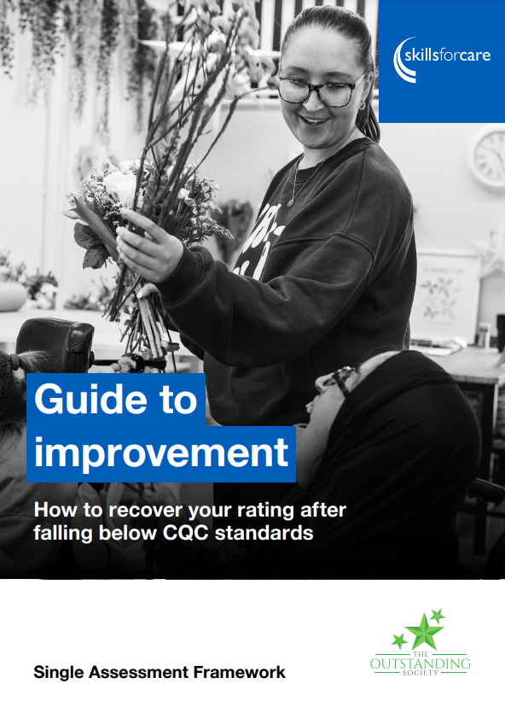
Guide to improvement
Skills for Care and The Outstanding Society have co-developed a new edition of our Guide to improvement
Shaped around the CQC Single Assessment Framework, the guide looks at what has caused adult social care services to be rated Requires improvement or Inadequate since 2023.
The guide is designed to help frontline managers and others at the service to embed sustainable solutions informed by services who have recovered their rating.
Discover how to engage your teams and identify practical solutions that will work for your service and understand the building blocks to improvement.
The guide is free and can be downloaded now
Notes:
https://www.skillsforcare.org.uk/resources/documents/Support-for-leaders-and-managers/good-and-outstanding-care/Improve-your-CQC-rating/Guide-to-improvement.pdf
Guide highlights
Understanding the building blocks to improvement, helping your service to overcome common barriers, embed a learning culture, and the system and processes needed to strengthen quality
How to engage your teams, service users, and stakeholders in identify practical solutions that will work for your service
What’s are the recurring issues causing services to fall below CQC expectations on each Quality Statement, how might this breach CQC regulations, and how to tackle these issues

Slide 30
Deputy manager networks
These networks are specifically for deputy managers, team leaders and assistant managers
Virtual meetings facilitated by a Skills for Care Locality Manager.
Great opportunity for deputies to meet the challenges they face in their day-to-day work.
Opportunity to build connections and a peer supportive network.
Facilitate the sharing of best practice and learning.
New meetings dates for the networks are available on the website.
Find your local deputy manager network:
www.skillsforcare.org.uk/deputymanagers
Notes:
Skills for Care currently supports local networks covering all LA areas in England, which are recognised as being invaluable by many managers.
We know the benefits that these local networks provide to managers, and that is why we set up deputy manager networks as well.
Each network meeting will be virtual and facilitated by a Skills for Care Locality Manager. It will focus on themes including wellbeing and resilience, self-confidence and personal effectiveness, delegation with confidence and dignity, communicating inside and out and making sense of information.
Note for LM’s
Might be a good opportunity to promote the dates of your local meetings and link if available
UPCOMING DATES:
Eastern
Wednesday 17 September 2025 | 10:30 - 12:00
Wednesday 25 February 2026 | 10:30 - 12:00
LSE
Thursday 23 October 2025 | 10:00 - 12:00
Wednesday 25 March 2026 | 10:00 - 12:00
Midlands
Tuesday 16 September 2025 | 12:00 – 14:00
Tuesday 10 February 2026 | 12:00 – 14:00
NW
Tuesday 4 November 2025 | 13:00 - 15:00
Tuesday 3 March 2026 | 13:00 - 15:00
SW
Wednesday 15 October 2025 | 14:00 – 15:30
Wednesday 21 January 2026 | 14:00 – 15:30
YHNE
Tuesday 7 October 2025 | 10:00 – 11:30
Monday 19 January 2026 | 13:00 – 14:30

Slide 31
Nominated individuals / CEO networks
Nominated individuals, CEOs and other senior leaders play a critical role in the provision of high-quality, person-centred care.
NI / CEO networks
Our networks provide a space for meaningful strategic collaboration with other leaders, managers and stakeholders to discuss the implications of national, regional and local strategies and opportunities for providers and their workforce. Find out more
Nominated individuals' handbook – a practical guide
This handbook looks at key aspects of the NI role and shares top tips so you can continue to provide high-quality, person-centred care to the people you support. Download your free copy
Nominated individuals – Annual national event
Thursday 27 November | 13:30 – 15:30
This will be our fifth national event for nominated individuals, which will cover key sector developments and updates.
Save the date – booking details coming soon…
Notes:
https://www.skillsforcare.org.uk/NI-CEOnetworks
https://www.skillsforcare.org.uk/resources/documents/Support-for-leaders-and-managers/Nominated-Individuals/Nominated-individual-handbook-a-practical-guide.pdf
Note for LM’s
Might be a good opportunity to promote the dates of your local meetings and link if available.
UPCOMING DATES
Eastern NI
Monday 15 September 2025 | 14:00 – 16:00
Monday 8 December 2025 | 14:00 – 16:00
Monday 2 March 2026 | 14:00 – 16:00
LSE NI
Thursday 9 October 2025 | 10:00 – 12:00
Thursday 5 February 2026 | 10:00 – 12:00
LSE CEO
Tuesday 7 October 2025 | 13:00 - 15:30
Tuesday 24 February 2026 | 13:00 - 15:30
Midlands NI
Thursday 11 September 2025 | 10:00 – 15:00
Thursday 12 March 2026 | 10:00 – 15:00
NW Strategic Leaders
Wednesday 5 November 2025
SW NI
Tuesday 4 November 2025 | 14:00 – 15:30
Thursday 12 March 2026 | 14:00 – 15:30
YHNE NI
Wednesday 29 October 2025 | 09:30 – 11:00
Wednesday 4 February 2026 | 09:30 – 11:00
YHNE CEO
Wednesday 19 November 2025 | 09:30 – 11:00
Wednesday 4 March 2026 | 09:30 – 11:00

Slide 32
Creating a positive workplace culture seminar
Join our transformative seminar and learn how to create a workplace culture built on inclusivity, compassion, and collaboration.
This interactive session will give you the tools and confidence to foster a positive work environment.​
Highlights include hands-on exercises with the Culture Iceberg model and positive culture toolkit, strategies to challenge and change workplace norms, and practical steps for enhancing team wellbeing and performance.​
📅 Dates: Thursday 30 October
⏰ Time: 10:00–15:30​
💷 Cost: £250 + VAT per person​ ​
Register today www.skillsforcare.org.uk/CultureSeminar​
Notes:
http://www.skillsforcare.org.uk/CultureSeminar
Learning outcomes
Better understand the core elements of a positive workplace culture and why it’s important.
Learn how to apply the Culture Iceberg model and positive culture toolkit to improve workplace culture.
Build your evidence of your culture in line with the I/We statements and the Care Quality Commission (CQC) Single Assessment Framework.
Analyse your workplace culture and develop a plan for improvement
Cost
£250 +VAT per person.
10% discount is available for ASC-WDS account holders. Provide your ASC-WDS account number when registering.
Payment can be made by credit card or invoice. Payment in full is required before the seminar takes place.

Slide 33
Recruit to retain
This programme offers practical, values-based strategies to strengthen recruitment, support staff development and reduce turnover.
Our three-day interactive programme provides practical tools and hands-on experiences to enable you to:
Strengthen recruitment: attract top talent and create a strong pool of potential employees.
Support staff development: empower your team with the skills and knowledge they need to thrive - and stay.
Reduce turnover: create a positive and supportive work environment that retains your best people.
Find out more
Notes:
https://www.skillsforcare.org.uk/news-and-events/Events/May/Recruit-to-retain.aspx
The Recruit to retain programme is designed specifically for CQC-regulated adult social care services, offering practical, values-based strategies to strengthen recruitment, support staff development, and reduce turnover.
The CQC's focus on safe and effective staffing is deeply connected to how well an organisation recruits, inducts, and supports its staff, all of which must be grounded in the organisation's core values.
This three-day interactive workshop provides practical tools and hands-on experiences to seamlessly integrate these principles into your daily operations. With a focus on real-world application, you'll gain immediately actionable strategies to create a values-driven, supportive workplace that attracts and retains staff.
This will ultimately save your organisation significant future recruitment costs, add value to the day-to-day care you deliver by a trusted care team, and provide robust evidence to the CQC about your well-led and safe practice.

Slide 34
Moving up programme
Bookings now open for our Moving Up programme starting in October 2025
Our Moving Up programme supports Black and Asian minority groups who are managers or aspiring managers and have the desire and drive to progress in their career but are facing blockages and resistance preventing them from doing so.
The programme will be delivered through blended learning – a combination of
self-learning modules and three live online sessions. Cost is £750 + VAT.
(£525 can be claimed towards the cost via LDSS)
The workshop dates are:
Thursday 9 October | 09:15 - 16:00
Thursday 6 November | 09:15 - 16:00
Thursday 11 December | 09:15 - 16:00
Find out more and register www.skillsforcare.org.uk/MovingUp
Notes:
https://www.skillsforcare.org.uk/Support-for-leaders-and-managers/Developing-leaders-and-managers/Moving-Up.aspx
The programme starts on Thursday 25 September 2025 - programme starts - participants access the virtual learning environment (LMS)
Registration closes 17:00 on 22 September2025.
£750+VAT.
ADASS members may qualify for a discount - contact your local ADASS.
Adult social care providers can claim money towards the cost of the programme via LDSS.

Slide 35
Other resources
To support you in your role and to support your services

Slide 36

Effective supervision
Effective supervision supports good working relationships, helps you to address any issues and celebrate achievements.
Supervision plays a key role in supporting your workforce to deliver high-quality care and support.
Your workforce is your most valuable resource and Skills for Care has some resources to help you manage your workforce:
Effective supervision guide: this guide will help you to plan and deliver effective supervisions. It includes the supervision functions and why it’s important and attributes of a successful supervisor and how to develop supervisors
Effective supervision webinar: explore practical approaches to developing new supervision skills and how this benefits the staff you support
Find out more
Notes:
https://www.skillsforcare.org.uk/Support-for-leaders-and-managers/Managing-people/Supervision.aspx
Effective supervision guide: https://www.skillsforcare.org.uk/resources/documents/Support-for-leaders-and-managers/Managing-people/Supervision/Effective-supervision-guide.pd

Slide 37
eLearning module: Ten public health tips for social care workers
A free learning module tailored specifically for people who work in adult social care.
It offers practical guidance on how your practice relates to public health approaches and how to further integrate these approaches into your day-to-day work, building on the knowledge you already have.
Key topics include preventing illness, promoting wellbeing and mental health, and supporting healthy aging. Completing the module will enhance the quality of care for those you support and deepen your understanding of public health.
Find out more
Notes:
https://www.skillsforcare.org.uk/Developing-your-workforce/Care-topics/Ten-public-health-tips-elearning-module/Ten-public-health-tips-elearning-module.aspx

Slide 38
Learning from accidents and events eLearning
This interactive module is designed to support managers and leaders in all adult care settings carry out learning reviews that bring people together to holistically explore an adverse event or near miss.
Learning reviews allow teams to explore different perspectives and create a positive action plan that supports individuals and seeks to avoid repeat incidents.
Through the 35-minute digital learning module you’ll:
discover what learning reviews are, why they’re needed and how they can help you
learn how managers can move from completing reviews at an individual level to involving the wider team
find practical tips for embedding learning reviews into your working environment.
The cost per module is £40 - discounts are available and the cost can be claimed back through LDSS.
Find out more
Notes:
https://www.skillsforcare.org.uk/Developing-your-workforce/Care-topics/Learning-from-events-digital-learning-module/Learning-from-events-digital-module.aspx
https://www.gov.uk/government/publications/adult-social-care-learning-and-development-support-scheme
You can access Skills for Care’s eLearning modules on our new learning management system, which provides an improved experience for customers accessing and completing our eLearning modules. www.learningfor.care
All the existing modules will be available to purchase on the new platform, except for the CQC modules which are currently being updated and will be available from the end of October.
Adult Social Care Workforce Data Set (ASC-WDS) account holders and bulk purchases will be eligible for a 10% discount. Payment is via debit or credit card. Bulk purchases will have the option to be paid via invoice.
More information about the modules can be found at www.skillsforcare.org.uk/eLearning
If you have any queries, please contact LMSenquiries@skillsforcare.org.uk

Slide 39
Introductory modules for managers
11 eLearning modules to develop skills in leadership, succession planning and developing future talent
Leading and managing in adult social care
Supporting and developing teams
Regulation and governance
Effective communication
Working with partners
Leading a person-centred service
Safeguarding and mental capacity
Making decisions
Managing resources
Learning and innovating
Personal development and wellbeing
www.skillsforcare.org.uk/IntroductoryModulesForManagers
The cost per module is £40.
Discounts are available and the cost can be claimed back through LDSS.
10% discount for ASC-WDS account holders
Notes:
www.skillsforcare.org.uk/IntroductoryModulesForManagers
https://www.gov.uk/government/publications/adult-social-care-learning-and-development-support-scheme
Our new and improved Introductory modules for managers support the development of aspiring and new managers.
The modules offer engaging introductions to key topic areas to peak learners’ interest and provide opportunities to reflect, ideas to improve practices, and motivation to learn more. Based on the Manager Induction Standards, the re-developed modules now feature up to date content and increased accessibility for learners.
Module duration:
The modules will take between 40 to 60 minutes to complete and this can be done at a time and a pace to suit the learner. They’re simple and engaging to follow and are relevant across different services and settings.
Cost:
Price per single module: £40
Package deal price (full module suite): £350 (saving £90)
Each module (or the full bundle) is purchased on a 2-year renewable license, with enrolment access to the module for a period of 2 years from date of purchase.
You can access Skills for Care’s eLearning modules on our new learning management system, which provides an improved experience for customers accessing and completing our eLearning modules. www.learningfor.care
All the existing modules will be available to purchase on the new platform, except for the CQC modules which are currently being updated and will be available from the end of October.
Adult Social Care Workforce Data Set (ASC-WDS) account holders and bulk purchases will be eligible for a 10% discount. Payment is via debit or credit card. Bulk purchases will have the option to be paid via invoice.
More information about the modules can be found at www.skillsforcare.org.uk/eLearning
If you have any queries, please contact LMSenquiries@skillsforcare.org.uk

Slide 40
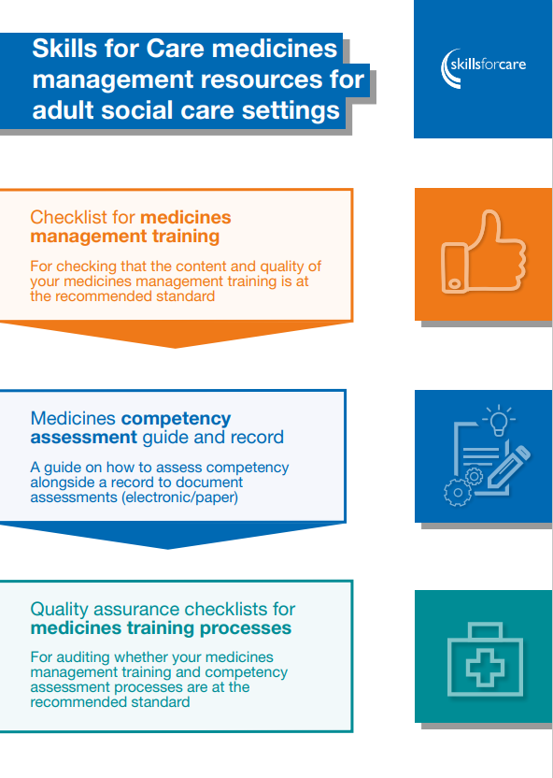
Medicines management resources
Resources and support for adult social care providers with medicines management
The resources have been developed for people who are responsible for purchasing and/or checking the quality of external or in-house medicines management training for care workers and managers.
Explore new medicines management guidance and checklists, developed to support care providers to assess their medicines management education and training to ensure that it is safe and effective.
You can also discover signposting and advice for meeting CQC expectations in this area.
Visit the webpage
Notes:
https://www.skillsforcare.org.uk/Support-for-leaders-and-managers/Managing-a-service/Prevention-in-social-care/Medicines-management-resources.aspx

Slide 41
National induction for health and social care
Skills for Care and NHS England have created free-to-access induction materials for anyone new to a role in health and social care
The ‘National induction for health and social care’ brings together virtual learning modules and resources to equip new starters with a clear understanding of health and social care, helping to build a sense of belonging and support retention.
It introduces different subjects important to social care, such as how to deliver personalised care, why we have regulation, what roles we might come across in our work and what they do.
All content is available online to use as part of your induction or as a refresher for existing staff, alongside your organisation specific induction.
Find out more
Notes:
https://learninghub.nhs.uk/catalogue/National-induction-for-health-and-social-care

Slide 42

Digital skills eLearning
Free-to-access, bitesize digital eLearning modules
Designed to support people working in adult social care to gain knowledge and understanding on how digital, data and technology is used in the sector.
The titles and themes of the seven modules are:
using technology to support person-centred care
technical skills in using technology
communicating through technology
using and managing data
being safe and secure online
ethical use of technology
digital learning, development and wellbeing.
Learn more about the eLearning modules
Notes:
https://www.skillsforcare.org.uk/Support-for-leaders-and-managers/Managing-a-service/Digital-technology-and-social-care/Digital-Skills-eLearning.aspx
To support adult social care staff to develop their knowledge and confidence in using digital technology, Skills for Care was commissioned by the NHS Transformation Directorate to develop a suite of free-to-access ‘bitesize’ digital skills eLearning modules, in line with the Digital Skills Framework. They were co-developed with the adult social care sector, with contributions from care providers, people drawing on care and support and subject matter experts.
These modules are designed to support people working in the sector to gain knowledge and understanding on how digital, data and technology is used in the delivery of care.
Each module is short and has a set of three learning chapters and objectives.
You can access Skills for Care’s eLearning modules on our new learning management system, which provides an improved experience for customers accessing and completing our eLearning modules. www.learningfor.care
More information about the modules can be found at www.skillsforcare.org.uk/eLearning
If you have any queries, please contact LMSenquiries@skillsforcare.org.uk

Slide 43
Share your experience​
We’re looking for case studies, quotes or potential speakers​
DHSC initiatives: including Care Workforce Pathway, the L2 Care Certificate qualification or the Learning and Development Support Scheme​.
  - Help DHSC initiatives achieve maximum impact and ensure continued positive interventions.​
Impact of Skills for Care: tell us how Skills for Care’s networks, resources or support have positively impacted your service​.
  - Help evidence the value of Skills for Care and ensure continued support.​
Good practice examples: in workforce development, recruitment and retention, the use of digital technology, staff wellbeing support or delegated healthcare activities and prevention​.
  - Help others learn from your experience and enhance quality and reputation of adult social care.​
Notes:
LMs "please share any positive stories and case studies in the relevant SI channels"
We’re currently sourcing input from care providers across the sector to feed into a few different pieces of work. We’re flexible on what type of contributions we’re looking for- probably shaped by what the example you might have to share is. But we might want to produce some case study content or take a quote or testimonial to use in articles or blogs. We might even ask if you’d be happy to share your knowledge as a guest speaker at a network meeting or similar. We may share your examples with our funders (the Department of Health & Social Care and the NHS Transformation Directorate) or with other providers via our website, e-newsletters etc. We’ll always ask for permission to use anything in a public-facing forum. ​
​
We’d be delighted to hear from you if you can help us with any of these topic areas: ​
If you’ve used any of the recent sector reform outputs, particularly Care Workforce Pathway, the L2 Care Certificate qualification or the Learning and Development Support Scheme. Even if you haven’t used them yet but you appreciate the intentions of the project and plan to use them, we’d still love to hear from you. ​
WHY? The DHSC initiatives has been in the works for a while, and they aim to help address some of the big issues around recruitment and retention in the sector. We know that the understanding of these initiatives is varied across the sector, but for them to have the intended impact, they need to be widely adopted and recognised by the care providers. By lending your voice to the conversation about these projects, you can help the sector make the most of these opportunities and ensure government continues to provide support. ​
​
Something that helps us demonstrate how the support and resources available from Skills for Care are making a difference in the sector. Think along the lines of: How has being part of a network shaped the work that you do? Have you used one of our guides to implement changes in your organisation? What was the impact of those changes? Increased retention? Better quality of care? Improved CQC rating? ​
WHY? Sharing how Skills for Care’s support and resources have had an impact on your business will help us build a vital evidence base that we can use with funders. We know our work has a positive impact on the sector, but these examples help us demonstrate that. Ultimately it helps us to continue to secure funding, which means we can continue to support you. ​
​
Anything that showcases the fantastic and innovative work that’s happening in the sector, particularly good practice examples in workforce development, recruitment and retention, the use of digital technology, staff wellbeing support or delegated healthcare activities and prevention​
WHY? The reason behind this one is fairly straight forward- you can help others in the sector to learn from your experiences. We all want to ASC sector to be an attractive place to work, to be recognised as the skilled workforce we are and to ultimately deliver the right care and support so by helping others to improve, you’re not only doing good for the sector but ultimately improving the proxy reputation of your organisation as part of that sector. ​
If you’re regulated by CQC, you can also use all of these examples as evidence of activity under the “partnerships and communities” topic for “Well-led”. It says you should work with others, including peer to peer support to help share best practice. ​

Slide 44

LGBTQ+ learning framework
This learning framework for working with LGBTQ+ people in later life aims to provide a base for identifying the insights, knowledge, understanding and skills that the social care workforce need to help them work effectively with individuals from gender and sexually diverse communities.
The framework is intended to be used by social care employers, employees, training providers, regulators, commissioners, policy makers and others to build their own knowledge and support colleagues’ understanding of how to better support LGBTQ+ people in later life.
Updated to include an additional topic which covers ‘LGBTQ+ religion and spirituality in later life’.
www.skillsforcare.org.uk/LGBTQFramework
Notes:
https://www.skillsforcare.org.uk/Support-for-leaders-and-managers/Supporting-a-diverse-workforce/LGBTQ-learning-framework.aspx

Slide 45

Training resources to help support personal relationships
Take a look at our training materials to help develop the skills and knowledge needed to support people who draw on services with personal relationships.
The trainer materials include PowerPoint slides, which are supported by a training facilitator guide, lesson plan and learner handouts and worksheets.
They complement our ‘Supporting personal relationships guide’ and are focused on enabling social care providers to offer support in a way that respects peoples’ choices and values whilst keeping them safe.
Find out more
Notes:
https://www.skillsforcare.org.uk/Developing-your-workforce/Care-topics/Supporting-personal-relationships/Supporting-personal-relationships.aspx
The programme includes a brief introduction, followed by four modules that can be delivered individually or as a complete package. The training areas are:
1. Understanding sexuality and relationships: barriers, benefits and the impact of staff values
2. Roles, regulations and the law
3. Sexual safety and autonomy
4. Practical approaches to relationships and sexuality support
The ‘Supporting personal relationships’ guide and trainer materials are supported by the Care Quality Commission and compliment their guidance around inspection in the area of relationships and sexuality in adult social care services.

Slide 46

Resources to support culturally appropriate care
These resources have been produced to help you have a clearer understanding of culturally appropriate care and what that may mean to individuals you support.
The ‘Culturally appropriate care guide’ covers a broad range of topics that will help you to learn about and be sensitive to people’s cultural identity or heritage.
Use the supporting training resources to implement the learning from the guide at your service.
www.skillsforcare.org.uk/CulturallyAppropriateCare
Notes:
www.skillsforcare.org.uk/CulturallyAppropriateCare
Notes:
The ‘Culturally appropriate care guide’ covers a broad range of topics that will help you to learn about and be sensitive to people’s cultural identity or heritage. Whether its looking to understand what is meant by exclusion and inclusion, find out how to focus on people’s life stories or improve support for people living with dementia, this guide is a great place to go for advice, insight and inspiration from real-life stories.
To support the learning within the guide, Skills for Care has also published a series of resources for use in training and development. These cover supporting individuals from ethnic minority groups and backgrounds, stereotyping, and supporting relationships and people who are lesbian, gay, bisexual, transgender, queer and others (LGBTQ+). They can be used individually, or as part of a whole package of training.

