Slide 1
International recruitment
Introduced by Ali Porteous
Locality manager Southwest London
Notes:
Introduce yourself, offer a bit of background

Slide 2

International Recruitment
Notes:
International recruitment has always been part of the recruitment option, getting a helping hand from abroad has been a backbone to health and social care for years, but due to a number of challenges we now have to look more closely at recruitment options

Slide 3

Notes:
Before starting any work to developed a team it important to consider the workforce plan. This may be a formal document reviewed regular to plan your future workforce needs. Or could be more informal, less recorded and reviewed. But we all do workforce planning in one way or another, what is a rota if not a plan for you workforce, if that’s all you have then we can look at the key things you may want to consider when planning for new and existing team members

Slide 4
Right people: ensure you have people with the right values, attitudes, and behaviors to meet the needs of the people who draw on care and support services.​
Right culture: ensure you have an environment in which staff feel valued, safe, and confident to raise questions, express concerns, talk about their experiences and make suggestions for service improvement.​
Right size: ensure you have the right number of people in the right roles spending the right amount of time to deliver effective care and support. ​
Right shape: ensure you have the right balance between different types and levels of roles, and between experienced staff and new starters. ​
Right place: ensure the right staff resources are available in the right location to meet needs​.
Right capability: ensure that staff have the skills and competencies needed to deliver the care and support required​.
Right cost: think about value for money.
Notes:
7 key things to aim to get right, reviewing each area to develop the plan for international recruitment, once you have an idea of the roles yo need covered it is then easier to identify what team members you need.

Slide 5
Covering the cost of training
Funded training
WDF changes
Local authority training
Budgeted funded training
Shared training resources
Local colleges
Notes:
Change is coming and the key is creativity

Slide 6
Workforce Planning Resources
Practical approaches to operational workforce planning
This guide for adult social care providers will help you anticipate how your workforce needs to change and develop as new business opportunities present themselves.
Workforce planning templates
Download our nine templates covering PESTLE, SWOT, analysis recording, organisational gap analysis, worforce gap analysis, risk log, workforce plan, workforce plan implementation and monitoring.
Notes:
At Skills for Care we have a number of resources to help you.

Slide 7
Why do we need to recruit internationally?
Rise in Demand – There is an increasing need and rise in demand for healthcare professionals as a result of an ageing population, an ageing workforce, and an increased focus on the quality of care.
Vacancy Rates Soaring – NICE recommend a maximum vacancy rate of 5% nationally. Currently the vacancy rate is almost double this with one in nine nursing posts lying vacant. In some hospitals that goes up to one in three. There is a shortage of approximately 40,000 nurses in the UK alone.
Brexit – Britain’s departure from the UK has resulted in a significant drop in the supply of healthcare candidates from the EU. In some areas we need to look further afield to find the specialist skills we need.
Notes:
Why are we looking at international recruitment. review the reason for you, are there local challenges you haven’t addressed?

Slide 8
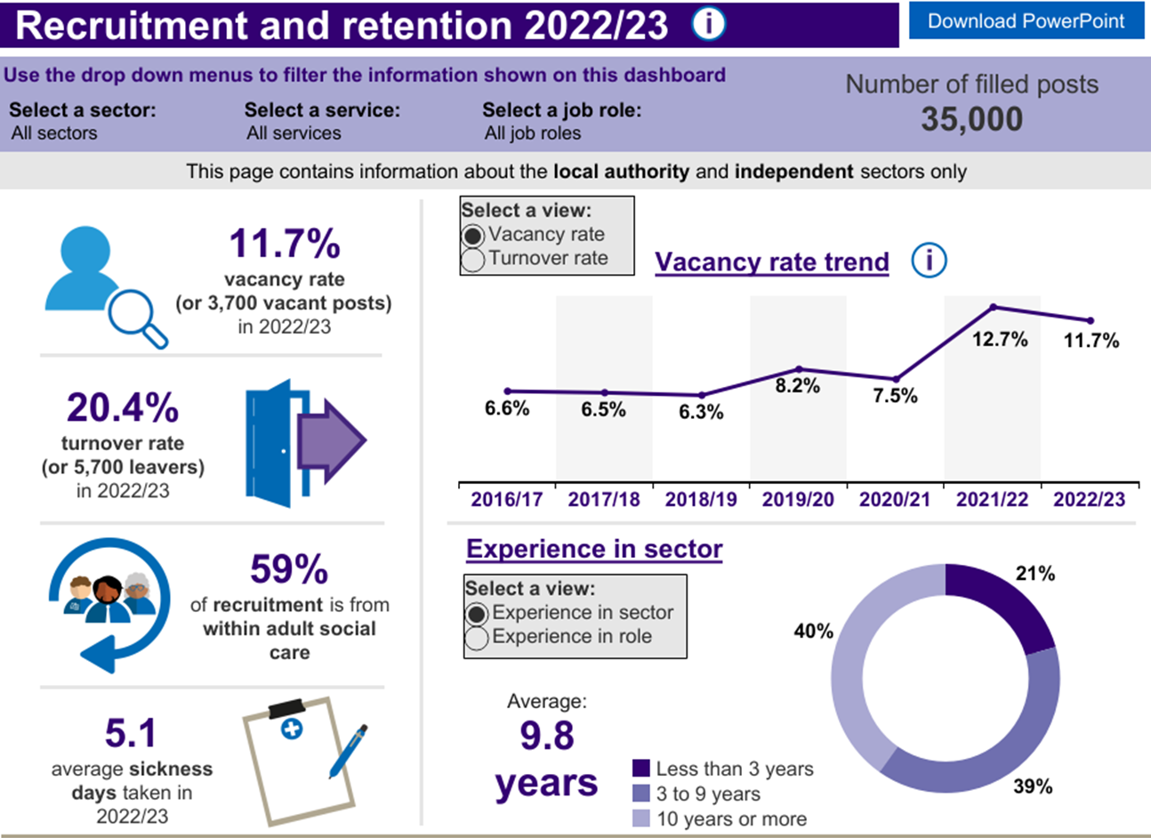
Why we need international recruitment

Slide 9
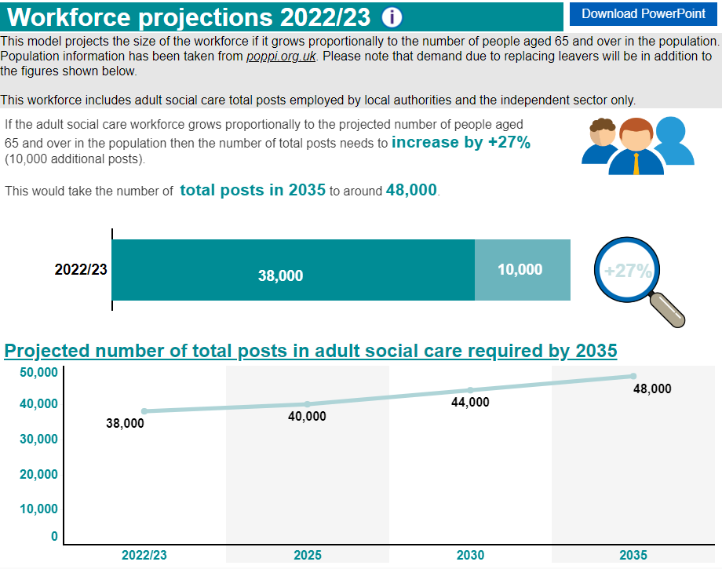

Slide 10
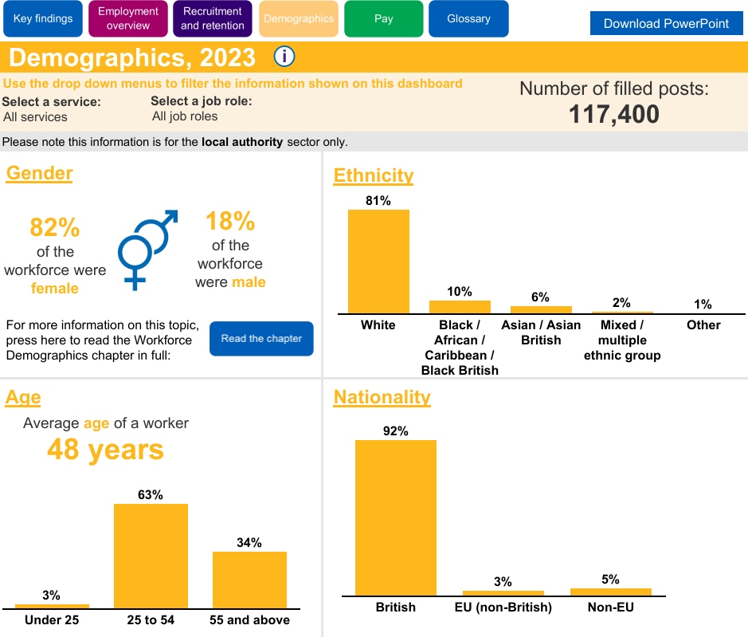
Notes:
The workforce employed by adult social services departments in England (skillsforcare.org.uk) thinking about the make up of the industry, how can international recruitment ensure you continue to provide the services requires.

Slide 11
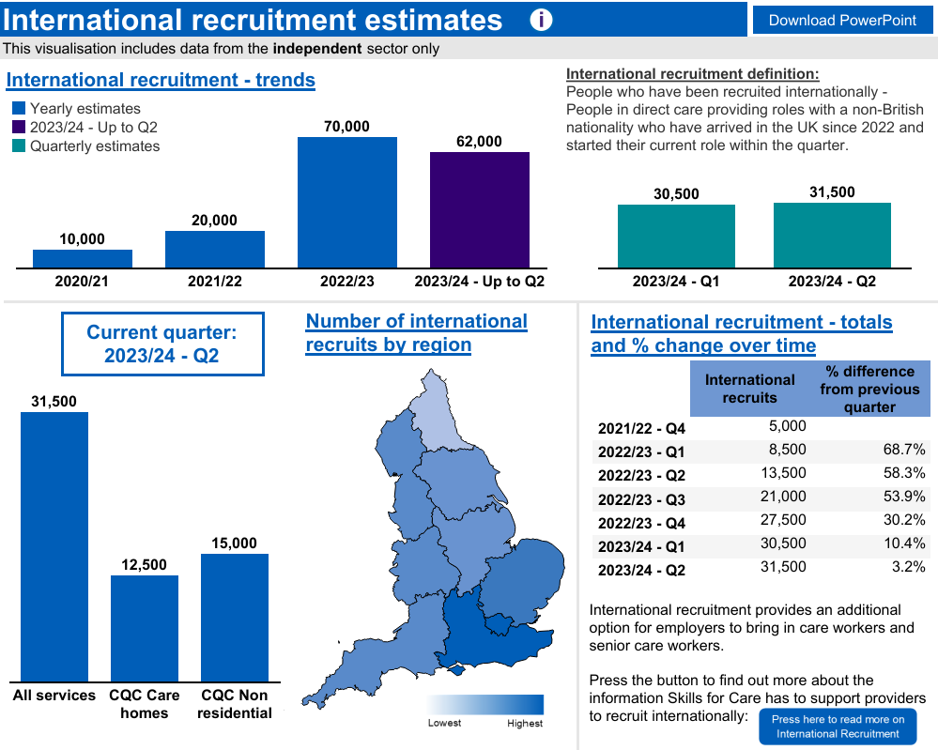
Notes:
International recruitment (skillsforcare.org.uk a lot of people have travelled here for work, different areas have used the sponsorship system in different ways, in the south east we have specific challenges when hiring international workers. With legislating changes it is likely the predicted numbers may change as we move forward. How many people arrive with one sponsor and transferer to others?

Slide 12










Look at all the ways you can recruit!
Notes:
Before you start looking for a team member from abroad look at the availability locally, are you using all the resources available, paid and unpaid to find you team?

Slide 13
Look at all options first
Widen your talent pool
Remove unfair barriers and attract people from different backgrounds, including international candidates, 16-17 year olds, candidates with disabilities and those with criminal convictions.
Care Friends
The Care Friends app makes it straightforward for staff to share vacancies on social media and rewards them for doing so.
I Care... Ambassadors
Attend job fairs and visit local schools and colleges to reach many potential recruits at one time. Your existing workforce are great advocates and potential recruits can learn a lot from the I Care...Ambassadors
Notes:
Think about local and national recruitment opportunities

Slide 14
International Recruitment Resources
Becoming a Visa Sponsor - Help Sheet for ASC Providers
Produced by the DHSC, this document takes you step-by-step through the process of gaining your sponsorship licence.
Overseas recruitment bite-size guide for social care providers
Produced by the Local Government Association, ADASS and the South East Social Care Alliance, the overseas recruitment bite-size guide for social care providers helps care providers explore and maximise opportunities that overseas recruitment offers.

Slide 15
Who runs the process
Different ways of doing it
Personal
Companies
Agencies
Sponsorship of existing workers
For further information from Skills for Care follow the link below.
https://www.skillsforcare.org.uk/Recruitment-support/International-recruitment/International-recruitment.aspx
Notes:
Once you have settled on international recruitment being your best step, a clear plan needs to be made to ensure the project is owned, recorded, run and reviewed. This can be done in house, via a third company or agency specially supporting sponsorship they can also help with people already in the country and looking to change sponsors.

Slide 16

Ethical recruitment
Values and culture
Notes:
Any kind of recruitment needs to reflect the companies needs and values, when recruiting from over seas this can be even more important

Slide 17

Notes:
When the media leads with this type of headline, we have a lot to do to convince our teams that international recruitment is the way forward.

Slide 18
Ethical and safe recruitment
Ethical international recruitment: what you need to know
Our latest data shows that 70,000 people were recruited from abroad into direct care giving roles in 2022/23. We look at what you need to know about ethical international recruitment.
Safer Recruitment checklist
Recommendations that employers can take to gather and assess criminal record information for all applicants, including displaced people, to demonstrate you are taking a fair and consistent approach across all candidates
Notes:
Information on recruitment and supporting people safely

Slide 19

Values in the workplace
https://www.skillsforcare.org.uk/Recruitment-support/Values-based-recruitment/Values-based-recruitment.aspx
Notes:
The values of the company should be clearly explained to providers, values based training and recruitment links

Slide 20

Culture of the workplace
https://www.skillsforcare.org.uk/news-and-events/Spotlight-on/Developing-a-positive-workplace-culture.aspx
Notes:
If people like you values, they can start to see the culture they will be joining….direct to culture slide

Slide 21
Ethical recruitment and Inclusive
Some of the key ethical considerations include:
Researching which country you plan to recruit from: some countries are on a red list meaning you can’t actively recruit from these places.
Selecting from the Ethical Recruiters List if working with recruitment agencies
Ensuring that candidates have all the information they need about the job up-front to be able to make an informed decision.
Notes:
We should be humbles by anyone who leaves their home and family for a better life, so when we support people to come over we must focus on ensuring people are supported to settle and create a life.

Slide 22





Notes:
Supporting new staff in all areas of their lifes is a key component to retaining your new team member.

Slide 23

.
alison.porteous@skillsforcare.org.uk

