Slide 1

Information please, in confidence
As part of the Care Association Alliance national survey
The fee rates you’re receiving from LAs

Slide 2
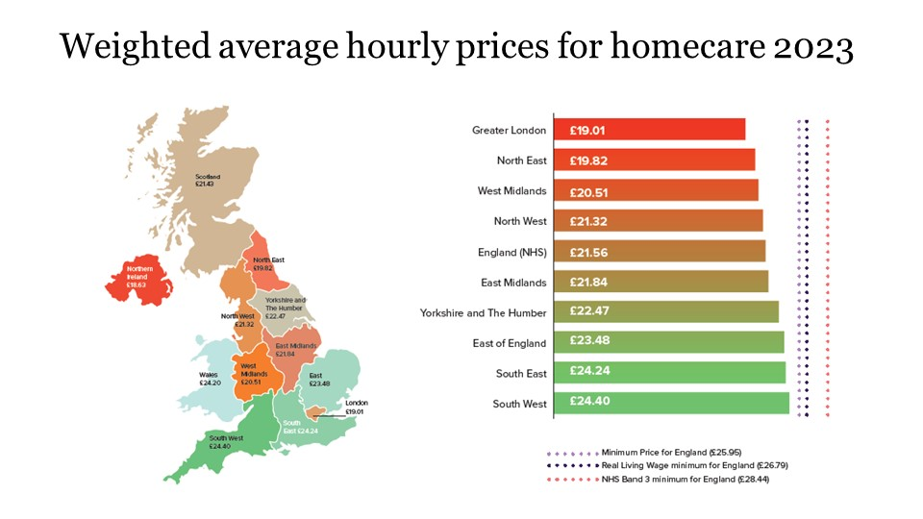

Slide 3
Travel time for DCA staff
Travel time between calls counts as paid work time, not lunch break.
Not paying the travel time could lower the pay rate below the min wage and make you liable for prosecution. See this HMRC webinar https://lcasforum.org/international-recruitment/
Sign up to ACAS and HMRC updates.
If you are contracted to pay the LLW, then it should be paid, LAs are now checking this.
The LLW is now being rolled out by M&S and Tesco as examples, more competition for your staff.

Slide 4
Companies House update
As of March 4th 2024, a range of measures to combat fraud
greater powers to query information and request supporting evidence
stronger checks on company names
new rules for registered office
a requirement for all companies to supply a registered email address
requirement for subscribers to confirm they’re forming a company for a lawful purpose
the ability to share data with other government departments and law enforcement agencies

Slide 5
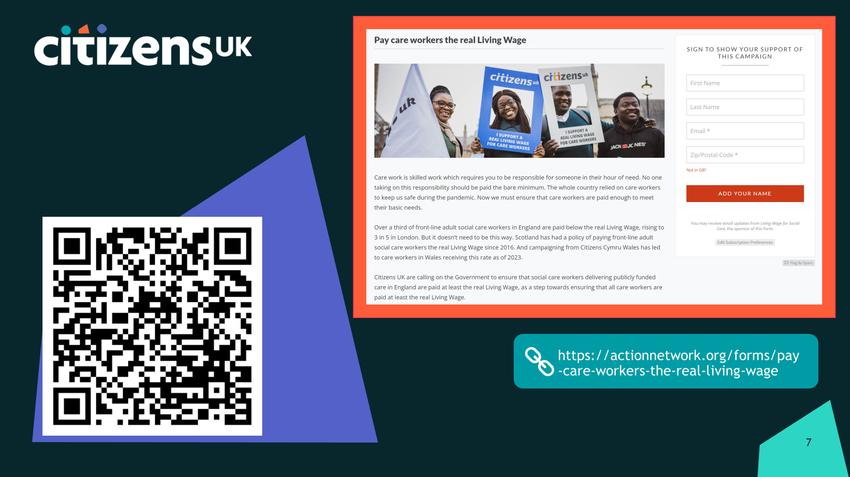

Slide 6
ACAS - www.acas.org.uk
Inclusive workplaces: making changes to better support neurodiversity - 14 March
Let's talk about menopause at work - 20 March
Flexible working requests: a case study and the law - 21 March
Carer's Leave - the law explained - 26 March
Sickness absence: supporting your staff - 27 March
These Acas webinars
- Are free to attend
- Are run by Acas experts
- Cover the essentials of employment law and employment relations
- Are typically run for an hour or less - allowing those with time constraints to attend
- Are designed for small and medium business attendees
- Provide the opportunity for Q&A

Slide 7
World Sleep Day – Keeping Well NWL
15th March is World Sleep Day. For health and social care staff, factors like working shift patterns can have a big impact on the quality of staff’s sleep. Poor sleep can in turn impact our mood and how we feel.
You can find more information, support and resources on the Keeping Well website sleep page, and ways to get involved with World Sleep Day here.
We are here to support you. Get in touch with us by:
Telephone: 0300 123 1705
Email: keepingwell.nwl@nhs.net
Complete a self-referral form

Slide 8
Any queries,
contact Peter Webb peter@lcasforum.org 07956878901
Or
Dudley Sawyerr dudley@lcasforum.org 07984466130
E&OE

