Slide 1








International recruitment Organisational & Pastoral Support
South-West London

Slide 2

Session Overview
Introductions
About PJs Community Services
Background, Media & overview
South West London offer
High level workshops
Pastoral Support
Key agencies
Responsibilities of Sponsors
Questions

Slide 3

Introductions
Claudine Reid MBE – Project Manager
Laura Etiley - Project Co-Ordinator
South London
Caramel – Project Co-Ordinator
North London
claudine@pjsgroup.co.uk
laura@pjsgroup.co.uk
Caramel@pjsgroup.co.uk

Slide 4
About PJs Community Services
PJ’s Community Services is a multi-award-winning Social Enterprise, established in 1992 with a focus on Community transformation. PJ’s delivers its mission by providing:
Care to vulnerable adults & young people
Education & support to young people that are at risk of exclusion the support is also extended to the families.
Social Enterprise support to organisations and individuals
Community wellbeing projects
We employ 60 staff and offer a range of innovative and transformational services to BAME communities, young people, women, men and faith communities.

Slide 5
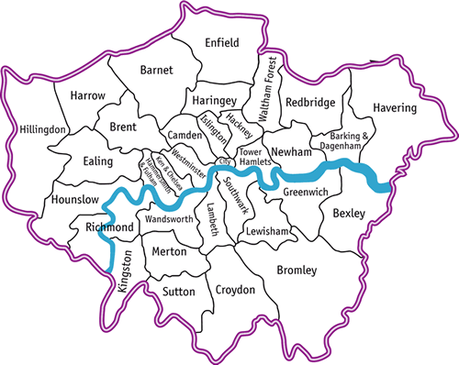
Background
South West London have commissioned PJs Community Service on behalf of the six boroughs of Croydon, Sutton, Merton, Wandsworth, Richmond & Kingston to provide support to providers to better support overseas workers.
North Central London have commissioned PJs Community Services on behalf of the five boroughs of Barnet, Camden, Enfield, Haringey & Islington, to provide an in-depth pastoral care and support program to international recruits that are already working in the UK.

Slide 6
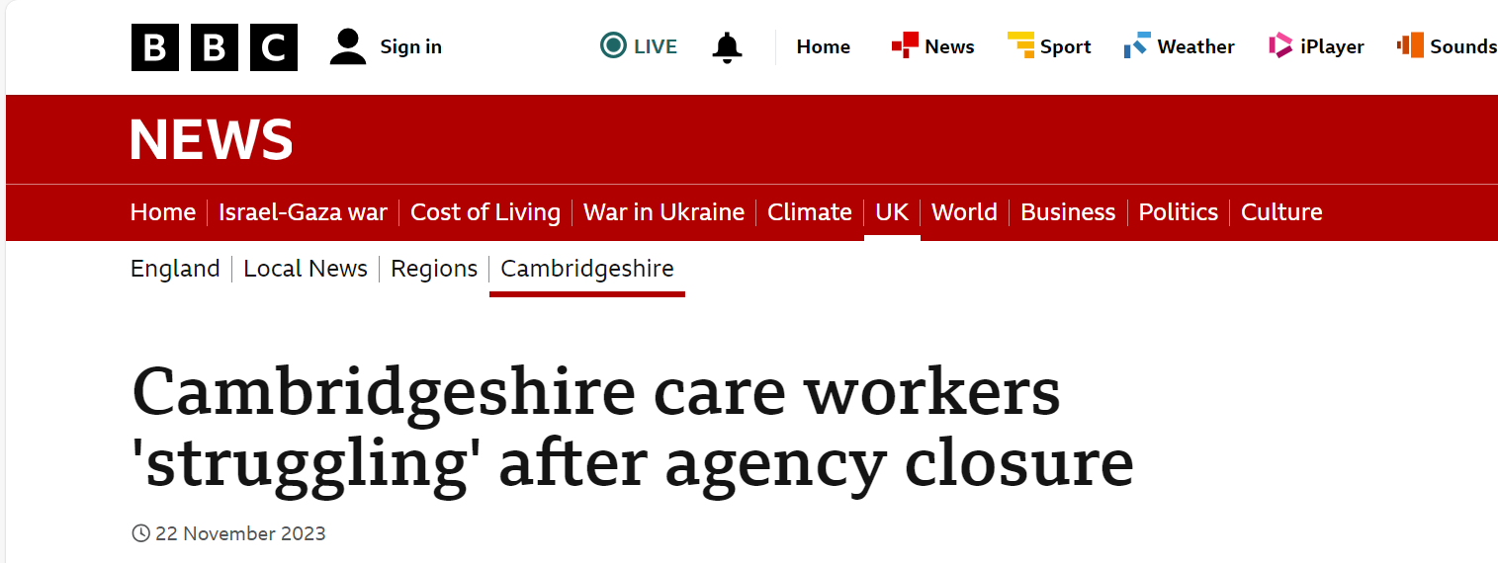
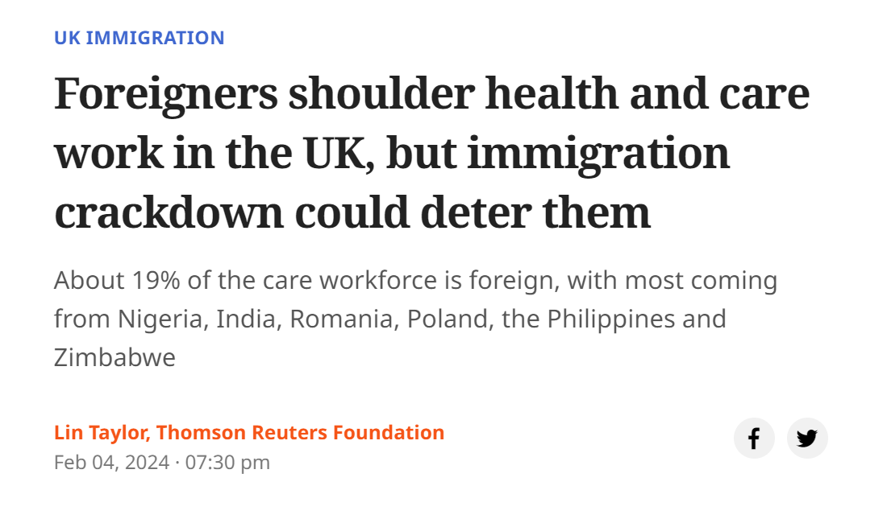
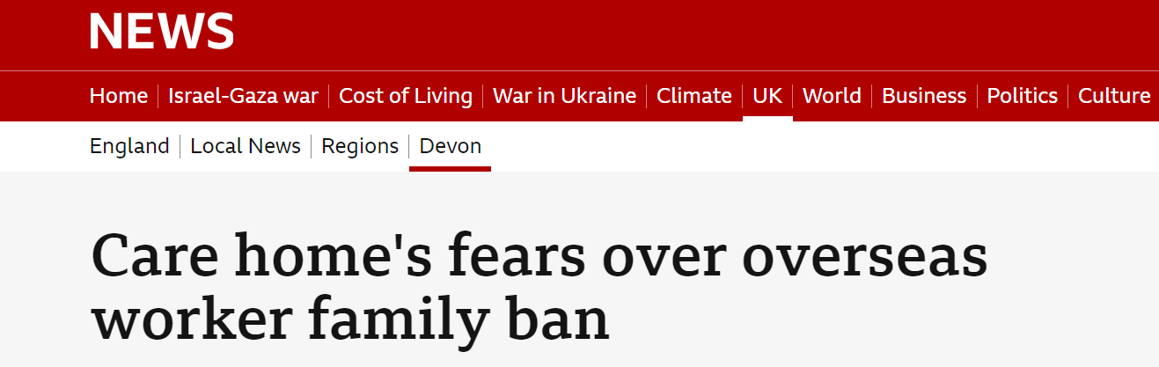
Media Highlights

Slide 7
High level overview
SOUTH WEST LONDON
Enhanced organisational & workforce development supporting both providers and international recruits.
Post arrival support for recruits including temporary accommodation (up to 2 weeks), Mandatory training & delivery of a pastoral support to help them settle into work and life.

Slide 8
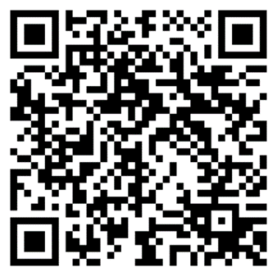
South West London QR

Slide 9
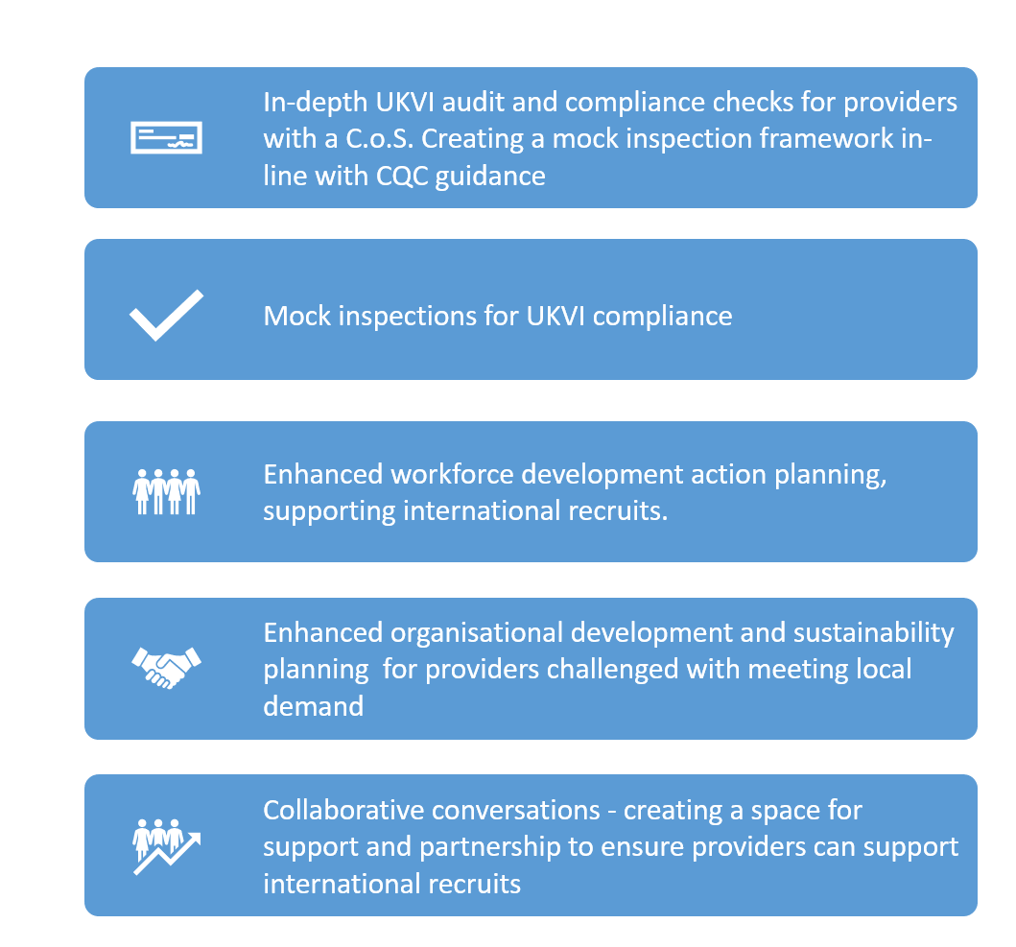
South
West
London

Slide 10
7 High level Workshops
We are offering 7 high level workshops touching on 5 main topics
Roles and Responsibilities
Compliance
Pastoral Support
Workforce Solutions
Audit/Mock Inspections

Slide 11
Pastoral Support
Cultural Intelligence
Mandatory Training
Welcome Pack
Pastoral Care Sessions

Slide 12




Slide 13
Responsibilities of Sponsors
Applicants must demonstrate adequate skills, experience & qualifications for the role
Normally, the applicant will be responsible for paying for their UK Visa (Health & Care Visa @ £284)
Only assign certificates of sponsorship to workers when the job is suitable for sponsorship and on the current skills shortage list
You must also guarantee to pay an overseas worker at least £20,963.00 a year (or £10.75 per hour) and 37.5 hours a week. Due to abuse, this is now checked via HMRC RTA payroll
They can only work for your company
We will work with you to advise on HR and monitoring and compliance for your overseas workers
Sponsors face prosecution and fines, your licence may be downgraded, suspended or withdrawn if you do not fulfil these responsibilities

Slide 14

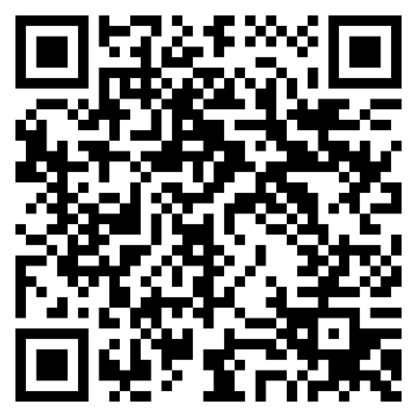
Thank you
Any questions?
South West London
laura@pjsgroup.co.uk
https://form.jotform.com/240353047111341

