Slide 1





UNLOCKING SPONSORSHIP LICENCES: “Costs, Complexities, and Compliance”
costs, complexities and compliance

Slide 2


INTERNATIONAL RECRUITMENT GUIDANCE
FOR SOCIAL CARE PROVIDERS & MANAGERS
WHO WE ARE
The London Care and Support Forum, is part of the Care Association Alliance – national group of care
associations.
We work with commissioners, providers and other stakeholders, such as Skills for Care to provide a supportive facility for the exchange of information, the creation of a better understanding of user requirements in a constantly changing marketplace and to encourage higher quality standards through workforce development, enhanced management and good leadership.
Notes:
Having been in existence for a number of years, the Covid epidemic changed the way that LCAS worked and that was in response to the needs and wants of social care providers. Covid (& Brexit) have changed the way that we and most other systems work and interact. International recruitment and international recruits, long a feature of social care & health have taken on a new dimension and remain vitally important to the sectors. It is important to say and to stress, that supporting Irs and ensuring they have good experience in the UK is key to gaining more Irs and the future of IR use and social care. Good working practises are essential whether Irs are employed or not and a good organisational culture is vital to that. To ensure effective recruitment, retention and staff development, all knock on to quality and are reflected in CQC inspections.

Slide 3

https://youtu.be/ikoKg1IQ-hI

Slide 4
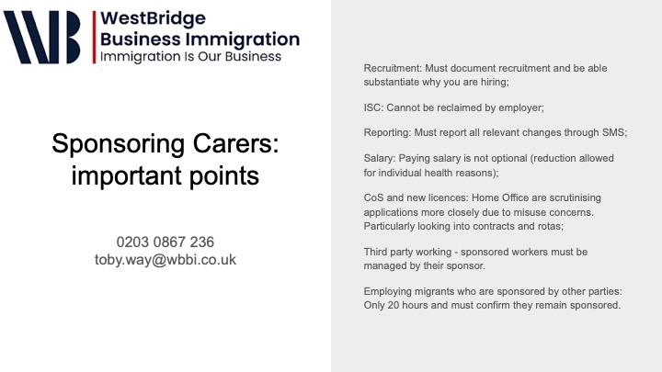

Slide 5


Slide 6
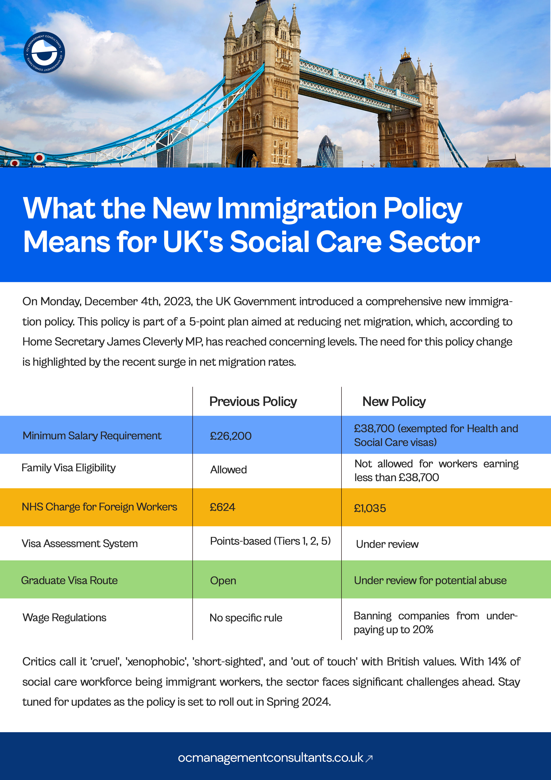
Notes:
The Government has announced a series of immigration reforms to reduce the level of legal migration, which has reached record-breaking figures in accordance with the latest reports.

Slide 7
Notes:
The headline was that the minimum salary requirement for a Skilled Worker visa will increase to £38,700 from £26,200. However, this will not apply to those coming to work under the health and care worker visa route. This is a relief for care operators, as the increased would be impossible to pay given current local authority funding constraints.
Care Workers will not be permitted to bring their dependants to the UK, reversing the current rules. Given that most workers bring their dependent children, a ban on doing so is likely to make working in the UK less attractive and they may look to other countries instead. This is likely to reduce the number of overseas care workers coming to the UK at a time when there is a significant shortage of staff;
Dependants of students will not be permitted to join from early next year, except for migrants pursuing Higher Education courses. However, such exemption is about to be reviewed. We have seen a significant increase in people on student visas working in the care sector and it is possible that these restrictions will reduce numbers, although this group are likely to be more socially mobile than other workers.

Slide 8

The above changes are. expected to come into effect from Spring 2024……..
Notes:
With around 152,000 vacancies in social care and with an iflux of 50,000 plus staff alone this year from overseas, it’s surprising the government has gone down this road. A "shortage occupation list" exists to help employers fill certain roles.
These jobs have a lower salary threshold, making it easier for applicants to gain the required number of points to get a visa.
Jobs currently on the list include:
jobs in health and education
care workers

Slide 9
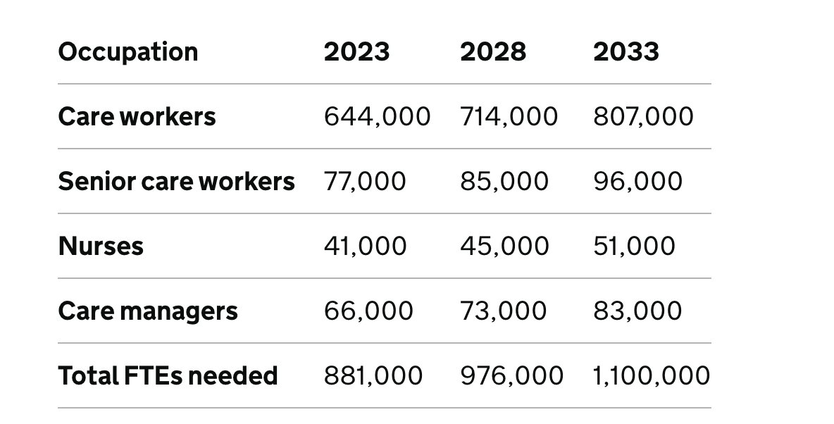
Migration Advisory Committee (MAC) Review
Notes:
Migration Advisory Committee (MAC) to
undertake an independent review of adult social care, and the impact the ending freedom of movement has had on the sector.
The highest proportion of visas being issued, with Skilled Worker and Health and Care Worker visas accounting for 63% Social care is a significant contributor to the UK economy of £51.5 Billion activity in England

Slide 10
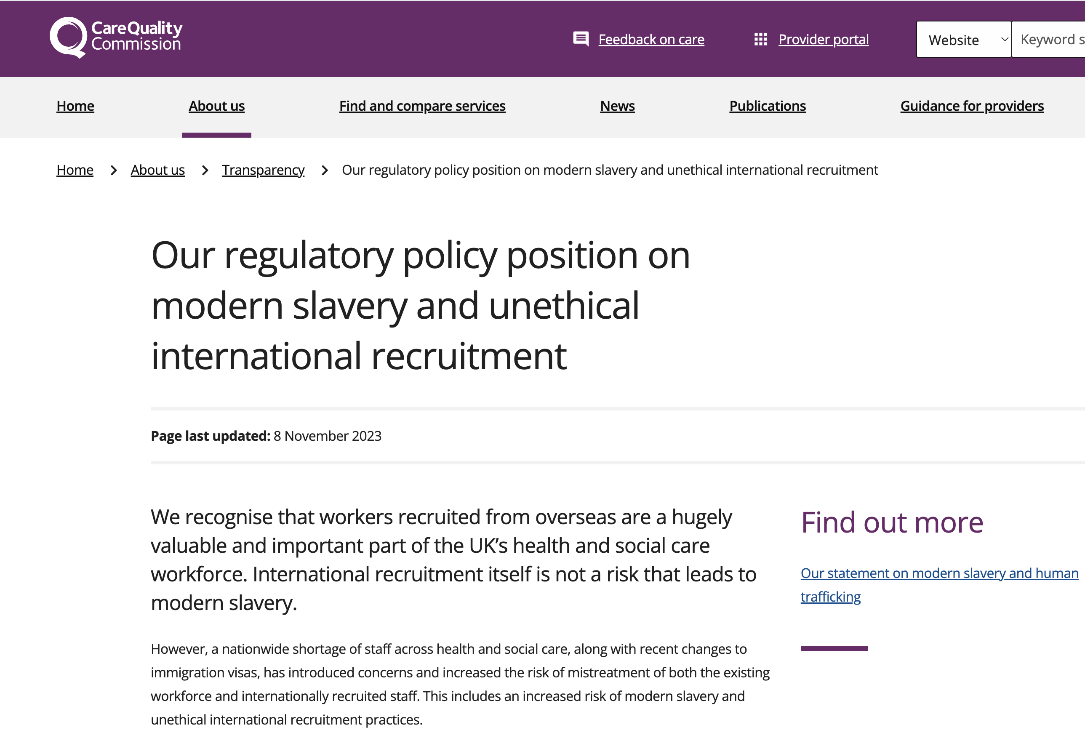
Notes:
Today’s measures will ensure we continue to protect our NHS and social care systems while addressing significant concerns that have emerged since the introduction of the visa about high levels of non-compliance and worker exploitation and abuse within the adult social care sector, particularly for overseas workers employed within care occupations.

Slide 11





INTERNATIONAL RECRUITMENT GUIDANCE
FOR SOCIAL CARE PROVIDERS & MANAGERS

Slide 12

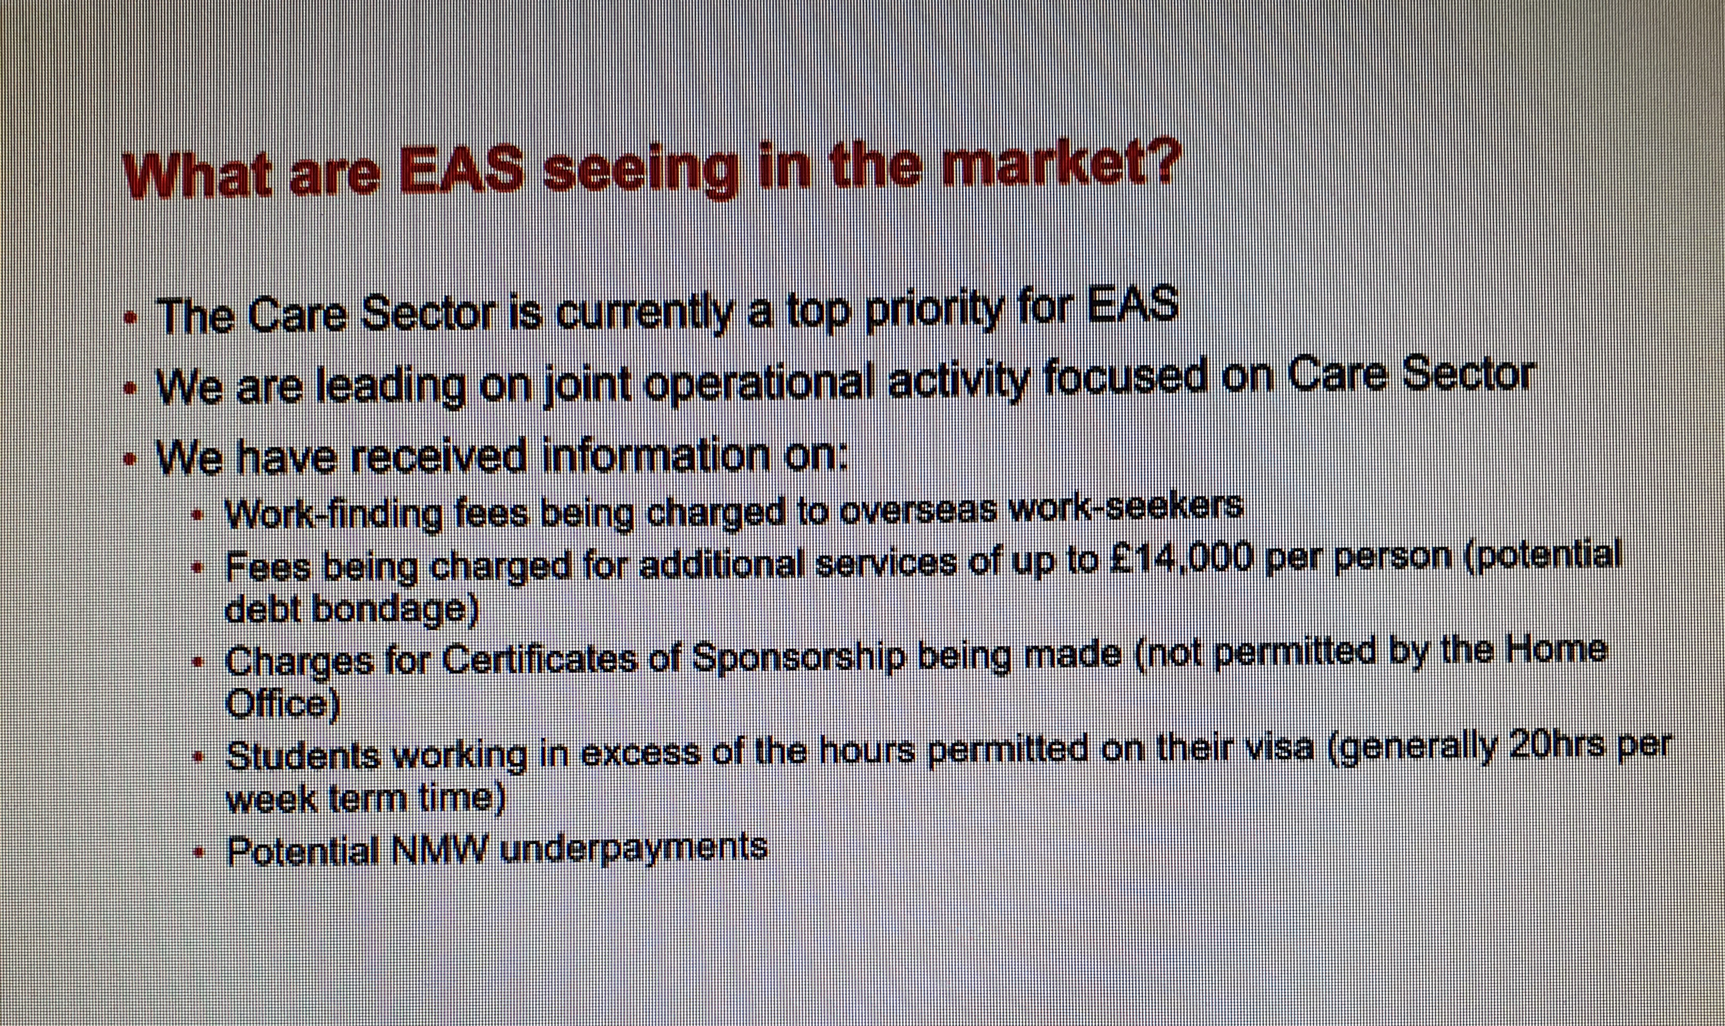
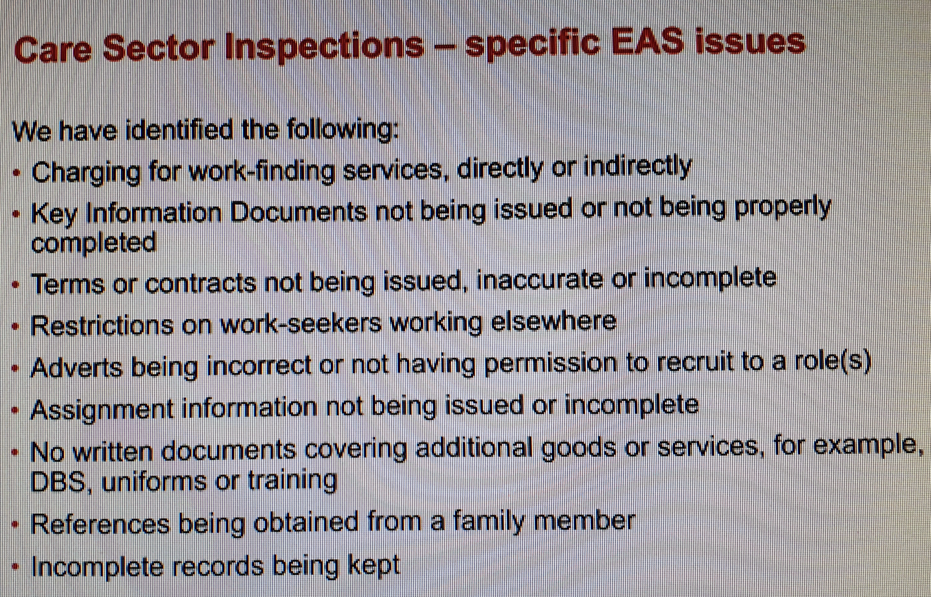

Slide 13
INTERNATIONAL RECRUITMENT GUIDANCE
FOR SOCIAL CARE PROVIDERS & MANAGERS
Q & A

Slide 14


Any queries,
Contact Peter Webb peter@lcasforum.org
07956878901
Or
Dudley Sawyerr dudley@lcasforum.org
07984466130
WhatsApp: 07403010207

