Slide 1
NWL Social Care Digital Programme
(DSPT and DSCR)
8th November 2023

Slide 2




What is the Data Security and Protection Toolkit (DSPT)?
An online self assessment
of your organisation’s data security
Demonstrates compliance
with data protection legislation
Reviewed annually
(June deadline each year)
Gives advice and is a checklist of good practice
Notes:
National programme funded by NHSX
Its overall aim is to help make sure adult social care providers have good data and cyber security in place
The DSPT is a free, online self-assessment of health and social care providers’ data security and protection policies, procedures and processes. It is not just about your technology – it is about any information you hold about any person - staff, clients or visitors – that enables you to demonstrate that you are compliant with data protection legislation (GDPR and the Data Protection Act and the 10 health and social care data standards).
The DSPT should be completed every year. This means that it is a rolling process. You can go in and out throughout the year and can make updates at any time. IT DOES NOT NEED TO BE DONE ALL AT ONCE. To note – the majority of the work is in the first year getting everything up together – then in subsequent years it’s about keeping it updated as your answers roll forward from one year to the next.
DSPT is the NHS’s online self-assessment toolkit that all social care providers should complete as they will hold, process or share peoples’ personal data. The questions in the toolkit are specific to the sector – if you register on the toolkit as a social care organisation then you will see questions that are specific to social care providers. This means that the toolkit is a valuable source of advice about what you need to do: it’s a best practice checklist. If you want to know what you should be doing about data protection, information or cyber security then the toolkit will tell you.
Remember, it’s not just about technology as you need to follow best practice and comply with the Data Protection Act even if you don’t use any tech.
It consists of 43 mandatory questions to help you think about data and cyber security in your organisation. Completion of it lets others know that you’ve thought carefully about this area.
- Also worth mentioning that completing the DSPT to ‘Approaching Standards’ is a great start but you will not be considered as DSPT compliant until you have completed the Toolkit to ‘Standards Met’ for that year. So, for example: this year, everyone published at ‘Standards Met’ or ‘Standards Exceeded’ in the 22/23 Toolkit OR the 23/24 Toolkit will currently be considered as DSPT Compliant. However, those published in the 22/23 Toolkit will only remain compliant until June 2024, whereas those published in the 23/24 Toolkit will remain compliant until June 2025.

Slide 3






Why is the DSPT Important?
Data and cyber security is important for safe sharing of records – especially with increased use of digital technology during the pandemic.
It will help protect your business from the risk of being fined for a data breach and from the disruption of a cyberattack.
It’s a contractual requirement from health (and often from councils) to complete the DSPT.
It’s your passport to shared care records and other digital innovations with health services, enabling you to be part of a truly joined up care network with the interests of the people you support and care for at the center.
The DSPT will demonstrate compliance with legal and CQC requirements.
It will help you keep people’s confidential information safe.

Slide 4
Current H&F DSPT Compliance, 30th October
Average compliance across NWL care home providers
Average compliance across NWL domiciliary care / other providers

Slide 5
Digital Social Care Records
A Digital Social Care Record (DSCR) is a software tool that allows providers to digitally record care information in real time, replacing traditional paper records. These systems are sometimes also called electronic care plans, electronic care records or electronic care management software.
DSCR solutions ensure that residents receive the right care at the right time and the right people have access to the information they need to deliver that care.
NWL ICB and the North West London Local Authorities are working in partnership to support care providers using paper records to switch to one of the NHS England Assured DSCR Solutions.
Providers who currently use paper records will be able to receive support in the form of:
Information and support to understand the NHSE Assured DSCR Solutions, so that providers can find the best solution for them
Financial support, by way of a one-off grant payment, to help fund the purchase and implementation of a DSCR solution
Support to meet prerequisite Data Security and Protection Toolkit (DSPT) standards and to access other digital systems such as the London Shared Care Record

Slide 6


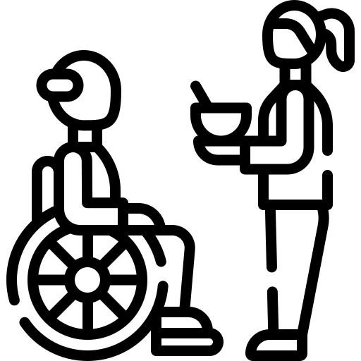
What are the benefits of DSCR?
Benefits for Residents
Remote access for residents and, with consent, their families and loved ones
Availability of all key information is in one place, accessible at the point of care
Improved care, including better facilitation of hospital admissions and discharges and more comprehensive briefs available to clinicians and AHPs
Benefits for Care Managers
Aligns with CQC best practices and emerging digitisation standards in the single assessment framework
Easier and more efficient processes for providing information to commissioners and regulators
Increased security and a reduction in archiving, printing and scanning costs, and the overall environmental impact when compared to paper records
Access to real time data to review and analyse organisational and care trends
Benefits for Care Staff
Faster, more accurate, and safer information sharing to support the provision of health and care services
Minimisation of risks such as medication errors, dehydration, or missing visits
Support for other important health and care functions such as service management, planning and research
Ease of reading existing notes and recording new notes into the record, with records accessible from anywhere
Reduction in time spent on administration, allowing more time to provide care

Slide 7

How to get support for DSCR
What will care providers have to do?
To be eligible for the DSCR project, care providers will have to:
Meet DSPT standards for the current year
Work with the programme to identify and address digital maturity needs (e.g. portable device access, network connectivity) prior to purchasing a DSCR
Select a DSCR from the Assured Solutions List
Enter into an agreement to take part in and receive funding, which will include commitment to purchasing, implementing, and funding the costing costs after Year 1 for the selected assured DSCR solution
Who to contact?
For more information and to get in touch about DSCR support, please contact the NWL Social Care Digital Programme at nhsnwl.ehch@nhs.net

