Slide 1


lcas forum 8th NOVEMBER 2023
Hammersmith and Fulham Dementia Partnership Board
Year One Implementation of the H&F Dementia Strategy – becoming a
Dementia Friendly Community
Key Achievements 2022/2023

Slide 2
Year One Priorities as identified by our residents, stakeholders and businesses
Overarching priority - getting an early and accurate diagnosis within clearly understood timeframes
Priority 1 - Clear, accessible information about how to get services and support
Priority 2 - Services must meet the evidenced needs of people with dementia and their carers and families as opposed to assumed needs
Priority 3 - A range of dementia specific and dementia inclusive activities that give choice and control, reduce social isolation and promote equality
Priority 4 - Hammersmith and Fulham to be a Dementia Friendly Community

Slide 3
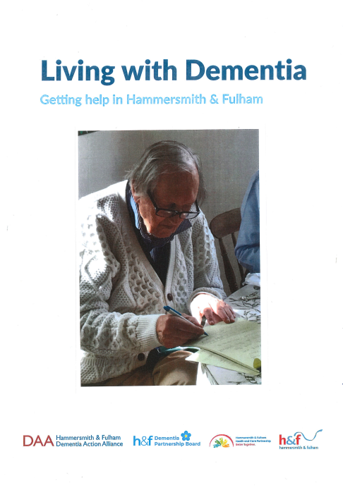
Priority 1 - Clear, accessible information about how to get services and support
* Our H&F Dementia Guide – to be launched
in Dementia Action Week 15-21 May 2023 at reception for GPs, Primary Care, Dementia Link Workers and staff of the Older Peoples Mental Health Service

Slide 4
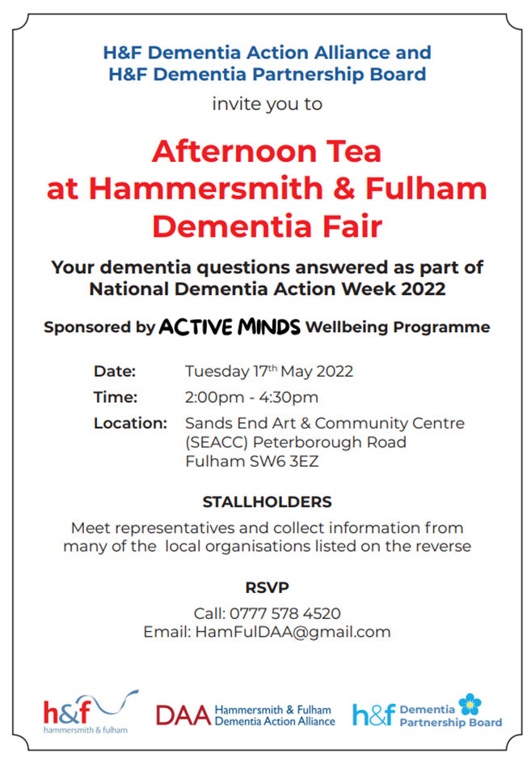
Priority 1 - Clear, accessible information about how to get services and support
* A celebration of our integrated partnership working
* Over 150 residents attending, and 20 local organisations and services represented
* Early recruitment of our future dementia co-producers

Slide 5
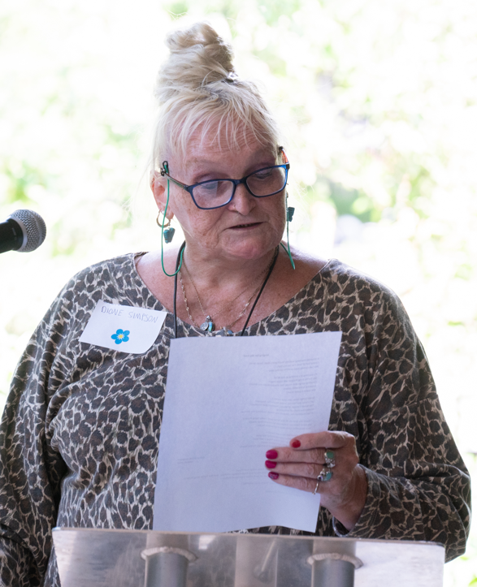
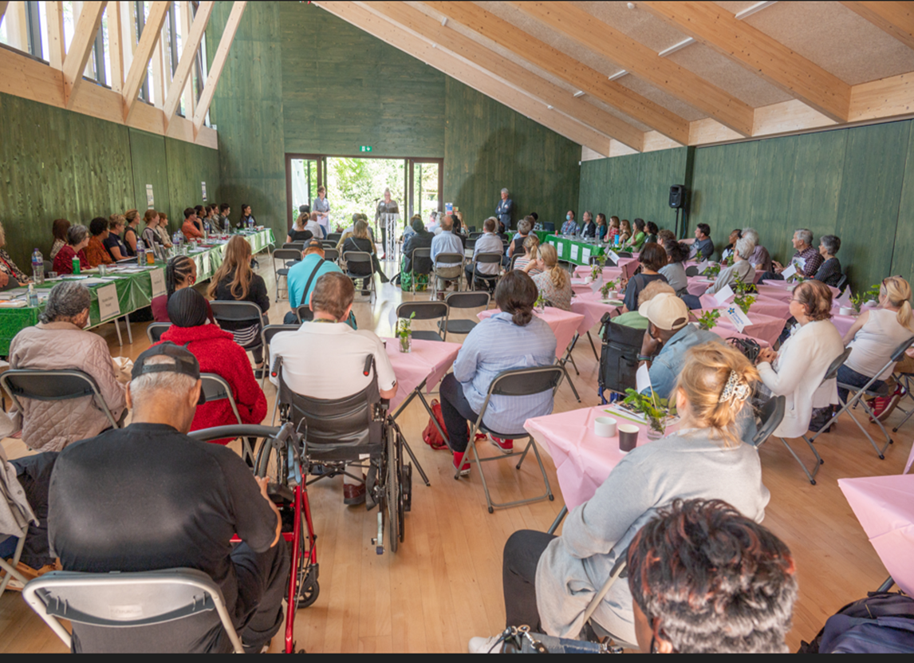
Priority 2 - Services must meet the evidenced needs of people with dementia and their carers and families as opposed to assumed needs
* “Nothing about us without us” - how residents experience our services and support – Dionne describing her experience of living with dementia at the Dementia Fair on 1th May 2022.

Slide 6
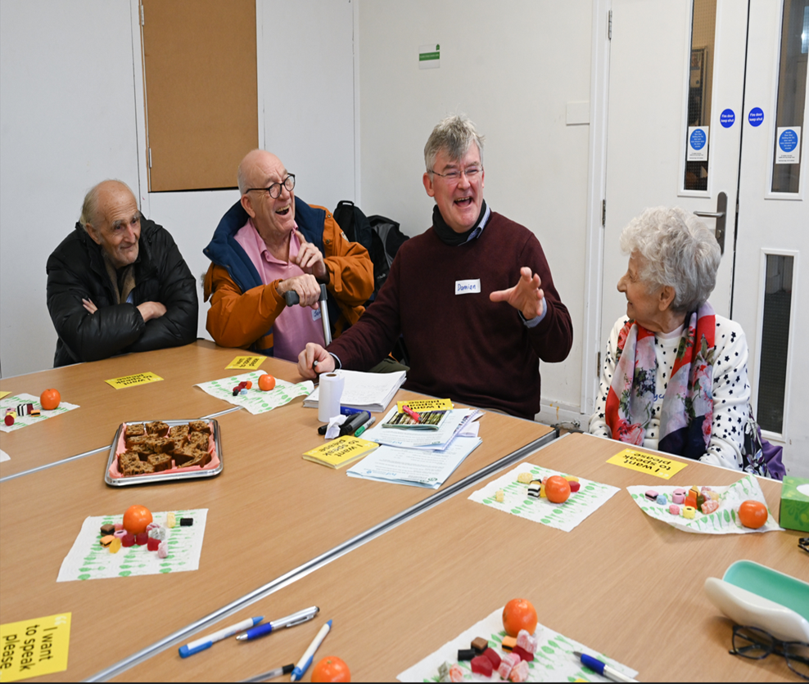

Priority 2 - Services must meet the evidenced needs of people with dementia and their carers and families as opposed to assumed needs
* ‘Innovations in Dementia’ growing our co- production with 8 residents with dementia
* Peer support for people with dementia, sharing information and experiences

Slide 7
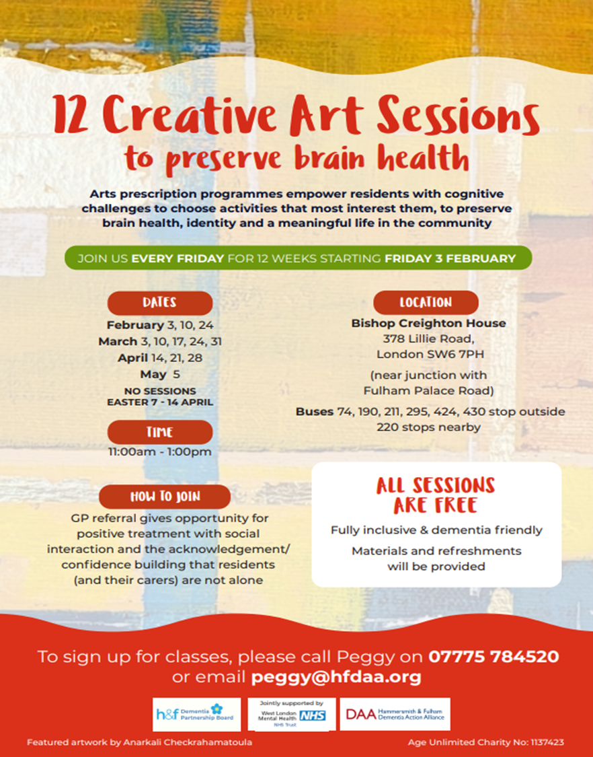
Priority 2 - Services must meet the evidenced needs of people with dementia and their carers and families as opposed to assumed needs
* Year one of our Dementia Hub activities
delivered across the borough
84 residents accessed Art Sessions and
624 accessed Dementia Friendly Bingo
* Support for residents waiting for a diagnosis – they
have seen GP and have been referred to OPMHS.

Slide 8
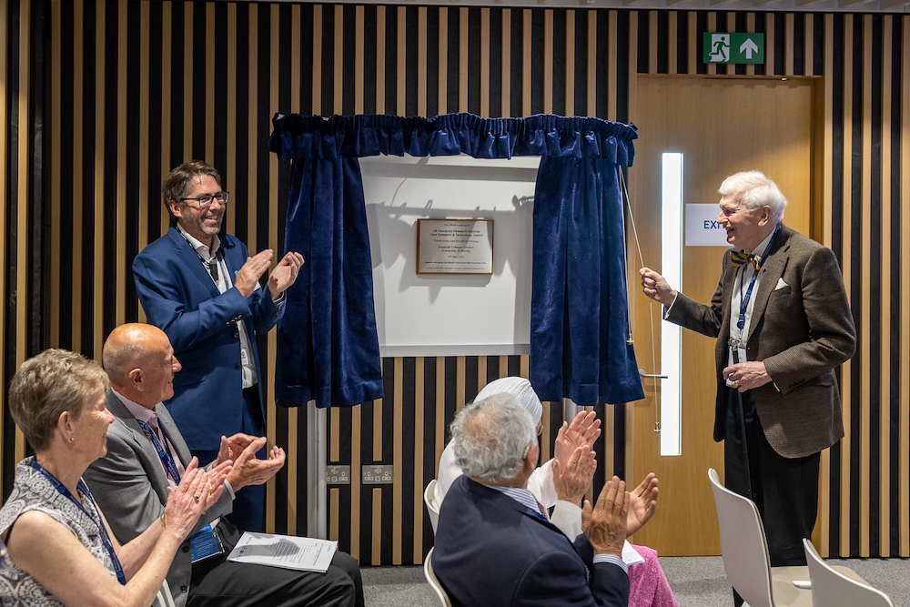
Priority 2 - Services must meet the evidenced needs of people with dementia and their carers and families as opposed to assumed needs
* Launch of the UK DRI Care Research & Technology Centre in May 2022 – a multi-million pound research facility to improve the lives of people living with dementia

Slide 9
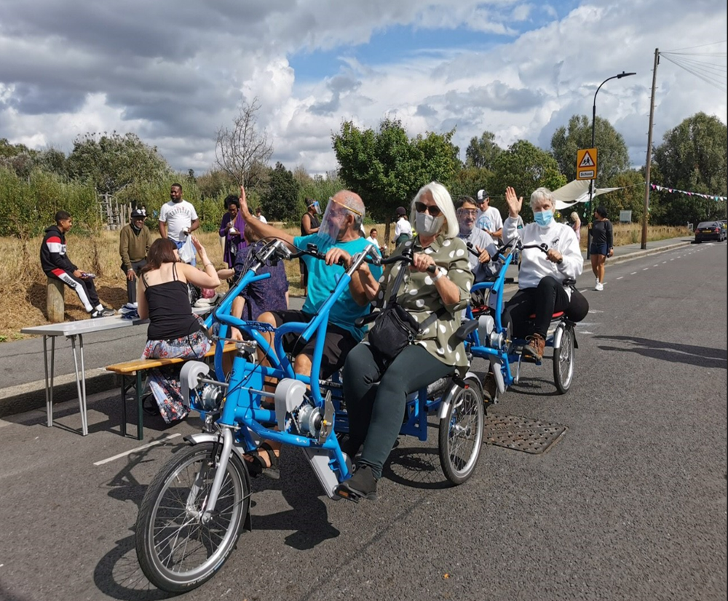
Priority 3 - A range of dementia specific and dementia inclusive activities that give choice and control, reduce social isolation and promote equality
* All Ability Cycling Hub on Fridays – For Brian CIC with Bikeworks

Slide 10
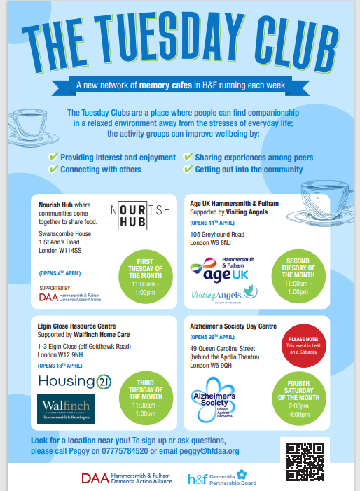
Priority 3 - A range of dementia specific and dementia inclusive activities that give choice and control, reduce social isolation and promote equality
* Dementia Hub (and spoke) activities to reach residents living across the borough commencing in April 2023.

Slide 11
Priority 3 - A range of dementia specific and dementia inclusive activities that give choice and control, reduce social isolation and promote equality
* ‘Better Together’ – promoting services and
support for older residents whilst having fun.
Over 300 residents have benefitted from Silver
Socials to date.

Slide 12
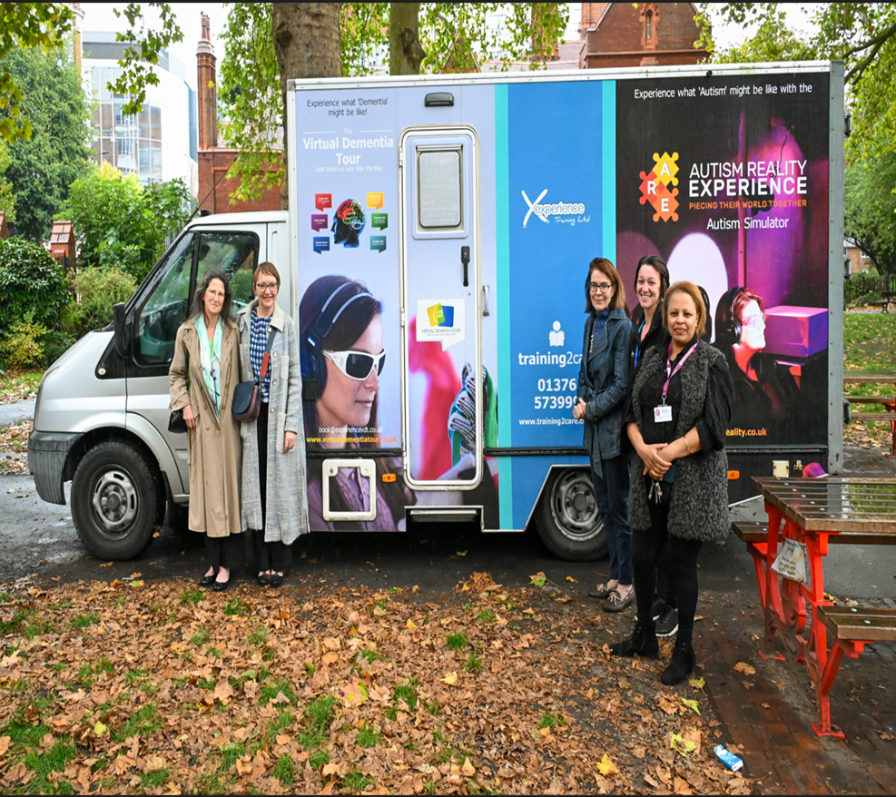
Priority 4 - Hammersmith and Fulham to be a Dementia Friendly Community
* Promoting awareness of dementia across
Hammersmith and Fulham – public, private,
voluntary and community sectors.
* 57 residents, staff and stakeholders accessed the dementia immersive experience on 30 September 2022.

Slide 13
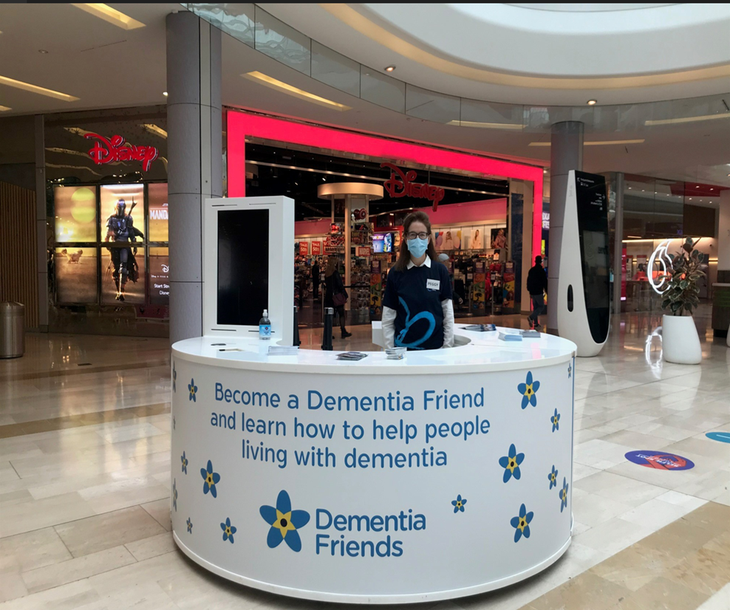
Priority 4 - Hammersmith and Fulham to be a Dementia Friendly Community
* Dementia Action Week 2022 – Westfield
* Partnership with local businesses a key priority for Year 2 Dementia Strategy Implementation
* Over 100 residents accessed information about dementia

Slide 14
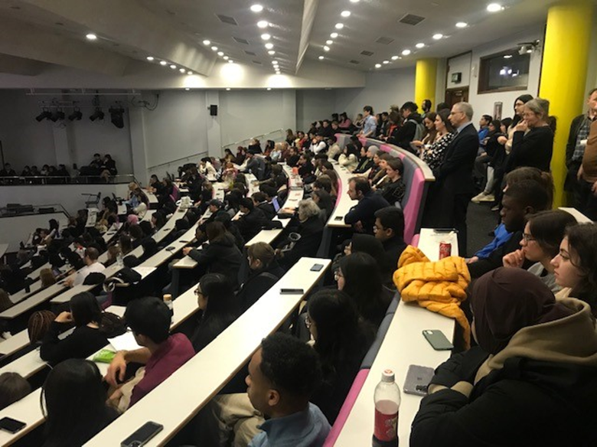

Priority 4 - Hammersmith and Fulham to be a Dementia Friendly Community
* Imperial College School of Medicine Dementia Friends session
* Hammersmith and Fulham now has target
1000 Dementia Friends

Slide 15

Priority 4 - Hammersmith and Fulham to be a Dementia Friendly Community
* Seven Adult Social Care staff passed the
‘Social Works’ Level 2 Award in Awareness in
Dementia

Slide 16
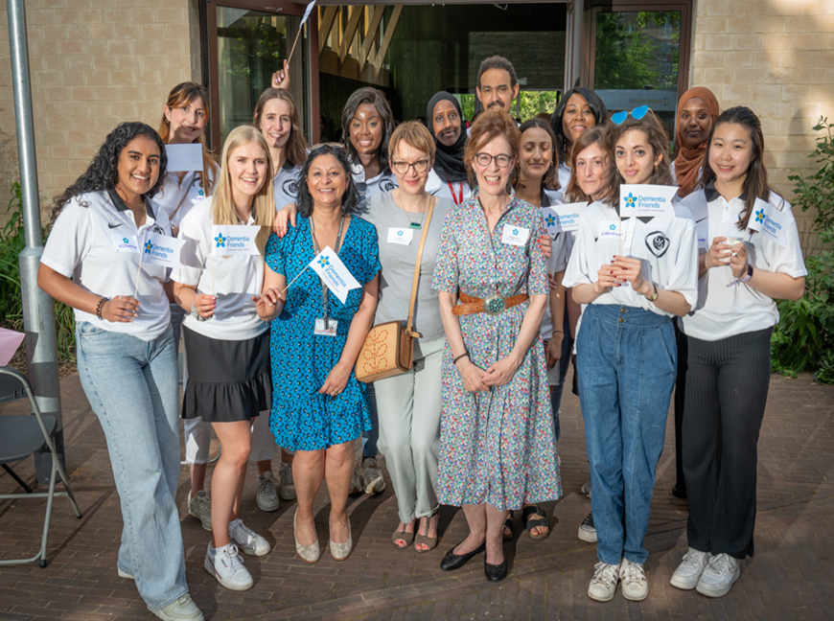
Priority 4 - Hammersmith and Fulham to be a Dementia Friendly Community
* Staff and volunteers at the May 2022 Dementia Fair

Slide 17
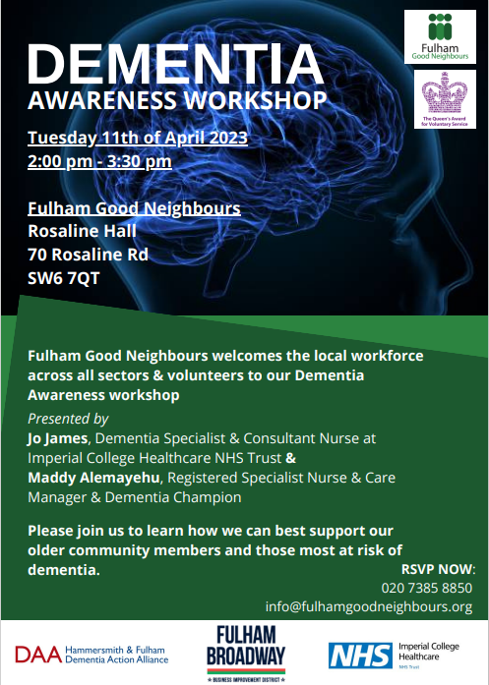
Priority 4 - Hammersmith and Fulham to be a Dementia Friendly Community
* Fulham Good Neighbours promoting Dementia Awareness with Jo James, Imperial College Healthcare NHS Trust on 11th April 2023.

Slide 18
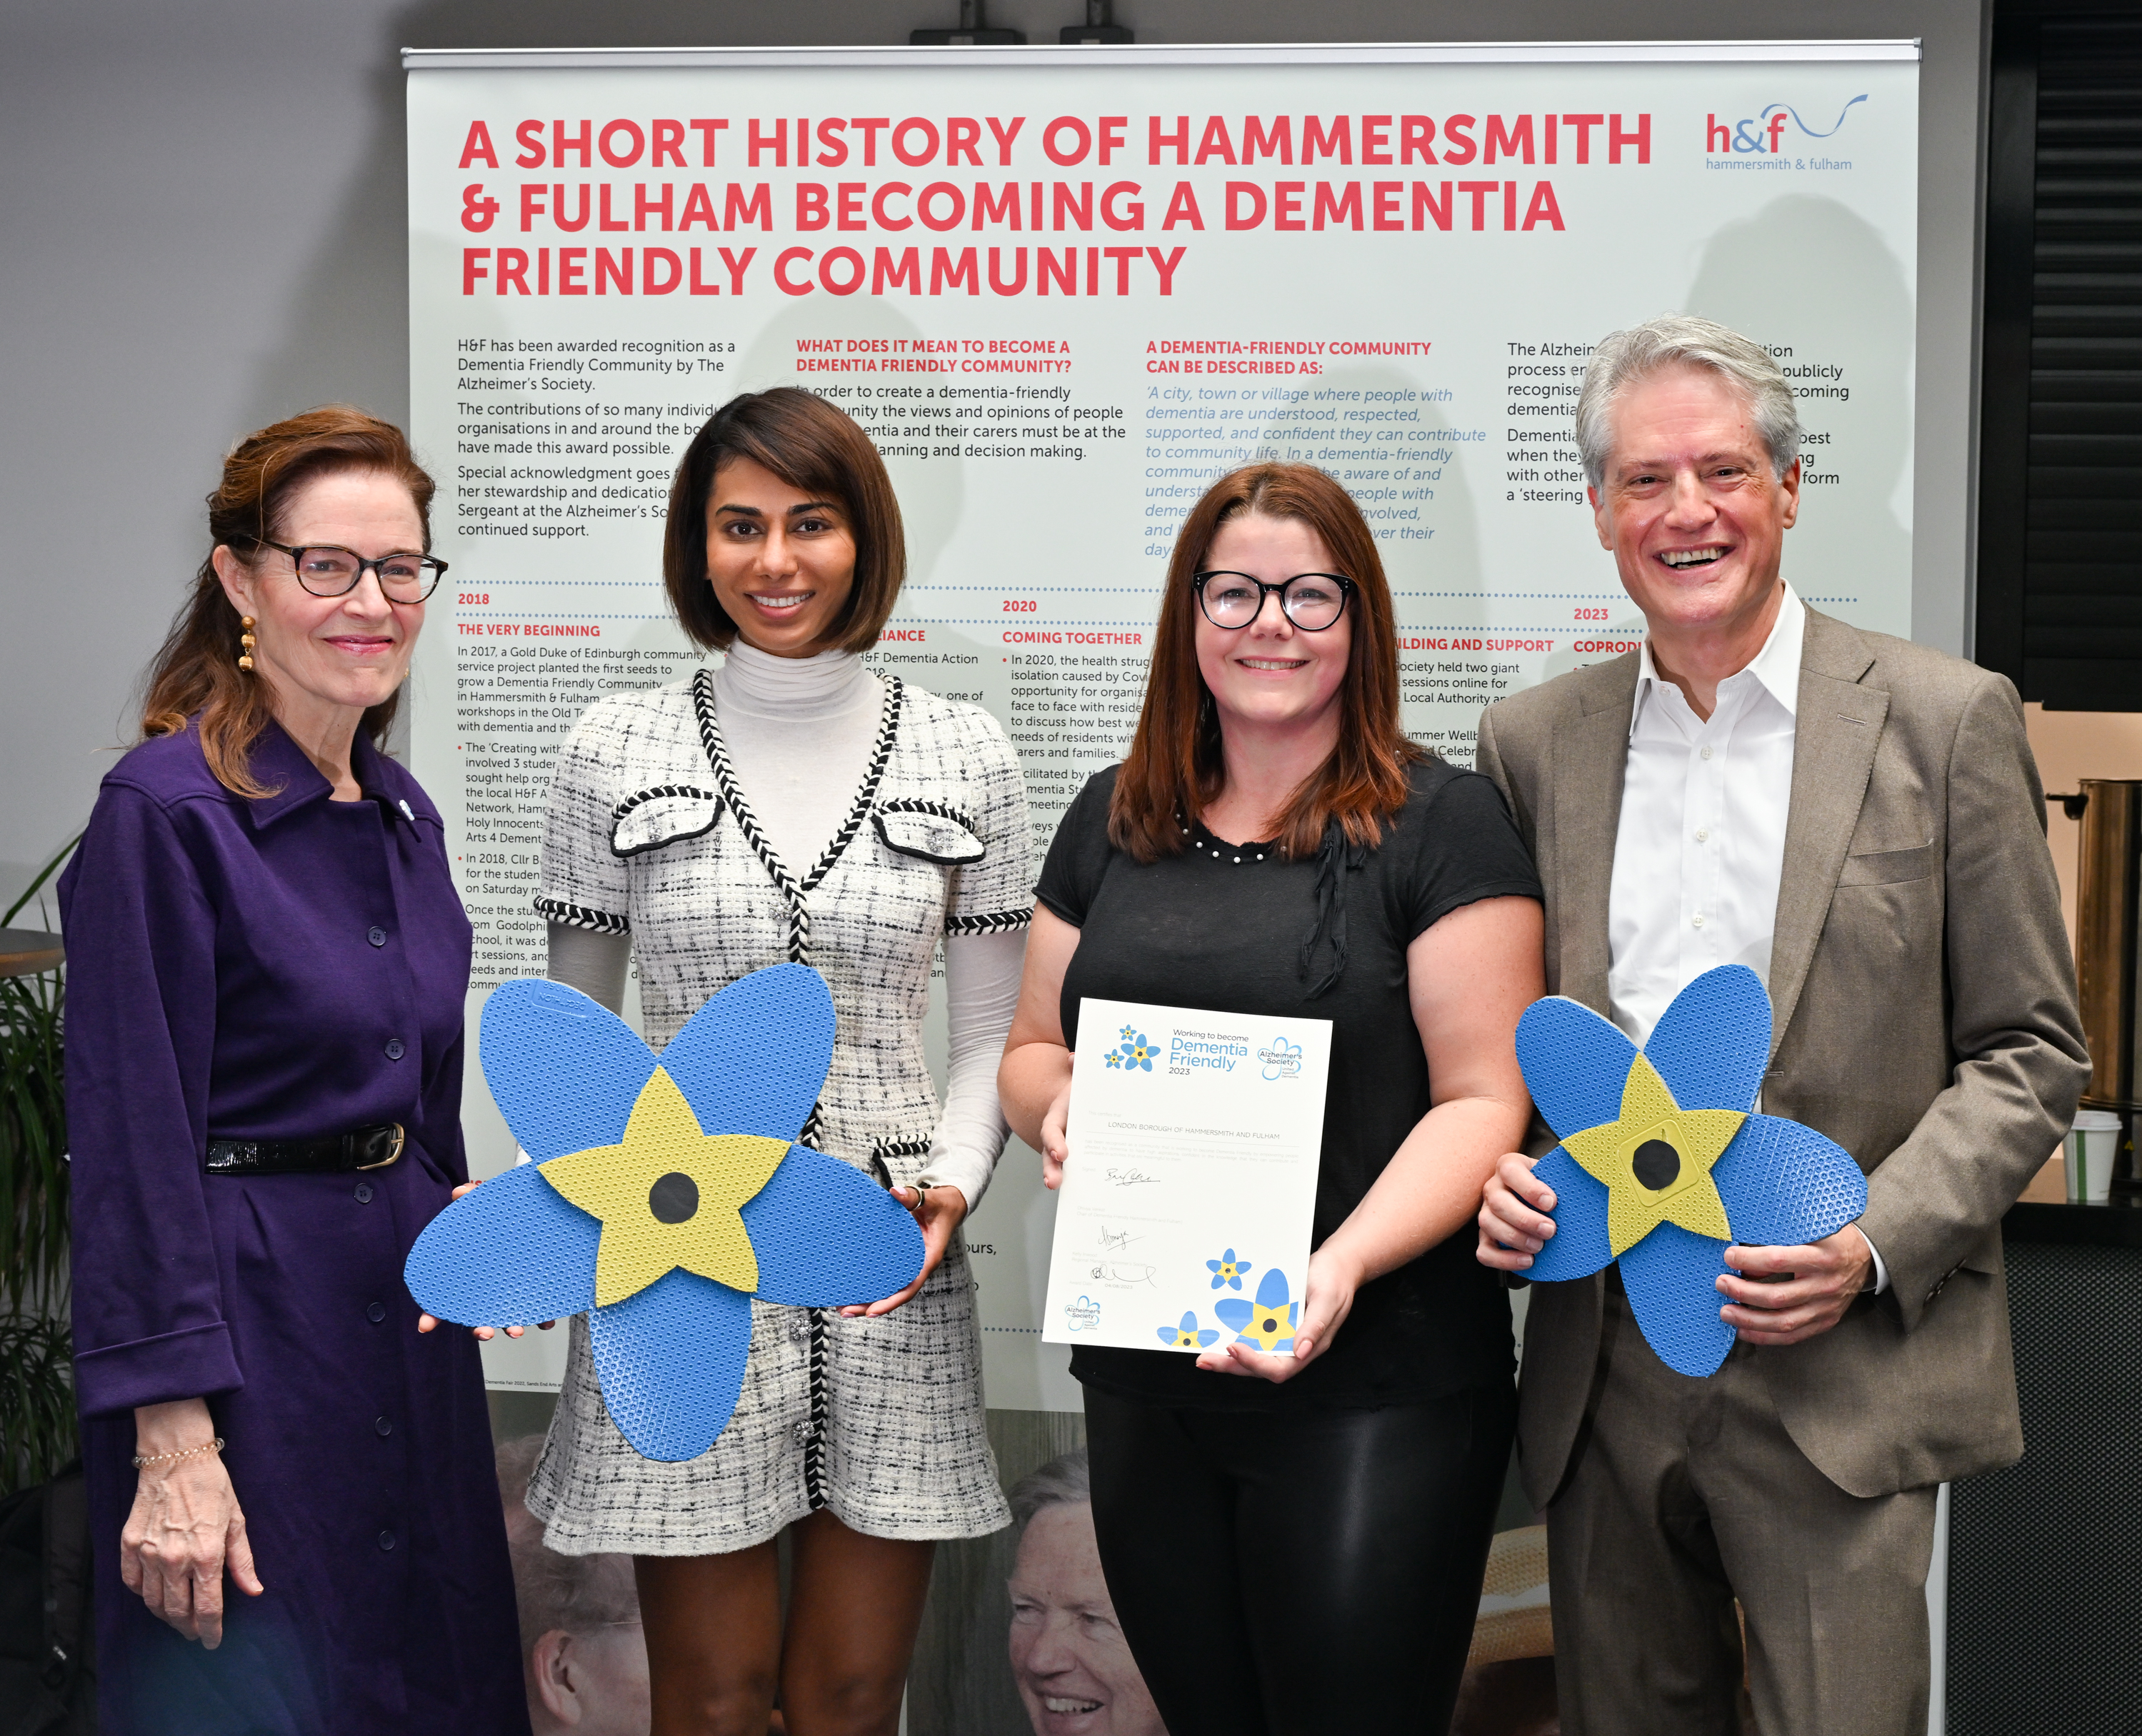
Hammersmith and Fulham received a Dementia Friendly Community recognition Award presented to us by the Alzheimer’s Society.
The Award acknowledges our collaboration across the public, private and voluntary sector in becoming a Dementia Friendly Community - we are hugely proud to have reached this milestone.

Slide 19
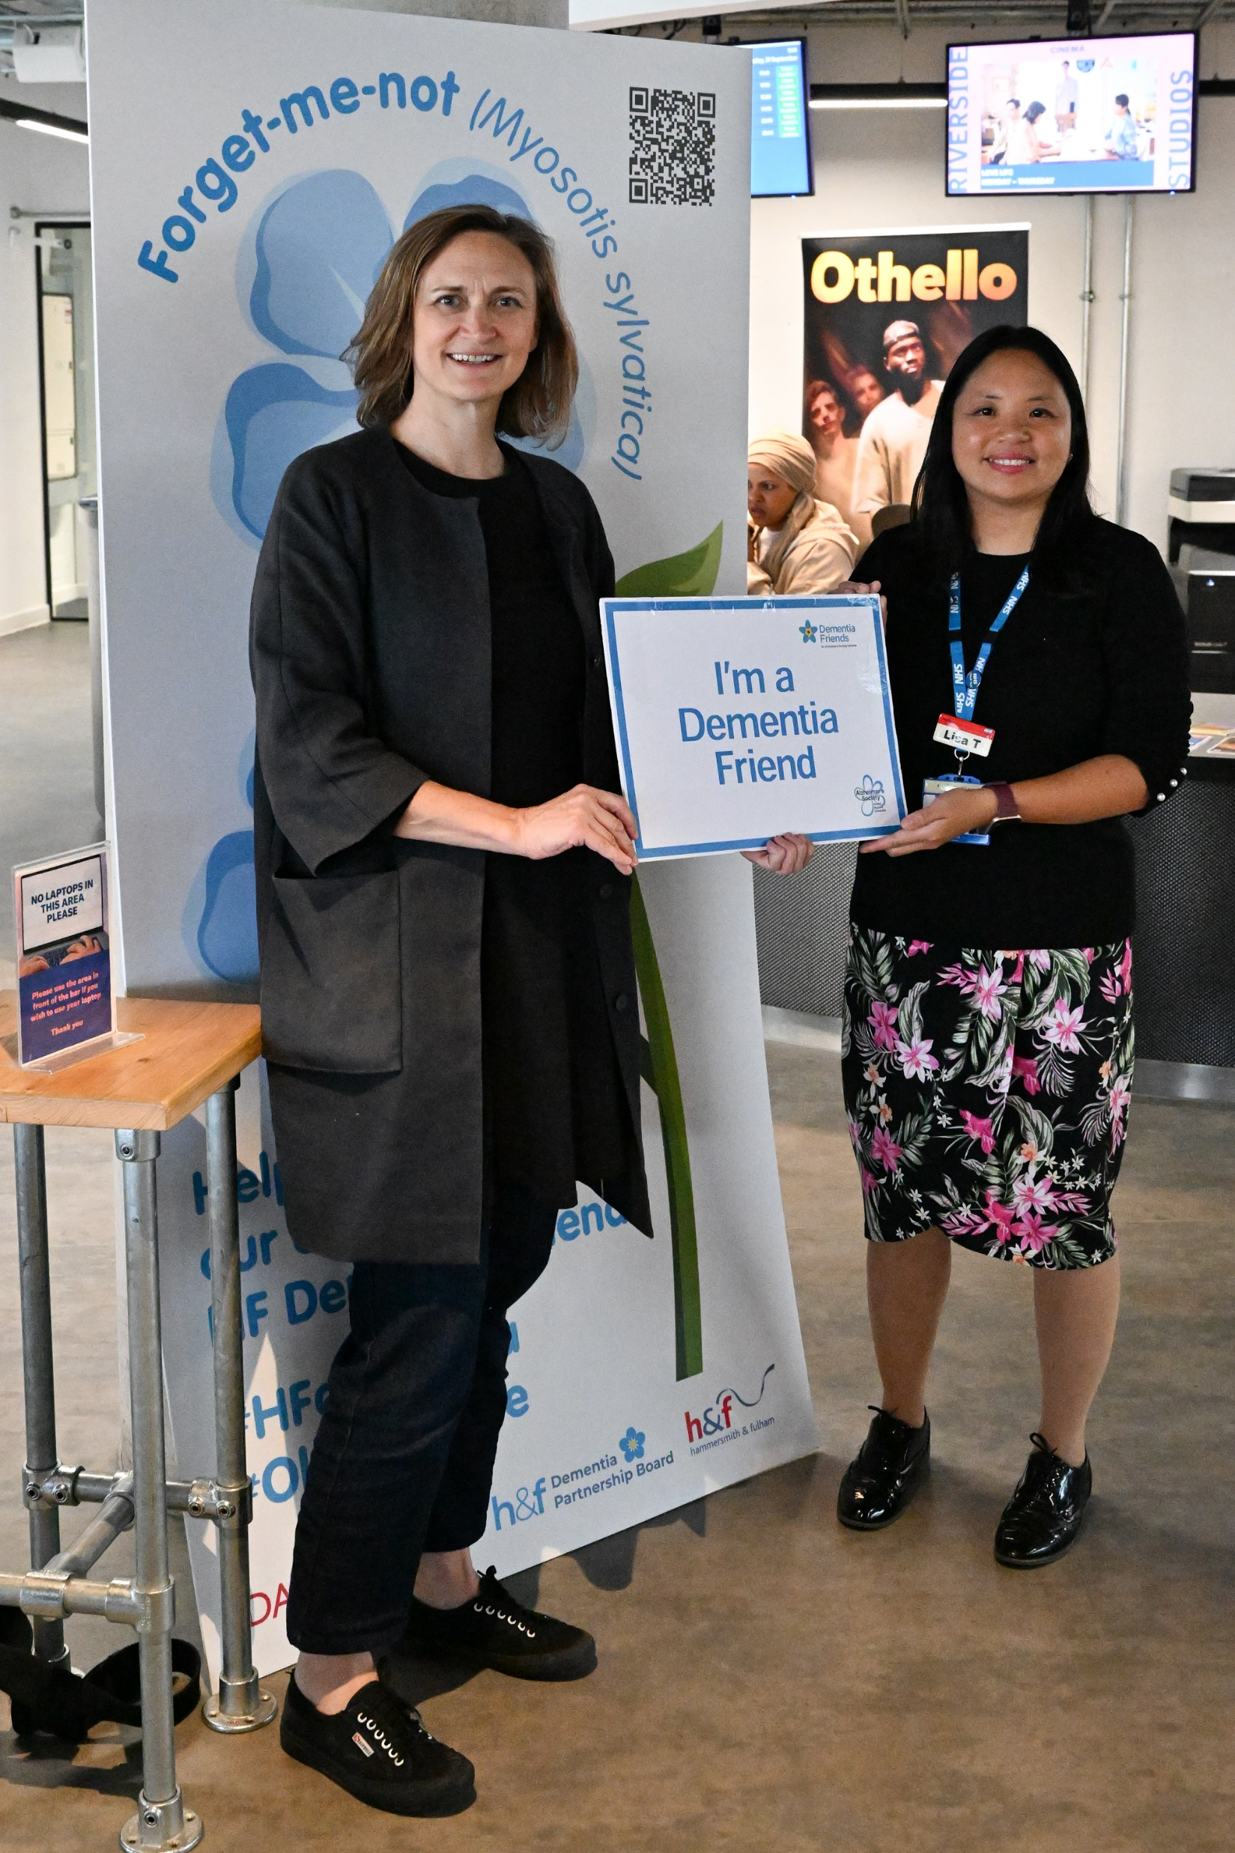
The Dementia Friendly Community Recognition Award event was held at the Riverside Studio in September 2023.

