Slide 1

CQC and Adult Social Care
Our vision for Independent Living
LCAS Forum on 8th November 2023

Slide 2
What we are covering…..
WHY?
- Why Independent Living and Co-production are key to all we do in H&F
    Relevance to the CQC Inspection Framework
WHAT?
    Independent Living Vision
    Pillars of Independent Living & understanding barriers to inclusion
    Council’s commitment to Equity, Diversity & Inclusion and Co-production
HOW?
    Our H&F journey – residents driving change
    Making Independent Living a reality
    Ensuring Co-production is how we achieve change – and support for this
Notes:
Ann
Introduction to the session and links with theme of SW month Respecting Diversity through Joint Social Action

Slide 3
CQC Inspection – context from CQC
Aim is to understand how the care provided in a local area is improving outcomes for people and reducing inequalities in their access to care, their experiences and outcomes from care.
This means looking at how services are working together within an integrated system, as well as how systems are performing overall.
CQC are also committed to protecting human rights through our regulation.
Our new single assessment framework focuses on what matters to people who use local health and social care services and their families
We are committed to ensuring we consider the experiences of people most likely to have poor access, experiences or outcomes from care.
Notes:
Last point – furthest away from decision making…

Slide 4
CQC Themes
H&F Commitments
Independent Living
Rights, Choice, Control
Pillars - Cross-council commitment / partners
Not charging
Equity & Diversity
Understanding and addressing barriers together
Tackling and eliminating discrimination
Inclusion
Aim to be the most accessible borough
Leaving no one behind
Co-production
Doing things with residents not to residents
Strategic and individual decision making
Resident led & peer support
Results in better outcomes (& safer)
How local authorities work with people
How local authorities provide support
How local authorities ensure safety within the system
Leadership

Slide 5
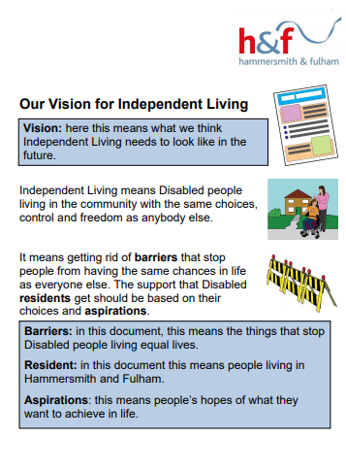
H&F Vision for Independent Living
The right of all Disabled people to live in the community with the same choices and opportunities as anyone else
About choice and control in All aspect of our lives – not about doing everything by yourself
All Disabled people, all ages – inclusive definition
Intersectionality – people facing multiple barriers and discrimination – promoting equality and inclusion
Based on UN Convention on the Rights of Persons with Disabilities, Article 19
12 Pillars of Independent Living
Social Model of Disability – remove the barriers to inclusion
Developed by Disabled People as a challenge to institutionalisation - A shift in power to the individual
See H&F website and IL Video
https://youtu.be/69fgXgA0gNk
Notes:
Are all your colleagues / teams aware. Do you go through this.
So what do we mean by Independent living?
Ann - Ask people to look at the Vision – watch Lisa’s video?
Human Rights

Slide 6

Independent Living
– a Council-wide Priority
1. Disabled people living in the community with the same choices, control and freedom as anybody else
2. It’s about rights, equality and inclusion – everyone counts, everyone benefits
3. It means all Disabled people of all ages being treated with respect, having full opportunities, living in their own homes.
4. Getting rid of the barriers and discrimination that stop people from having the same chances in life as everyone else
5. It comes from Disabled people’s challenge to institutionalisation. A shift in power
6. A council-wide priority that will support better economic recovery and resilience and drive everything we do in social care .
Notes:
Summary – key points if needed

Slide 7
12 Pillars of Independent Living
Disabled people set out these pillars 50 years to show what needs to be in place for a good quality of life.
This is why we need to join up our approaches and not work in silos – all these pillars are important. We need to understand & remove the barriers to this
Appropriate and accessible information
Appropriate and accessible health and social care provision
A fully accessible transport system
Full access to the environment
Adequate provision of technical aids and equipment
Availability of accessible and adapted housing
Adequate provision of personal assistance
Availability of inclusive education and training
Equal opportunities for employment
Availability of independent advocacy and self-advocacy
Availability of peer counselling
An adequate income
Notes:
Making Independent Living a reality – ASC & Children’s priorities
What this means for Commissioning
What this means for the Council – All of the Council’s work all of the time
Governance
Decision making

Slide 8
Independent Living - It’s not an option…it’s how we work
“We’ve done lots already but need to do more as barriers remain, even more so for Disabled refugees and asylum seekers or people in institutions, for example.
“Social Care should facilitate Independent Living. We are learning a huge amount as residents are more connected and as a result, we are changing how we work.”
Linda Jackson Strategic Director for Independent Living (DASS) Hammersmith and Fulham
Notes:
Ann

Slide 9
What’s Co-production?
Co-production means local Disabled residents are working together with decision makers; to actively identify, design, and evaluate policy decisions and service delivery that affect our lives and remove the barriers we face.
From “Nothing About Disabled People without Disabled People” report
It’s how we achieve change
Notes:
Tara
Being updated to be about all residents

Slide 10
A few reasons why Co-production matters….
Change is possible – people make a difference
People are invested in getting it right – for the right reasons
Everyone’s voice counts – Inclusion, Equity & Diversity
It’s about strategic decisions as well as individual decisions
Change is not imposed
Sharing power – we all learn, we develop solutions together
Evidence and impact – more people believe that change is possible
Better results – we get the changes that people want and value (& makes £ sense)
Others……
Notes:
Seeing ourselves – the more change we see, the more we believe is possible
People furthest away from decision making

Slide 11
So Co-production is….
A key Council priority - Doing things with residents not to residents (better results)
  The way we will work together to make things happen and bring about positive change.
  For ALL residents. Started with Disabled residents as they were furthest away from decision-making
In evidence - Disabled people have fought for and achieved change – legislation, policies, direct payments
  Campaign to end charging for social care at home & in the community
  Disabled People’s Commission - ‘Nothing About Disabled People Without Disabled People’ commitment to Independent Living
  Examples of resident-led change and strategies – e.g. on Dementia; Direct Payments, DP Housing Strategy,
About leadership and governance
  Role of Disabled People’s Organisations
  A Co-production Structure – to ensure drive and influence – not an add on - HFCIG plus 6 co-production Groups
  Co-production sees Disabled people as ‘experts by experience’ and leaders
Inclusive and how WE work and how we will deliver change
  Disabled people should be involved in all the decisions that affect their lives
  Based on Residents identifying barriers and then working together to find solutions
  Some people face more than one type of discrimination and are further away from decision making – they must be part of co-production. Together we need to find better ways to do this
Notes:
Tara
what we mean by coproduction and why its important…..
What is co-production and why is it important?
Well, firstly it is a key Council priority - Doing things with residents not to residents
Co-production is the way we will work together to make things happen and bring about positive change. It is for ALL residents. It started with Disabled residents as they were furthest away from decision-making
Disabled people should be involved in all the decisions that affect their lives
The Disabled People’s Commission set out this commitment in their report ‘Nothing About Disabled People Without Disabled People’ which is on the LBHF website
We are looking at Residents as experts by experience – this involves identifying barriers and then working together to find solutions. The key message is that change is possible
Coproduction in already in action: We have the Civic campus which is award winning in terms of our commitment to working with residents and taking an Inclusive Design approach; Disabled People’s Housing Strategy; Digital Accessibility Group, Disaand the bility Forum Planning Group; Improving Direct Payment Support; H&F Coproduction Implementation Group
Disabled People Commission Working definition:
“Co-production means Disabled residents and decision makers are working together to plan, design and review policy and services to get rid of the barriers we face”
Co-production addresses barriers to equality, diversity and inclusion
Intersectionality is an analytical framework for understanding how aspects of a person's social and political identities combine to create different modes of discrimination and privilege. Examples of these aspects include gender, caste, sex, race, class, sexuality, religion, age, physical appearance, and height.
Kevin Hammersmith & Fulham Co-Production implementation group (HFCIG) drives implementation of 8 recommendations and the vision. Councillors / Residents / Officers working together.

Slide 12

Embedding Independent Living & Coproduction in everything we do!
Co-production Matters (formerly HFCIG (– new structure with reps from the 6 Co-production groups in H&F
New Independent Living Co-production Delivery Group - we can’t develop Independent Living without residents
Building capacity - Co-production training courses for Disabled residents and workers in H&F – Action on Disability
Dementia Strategy and Good Life with Dementia
Disabled People’s Organisations / resident-led organisations
Direct Payments Support Service, Peer Support and DP Steering Group – DPs as facilitators of IL
Co-production Building Trust work – people out of borough
Working with residents who have more than one experience of discrimination
Promoting Independent Living by developing and all age support and services / new services that are co-produced and facilitate IL
By breaking down silos - reforming how the Council works
New Rethink facilitated co-production with residents with lived experience of mental health
Autism Strategy
Building our confidence, our evidence and ensuring we can all explain this as the way we work…
Supporting our approach
Co-production Checklist & Guidance
Jobs landing page – JDs
Training and support for workers
Networks for workers
H&F influencing national best practice
YOU / US / OUR TEAMS
Notes:
Tara – v brief
Neema to set up wordcount poll for “what are you proud of in terms of work you are doing to raise the roof?”
RANA TO KEEP AN EYE ON THE CHAT

Slide 13
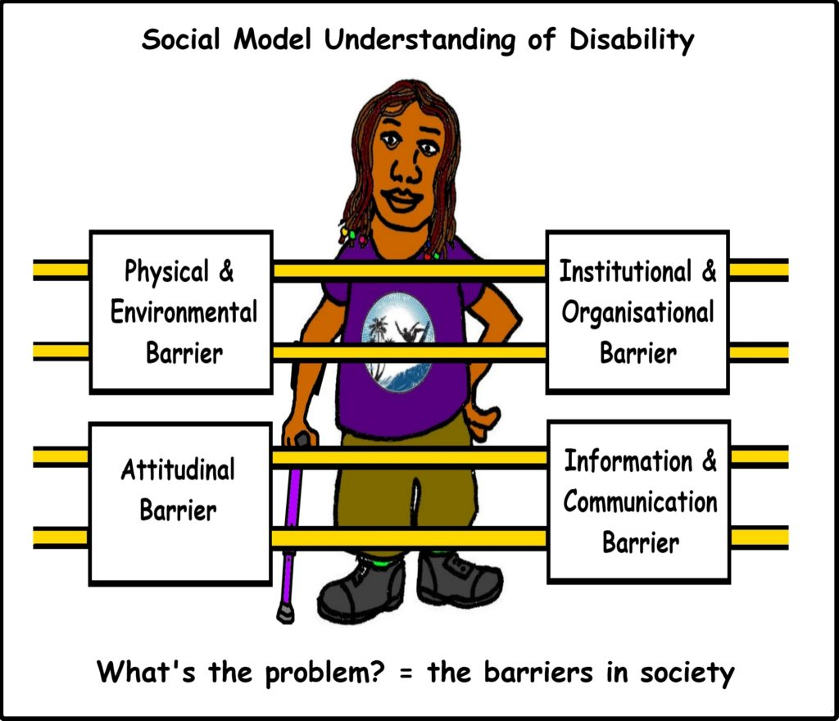
Summary - H&F Commitments and priorities
Doing things with residents not to them - Co-production
Nothing about Disabled People without Disabled People
LBHF commitment to Independent Living – rights, inclusion, equity, choice – ground-breaking!
Only Council in England not to charge for community based care & support*
Aim to be the most Inclusive & Accessible borough in the country
All underpinned by the Social Model of Disability – remove barriers
It’s a Team, Service, Corporate & wider stakeholders across the public, private and voluntary sector - we all
have a role to play in making it happen!
Thank you
Notes:
Summary

