Slide 1

Understanding our new approach
John Clifford
Senior Specialist
LCAS Forum, 8th November

Slide 2

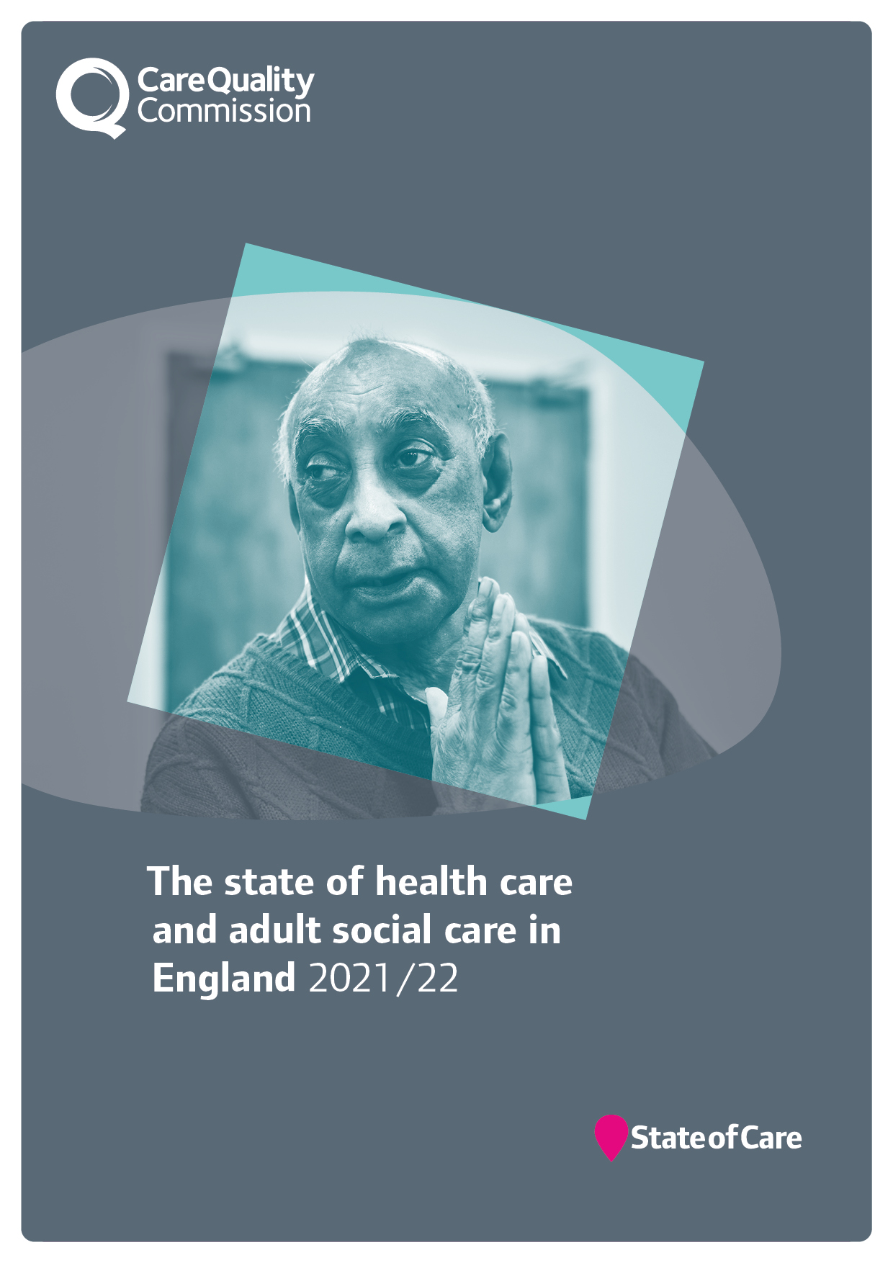
Our role and purpose
The Care Quality Commission is the independent regulator of health and adult social care in England.
We make sure health and social care services provide people with safe, effective, compassionate, high-quality care and we encourage care services to improve.

Slide 3

Unique oversight of care
28,037 adult social care services
137 NHS acute hospital trusts
10 NHS ambulance trusts
256 Independent Ambulance providers
216 hospices
49 NHS mental health trusts
271 independent mental health locations
11,266 dental practices
6,417 GP practices
1,410 Independent acute locations
216 NHS or independent community health providers
281 urgent care and out of hours
39 slimming clinics
135 prison healthcare locations
6,383 services for autistic people and people with a learning disability
Is it safe?
Is it effective?
Is it caring?
Is it responsive?
Is it well-led?
Notes:
Updated June 2023 by Ayse Sema
Numbers produced by Performance team.

Slide 4

Why we’re changing?
To have a greater focus on care across local areas or systems
To use our new regulatory powers effectively to improve people’s care
To make our regulation less complex and more efficient
To regulate in a smarter way
To work better with the sector
as it changes and recovers
Notes:
Our strategy sets out an ambitious future that will ensure we keep delivering our purpose. To deliver that strategy effectively, we need to change how we work.
We know that it’s important to understand the quality of care in a local area or system in order to improve it and keep people safe. It’s often when people move between care services that they fall through the cracks and have a poorer experience.
We now have new regulatory powers that allow us to offer the public and Parliament a meaningful and independent view on care at a system and local authority level. We need to make sure that we use our new and existing powers effectively to improve people’s care and deliver our strategy, so we’re changing how we work and how we regulate to do this.
Before the pandemic, we were clear that we needed a way to look at the quality of care across health and care systems. We knew our regulation needed to be less complex and more efficient. We wanted to regulate in a smarter way – being able to adapt and respond to risk, uncertainty and demand, with data and information at our fingertips. The pandemic has highlighted the areas that we already knew needed to change.
Now, as we emerge from the pandemic, the health and care sector itself has changed and is struggling to recover along with new challenges and risks. We want to work with the sector, as an effective partner. We simply can’t stand still – we must transform to adapt to the changing nature of health and care provision and the changing needs of people who use services.

Slide 5
Our transformation
Our transformation and new approach will build on three key pillars:
  Our strategy
  Our risk-based approach during the pandemic
  Our new statutory roles
Underpinned by the data we gather, we will use our new and existing powers to improve people’s care.
We’re changing how we work and how we regulate

Slide 6
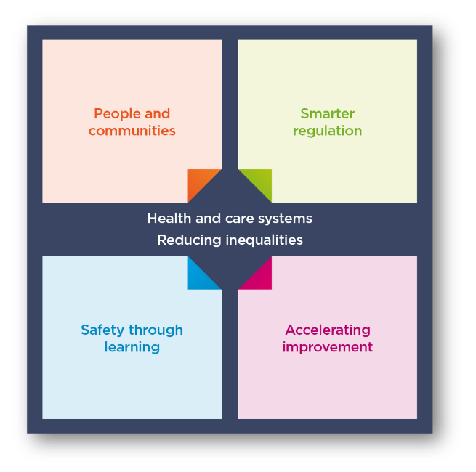
Our strategy
Our overall aim and focus is on tackling inequalities
and driving improvement
Notes:
Our strategy published in May 2021 is a strategy for the changing world of health and social care. We are being ambitious.
The health and social care landscape has changed drastically since 2016, when our previous strategy was published. Changes in the health and social care sector have been accelerated by the pandemic, increasing the needs of those who access health and social care services and placing additional challenges on service providers to meet them.
Our role as the regulator of health and social care in England has also been impacted greatly by the pandemic, affecting our ability to inspect all services and provide the necessary assurance to the public of their safety.
We’re on a journey to change how we regulate to improve care for everyone.
Our strategy strengthens our commitment to deliver our purpose: to ensure health and care services provide people with safe, effective, compassionate, high-quality care and to encourage those services to improve. Our strategy is purposefully ambitious, and to implement it we will need to work closely with others to make it a reality. We’ll review this strategy regularly so we can adapt to changes and be prepared for what the future holds.
Our strategic themes:
We’ll continue building the underpinning systems and structures, and making changes, to enable our strategy over the next two to three years, but full realisation of the strategy will take longer as we continuously learn and evolve, responding to changes in the world around us.
the four interlinked themes that will determine the changes we will make;
People and communities
Smarter regulation
Safety through learning
Accelerating improvement
All of this comes back to our core ambition of tackling inequalities. We’re pushing for equality of access, experiences and outcomes from health and
social care services

Slide 7

Tackling inequalities
Our strategy has the core ambition of tackling inequalities
The pandemic exacerbated inequalities - people who were less likely to receive good care before the pandemic are often the same groups disproportionally impacted by COVID-19.
We’re pushing for equality of access, experiences and outcomes from health and
social care services

Slide 8


Improving outcomes for people and reducing inequalities
Our new powers to oversee local authorities and integrated care systems under the Health and Care Bill will support us to deliver the objectives and ambition of our strategy.
They will allow us to look at how effectively care is provided in a local system, and how it is improving outcomes for people and reducing inequalities in their care.
This will be transformative in how we bring together a view of quality across a local area, put people at the centre and help drive improvement in care.
Notes:
The final version of the Act:
Gives CQC a duty to independently review and assess how Local Authorities are delivering their Care Act functions under Part 1.
Creates new powers for CQC to have oversight of Integrated Care Systems (ICSs), putting three key themes for assessment on the face of the Bill – Leadership, integration and quality and safety.
Introduces a requirement for all health and social care providers who carry out regulated activities to ensure that their staff receive specific training appropriate to their role on learning disabilities and autism. The Secretary of State (SofS) is also required to produce a Code of Practice with regards to training on learning disability and autism.
Creates a duty for CQC to enforce the NHS food and drink standards. The Bill imposes requirements on NHS hospitals in connection with food or drink provided or made available to any person on hospital premises in England that are used in connection with the carrying on of a regulated activity. Further regulations will be made which will specify the nutritional standards or requirements which are to be complied with.
New powers –
We now have new powers to oversee local authorities and integrated care systems under the Health and Care Bill.
These will support us to deliver the objectives in our strategy by allowing us to look more effectively at how the care provided in a local system is improving outcomes for people and reducing inequalities in their care.
We’ve engaged extensively over the last year on how we’ll do this, including two large workshops with around 400 representatives from across the country and establishing an expert advisory group to provide dedicated input.
This will be transformative in how we bring together a view of quality across a local area, put people at the centre and help drive improvement in care.

Slide 9
What will change?
Our new approach will fall into four main areas:
New technology – we’ll be able to harness what we hear from people using services through new data and insight skills and technology
New policy – we’ll use a single quality assessment framework for all service types and at all levels
New ways of organising – we’ll be working in multidisciplinary teams to make sure we can look at quality better across an area
New responsibilities – we’ll build on our previous activity looking at how services work together across a local area with new powers to look at Integrated Care Systems and local authorities
Notes:
New technology – we’ll be able to harness what we hear from people using services through new skills and technology for data and insight, supporting our colleagues to make decisions. This is coupled with a better experience for providers through our new online portal, to reduce burden and increase the quality of data we collect from them.
New policy – we’ll use a single quality assessment framework for all service types and at all levels, from registration through to provider assessments and assessments of integrated care systems (ICSs) and local authorities. This will be the basis for our judgements about quality.
New ways of working – we’ll be working in teams with a mix of expertise and experience of different health and social care sectors to make sure we can share specialist skills and knowledge about all sectors. This means bringing people together who have different perspectives to give us the best view of services across a local area.
New powers – we’ll build on our previous activity looking at how services work together across a local area with new powers to look at ICSs and local authorities, which will help to hold them to account and encourage improvement.
All of this will enable us to present a better view of the quality of care being delivered in health and care services and in local areas. It will be built on how people experience care and what matters to them. We will be able to better spot health inequalities and disparities between areas, so we can provide better information to partners to help improve care for everyone.

Slide 10

New technology
We’re developing and will begin to roll out our new regulatory platform
We’ve already improved how our notifications work
We’re making it easier to interact with us through the portal
We’re working towards delivering a
seamless registration service
This technology will
transform how we work
Notes:
New technology –
We’ve built on the technology we developed during the pandemic to create the early stages of our new regulatory platform. Using a strong base of user research and other engagement work, we’re now planning how we will roll it out in a limited and controlled way over the coming months.
We’ve already improved how our notifications work, making providers’ lives easier, as well as ensuring that the information we receive comes to us in a structured way so that we can analyse it quickly.
Alongside this, we’re also making it easier to interact with us through the portal, allowing people to do simple things they couldn’t previously.
We’ve made progress towards delivering a seamless registration service. This is a vital part of our regulatory model and a crucial first step in ensuring services deliver safe, effective, compassionate and high-quality care.
This technology will be transformative to how we work. We’ve taken a few important steps and over the coming months we want to start sharing these with stakeholders.

Slide 11

Our new online portal
We’ve created a new online portal for providers to interact with us in a simple and intuitive way.
Some examples of what this new portal will allow providers to do:
Easily share information with the CQC,
including submitting notifications
Register or apply to make changes to their
registration
Manage their user accounts and easily
access information about their activity
Some providers have now been invited to login and start using its functionality.
Notes:
We’ve created a new online portal that will be simple and intuitive to enable providers to submit information to us. We want to make it easier for providers to work with us, so we’ll collect data in a more structured format. We will ask you to validate the information we hold and ask for the information we cannot get elsewhere and in a way that makes it easy to get right the first time – both for registration and assessment use.
Once fully launched, all providers will be able to:
register with CQC for the first time
submit notifications and share information
apply to make changes to their registration
manage their user accounts and contact preferences online access the registration data CQC holds about them and update this as required, in time, we’ll also provide benchmarking information too

Slide 12

Outcome data
A consistent framework powered by our new technology​
Feedback from people and communities
Data and insight risk profiles
Up to date ratings
Evidence gathering and assessment
Notes:
Our new and now consistent approach, powered by the technology and data will enable us to reach our strategic aims.
We’ll use the information that the public and providers give to us in a smarter way. Our regulatory activity will be driven people’s needs particularly taking into account feedback on how they move between services.
We’ll be smarter and more dynamic, using technology to be able to give providers and the public more up-to-date view of quality and high- quality information.
As we move towards a more consistent approach, supported by better data, we’ll be able to foster a culture of learning and improvement – for stronger safety cultures across health and care.
We’ll be accelerating improvement by enabling health and care services and local systems to access support to help improve the quality of care where it’s needed most.
​
​

Slide 13
Changes to our regulatory approach
Multiple assessment frameworks
Single assessment framework
Ongoing monitoring and with inspections scheduled according to previous rating
Ongoing assessment of quality and risk
Evidence gathered during onsite inspection (single point in time)
Evidence gathered at multiple points in time (not just through inspection)
Judgements and ratings decisions made using ratings characteristics
Teams assign score to evidence
Narrative inspection report
Ratings updated, short narrative published
Notes:
This slide is animated. Each click of your mouse or clicker, should give you a new line.
We know that it’s helpful to see how our future model relates to what we’ve been doing over the last 8+ years – here are some examples of what could feel different. On the left hand side of the screen you have how things are now, on the right is how it will work in future.
Our assessment framework
Now: we have three different frameworks (registration, health, ASC) covering our five key questions – they are duplicative (eg across the KLOEs) and are not fully relevant to health and care today.
Future: we’ll have a single assessment framework that cover all sectors, services, levels – this will simplify things greatly for providers and ourselves. What we look at won’t change significantly, but how we do it will feel very different.
Our assessment approach
Now: We have separate ‘monitor’, ‘inspect’ and ‘rate’ steps and we inspect at a set point in time, based mainly on the previous rating.
Future: We’re moving away from separate ‘monitor’, ‘inspect’ and ‘rate’ steps in our model and will instead use the information we receive, collect and analyse to assess providers more frequently, without being tied to set dates.
The information will come from multiple sources and gathered in a variety of ways. Our operational colleagues will have a key role in increasing the flow of information into the regulatory platform. This will be a dynamic process and presented to colleagues in a clear and accessible dashboard through the regulatory platform, helping us make better decisions.
This does also not mean fewer inspections for high risk services. Our colleagues will have a greater ability to identify the best course of action - this could be that they work in the local area to find out more information, or schedule a site visit to the service to observe care or speak to staff. It is important to note that in settings where there is a higher likelihood of a closed culture developing we would prioritise these services for site visits for these services. More flexibility and improved prioritisation across all services means we can focus our activity where it’s most needed.
Categorising and scoring evidence
Now: make judgements against the ratings characteristics and the key question ratings aggregate to give us an overall rating.
Future: We want to be more consistent and transparent in our approach and how we make judgments on quality. We want our ratings to better reflect the care people are receiving and be clearer about where a provider or service sits within a rating. To address this, we’re developing a way to categorise and score evidence as part of our assessments.
Reporting and outputs from our assessments
Now: we publish long pdf reports that are not very accessible and take time for us to write and for the public to read.
Future: We are moving away from long pdf reports – we know that they don’t work for the public or for providers. They are inaccessible and not fit for what people expect from us. We also know that they take up much of our inspectors valuable time to produce them in the first place.
We will be able to give a much more up to date view of quality. We can’t do that unless we streamline the processes around publishing reports. We want to make them shorter, and more tailored to the audiences that use and read them. People will be able to make better choices about their care as information will be presented more clearly and detailed benchmarking information to help the provider improve will use the provider portal, rather than be published online

Slide 14
What’s not changing
Unannounced and unannounced inspections
Provider information returns (for now)
Notes:
This slide is animated. Each click of your mouse or clicker, should give you a new line.
We know that it’s helpful to see how our future model relates to what we’ve been doing over the last 8+ years – here are some examples of what could feel different. On the left hand side of the screen you have how things are now, on the right is how it will work in future.
Our assessment framework
Now: we have three different frameworks (registration, health, ASC) covering our five key questions – they are duplicative (eg across the KLOEs) and are not fully relevant to health and care today.
Future: we’ll have a single assessment framework that cover all sectors, services, levels – this will simplify things greatly for providers and ourselves. What we look at won’t change significantly, but how we do it will feel very different.
Our assessment approach
Now: We have separate ‘monitor’, ‘inspect’ and ‘rate’ steps and we inspect at a set point in time, based mainly on the previous rating.
Future: We’re moving away from separate ‘monitor’, ‘inspect’ and ‘rate’ steps in our model and will instead use the information we receive, collect and analyse to assess providers more frequently, without being tied to set dates.
The information will come from multiple sources and gathered in a variety of ways. Our operational colleagues will have a key role in increasing the flow of information into the regulatory platform. This will be a dynamic process and presented to colleagues in a clear and accessible dashboard through the regulatory platform, helping us make better decisions.
This does also not mean fewer inspections for high risk services. Our colleagues will have a greater ability to identify the best course of action - this could be that they work in the local area to find out more information, or schedule a site visit to the service to observe care or speak to staff. It is important to note that in settings where there is a higher likelihood of a closed culture developing we would prioritise these services for site visits for these services. More flexibility and improved prioritisation across all services means we can focus our activity where it’s most needed.
Categorising and scoring evidence
Now: make judgements against the ratings characteristics and the key question ratings aggregate to give us an overall rating.
Future: We want to be more consistent and transparent in our approach and how we make judgments on quality. We want our ratings to better reflect the care people are receiving and be clearer about where a provider or service sits within a rating. To address this, we’re developing a way to categorise and score evidence as part of our assessments.
Reporting and outputs from our assessments
Now: we publish long pdf reports that are not very accessible and take time for us to write and for the public to read.
Future: We are moving away from long pdf reports – we know that they don’t work for the public or for providers. They are inaccessible and not fit for what people expect from us. We also know that they take up much of our inspectors valuable time to produce them in the first place.
We will be able to give a much more up to date view of quality. We can’t do that unless we streamline the processes around publishing reports. We want to make them shorter, and more tailored to the audiences that use and read them. People will be able to make better choices about their care as information will be presented more clearly and detailed benchmarking information to help the provider improve will use the provider portal, rather than be published online

Slide 15
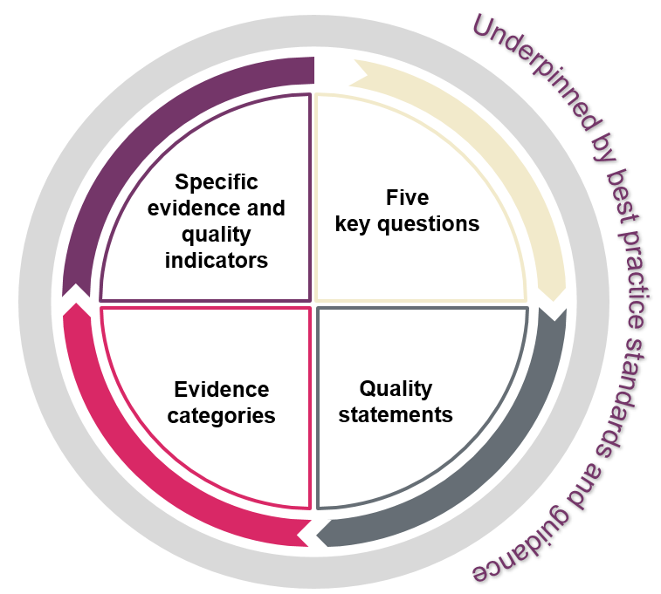
Single Assessment Framework
We’ve developed a single assessment framework, replacing
the current four separate frameworks and we'll use it to assess
all service types and as the basis for assessing local authorities
and integrated care systems
Our ratings and five key questions will stay central to our approach
We’re replacing our existing key lines of enquiry and prompts with ‘quality statements’
We’re moving away from separate ‘monitor’, ‘inspect’ and ‘rate’ steps
We will assess providers in a more flexible way to provide an up-to-date view of quality
It will allow us to better identify trends and patterns across areas
Notes:
New policy –
On the back of strong engagement across all our external audiences we’ve developed a single assessment framework. We’ll use this to assess quality in all service types, and at all levels as well as for local authorities and integrated care systems. This will replace the current four separate frameworks for registering and assessing healthcare and adult social care services.
We confirmed that our ratings and five key questions will stay central to our approach, but we’re replacing our existing key lines of enquiry and prompts with ‘quality statements’. These will reduce the duplication that’s in our current assessment frameworks and will allow us to focus on key topic areas under each key question. We call the quality statements ‘we statements’ as they’re written from a provider, local authority or ICS perspective to help them understand what we expect of them.
Our new assessment approach means we’re moving away from separate ‘monitor’, ‘inspect’ and ‘rate’ steps. Instead, we will use information from a range of sources to assess providers more frequently and in a more flexible way, without being driven by a previous rating. This is key to us achieving our strategic ambition of providing an up-to-date view of quality.

Slide 16


‘I’ statement: When I move between services, settings or areas, there is a plan for what happens next and who will do what, and all the practical arrangements are in place.
‘We/quality’ statement: We work in partnership with others to establish and maintain safe systems of care in which people's safety is managed, monitored and assured, especially when they move between different services.
Notes:
I is the person using the service, and the we is the provider, ICS or LA - it is a commitment on their part
The following quality statements are ‘we’ statements

Slide 17
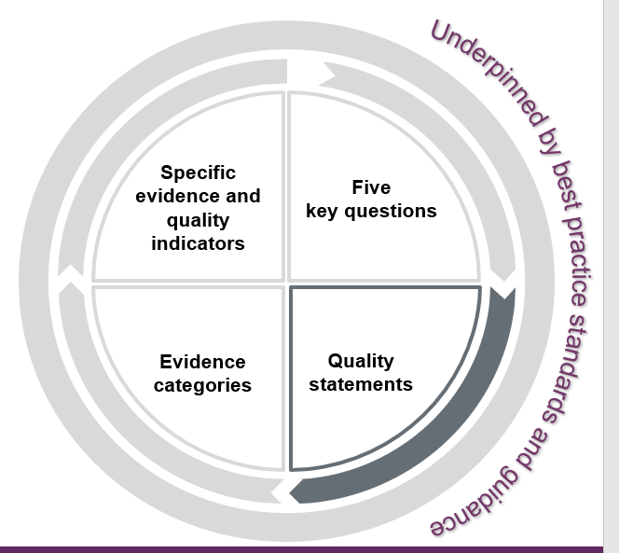

What are quality statements?
Quality statements are the commitments that providers, commissioners and system leaders should live up to. Expressed as ‘we statements’, they show what is needed to deliver high-quality, person-centred care.
The quality statements show how services and providers need to work together to plan and deliver high quality care. They directly relate to the regulations.
When they refer to 'people' we mean people who use services, their families, friends and unpaid carers.
Source: https://www.cqc.org.uk/assessment/quality-statements

Slide 18
Quality statements:
What do we mean by caring?
Independence, choice and control
We promote people’s independence, so they know their rights and have choice and control over their own care, treatment and wellbeing.
Kindness, compassion and dignity
We always treat people with kindness, empathy and compassion and we respect their privacy and dignity. We treat colleagues from other organisations with kindness and respect.
Responding to people's immediate needs
We listen to and understand people’s needs, views and wishes. We respond to these in that moment and will act to minimise any discomfort, concern or distress.
Treating people as individuals
We treat people as individuals and make sure their care, support and treatment meets their needs and preferences. We take account of their strengths, abilities, aspirations, culture and unique backgrounds and protected characteristics.
Workforce wellbeing and enablement
We care about and promote the wellbeing of our staff, and we support and enable them to always deliver person centred care.
Source: https://www.cqc.org.uk/assessment/quality-statements
Notes:
Kindness, compassion and dignity
We always treat people with kindness, empathy and compassion and we respect their privacy and dignity. We treat colleagues from other organisations with kindness and respect.
Regulated Activities Regulations 2014
Regulation 9: Person-centred care
Regulation 10: Dignity and respect
Also consider
Regulation 12: Safe care and treatment
Treating people as individuals
We treat people as individuals and make sure their care, support and treatment meets their needs and preferences. We take account of their strengths, abilities, aspirations, culture and unique backgrounds and protected characteristics.
Related regulations
Regulated Activities Regulations 2014
Regulation 9: Person-centred care
Regulation 10: Dignity and respect
Regulation 14: Meeting nutritional and hydration needs
Regulation 15: Premises and equipment
Independence, choice and control
We promote people’s independence, so they know their rights and have choice and control over their own care, treatment and wellbeing.
Related regulations
Regulated Activities Regulations 2014
Regulation 9: Person-centred care
Regulation 12: Safe care and treatment
Also consider
Regulation 10: Dignity and respect
Responding to people's immediate needs
We listen to and understand people’s needs, views and wishes. We respond to these in that moment and will act to minimise any discomfort, concern or distress.
Related regulations
Regulated Activities Regulations 2014
Regulation 9: Person-centred care
Regulation 10: Dignity and respect
Regulation 11: Need for consent
Regulation 12: Safe care and treatment
Also consider
Regulation 16: Receiving and acting on complaints
Workforce wellbeing and enablement
We care about and promote the wellbeing of our staff, and we support and enable them to always deliver person centred care.
Related regulations
Regulated Activities Regulations 2014
Regulation 9: Person-centre care
Regulation 12: Safe care and treatment
Regulation 17: Good governance
Regulation 18: Staffing

Slide 19
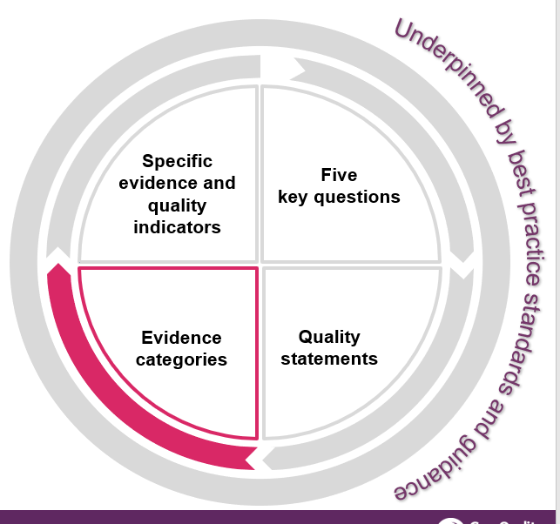
What are evidence categories?
They are six categories that we have grouped into different types of evidence that we will look at.
Evidence categories help us to do a few things;
Tailor how we assess quality statements depending on the level or sector we’re focusing on
Collect and store evidence in a structured way
Be more targeted in what we spend our time looking at
Guide how we’ll look at different evidence; supporting colleagues and providers to have a better understanding on the methods we’d use to collect said evidence
We will make clear what we look at in our assessments by setting out the key evidence categories we’ll focus on for each quality statement.
https://www.cqc.org.uk/assessment/evidence-categories

Slide 20
People’s experience of health and care services
This is all types of evidence from people who have experience relating to a specific health or care service, or a pathway across services. It also includes evidence from families, carers and advocates for people who use services.
We define people’s experiences as:
“a person’s needs, expectations, lived experience and satisfaction with their care, support and treatment. This includes access to and transfers between services”.
Find out about the importance of people’s experience in our assessments
https://www.cqc.org.uk/assessment/evidence-categories
Notes:
Evidence from people’s experience of care includes:
phone calls, emails and Give feedback on care forms received by CQC
interviews with people and local organisations who represent them or act on their behalf
survey results.
feedback from the public and people who use services obtained by:
community and voluntary groups
health and care providers
local authorities
groups representing:
people who are more likely to have a poorer experience of care and poorer outcomes
people with protected equality characteristics
unpaid carers

Slide 21
Feedback from staff and leaders
This is evidence from people who work in a service, local authority or integrated care system, and groups of staff involved in providing care to people.
It also includes evidence from those in leadership positions.
This includes, for example:
results from staff surveys and feedback from staff to their employer
individual interviews or focus groups with staff
interviews with leaders
feedback from people working in a service sent through our Give
feedback on care service
whistleblowing
https://www.cqc.org.uk/assessment/evidence-categories

Slide 22
Feedback from partners
This is evidence from people representing organisations that interact with the service or organisation that is being assessed.
We may gather evidence through interviews and engagement events.
The organisations include, for example:
commissioners
other local providers
professional regulators
accreditation bodies
royal colleges
multi-agency bodies.
https://www.cqc.org.uk/assessment/evidence-categories

Slide 23
Observation
Observing care and the care environment will remain an important way to assess quality.
Most observation will be carried out on the premises by CQC inspectors and Specialist Professional Advisors (SpAs).
External bodies may also carry out observations of care and provide evidence, for example, Local Healthwatch. Where the evidence from organisations such as Healthwatch is specifically about observation of the care environment, we will include it in this category, and not in the people’s experiences category.
We will not use the observation category for local authority assessments. It
does not apply to a local authority context.
All observation is carried out on site.
https://www.cqc.org.uk/assessment/evidence-categories

Slide 24
Processes
Processes are any series of steps, arrangements or activities that are carried out to enable a provider or organisation to deliver its objectives.
Our assessments focus on how effective policies and procedures are. To do this, we will look at information and data sources that measure the outcomes from processes. For example, we may consider processes to:
measure and respond to information from audits
look at learning from incidents or notifications
review people's care and clinical records.
https://www.cqc.org.uk/assessment/evidence-categories

Slide 25
Outcomes
Outcomes are focused on the impact of care processes on individuals. They cover how care has affected people’s physical, functional or psychological status.
We consider outcomes measures in context of the service and the specifics of the measure.
Some examples of outcome measures are:
mortality rates
emergency admissions and re-admission rates to hospital
infection control rates
vaccination and prescribing data.
https://www.cqc.org.uk/assessment/evidence-categories
Notes:
We also source the information from:
patient level data sets
national clinical audits
initiatives such as the patient reported outcome measures (PROMs) programme.

Slide 26
Effective
Supported living services example
Assessing needs; We maximise the effectiveness of people’s care and treatment by assessing and reviewing their health, care, wellbeing and communication needs with them.
Quality statement
Key evidence category
People's experience
Processes
Feedback from people collected by CQC, the provider, local community groups and other stakeholders
Give feedback on care
Assessments and records of meeting needs under the Equality Act 2010
Assessments and/or best interest decisions under the MCA
Clinical tools to assess pain and monitor risk
People’s care records or clinical records
Evidence type examples
https://www.cqc.org.uk/assessment/evidence-categories/care-homes-and-supported-living-services-evidence-categories
Notes:
We want to be clear with providers about the evidence we will be looking for as part of our assessments. This will vary depending on a number of things, for example the type or model of service or whether it’s at registration. It’s vital that we tailor our single assessment framework so it works for everyone.
To do this we have set out the key evidence categories we’ll collect evidence in to assess each quality statement in your sector.
In this example, we’re looking at the Assessing needs for Supported living services. You can see that there are two of key categories noted:
People’s experiences in health and social care
Processes
This means that each time we come to assess this quality statement, we’ll have used evidence in each of these categories to come to a judgement.
It will only be the first assessment under our new approach, and for services newly registering with us, that we’ll look at every key evidence category though. Future assessments could include a blend of new and existing evidence.
A further way of tailoring our assessment framework is by setting out some example types, these you can see along the bottom row. These should be viewed as examples only, and not a checklist that providers should be using.

Slide 27
A timeline for providers
EARLY ACCESS TO PORTAL
(July)
USING OUR NEW FRAMEWORK
(from November)
PORTAL ROLL OUT
(from September)
FUTURE
(from beginning of 2024)
WEBINAR
(end of August)
WEBINAR
(2 August)
WEBINAR
(September)
WEBINAR
(October)
WEBINAR
(November)
A group of providers have been invited to log onto the new provider portal
We’ll roll out the new portal to all providers in phases from September.
We plan to start using our new single assessment framework starting with providers in the South of England
We’ll use our current assessment framework until the rollout of the new framework is complete
https://www.cqc.org.uk/news/our-transformation-plan-and-new-approach-summer-update
Notes:
Created and updated by Ayse Sema – 14 August 2023
THIS SLIDE IS ANIMATED. ONE CLICK AND IT’LL START TO APPEAR.
Webinars:
2 August – Timeline to introducing our new regulatory approach and provider portal - can now be accessed on YouTube
End of August – Introducing quality statements and evidence categories
September – Introducing how we'll collect and score evidence to produce ratings
October – Frequency of assessment in the new regulatory approach and national risk profiles
November – New provider portal - an update on how we're rolling this out and new functionality available from November

Slide 28

New responsibilities
CQC has new responsibilities:
  The Health and Care Act gives CQC
  a role in reviewing integrated care systems
  It also gives CQC a duty to assess how local authorities are meeting their social care duties under part 1 of the Care Act
These will allow us to look more effectively at how care provided in a local system is improving outcomes and reducing inequalities.
We’ve engaged extensively on how we’ll do this. We want to bring together a view of quality across a local area and put people at the centre of driving improvement in care.
Notes:
The final version of the Act:
Gives CQC a duty to independently review and assess how Local Authorities are delivering their Care Act functions under Part 1.
Creates new powers for CQC to have oversight of Integrated Care Systems (ICSs), putting three key themes for assessment on the face of the Bill – Leadership, integration and quality and safety.
Introduces a requirement for all health and social care providers who carry out regulated activities to ensure that their staff receive specific training appropriate to their role on learning disabilities and autism. The Secretary of State (SofS) is also required to produce a Code of Practice with regards to training on learning disability and autism.
Creates a duty for CQC to enforce the NHS food and drink standards. The Bill imposes requirements on NHS hospitals in connection with food or drink provided or made available to any person on hospital premises in England that are used in connection with the carrying on of a regulated activity. Further regulations will be made which will specify the nutritional standards or requirements which are to be complied with.
New responsibilities –
We now have new powers to oversee local authorities and integrated care systems under the Health and Care Bill.
These will support us to deliver the objectives in our strategy by allowing us to look more effectively at how the care provided in a local system is improving outcomes for people and reducing inequalities in their care.
We’ve engaged extensively over the last year on how we’ll do this, including two large workshops with around 400 representatives from across the country and establishing an expert advisory group to provide dedicated input.
This will be transformative in how we bring together a view of quality across a local area, put people at the centre and help drive improvement in care.

Slide 29
CQC scope: local authorities
The initial focus of our local authority assessments will be across four themes:
Theme 1: Working with people
Assessing needs
Supporting people to live healthier lives
Theme 2: Providing support
Care provision, integration and continuity
Partnerships and communities
Theme 3: Ensuring safety
Safe systems, pathways and transitions
Safeguarding
Theme 4: Leadership
Learning, improvement and innovation
Governance, management and sustainability
Equity in experience and outcomes
Notes:
Most recent update: 15 February
The initial focus of our local authority assessments will be across four themes:
Working with people – more detail on next slide
Providing support - market shaping, commissioning, workforce capacity and capability, integration and partnership working
Ensuring safety - safeguarding enquiries, reviews, Safeguarding Adults Board, safe systems, pathways and continuity of care
Leadership and workforce - culture, strategic planning, learning, improvement, innovation, governance, management and sustainability
a subset of quality statements from the single assessment framework will sit under each theme

Slide 30

Where are we with local authority assurance?
We have now completed our fieldwork for all five pilots; Birmingham City Council, Lincolnshire County Council, North Lincolnshire Council, Nottingham City Council and Suffolk County Council.
provide a report and indicative scores for all quality statements as well as an overall indicative rating
start formal assessments later this year
evaluate our approach throughout all pilots and incorporate learning into our formal assessments
We will…
https://www.cqc.org.uk/news/testing-our-approach-local-authority-assessments

Slide 31

Our vision for assessments
LA and ICS assessments will help us illustrate the quality of care in a local area and provide independent assurance
By developing an evidence base on how LAs are delivering their Care Act duties we can; report on what we find locally and nationally, and highlight challenges, risks and the impact on the local population
We can support improvement through showcasing best practice and new/innovative ways LAs and ICSs’ are providing care and support to local people.
We will use our evidenced and independent voice to inform and influence wider system reform.
Notes:
For context
DHSC are progressing several new assurance, data and support measures which will help to inform DHSC what is working well in the sector and what is not and to help drive progress. This is part of the overall strategy and actions to deliver the Gov’ts vision for adult social care.
These measures include:
A duty for the Care Quality Commission (CQC) to independently review and assess local authority performance in delivering their adult social care duties.
New legal powers for the Secretary of State to intervene in local authorities to secure improvement.
An adult social care data framework to improve the quality and availability of data nationally, regionally and locally.
An increase in improvement funding to support local authorities to strengthen their market shaping and commissioning capabilities.
So in essence, the LAA work is part of a wider set of measures that will contribute to system reform.
The bullet points on the slide set out some of the ways the CQC LAA work will contribute to this.

Slide 32
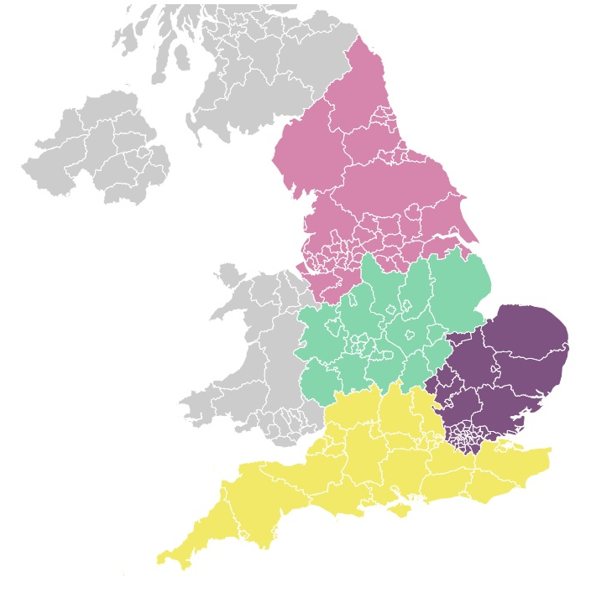
Emerging themes from our co-production and system work to date
Some system partners don’t feel that they have equal or enough influence within their local system
Sharing data continues to be a barrier, due to the different ways that data is collected and stored
Workforce shortages and sharing workforce between health and social care continues to be an issue.
System leaders know that they need to have a better understanding of the diverse health and care needs of their populations, as well as addressing inequalities of access and outcomes
The potential in adult social care is not always well understood, especially by health partners who see it through the lens of discharge and not the whole pathway.
Notes:
Not all partners feel they are equal or have appropriate levels of influence within the system, this is particularly the case for independent health, social care providers and local authorities.
Data interoperability between system partners continues to be a barrier
Workforce shortages and sharing workforce between health and social care continues to be an issue.
System leaders consistently recognise and prioritise the need to develop a fuller understanding of the diverse health and care needs of their populations and address inequalities of access and outcomes
More broadly, the potential of adult social care is not always well understood and respected by health partners who tend to view things through the narrow lens of discharge rather than the whole pathway. We can shine a light on these issues because of our unique and independent oversight of health and social care.

Slide 33
CQC and Ofsted
All providers of supported accommodation for 16- and 17-year-old looked-after children and care leavers have a duty to register with Ofsted by 28 October 2023.
Reference: Guide to the Supported Accommodation Regulations including Quality Standards (DFE)
A provider could be registered both with CQC and Ofsted, if they provide a CQC-regulated activity and also offer supported accommodation to children in care and care leavers.
However, supported accommodation is very unlikely to be an appropriate option for children who require help and support with personal care, have limited unsupervised time and whose care plan is for ongoing care and accommodation beyond the age of 18.
Unless a provider supports, or intends to support, looked after children or care leavers aged 16 and 17 and they are placed under s22C(6)(d) or s23B(8)(b) of the Children Act 1989, then there is no requirement to register with Ofsted

Slide 34
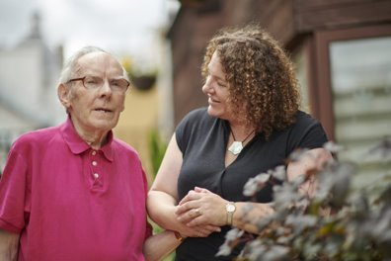
Digitisation in social care: why it matters
Good quality records underpin high-quality care
Digital records far exceed capabilities of paper
  Efficiency, automation, reporting and sharing
And that's just the start of innovation ….
State of Care Oct 2022 - Better data and data sharing are the critical components before providers can begin to address system-wide issues in a meaningful way
Notes:
So the other aspect I’m keen to touch on is digitization in social care and to make it really clear that CQC fully supports the adoption of digital social care records
And Why ? CQC know that good quality records underpin safe, effective, compassionate, high-quality care. They ensure that accurate information gets to the right people, when they need it.
and digital record systems far exceed the capabilities and benefits of paper-based records.
Because they help providers to minimise the risks to peoples’ safety
They support their staff to respond more quickly to peoples’ needs
and share important information quickly and safely
And for providers they don’t just help underpin good quality care, they
Help you operate more efficiently
They give management information and insight not possible with paper records.
And that's just the start, when you look at the systems available, you'll see they are innovating with other digital features that help improve the quality of care for service users and their families.
But there’s another benefit that’s even more important than all of this:
In CQC’s State of Care report last year we said - Better data and data sharing are the critical components before providers can begin to address system-wide issues in a meaningful way
We know that the integrated nature of health and care demands that we have a full picture of the people’s experience, so we can understand and address these issues

Slide 35
What do good digital social care records look like?
Minimum requirements:
each person using its service
the employment of staff
the overall management of the regulated activity.
This applies to paper and digital records. Records must be accurate, complete and up-to-date.
We routinely look at a provider’s records as part of our inspection activity, focusing on:
the information in the records
how that information is used
the security measures to store and share the information.
We do not endorse or recommend a specific digital social care record system.
The Digitising Social Care programme provides resources to help you when choosing a digital social care record system.
Notes:
What do good digital social care records look like?
Assessing and inspecting
As with all aspects of care, we will assess records against our current key lines of enquiry. Later in the year, we will implement our new regulatory approach and continue to assess records using our new single assessment framework. We will update this guidance as appropriate to reflect any changes.
We do not assess the standard or technical functioning, or capabilities of the digital record systems themselves.

Slide 36
The benefits of a good digital records system
For people using services:
It’s easier for people to access their own records.
People will be able to spend more time with staff and engage in meaningful interactions with them.
When people’s needs change, services will be able to respond quickly and share information with partners in their care, making care safer.
Risks such as medication errors, dehydration or missed care visits will be minimised.
For providers and staff:
Recording information in real time will allow people in different locations to access and update it wherever they are.
Staff will be able to do their job more effectively and efficiently.
Digital systems will support effective quality monitoring of the service, enabling services to share and compare data to improve people’s care.
Storing information digitally is easier and needs less physical space.
People’s information will be handled more securely through automatic back-up of data, the cyber security of cloud-based services, and by using multi-factor authentication.
For the wider health and social care system:
People’s information can be used across the local health and care system to make sure their care is joined up and to support the needs of the local population.
There will be better use of resources across the local health and care system, which can help to support other important health and care functions, such as service management, planning and research.

Slide 37
Working with CQC – points to consider
We are aware that you need to meet your own data governance requirements, particularly around preventing accidental changes or loss of data. Read-only access to records means you can be confident that you can prevent accidental data changes or loss.
If you have guest log-in details for the system, you should provide these where you and the inspection team member are confident that they can independently access the records they need to see. Where available, this should be read-only access. You should not use the log-in details (including smart cards) of anyone who is not present.
If read-only access is not available or the inspection team member needs support to use the system, you should help them to access the records they ask to see. For example, you could have a staff member available.
Notes:
We are aware that you need to meet your own data governance requirements, particularly around preventing accidental changes or loss of data. Read-only access to records means you can be confident that you can prevent accidental data changes or loss.
If you have guest log-in details for the system, you should provide these where you and the inspection team member are confident that they can independently access the records they need to see. Where available, this should be read-only access. You should not use the log-in details (including smart cards) of anyone who is not present.
If read-only access is not available or the inspection team member needs support to use the system, you should help them to access the records they ask to see. For example, you could have a staff member available.
Generally, where an inspection team member can access the digital records they need, they will not ask for paper copies. However, there are circumstances where you should provide hard copies, for example if waiting for a member of staff to assist would prevent them from carrying out their inspection activity. We may request specific formats where it is necessary for regulatory decision making or taking enforcement action. We will explain this request clearly.

Slide 38

Find out more
We are here to help you
We are here to support you
Sources of best practice and much more, can be found on our webpage
https://www.cqc.org.uk/guidance-providers/adult-social-care/digital-record-systems-adult-social-care-services
Notes:
Sources of best practice and guidance

Slide 39








Provider Bulletin
https://www.cqc.org.uk/news/newsletters-alerts/email-newsletters-cqc or Search: CQC bulletin
Publications
https://www.cqc.org.uk/publications
Social
@CQCProf @CQCProf
youtube.com/user/cqcdigitalcomms
facebook.com/CareQualityCommission
CQC is changing – YouTube playlist
https://youtube.com/playlist?list=PLEwLzOd_XW-IU-FCX2gvNu3OYG1aHn365
Digital platform
https://cqc.citizenlab.co/en-GB/ or Search: Citizenlab CQC
Podcasts
Wherever you listen to podcasts
Search: CQC Connect
Blogs
https://medium.com/@CareQualityComm
or Search: Medium CQC
Notes:
CQC is changing playlist
This will have a playlist of all of the webinars that we have conducted in this period of time on the transformation
The last webinar, on the 2 August, will be here too

Slide 40

Any questions?
John Clifford
ASC Senior Specialist
www.cqc.org.uk
enquiries@cqc.org.uk
@CQCProf
youtube.com/user/cqcdigitalcomms
facebook.com/CareQualityCommission

