Slide 1

Haseen Gokani
Onboarding & Training Manager

Slide 2

About CareVision
Built from the ground up using the trials and tribulations of running a care home. Each element was carefully planned, through the experience of my parents running homes and combined with love of technology and elderly care
We used our homes to trial the app and software
We collaborated with district nurses, GP’s, families, CQC inspectors and listened to all of their perspectives when developing Care Vision
We worked with other providers and looking at the issues that they face

Slide 3









What does CareVision do?
Care Management
Designed from a user-friendly care perspective.
E-MAR
Simple and easy to use EMAR interface. Real-time audits
Visitors Book
Fully paperless, GDPR compliant, and includes visitor surveys.
Rota
Use our clocking-in machine to accurately record attendance
Accounts
Accounts is an essential part of any business.
Family App
Saving on valuable admin time updating families
House Keeping
Housekeepers, Maintenance and Laundry staff hold
Chef
Food and nutrition care: Quality foods for healthy diets

Slide 4
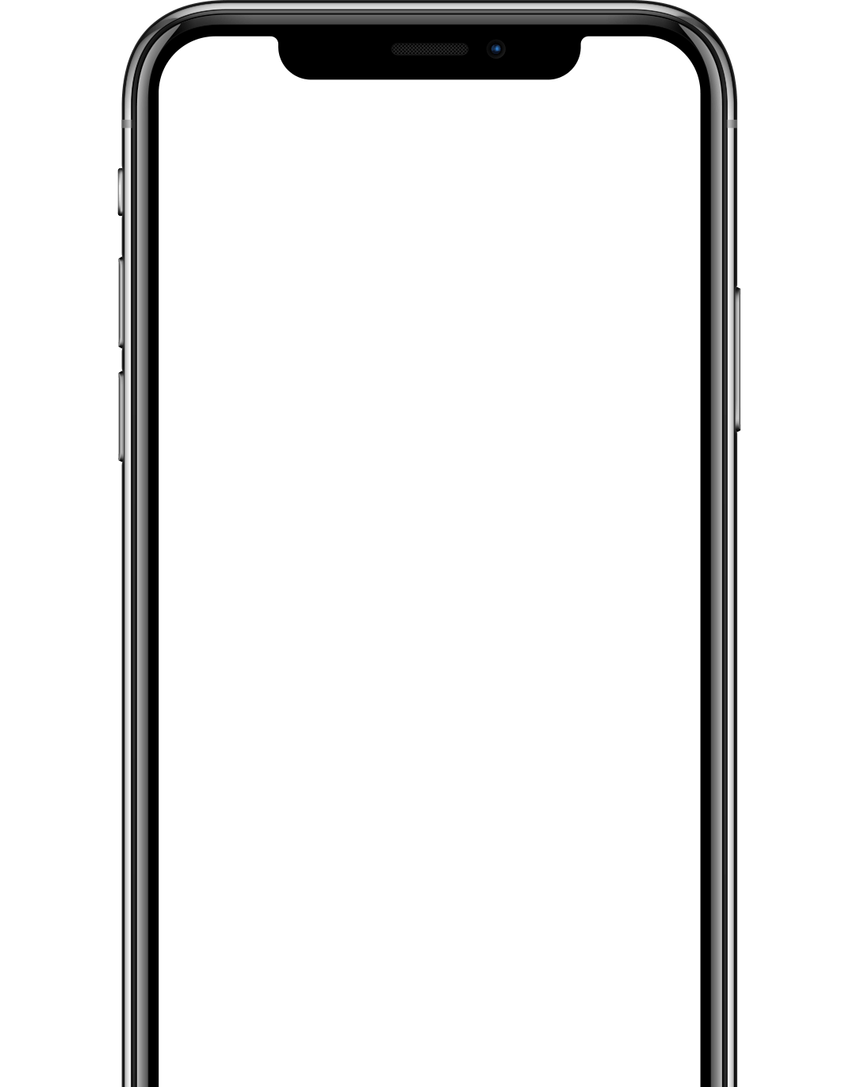
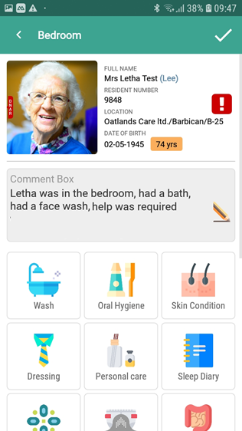


Come see CareVision now

Slide 5
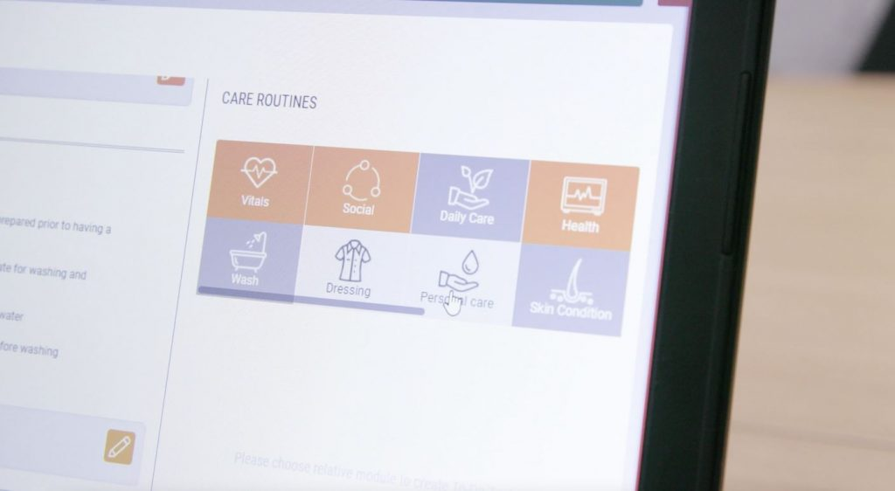


Contact us for more details
www.carevisioncms.co.uk
0208 768 9809

