Slide 1

LCAS Croydon Event
Duncan Paterson
CQC Operations Manager
27 September 2023

Slide 2

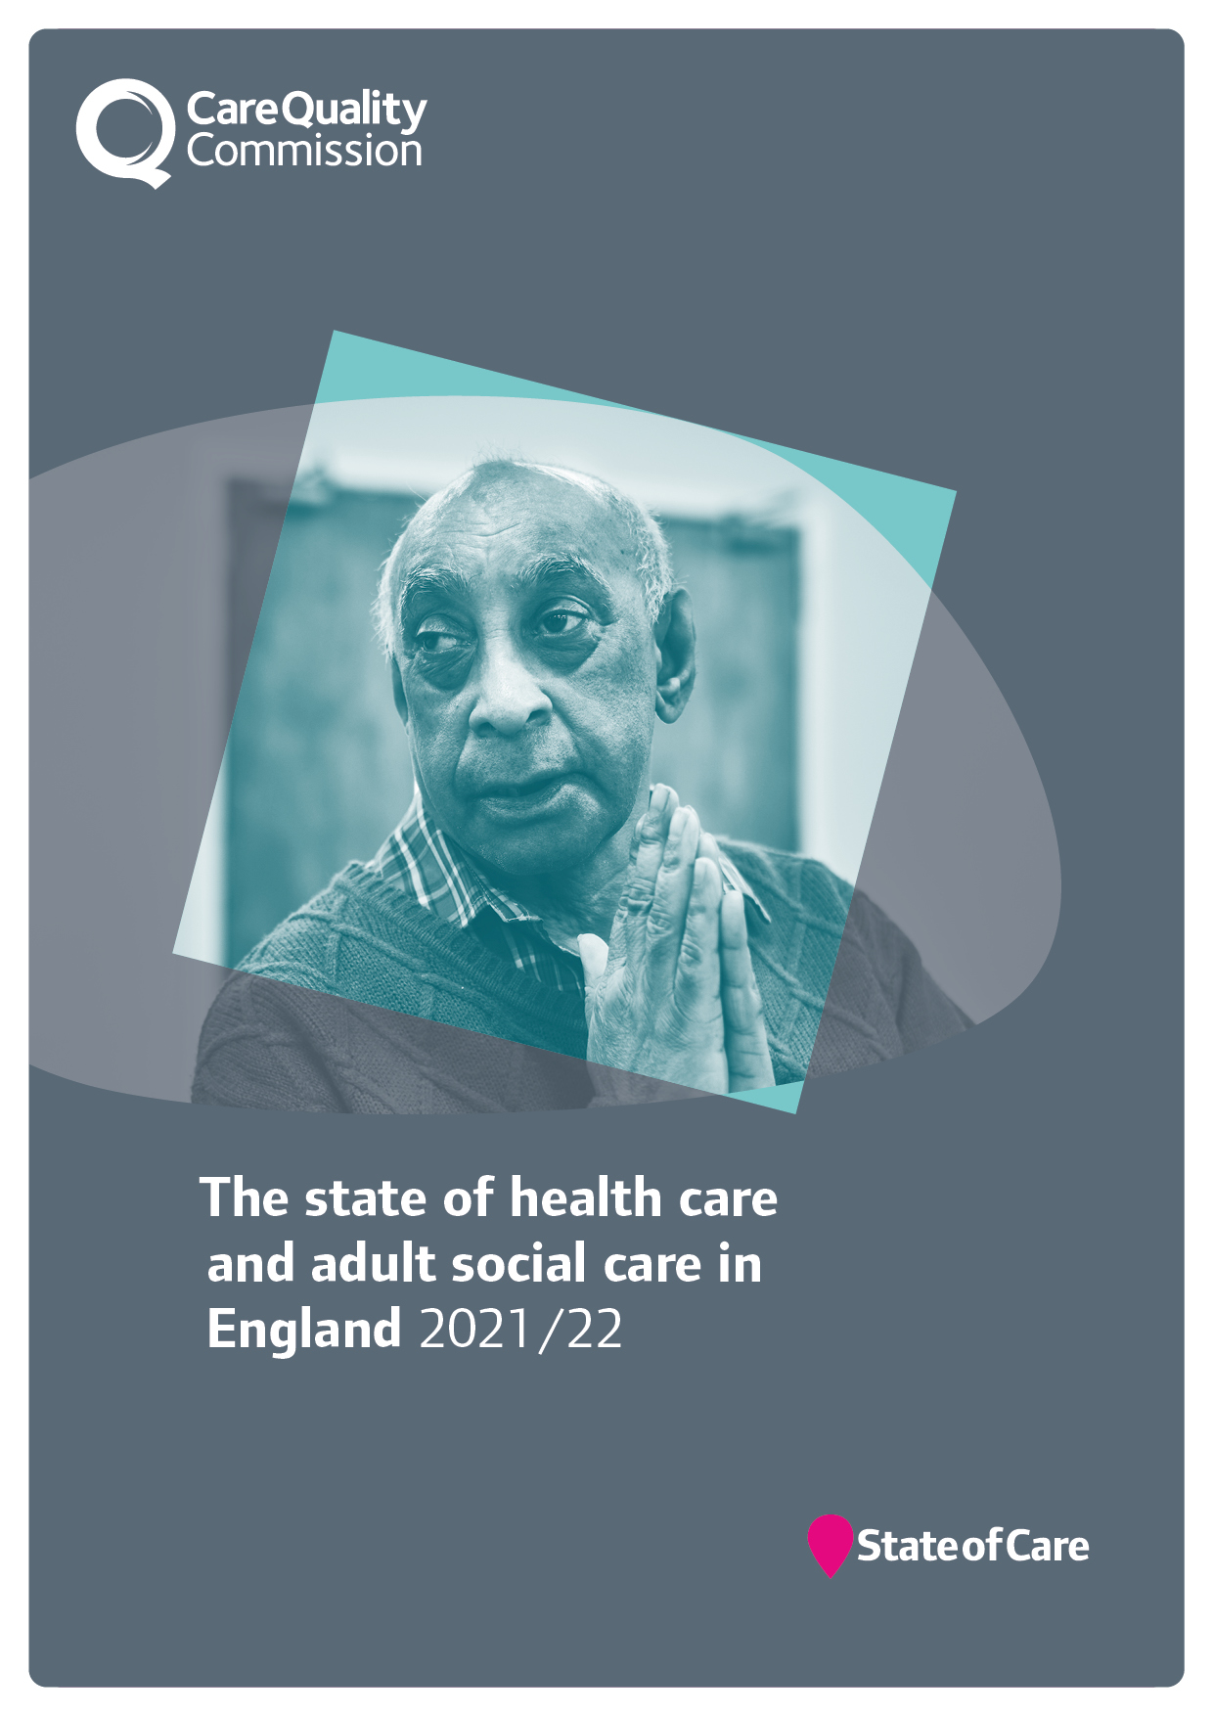
Our role and purpose
The Care Quality Commission is the independent regulator of health and adult social care in England.
We make sure health and social care services provide people with safe, effective, compassionate, high-quality care and we encourage care services to improve.

Slide 3

Why we’re changing?
To have a greater focus on care across local areas or systems
To use our new regulatory powers effectively to improve people’s care
To make our regulation less complex and more efficient
To regulate in a smarter way
To work better with the sector
as it changes and recovers
Notes:
Our strategy sets out an ambitious future that will ensure we keep delivering our purpose. To deliver that strategy effectively, we need to change how we work.
We know that it’s important to understand the quality of care in a local area or system in order to improve it and keep people safe. It’s often when people move between care services that they fall through the cracks and have a poorer experience.
We now have new regulatory powers that allow us to offer the public and Parliament a meaningful and independent view on care at a system and local authority level. We need to make sure that we use our new and existing powers effectively to improve people’s care and deliver our strategy, so we’re changing how we work and how we regulate to do this.
Before the pandemic, we were clear that we needed a way to look at the quality of care across health and care systems. We knew our regulation needed to be less complex and more efficient. We wanted to regulate in a smarter way – being able to adapt and respond to risk, uncertainty and demand, with data and information at our fingertips. The pandemic has highlighted the areas that we already knew needed to change.
Now, as we emerge from the pandemic, the health and care sector itself has changed and is struggling to recover along with new challenges and risks. We want to work with the sector, as an effective partner. We simply can’t stand still – we must transform to adapt to the changing nature of health and care provision and the changing needs of people who use services.

Slide 4
Our transformation
Our transformation and new approach will build on three key pillars:
  Our strategy
  Our risk-based approach during the pandemic
  Our new statutory roles
Underpinned by the data we gather, we will use our new and existing powers to improve people’s care.
We’re changing how we work and how we regulate

Slide 5
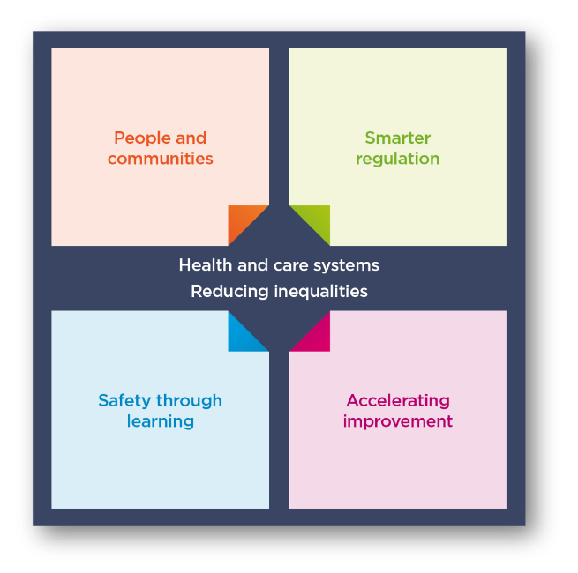
Our strategy
Our overall aim and focus is on tackling inequalities
and driving improvement
Notes:
Our strategy published in May 2021 is a strategy for the changing world of health and social care. We are being ambitious.
The health and social care landscape has changed drastically since 2016, when our previous strategy was published. Changes in the health and social care sector have been accelerated by the pandemic, increasing the needs of those who access health and social care services and placing additional challenges on service providers to meet them.
Our role as the regulator of health and social care in England has also been impacted greatly by the pandemic, affecting our ability to inspect all services and provide the necessary assurance to the public of their safety.
We’re on a journey to change how we regulate to improve care for everyone.
Our strategy strengthens our commitment to deliver our purpose: to ensure health and care services provide people with safe, effective, compassionate, high-quality care and to encourage those services to improve. Our strategy is purposefully ambitious, and to implement it we will need to work closely with others to make it a reality. We’ll review this strategy regularly so we can adapt to changes and be prepared for what the future holds.
Our strategic themes:
We’ll continue building the underpinning systems and structures, and making changes, to enable our strategy over the next two to three years, but full realisation of the strategy will take longer as we continuously learn and evolve, responding to changes in the world around us.
the four interlinked themes that will determine the changes we will make;
People and communities
Smarter regulation
Safety through learning
Accelerating improvement
All of this comes back to our core ambition of tackling inequalities. We’re pushing for equality of access, experiences and outcomes from health and
social care services

Slide 6
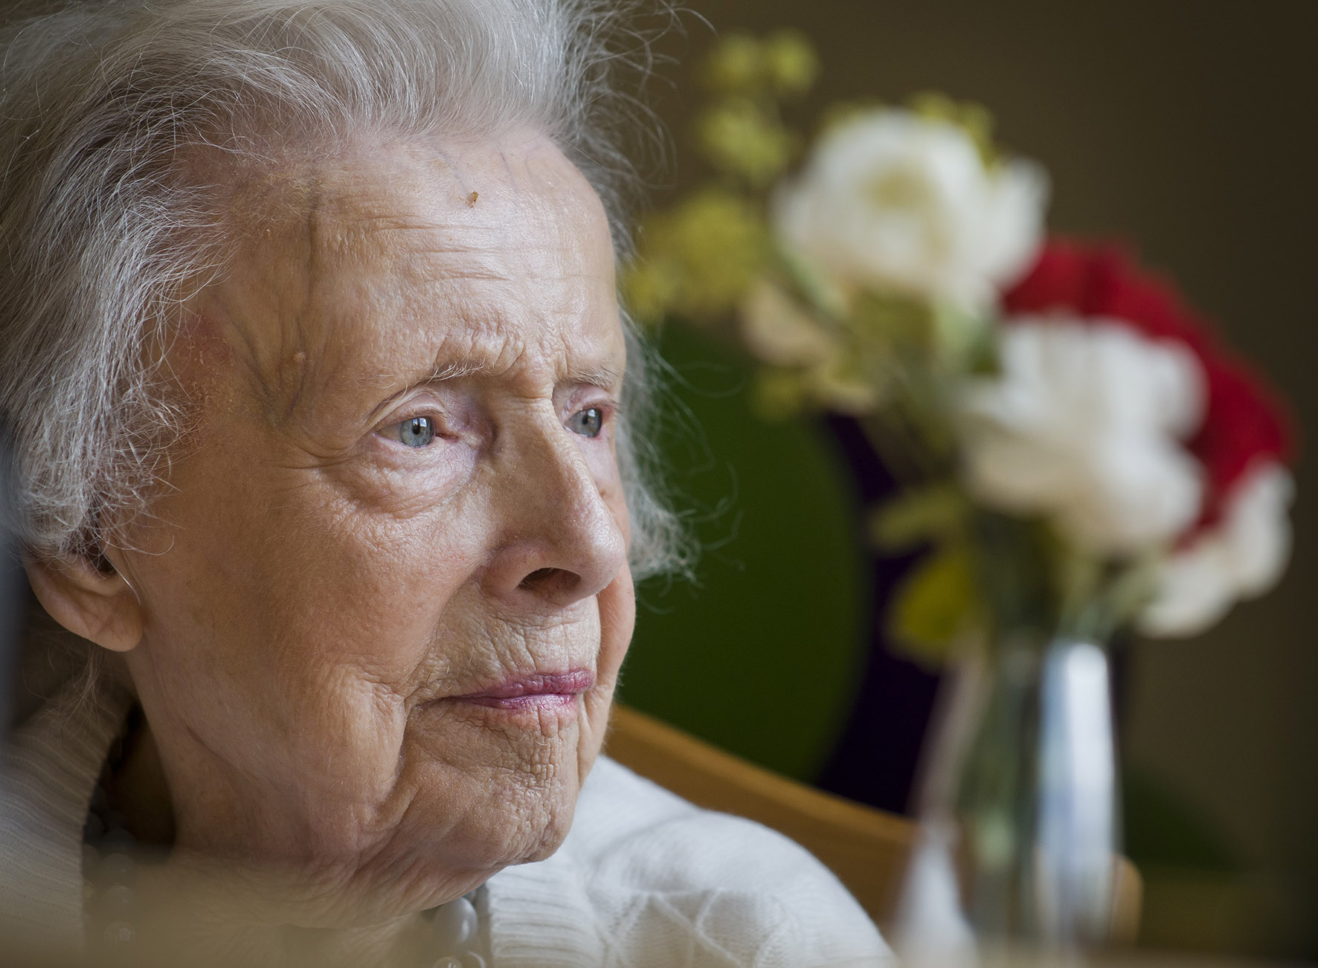

Improving outcomes for people and reducing inequalities
Our new powers to oversee local authorities and integrated care systems under the Health and Care Bill will support us to deliver the objectives and ambition of our strategy.
They will allow us to look at how effectively care is provided in a local system, and how it is improving outcomes for people and reducing inequalities in their care.
This will be transformative in how we bring together a view of quality across a local area, put people at the centre and help drive improvement in care.
Notes:
The final version of the Act:
Gives CQC a duty to independently review and assess how Local Authorities are delivering their Care Act functions under Part 1.
Creates new powers for CQC to have oversight of Integrated Care Systems (ICSs), putting three key themes for assessment on the face of the Bill – Leadership, integration and quality and safety.
Introduces a requirement for all health and social care providers who carry out regulated activities to ensure that their staff receive specific training appropriate to their role on learning disabilities and autism. The Secretary of State (SofS) is also required to produce a Code of Practice with regards to training on learning disability and autism.
Creates a duty for CQC to enforce the NHS food and drink standards. The Bill imposes requirements on NHS hospitals in connection with food or drink provided or made available to any person on hospital premises in England that are used in connection with the carrying on of a regulated activity. Further regulations will be made which will specify the nutritional standards or requirements which are to be complied with.
New powers –
We now have new powers to oversee local authorities and integrated care systems under the Health and Care Bill.
These will support us to deliver the objectives in our strategy by allowing us to look more effectively at how the care provided in a local system is improving outcomes for people and reducing inequalities in their care.
We’ve engaged extensively over the last year on how we’ll do this, including two large workshops with around 400 representatives from across the country and establishing an expert advisory group to provide dedicated input.
This will be transformative in how we bring together a view of quality across a local area, put people at the centre and help drive improvement in care.

Slide 7
What will change?
Our new approach will fall into four main areas:
New technology – we’ll be able to harness what we hear from people using services through new data and insight skills and technology
New policy – we’ll use a single quality assessment framework for all service types and at all levels
New ways of organising – we’ll be working in multidisciplinary teams to make sure we can look at quality better across an area
New responsibilities – we’ll build on our previous activity looking at how services work together across a local area with new powers to look at Integrated Care Systems and local authorities
Notes:
New technology – we’ll be able to harness what we hear from people using services through new skills and technology for data and insight, supporting our colleagues to make decisions. This is coupled with a better experience for providers through our new online portal, to reduce burden and increase the quality of data we collect from them.
New policy – we’ll use a single quality assessment framework for all service types and at all levels, from registration through to provider assessments and assessments of integrated care systems (ICSs) and local authorities. This will be the basis for our judgements about quality.
New ways of working – we’ll be working in teams with a mix of expertise and experience of different health and social care sectors to make sure we can share specialist skills and knowledge about all sectors. This means bringing people together who have different perspectives to give us the best view of services across a local area.
New powers – we’ll build on our previous activity looking at how services work together across a local area with new powers to look at ICSs and local authorities, which will help to hold them to account and encourage improvement.
All of this will enable us to present a better view of the quality of care being delivered in health and care services and in local areas. It will be built on how people experience care and what matters to them. We will be able to better spot health inequalities and disparities between areas, so we can provide better information to partners to help improve care for everyone.

Slide 8

New technology
We’re developing and will begin to roll out our new regulatory platform
We’ve already improved how our notifications work
We’re making it easier to interact with us through the portal
We’re working towards delivering a
seamless registration service
This technology will
transform how we work
Notes:
New technology –
We’ve built on the technology we developed during the pandemic to create the early stages of our new regulatory platform. Using a strong base of user research and other engagement work, we’re now planning how we will roll it out in a limited and controlled way over the coming months.
We’ve already improved how our notifications work, making providers’ lives easier, as well as ensuring that the information we receive comes to us in a structured way so that we can analyse it quickly.
Alongside this, we’re also making it easier to interact with us through the portal, allowing people to do simple things they couldn’t previously.
We’ve made progress towards delivering a seamless registration service. This is a vital part of our regulatory model and a crucial first step in ensuring services deliver safe, effective, compassionate and high-quality care.
This technology will be transformative to how we work. We’ve taken a few important steps and over the coming months we want to start sharing these with stakeholders.

Slide 9

Our new online portal
We’ve created a new online portal for providers to interact with us in a simple and intuitive way.
Some examples of what this new portal will allow providers to do:
Easily share information with the CQC,
including submitting notifications
Register or apply to make changes to their
registration
Manage their user accounts and easily
access information about their activity
Some providers have now been invited to login and start using its functionality.
Notes:
We’ve created a new online portal that will be simple and intuitive to enable providers to submit information to us. We want to make it easier for providers to work with us, so we’ll collect data in a more structured format. We will ask you to validate the information we hold and ask for the information we cannot get elsewhere and in a way that makes it easy to get right the first time – both for registration and assessment use.
Once fully launched, all providers will be able to:
register with CQC for the first time
submit notifications and share information
apply to make changes to their registration
manage their user accounts and contact preferences online access the registration data CQC holds about them and update this as required, in time, we’ll also provide benchmarking information too

Slide 10
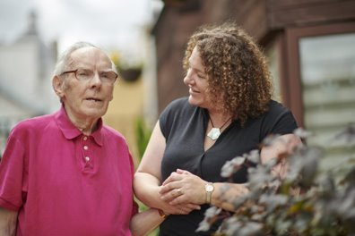
Digitisation in social care: why it matters
Good quality records underpin high-quality care
Digital records far exceed capabilities of paper
  Efficiency, automation, reporting and sharing
And that's just the start of innovation ….
State of Care Oct 2022 - Better data and data sharing are the critical components before providers can begin to address system-wide issues in a meaningful way
Notes:
So the other aspect I’m keen to touch on is digitization in social care and to make it really clear that CQC fully supports the adoption of digital social care records
And Why ? CQC know that good quality records underpin safe, effective, compassionate, high-quality care. They ensure that accurate information gets to the right people, when they need it.
and digital record systems far exceed the capabilities and benefits of paper-based records.
Because they help providers to minimise the risks to peoples’ safety
They support their staff to respond more quickly to peoples’ needs
and share important information quickly and safely
And for providers they don’t just help underpin good quality care, they
Help you operate more efficiently
They give management information and insight not possible with paper records.
And that's just the start, when you look at the systems available, you'll see they are innovating with other digital features that help improve the quality of care for service users and their families.
But there’s another benefit that’s even more important than all of this:
In CQC’s State of Care report last year we said - Better data and data sharing are the critical components before providers can begin to address system-wide issues in a meaningful way
We know that the integrated nature of health and care demands that we have a full picture of the people’s experience, so we can understand and address these issues

Slide 11
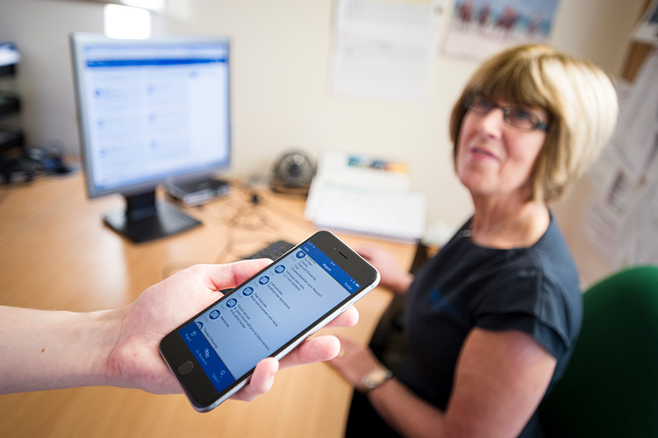
Find out more
We are here to help you
We are here to support you
Sources of best practice and much more, can be found on our webpage
https://www.cqc.org.uk/guidance-providers/adult-social-care/digital-record-systems-adult-social-care-services
Notes:
Sources of best practice and guidance

Slide 12
Changes to our regulatory approach
Multiple assessment frameworks
Single assessment framework
Ongoing monitoring and with inspections scheduled according to previous rating
Ongoing assessment of quality and risk
Evidence gathered during onsite inspection (single point in time)
Evidence gathered at multiple points in time (not just through inspection)
Judgements and ratings decisions made using ratings characteristics
Teams assign score to evidence
Narrative inspection report
Ratings updated, short narrative published
Notes:
This slide is animated. Each click of your mouse or clicker, should give you a new line.
We know that it’s helpful to see how our future model relates to what we’ve been doing over the last 8+ years – here are some examples of what could feel different. On the left hand side of the screen you have how things are now, on the right is how it will work in future.
Our assessment framework
Now: we have three different frameworks (registration, health, ASC) covering our five key questions – they are duplicative (eg across the KLOEs) and are not fully relevant to health and care today.
Future: we’ll have a single assessment framework that cover all sectors, services, levels – this will simplify things greatly for providers and ourselves. What we look at won’t change significantly, but how we do it will feel very different.
Our assessment approach
Now: We have separate ‘monitor’, ‘inspect’ and ‘rate’ steps and we inspect at a set point in time, based mainly on the previous rating.
Future: We’re moving away from separate ‘monitor’, ‘inspect’ and ‘rate’ steps in our model and will instead use the information we receive, collect and analyse to assess providers more frequently, without being tied to set dates.
The information will come from multiple sources and gathered in a variety of ways. Our operational colleagues will have a key role in increasing the flow of information into the regulatory platform. This will be a dynamic process and presented to colleagues in a clear and accessible dashboard through the regulatory platform, helping us make better decisions.
This does also not mean fewer inspections for high risk services. Our colleagues will have a greater ability to identify the best course of action - this could be that they work in the local area to find out more information, or schedule a site visit to the service to observe care or speak to staff. It is important to note that in settings where there is a higher likelihood of a closed culture developing we would prioritise these services for site visits for these services. More flexibility and improved prioritisation across all services means we can focus our activity where it’s most needed.
Categorising and scoring evidence
Now: make judgements against the ratings characteristics and the key question ratings aggregate to give us an overall rating.
Future: We want to be more consistent and transparent in our approach and how we make judgments on quality. We want our ratings to better reflect the care people are receiving and be clearer about where a provider or service sits within a rating. To address this, we’re developing a way to categorise and score evidence as part of our assessments.
Reporting and outputs from our assessments
Now: we publish long pdf reports that are not very accessible and take time for us to write and for the public to read.
Future: We are moving away from long pdf reports – we know that they don’t work for the public or for providers. They are inaccessible and not fit for what people expect from us. We also know that they take up much of our inspectors valuable time to produce them in the first place.
We will be able to give a much more up to date view of quality. We can’t do that unless we streamline the processes around publishing reports. We want to make them shorter, and more tailored to the audiences that use and read them. People will be able to make better choices about their care as information will be presented more clearly and detailed benchmarking information to help the provider improve will use the provider portal, rather than be published online

Slide 13
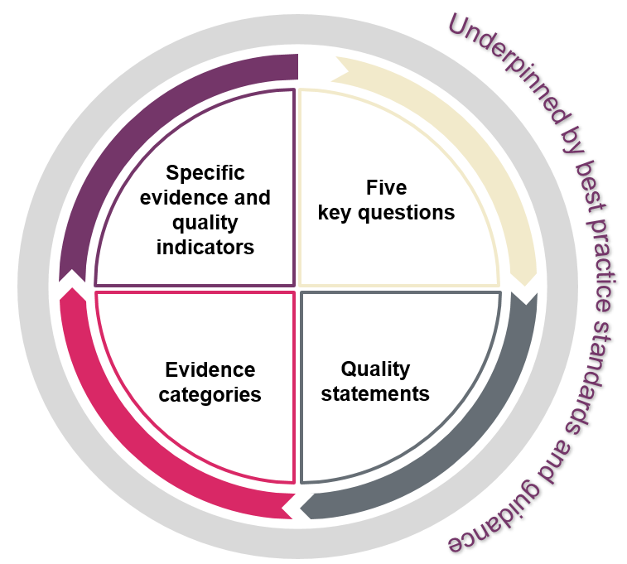
New policy
We’ve developed a single assessment framework, replacing
the current four separate frameworks and we'll use it to assess
all service types and as the basis for assessing local authorities
and integrated care systems
Our ratings and five key questions will stay central to our approach
We’re replacing our existing key lines of enquiry and prompts with ‘quality statements’
We’re moving away from separate ‘monitor’, ‘inspect’ and ‘rate’ steps
We will assess providers in a more flexible way to provide an up-to-date view of quality
It will allow us to better identify trends and patterns across areas
Notes:
New policy –
On the back of strong engagement across all our external audiences we’ve developed a single assessment framework. We’ll use this to assess quality in all service types, and at all levels as well as for local authorities and integrated care systems. This will replace the current four separate frameworks for registering and assessing healthcare and adult social care services.
We confirmed that our ratings and five key questions will stay central to our approach, but we’re replacing our existing key lines of enquiry and prompts with ‘quality statements’. These will reduce the duplication that’s in our current assessment frameworks and will allow us to focus on key topic areas under each key question. We call the quality statements ‘we statements’ as they’re written from a provider, local authority or ICS perspective to help them understand what we expect of them.
Our new assessment approach means we’re moving away from separate ‘monitor’, ‘inspect’ and ‘rate’ steps. Instead, we will use information from a range of sources to assess providers more frequently and in a more flexible way, without being driven by a previous rating. This is key to us achieving our strategic ambition of providing an up-to-date view of quality.

Slide 14
Our single assessment framework
Underpinned by best practice standards and guidance
Specific
evidence and quality indicators
Five
key questions
Our framework will assess providers, local authorities and integrated care systems with a consistent set of key themes ​
Giving us an up-to-date view of quality​
Helping us better identify trends and patterns across areas
Evidence categories​
Quality statements
https://www.cqc.org.uk/page/single-assessment-framework
Notes:
This is our single assessment framework for our regulation of providers, local authorities and systems. It focus on what matters to people who use health and social care services and their families. It is the key to us providing an up-to-date and accurate view of quality.
So why do we need a single assessment framework?
There are three main reasons why we need to change:
We need to make things simpler so we can focus on what really matters to people.
We need to better reflect how care is actually delivered by different types of service as well as across a local area.
We need one framework that connects our registration activity to our assessments of quality.
This will ultimately give us a clear and up to date view of quality and help us to better identify trends and patterns across the various areas.

Slide 15
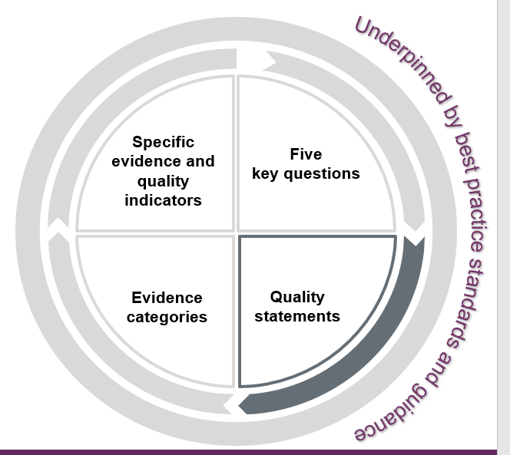

What are quality statements?
Quality statements are the commitments that providers, commissioners and system leaders should live up to. Expressed as ‘we statements’, they show what is needed to deliver high-quality, person-centred care.
The quality statements show how services and providers need to work together to plan and deliver high quality care. They directly relate to the regulations.
When they refer to 'people' we mean people who use services, their families, friends and unpaid carers.
Source: https://www.cqc.org.uk/assessment/quality-statements

Slide 16

Quality statements:
What do we mean by safe? 1/2
Learning culture
We have a proactive and positive culture of safety based on openness and honesty, in which concerns about safety are listened to, safety events are investigated and reported thoroughly, and lessons are learned to continually identify and embed good practices.
Safeguarding
We work with people to understand what being safe means to them as well as with our partners on the best way to achieve this. We concentrate on improving people’s lives while protecting their right to live in safety, free from bullying, harassment, abuse, discrimination, avoidable harm and neglect. We make sure we share concerns quickly and appropriately.
Safe systems, pathways and transitions
We work with people and our partners to establish and maintain safe systems of care, in which safety is managed, monitored and assured. We ensure continuity of care, including when people move between different services.
Involving people to manage risks
We work with people to understand and manage risks by thinking holistically so that care meets their needs in a way that is safe and supportive and enables them to do the things that matter to them.
Source: https://www.cqc.org.uk/assessment/quality-statements
Notes:
Safe
Safety is a priority for everyone and leaders embed a culture of openness and collaboration. People are always safe and protected from bullying, harassment, avoidable harm, neglect, abuse and discrimination. Their liberty is protected where this is in their best interests and in line with legislation.
Where people raise concerns about safety and ideas to improve, the primary response is to learn and improve continuously. There is strong awareness of the areas with the greatest safety risks. Solutions to risks are developed collaboratively. Services are planned and organised with people and communities in a way that improves their safety across their care journeys. People are supported to make choices that balance risks of harm with positive choices about their lives. Leaders ensure there are enough skilled people to deliver safe care that promotes choice, control and individual wellbeing.
Learning culture
We have a proactive and positive culture of safety based on openness and honesty, in which concerns about safety are listened to, safety events are investigated and reported thoroughly, and lessons are learned to continually identify and embed good practices.
Related regulations
Regulated Activities Regulations 2014
Regulation 12: Safe care and treatment
Regulation 16: Receiving and acting on complaints
Regulation 17: Good governance
Regulation 20: Duty of candour
Safe systems, pathways and transitions
We work with people and our partners to establish and maintain safe systems of care, in which safety is managed, monitored and assured. We ensure continuity of care, including when people move between different services.
Related regulations
Regulated Activities Regulations 2014
Regulation 12: Safe care and treatment
Regulation 17: Good governance
Also consider
Regulation 9: Person-centred care
Local authority assessments
We consider this quality statement, safe systems, pathways and transitions, under theme 3: how the local authority ensures safety within the system.
Safeguarding
We work with people to understand what being safe means to them as well as with our partners on the best way to achieve this. We concentrate on improving people’s lives while protecting their right to live in safety, free from bullying, harassment, abuse, discrimination, avoidable harm and neglect. We make sure we share concerns quickly and appropriately.
Related regulations
Regulated Activities Regulations 2014
Regulation 10: Dignity and respect
Regulation 12: Safe care and treatment
Regulation 13: Safeguarding service users from abuse and improper treatment
Also consider
Regulation 9: Person-centred care
Regulation 11: Consent
Regulation 17: Good governance
Regulation 20: Duty of candour
Local authority assessments
We consider this quality statement, safeguarding, under theme 3: how the local authority ensures safety within the system.
Involving people to manage risks
We work with people to understand and manage risks by thinking holistically so that care meets their needs in a way that is safe and supportive and enables them to do the things that matter to them.
Related regulations
Regulated Activities Regulations 2014
Regulation 9: Person-centred care
Regulation 11: Need for consent
Regulation 12: Safe care and treatment
Also consider
Regulation 10: Dignity and respect

Slide 17
Quality statements:
What do we mean by safe? 2/2
Safe environments
We detect and control potential risks in the care environment. We make sure that the equipment, facilities and technology support the delivery of safe care.
Infection prevention and control
We assess and manage the risk of infection. We detect and control the risk of it spreading and share any concerns with appropriate agencies promptly.
Safe and effective staffing
We make sure there are enough qualified, skilled and experienced people, who receive effective support, supervision and development. They work together effectively to provide safe care that meets people’s individual needs.
Medicines optimisation
We make sure that medicines and treatments are safe and meet people’s needs, capacities and preferences by enabling them to be involved in planning, including when changes happen.
Source: https://www.cqc.org.uk/assessment/quality-statements
Notes:
Safe environments
We detect and control potential risks in the care environment. We make sure that the equipment, facilities and technology support the delivery of safe care.
Related regulations
Regulated Activities Regulations 2014
Regulation 12: Safe care and treatment
Regulation 15: Premises and equipment
Regulation 17: Good governance
Safe and effective staffing
We make sure there are enough qualified, skilled and experienced people, who receive effective support, supervision and development. They work together effectively to provide safe care that meets people’s individual needs.
Related regulations
Regulated Activities Regulations 2014
Regulation 12: Safe care and treatment
Regulation 18: Staffing
Regulation 19: Fit and proper persons employed
Infection prevention and control
We assess and manage the risk of infection. We detect and control the risk of it spreading and share any concerns with appropriate agencies promptly.
Related regulations
Regulated Activities Regulations 2014
Regulation 12: Safe care and treatment
Regulation 15: Premises and equipment
Also consider
Regulation 17: Good governance
Medicines optimisation
We make sure that medicines and treatments are safe and meet people’s needs, capacities and preferences by enabling them to be involved in planning, including when changes happen.
Related regulations
Regulated Activities Regulations 2014
Regulation 9: Person-centred care
Regulation 12: Safe care and treatment
Also consider
Regulation 11: Need for consent

Slide 18
Quality statements:
What do we mean by caring?
Independence, choice and control
We promote people’s independence, so they know their rights and have choice and control over their own care, treatment and wellbeing.
Kindness, compassion and dignity
We always treat people with kindness, empathy and compassion and we respect their privacy and dignity. We treat colleagues from other organisations with kindness and respect.
Responding to people's immediate needs
We listen to and understand people’s needs, views and wishes. We respond to these in that moment and will act to minimise any discomfort, concern or distress.
Treating people as individuals
We treat people as individuals and make sure their care, support and treatment meets their needs and preferences. We take account of their strengths, abilities, aspirations, culture and unique backgrounds and protected characteristics.
Workforce wellbeing and enablement
We care about and promote the wellbeing of our staff, and we support and enable them to always deliver person centred care.
Source: https://www.cqc.org.uk/assessment/quality-statements
Notes:
Kindness, compassion and dignity
We always treat people with kindness, empathy and compassion and we respect their privacy and dignity. We treat colleagues from other organisations with kindness and respect.
Regulated Activities Regulations 2014
Regulation 9: Person-centred care
Regulation 10: Dignity and respect
Also consider
Regulation 12: Safe care and treatment
Treating people as individuals
We treat people as individuals and make sure their care, support and treatment meets their needs and preferences. We take account of their strengths, abilities, aspirations, culture and unique backgrounds and protected characteristics.
Related regulations
Regulated Activities Regulations 2014
Regulation 9: Person-centred care
Regulation 10: Dignity and respect
Regulation 14: Meeting nutritional and hydration needs
Regulation 15: Premises and equipment
Independence, choice and control
We promote people’s independence, so they know their rights and have choice and control over their own care, treatment and wellbeing.
Related regulations
Regulated Activities Regulations 2014
Regulation 9: Person-centred care
Regulation 12: Safe care and treatment
Also consider
Regulation 10: Dignity and respect
Responding to people's immediate needs
We listen to and understand people’s needs, views and wishes. We respond to these in that moment and will act to minimise any discomfort, concern or distress.
Related regulations
Regulated Activities Regulations 2014
Regulation 9: Person-centred care
Regulation 10: Dignity and respect
Regulation 11: Need for consent
Regulation 12: Safe care and treatment
Also consider
Regulation 16: Receiving and acting on complaints
Workforce wellbeing and enablement
We care about and promote the wellbeing of our staff, and we support and enable them to always deliver person centred care.
Related regulations
Regulated Activities Regulations 2014
Regulation 9: Person-centre care
Regulation 12: Safe care and treatment
Regulation 17: Good governance
Regulation 18: Staffing

Slide 19
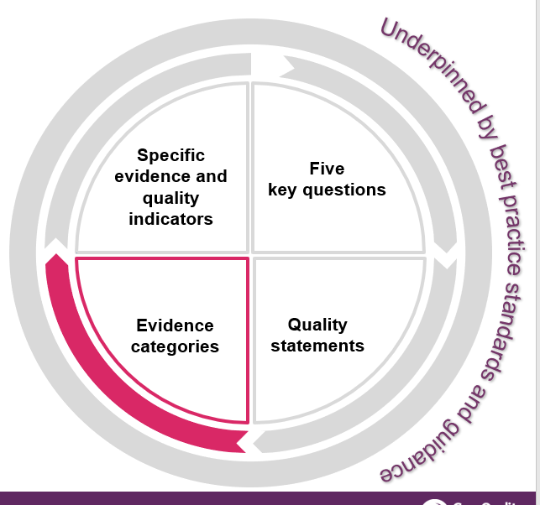
What are evidence categories? 1/2
They are six categories that we have grouped into different types of evidence that we will look at.
Each category sets out the types of evidence we use to understand:
the quality of care being delivered
the performance against each quality statement.
This is to make our judgements more transparent and consistent.
We will make clear what we look at in our assessments by setting out the key evidence categories we’ll focus on for each quality statement.
https://www.cqc.org.uk/assessment/evidence-categories

Slide 20
What are evidence categories? 2/2
We will provide some examples of types of evidence to make it easier to understand what we’ll look at.
The number of evidence categories that we need to consider and the sources of evidence we’ll collect varies according to:
the type or model of service
the level of assessment (service, provider, local authority or integrated care system)
whether the assessment is for an existing service or at registration.
https://www.cqc.org.uk/assessment/evidence-categories

Slide 21
People’s experience of health and care services
This is all types of evidence from people who have experience relating to a specific health or care service, or a pathway across services. It also includes evidence from families, carers and advocates for people who use services.
We define people’s experiences as:
“a person’s needs, expectations, lived experience and satisfaction with their care, support and treatment. This includes access to and transfers between services”.
Find out about the importance of people’s experience in our assessments
https://www.cqc.org.uk/assessment/evidence-categories
Notes:
Evidence from people’s experience of care includes:
phone calls, emails and Give feedback on care forms received by CQC
interviews with people and local organisations who represent them or act on their behalf
survey results.
feedback from the public and people who use services obtained by:
community and voluntary groups
health and care providers
local authorities
groups representing:
people who are more likely to have a poorer experience of care and poorer outcomes
people with protected equality characteristics
unpaid carers

Slide 22
Feedback from staff and leaders
This is evidence from people who work in a service, local authority or integrated care system, and groups of staff involved in providing care to people.
It also includes evidence from those in leadership positions.
This includes, for example:
results from staff surveys and feedback from staff to their employer
individual interviews or focus groups with staff
interviews with leaders
feedback from people working in a service sent through our Give
feedback on care service
whistleblowing
https://www.cqc.org.uk/assessment/evidence-categories

Slide 23
Feedback from partners
This is evidence from people representing organisations that interact with the service or organisation that is being assessed.
We may gather evidence through interviews and engagement events.
The organisations include, for example:
commissioners
other local providers
professional regulators
accreditation bodies
royal colleges
multi-agency bodies.
https://www.cqc.org.uk/assessment/evidence-categories

Slide 24
Observation
Observing care and the care environment will remain an important way to assess quality.
Most observation will be carried out on the premises by CQC inspectors and Specialist Professional Advisors (SpAs).
External bodies may also carry out observations of care and provide evidence, for example, Local Healthwatch. Where the evidence from organisations such as Healthwatch is specifically about observation of the care environment, we will include it in this category, and not in the people’s experiences category.
We will not use the observation category for local authority assessments. It
does not apply to a local authority context.
All observation is carried out on site.
https://www.cqc.org.uk/assessment/evidence-categories

Slide 25
Processes
Processes are any series of steps, arrangements or activities that are carried out to enable a provider or organisation to deliver its objectives.
Our assessments focus on how effective policies and procedures are. To do this, we will look at information and data sources that measure the outcomes from processes. For example, we may consider processes to:
measure and respond to information from audits
look at learning from incidents or notifications
review people's care and clinical records.
https://www.cqc.org.uk/assessment/evidence-categories

Slide 26
Outcomes
Outcomes are focused on the impact of care processes on individuals. They cover how care has affected people’s physical, functional or psychological status.
We consider outcomes measures in context of the service and the specifics of the measure.
Some examples of outcome measures are:
mortality rates
emergency admissions and re-admission rates to hospital
infection control rates
vaccination and prescribing data.
https://www.cqc.org.uk/assessment/evidence-categories
Notes:
We also source the information from:
patient level data sets
national clinical audits
initiatives such as the patient reported outcome measures (PROMs) programme.

Slide 27
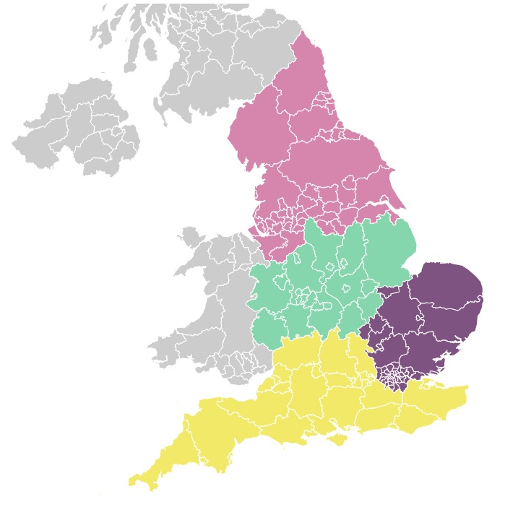
New way of organising
We’re reorganising ourselves into the Operations group and Regulatory leadership
Regulatory leadership is led by the Chief
Inspectors, and focuses on raising standards,
policy oversight, and external influence
Our operational teams work across four
geographic networks, with a mix of specialist
skills and knowledge to regulate in a way that
mirrors how care is delivered
We’ll have a system view and focus on listening to
people and communities
Notes:
New structure ­–
We’ve begun to reorganise ourselves by establishing our new Operations group and Regulatory leadership functions.
Our regulatory leadership function will be led by the Chief Inspectors, and focus on raising standards, having oversight of policy and playing a more influential role externally to support quality improvement and innovation
Our Operations group will be responsible for our regulatory activity, and has brought together three sectors. Our operational teams now work across four Networks or geographic areas (North, Midlands, London East of England and South) to deliver our regulatory activity so that we can begin to build a better picture of quality across an area.
We are still designing how much of this will work in detail, but we do know we’ll create multidisciplinary teams with specialist skills and knowledge, meaning we’re able to regulate in a way that mirrors how care is delivered today

Slide 28

New responsibilities
CQC has new responsibilities:
  The Health and Care Act gives CQC
  a role in reviewing integrated care systems
  It also gives CQC a duty to assess how local authorities are meeting their social care duties under part 1 of the Care Act
These will allow us to look more effectively at how care provided in a local system is improving outcomes and reducing inequalities.
We’ve engaged extensively on how we’ll do this. We want to bring together a view of quality across a local area and put people at the centre of driving improvement in care.
Notes:
The final version of the Act:
Gives CQC a duty to independently review and assess how Local Authorities are delivering their Care Act functions under Part 1.
Creates new powers for CQC to have oversight of Integrated Care Systems (ICSs), putting three key themes for assessment on the face of the Bill – Leadership, integration and quality and safety.
Introduces a requirement for all health and social care providers who carry out regulated activities to ensure that their staff receive specific training appropriate to their role on learning disabilities and autism. The Secretary of State (SofS) is also required to produce a Code of Practice with regards to training on learning disability and autism.
Creates a duty for CQC to enforce the NHS food and drink standards. The Bill imposes requirements on NHS hospitals in connection with food or drink provided or made available to any person on hospital premises in England that are used in connection with the carrying on of a regulated activity. Further regulations will be made which will specify the nutritional standards or requirements which are to be complied with.
New responsibilities –
We now have new powers to oversee local authorities and integrated care systems under the Health and Care Bill.
These will support us to deliver the objectives in our strategy by allowing us to look more effectively at how the care provided in a local system is improving outcomes for people and reducing inequalities in their care.
We’ve engaged extensively over the last year on how we’ll do this, including two large workshops with around 400 representatives from across the country and establishing an expert advisory group to provide dedicated input.
This will be transformative in how we bring together a view of quality across a local area, put people at the centre and help drive improvement in care.

Slide 29
CQC scope: integrated care systems
The focus of our integrated care systems will be these across 3 themes:
Leadership
Shared direction and culture
Integration
Safe systems, pathways and transitions
Quality and safety
Learning culture
Capable, compassionate and inclusive leaders
Governance and assurance
Partnerships and communities
Learning, improvement and innovation
Environmental sustainability
Workforce equality, diversity and inclusion
Freedom to Speak Up
Care provision, integration and continuity
How staff, teams and services work together
Supporting people to live healthier lives
Safe and effective staffing
Safeguarding
Equity in access
Equity in experiences and outcomes
www.cqc.org.uk/ICSguidance
Notes:
Interim guidance on our approach to assessing integrated care systems
This sets out the overall framework for our oversight of integrated care systems, focusing on the initial baselining period. It includes how we plan to gather evidence, report on findings and award ratings if requested to by HM Government.
The guidance focuses on:
Themes and quality statements
Evidence categories
How we will assess integrated care systems
Reporting and sharing information
Intervention and escalation
As we develop our model and transition to ongoing assessment, this guidance will include more detail. It will form the basis for comprehensive guidance on our regulatory processes.
You can now read our current interim guidance for assessing integrated care systems in the link provided here.

Slide 30
CQC scope: local authorities
The initial focus of our local authority assessments will be across four themes:
Theme 1: Working with people
Assessing needs
Supporting people to live healthier lives
Theme 2: Providing support
Care provision, integration and continuity
Partnerships and communities
Theme 3: Ensuring safety
Safe systems, pathways and transitions
Safeguarding
Theme 4: Leadership
Learning, improvement and innovation
Governance, management and sustainability
Equity in experience and outcomes
Notes:
Most recent update: 15 February
The initial focus of our local authority assessments will be across four themes:
Working with people – more detail on next slide
Providing support - market shaping, commissioning, workforce capacity and capability, integration and partnership working
Ensuring safety - safeguarding enquiries, reviews, Safeguarding Adults Board, safe systems, pathways and continuity of care
Leadership and workforce - culture, strategic planning, learning, improvement, innovation, governance, management and sustainability
a subset of quality statements from the single assessment framework will sit under each theme

Slide 31








Provider Bulletin
https://www.cqc.org.uk/news/newsletters-alerts/email-newsletters-cqc or Search: CQC bulletin
Publications
https://www.cqc.org.uk/publications
Social
@CQCProf @CQCProf
youtube.com/user/cqcdigitalcomms
facebook.com/CareQualityCommission
CQC is changing – YouTube playlist
https://youtube.com/playlist?list=PLEwLzOd_XW-IU-FCX2gvNu3OYG1aHn365
Digital platform
https://cqc.citizenlab.co/en-GB/ or Search: Citizenlab CQC
Podcasts
Wherever you listen to podcasts
Search: CQC Connect
Blogs
https://medium.com/@CareQualityComm
or Search: Medium CQC
Notes:
CQC is changing playlist
This will have a playlist of all of the webinars that we have conducted in this period of time on the transformation
The last webinar, on the 2 August, will be here too

Slide 32

Any questions?
Duncan Paterson
CQC Operations Manager
www.cqc.org.uk
enquiries@cqc.org.uk
@CQCProf
youtube.com/user/cqcdigitalcomms
facebook.com/CareQualityCommission

