Slide 1

Welcome to your registered manager network meeting
19/7/23

Slide 2
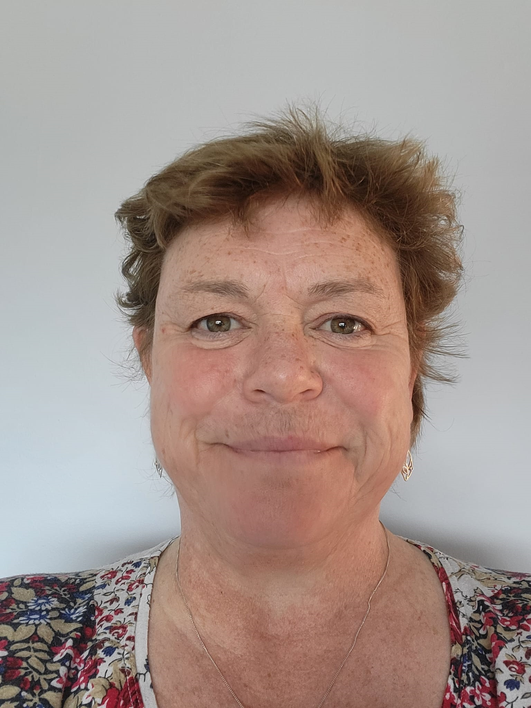
New Locality Manager
Ali Porteous
Specialist area –
Learning Disabilities
Recruitment and Retention
Background
Registered Manager
Regional Manager
Trainer
Recruitment and Retention project manager.

Slide 3
Latest information

Slide 4

#PositiveWorkplaceCulture
This June and July we’re shining our spotlight on developing a positive workplace culture, exploring what a workplace culture is and how you can create one.
A positive workplace culture supports staff to feel happy and confident at work and enables employers to find and keep great staff who will deliver the best care and support to others.
Throughout the campaign we’ll be providing information and resources to increase understanding of what a positive culture is and why it’s important, and providing practical tips and examples that employers and managers can use to support a positive workplace culture.
Find out more on our campaign page
Notes:
NEW : JUNE 2023
Campaign page: https://bit.ly/43hOhl0

Slide 5
Oliver McGowan draft code of practice
The draft Oliver McGowan Mandatory Training on Learning Disability and Autism code of practice outlines how health and care providers who are registered with the Care Quality Commission (CQC) can meet the legislative requirement introduced by the Health and Care Act 2022 to ensure staff receive training on learning disability and autism, appropriate to their role.
The public consultation on the draft code of practice will run for 12 weeks and closes on Tuesday 19 September 2023. Following this, the government will consider all consultation responses to inform any final changes to the draft code of practice.
Find out more and respond to the public consultation
Notes:
NEW: JULY 2023
https://www.gov.uk/government/consultations/oliver-mcgowan-draft-code-of-practice

Slide 6
Information for registered managers

Slide 7

Webinars to support
your service
Our series of webinars cover a wide range of topics – they are delivered to a live audience and recorded for further viewing.
Care topics
Digital, data and technology
Recruitment and retention
Managing a service
Managing people
HR
Wellbeing
www.skillsforcare.org.uk/RMwebinars
New recorded webinars
Safer employment – Effective references
Providing evidence to the CQC and New CQC inspection
Maximise retention and Maximise recruitment
Notes:
We’ve also developed a range of bite-size resources that can be used by all frontline managers to support our webinars which include tips, checklists and toolkits.

Slide 8

Upcoming webinar…
Involving people in care planning
Thursday 21 September I 10:00 – 11:00
Do you want to learn more about practical and person-centred ways to involve the people you support and meet expectations?
This webinar will provide insight into how other adult social services involve people in different parts of the care planning process, ensuring that people’s needs continue to be met through regular reviews and support. We will also explore how Outstanding rated services directly involve individuals to ensure a service delivers outcomes focused person-centred care.
This webinar is delivered in partnership with The Outstanding Society and is aimed at frontline managers, senior care workers, and others supporting the service to involve people in planning their daily care.
Register for the webinar now
Notes:
NEW: JULY 2023
https://events.skillsforcare.org.uk/skillsforcare/1631/home

Slide 9

Episode 9 | With good culture you can achieve anything
In the final episode of the current series of the care exchange, we are joined by Zoe Fry OBE from The Outstanding Society who is also the host of the ‘Care Insights’ podcast.
Together we look back at guests that have featured on both podcasts, and we reflect on the importance of:
Positive leadership and leading by example
Creating a culture that is based on kindness which we heard about when we spoke to Rosemary Pavoni S3 | E5 about knowing your staff
The benefits of looking at different ways of working by looking outwards to see what is happening in society and other organisations (Ben Miller S3 | E3)
Listen now: www.skillsforcare.org.uk/CareExchange
Notes:
NEW : JULY 2023
https://www.skillsforcare.org.uk/Support-for-leaders-and-managers/Support-for-registered-managers/The-care-exchange/The-care-exchange-Series-3.aspx
Series 4 announcement coming soon…

Slide 10
Our latest blogs and articles
What equality, diversity and inclusion means in the workplace
Baidar Khan, Registered Manager, Lets Care All discussed what equality, diversity and inclusion in the workplace means.
What does workplace culture mean and how do we create it?
Tracy Kite, Chief of Personal & Leadership Learning at Glassmoon Services shares what workplace culture means and how they’ve created it at Glassmoon.
Leaders’ role in developing a positive workplace culture
Christine Wint, Head of Leadership Development at Skills for Care discusses the importance of leaders in creating a positive workplace culture.
Resources to support you with developing a positive workplace culture
As leaders and managers an important part of your role is creating a positive workplace culture. We have resources to help you do just that.
Notes:
https://www.skillsforcare.org.uk/news-and-events/blogs/what-equality-diversity-and-inclusion-means-in-the-workplace
https://www.skillsforcare.org.uk/news-and-events/blogs/what-does-workplace-culture-mean-and-how-do-we-create-it
https://www.skillsforcare.org.uk/news-and-events/blogs/leaders-role-in-developing-a-positive-workplace-culture
https://www.skillsforcare.org.uk/news-and-events/blogs/resources-to-support-you-with-developing-a-positive-workplace-culture

Slide 11
Deputy manager networks
These networks are specifically for deputy managers, team leaders and assistant managers
Virtual meetings facilitated by a Skills for Care Locality Manager.
Great opportunity for deputies to meet the challenges they face in their day-to-day work.
Opportunity to build connections and a peer supportive network.
Facilitate the sharing of best practice and learning.
Find your local deputy manager network:
www.skillsforcare.org.uk/deputymanagers
Notes:
Skills for Care currently supports over 145 registered manager networks, which are recognised as being invaluable by many managers.
We know the benefits these networks provide to managers, so we are setting up a new network specifically for your deputies.
Each network meeting will be virtual and facilitated by a Skills for Care Locality Manager. It will focus on themes including wellbeing and resilience, self-confidence and personal effectiveness, delegation with confidence and dignity, communicating inside and out and making sense of information.
Please note that not every part of the country will be covered by a Deputy Manager Network this year but we will be looking at the success of the first networks to consider wider expansion at a later point. If there is not a network in your area, and you would be interested in joining one in future please email RM.networks@skillsforcare.org.uk.

Slide 12
Registered manager membership – renewal resource
As part of our registered manager membership, all members that renew their membership receive an exclusive resource
For those renewing from 1 April 2023, they will receive a hard copy of Compassionate Leadership by Professor Michael West CBE.
This book explores how attending to, understanding, empathising with and helping those you lead can support them to respond effectively to the challenges they face in their work. The four elements of compassionate leadership play a crucial part in all aspects of your role as manager, including staff wellbeing, retention, and creating safe, supported cultures within your services
Become a member for £35 a year.
www.skillsforcare.org.uk/membership
Notes:
NEW: APRIL 2023

Slide 13
Recruitment and retention
Training and development

Slide 14
Learning from events eLearning
Learning reviews allow teams to explore different perspectives and create a positive action plan that supports individuals and seeks to avoid repeat incidents.
Through the 35-minute digital learning module you’ll:
discover what learning reviews are, why they’re needed and how they can help you
learn how managers can move from completing reviews at an individual level to involving the wider team
find practical tips for embedding learning reviews into your working environment.
Employers can claim £50 per completed module from the Workforce Development Fund for every employee that completes the module.
Find out more
Notes:
https://www.skillsforcare.org.uk/Developing-your-workforce/Care-topics/Learning-from-events-digital-learning-module/Learning-from-events-digital-module.aspx

Slide 15
Introductory modules for managers
11 eLearning modules to develop skills in leadership, succession planning and developing future talent
Leading and managing in adult social care
Supporting and developing teams
Regulation and governance
Effective communication
Working with partners
Leading a person-centred service
Safeguarding and mental capacity
Making decisions
Managing resources
Learning and innovating
Personal development and wellbeing
Employers can claim £50 per completed module from the Workforce Development Fund
www.skillsforcare.org.uk/IntroductoryModulesForManagers
Notes:
Our new and improved Introductory modules for managers support the development of aspiring and new managers.
The modules offer engaging introductions to key topic areas to peak learners’ interest and provide opportunities to reflect, ideas to improve practices, and motivation to learn more. Based on the Manager Induction Standards, the re-developed modules now feature up to date content and increased accessibility for learners.
The 11 modules cover the following topic areas:
Module 1: Leading and managing in adult social care
Module 2: Supporting and developing teams (Part 1)
Module 2: Supporting and developing teams (Part 2)
Module 3: Regulation and governance
Module 4: Effective communication
Module 5: Working with partners
Module 6: Leading a person-centred service
Module 7: Safeguarding and mental capacity
Module 8: Making decisions
Module 9: Managing resources
Module 10: Learning and innovating
Module 11: Personal development and wellbeing
Module duration:
The modules will take between 40 to 60 minutes to complete and this can be done at a time and a pace to suit the learner. They’re simple and engaging to follow and are relevant across different services and settings.
Cost:
Price per single module: £15
Package deal price (full module suite): £130 (saving £35)
Each module (or the full bundle) is purchased on a 2-year renewable license, with enrolment access to the module for a period of 2 years from date of purchase.
Employers can claim £50 per completed module from the Workforce Development Fund. This funding contributes towards the cost of the digital learning, the employees time required to complete the module, and the time taken to apply and embed the learning within their organisation.
Usual WDF eligibility criteria applies including updating and completing ASC-WDS

Slide 16
Good and Outstanding care learning modules
We’ve launched a range of eLearning modules to help you understand the CQC inspection process, what is expected of your service and how you can best evidence these expectations
The 1-hour modules include:
Being prepared for CQC inspection.
Improving your CQC rating.
Delivering Outstanding care.
Anyone involved in CQC inspection can use the modules and will be awarded a certificate to evidence their completion.
Modules cost £15 – employers can claim £50 per participant from the Workforce Development Fund.
Find out more
Notes:
https://www.skillsforcare.org.uk/Support-for-leaders-and-managers/Good-and-outstanding-care/eLearning.aspx
Modules costs £15 (or £13.50 if your organisation uses the Adult Social Care Workforce Data Set).
Employers can claim £50 per participant, subject to the Workforce Development Fund (WDF) rules.

Slide 17
Updated Good and Outstanding toolkit
Later in 2023, the Care Quality Commission (CQC) will be updating their inspection process to utilise the ‘single assessment framework’.
We’ve created an updated version of our inspection toolkit to support you in understanding these changes and preparing for your next inspection.
The toolkit based around the current framework will continue to be available alongside this until the changes are brought in by the CQC.
Understanding what Good and Outstanding care looks like can help you achieve success in your inspections and ensure you are continuously providing high quality care.
www.skillsforcare.org.uk/Support-for-leaders-and-managers/Good-and-outstanding-care/Inspection-toolkit.aspx
Notes:
NEW: APRIL 2023
https://www.skillsforcare.org.uk/Support-for-leaders-and-managers/Good-and-outstanding-care/Inspection-toolkit.aspx
There are now two versions of the Good and Outstanding inspection toolkit available.
GO Online: Inspection toolkit (Key lines of enquiry version)
https://www.skillsforcare.org.uk/Support-for-leaders-and-managers/Good-and-outstanding-care/inspect/Inspection-toolkit.aspx
This covers the current CQC Assessment Framework shaped around the Key lines of enquiry (KLOEs).
The CQC will continue to use this framework until “late 2023” and so if you anticipate you will be inspected before the, this version can help you to prepare.
GO Online: Inspection toolkit (Single Assessment Framework version)
https://www.skillsforcare.org.uk/Support-for-leaders-and-managers/Good-and-outstanding-care/inspection-toolkit/Inspection-toolkit.aspx
This covers the forthcoming CQC Single Assessment Framework which will be introduced “late 2023” and their new Quality Statements.
Use this version if you want to prepare your service for the new monitoring and inspection focus that the CQC will be looking at in the years ahead.

Slide 18
Digital leadership programme
The Digital leadership programme is a national development between Skills for Care and The National Care Forum for both new and experienced managers of adult social care services.
The learning programme will support managers to gain the underpinning skills and knowledge of digital leadership that can be practically applied when implementing technology in a care service.
The four-day programme is delivered virtually over a six-week period and the objectives of the programme are:
The digital basics
Leadership and transformational change
Co-production
Using data to create change
Find out more
Notes:
NEW: MARCH 2023
https://www.skillsforcare.org.uk/Support-for-leaders-and-managers/Managing-a-service/Digital-technology-and-social-care/Digital-leadership-programme.aspx
Programme objectives
The digital basics – Equipping the essential knowledge for understanding digital technologies in care, providing the foundation of knowledge for the modules that follow.
Leadership and transformational change – A good leader must possess strong change management skills. This module considers change management with a digital lens, developing an understanding of leadership styles and influence, methodologies for procuring technology, developing and aligning digital strategy and ‘baking in’ feedback into the process.
Co-production – Designing and developing with people in receipt of care, identifying their needs and expectations provides better defined, safe and ethical solutions.
Using data to create change – An effective digital leader can use data and feedback to lead decisions, defining what data technology needs to collect and analyse will provide opportunities to improve, influence and inform innovation.
The 4 days are delivered over a 6-week period, between the hours of 10:00 – 16:00, enabling the learning from each day to be put into practice between sessions.
The programme is delivered virtually. It’s interactive and learners will participate in a variety of group and individual activities.
Learners will need to be able to commit to attend each of the four modules and be able to spend time developing an action plan and creating a presentation which will be delivered by the learner on day 4 of the programme.
Learners will only be able to receive a certificate of completion if they have participated in all four modules.
The programme costs £11,500 (for a maximum of 25 learners per programme)
We are pleased to confirm that employers can now claim £500 per participant, subject to the Workforce Development Fund (WDF) rules.

Slide 19
International recruitment support
Recruiting internationally is a great way to find skilled and diverse workers, but employers often tell us they have trouble navigating the legalities of recruiting internationally
Our international recruitment webpage has a range of resources including:
Webinar recordings
Guidance and checklist for gathering and assessing criminal record information including displaced people
Links to other useful sources of information including
  Overseas recruitment bite-size guide
  Code of practice for international recruitment
  Ethical recruiters list
  Government guidance
  Pastoral care guide for international recruitment
www.skillsforcare.org.uk/Internationalrecruitment
Notes:
https://www.skillsforcare.org.uk/Recruitment-support/Attracting-people/International-recruitment.aspx
New international recruitment support
Recruiting internationally is a great way to find skilled and diverse workers, but employers often tell us they have trouble navigating the legalities of recruiting internationally. Our international recruitment webpage has a range of resources including new guidance on gathering and assessing criminal record information for UK and non-UK nationals, including displaced people, written in partnership with employment experts.

Slide 20
Workforce intelligence / ASC-WDS

Slide 21
Changes to the ASC-WDS homepage
We’ve made changes to the ASC-WDS homepage to prompt users to update their most important data more often.
The changes include:
a new summary panel which gives users quick notifications about their records
red and amber flags to help the user understand the importance of each action
new graphic imagery to raise awareness of benchmarks and the Benefits Bundle, to encourage users to click through and access these valuable features.
By using ASC-WDS, you’re enabling us to produce more accurate insights about the adult social care workforce, resulting in more informed decision making about the future of the sector.
Create or login into your account
Notes:
NEW: APRIL 2023
https://asc-wds.skillsforcare.org.uk/login

Slide 22
Oliver McGowan mandatory training records
Use ASC-WDS to keep track of your Oliver McGowan Mandatory Training records.
You can now record Oliver McGowan Mandatory Training on Learning Disability and Autism in the Adult Social Care Workforce Data Set (ASC-WDS ).
This is a simple way to record and track which staff have completed the training. Having this information stored in one place can save you time and help you to evidence completion of the training during inspections.
Create or login into your account
Notes:
NEW: FEB 2023
https://asc-wds.skillsforcare.org.uk/login
Use ASC-WDS to keep track of your Oliver McGowan Mandatory Training records
You can now record Oliver McGowan Mandatory Training on Learning Disability and Autism in the Adult Social Care Workforce Data Set (ASC-WDS ). This is a simple way to record and track which staff have completed the training. Having this information stored in one place can save you time and help you to evidence completion of the training during inspections.
Log in to your ASC-WDS account and navigate to the ‘Training and qualifications’ section to add training to your account Sarah - Helen suggested a slight change to the first sentence so have just amended it slightly…

Slide 23
Upcoming webinar…
Take a virtual tour of the Adult Social Care Workforce Data Set
Tuesday 10 October I 14:00 – 14:45
Join us as we draw back the curtain and take a tour of the ASC-WDS service.
This session is designed to give social care providers who do not yet have an ASC-WDS account a demonstration of how the service works. It will be a practical demonstration of the service and will show you first-hand the key features which are already being used by over 20,000 care providers.
Benefits of an ASC-WDS account include:
Eligibility to claim from the Workforce Development Fund.
Record key information about your staff.
Access exclusive discounts and offers with the ASC-WDS Benefits Bundle.
Register for the webinar
Notes:
NEW: MAY 2023
https://events.skillsforcare.org.uk/skillsforcare/frontend/reg/thome.csp?pageID=487394&eventID=1542
ASC-WDS can help you save thousands of pounds for your organisation and provides access to a range of benefits including:
- Eligibility to claim from the Workforce Development Fund
- Record key information about your staff
- Manage your training records
- Define mandatory training for each job role
- Receive alerts when training is expired or expiring soon
- Benchmark your service against similar providers
- Access exclusive discounts and offers from Skills for Care and endorsed training providers
- Allows us to create vital intelligence which is used by sector stakeholders and decision makers
Join us as we draw back the curtain and take a tour of the ASC-WDS service. This session is designed to give social care providers who do not yet have an ASC-WDS account a demonstration of how the service works. It will show you first-hand the features which are already being used by 20,000 care providers.
This webinar is for: Owners, managers, learning and development leads, HR managers of organisations who don’t yet have an ASC-WDS account.

Slide 24
ASC-WDS Benefits Bundle
Did you know about the Adult Social Care Workforce Data Set (ASC-WDS) Benefits Bundle?
The Benefits Bundle gives all users of ASC-WDS access to exclusive discounts and special offers across a range of products and services from Skills for Care and the training providers we endorse.
Offers include:
20% off leadership courses from Grey Matter Learning
25% discount on eLearning from Neil Lee Training
£100 off leadership courses from Training in Care
10% off Skills for Care bookshop and
eLearning modules
…plus much more!
www.skillsforcare.org.uk/ASCWDS
Notes:
ADDED: NOVEMBER 2022
ASC-WDS Benefits Bundle – one year anniversary!
We’re celebrating one year of the Adult Social Care Workforce Data Set (ASC-WDS) Benefits Bundle!
The Benefits Bundle gives all users of ASC-WDS access to exclusive discounts and special offers across a range of products and services from Skills for Care and the training providers we endorse.
ASC-WDS is a free online data collection service that covers the adult social care workforce in England. It gives care providers access to funding for staff training and allows them to manage staff records and training in one place and the ability to benchmark performance with other providers.
Join over 20,000 care providers already using ASC-WDS and discover the benefits.
It includes offers from our endorsed training providers, who have gained a quality mark endorsement from Skills for Care.
Buy 2 training courses and get a third free with Coleman Training and Consultancy
20% off leadership courses from Grey Matter Learning
Get 25% discount on eLearning from Neil Lee Training
£100 off leadership courses from Training in Care
30% off Induction Training and Refresher Training Programme bundles with Total Training Solutions and Consultancy
10% off all Clinical and Mandatory training courses with Train with Care Ltd
Offers from Skills for Care include 10% off on the following products:
Our popular eLearning modules which include skills for frontline managers and help to meet or exceed CQC’s standards and prepare for inspection.
All publications in the Skills for Care bookshop
Skills for Care seminars, including our CQC support events and bespoke values-based recruitment and retention seminars.

