Slide 1



NICE – Supporting quality and safety in care
#Hello my name is….
Jane Moore
Associate Director, NICE Field Team (London region)
jane.moore@nice.org.uk
Jade Stacey
Implementation Facilitator, NICE Field Team
jade.stacey@nice.org.uk
Michelle Liddy
Medicines Implementation Consultant
michelle.liddy@nice.org.uk
© NICE 2023 All rights reserved.
Subject to Notice of rights
Notes:
https://www.nice.org.uk/brand
Our primary font colour across titles and body text is Rich Black. This should be used against white and grey backgrounds.
Our secondary font colour is Dark Grey. This should be used sparingly and should only be used for subtext which sits close to headings.
Our tertiary font colour is NICE White and should only be used when placing text on dark backgrounds.
Rich Black
RGB: 14/14/14
Dark Grey
RGB: 57/57/57
Headings should always be lower case apart from the first letter of a phrase.
Lato black or Arial bold font.
Body text should always be lowercase apart from the opening letter of a sentence

Slide 2

Put into the chat box
Which NICE guideline(s) have you used?
How or what did you use it for?
Notes:
ACTIVITY - PUT INTO THE CHAT BOX

Slide 3
Overview
NICE: who we are and what we do
Supporting staff training and development
Finding what you need
Medicines in care homes guideline
Medicines resources
Newsletter and staying up to date

Slide 4

About NICE guidance
Our guidance is based on the best available evidence. Our recommendations are put together by experts, people using services, carers and the public.
NICE guidance makes evidence-based recommendations on a wide range of topics, from preventing and managing specific conditions, improving health, and managing medicines in different settings, to providing social care and support to adults and children, and planning broader services and interventions to improve the health of communities.
Our guidance is used by a wide range of stakeholders across health and social care for a range of purposes including learning and development.
It supports a shared view of quality across health and care
Notes:
Expanding a little…… our guidance is based on the best available evidence and is produced collaboratively by experts, service users, people using services , carers and the wider public. It is subject to consultation and, when necessary challenge.
Covers a wide range of topics, from preventing and managing specific conditions, improving health, and managing medicines in different settings, to providing social care and support to adults and children, and planning broader services and interventions to improve the health of communities.
Our guidance is used to help inform decisions about patient care and also much more widely – for informing commissioning and business planning, health inequalities, specific programmes (for example CVD prevention), and also learning and development.
Very much supporting a shared view of quality across health and care.

Slide 5
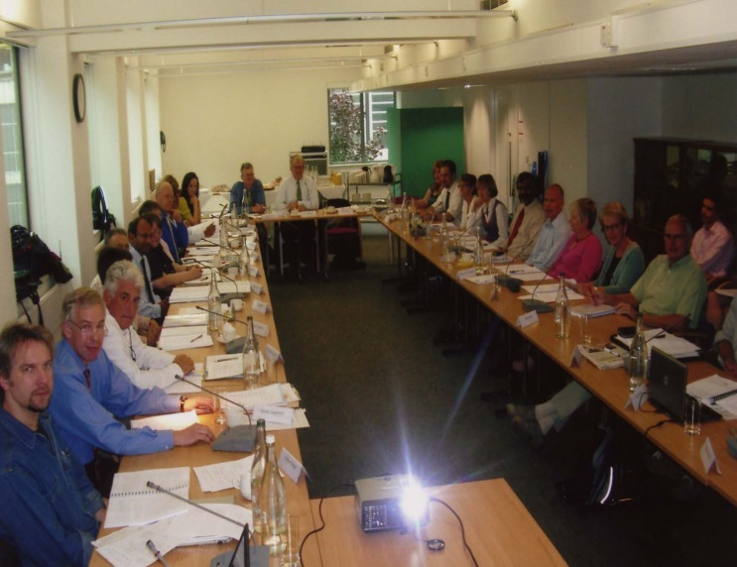
Who is involved?
Example of a care home guideline
Independent social worker
Service user x 2
Carer x 2
Managing Director, Home care organisation
Service Manager, Home care organisation
Chief Exec, UKHCA
CQC inspector
Director of Policy, Thinktank
Home care worker, Age UK
Project Manager, Sense
Director of Adult Social Care
Notes:
Our guidelines aren’t produced by NICE staff themselves but working groups of health and social care professionals, along with practitioners, technical experts and importantly also patients, service users, carers and members of the public.
Also have the option of inviting expert witnesses to provide expert advice in the absence of published evidence, and the option to call for evidence (ie ask stakeholders if they are aware of anything)
[Guideline Development Committee comprises – the chair, social care topic advisor, and technical and project management staff from NCCSC and NICE, members from the social care professions (providers and commissioners), other professionals if relevant, service user and carer members]
This image is of a guideline committee meeting prior to the pandemic. These committees now meet virtually but you can see the number of people who input into guideline development.

Slide 6
Some NICE examples…..
Managing medicines in care homes (SC1/QS85)
Managing medicines for adults receiving social care in the community (NG67/QS171)
Transition between inpatient hospital settings and community or care home settings for adults with social care needs (NG27)
Transition between inpatient mental health settings and community or care home settings (NG53/QS159)
Delirium: prevention, diagnosis and management (CG103/QS63)
Falls in older people: assessing risk and prevention (CG161/QS86)
Home care: delivering personal care and practical support to older people living in their own homes (NG21/QS123)
Intermediate care including reablement (NG74/QS173)
Mental wellbeing in over 65s: occupational therapy and physical activity interventions (PH16)
Mental wellbeing of older people in care homes (QS50)
Older people with social care needs and multiple long-term conditions (NG22)
Oral health for adults in care homes (NG48/QS151)
Pressure ulcers: prevention and management (CG179/QS89)
Safeguarding adults in care homes (NG189)

Slide 7
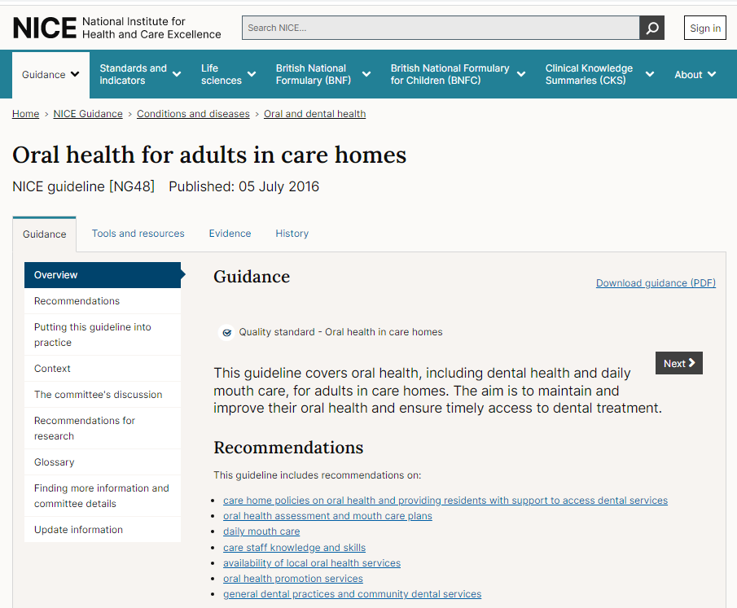
Notes:
Smiling matters:
52% of care homes visited had no policy to promote and protect people’s oral health
47% of care homes were not providing any staff training to support people’s daily oral healthcare
73% of residents’ care plans we reviewed only partly covered or did not cover oral health at all – homes looking after people with dementia being the most likely to have no plan in place
17% of care homes said they did not assess people’s oral health on admission
Aim is to maintain and improve their oral health and ensure timely access to dental treatment
Recommendations
Care home policies on oral health and providing residents with support to access dental services
General dental practices and community dental services
Oral health assessment and mouth care plans
Daily mouth care
Care staff knowledge and skills
Availability of local oral health services
Oral health promotion services

Slide 8
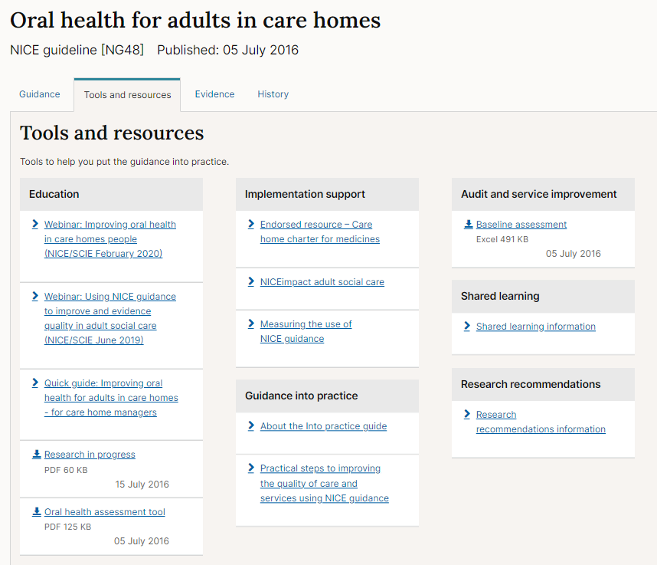
NHS Scotland’s Caring for Smiles: improving the oral health of adults in care settings in line with NICE Guidance and Quality Standards
The Oral Health Needs of Older People Living in Islington Nursing Homes.
Residential Oral Care Sheffield (ROCS): domiciliary dental care scheme to improve oral healthcare for patients in care homes
A Domiciliary Oral Health Improvement Practitioner for Vulnerable Adults linked to NHS General Dental Services Dental Domiciliary Care Services at Aneurin Bevan University Health Board
Notes:
The webinar provides:
an overview of the NICE guideline and support resources.
Links to CQC report
Case studies on how the guidance has been use to support improvement in practice
This webinar was led by:
Lindsey Deignan - Care home manager, Sheffield
Antony Hall - Head of Inspection for Primary Medical Services and Integrated Care in London, CQC
Margaret Naylor - Dentist, Sheffield.

Slide 9
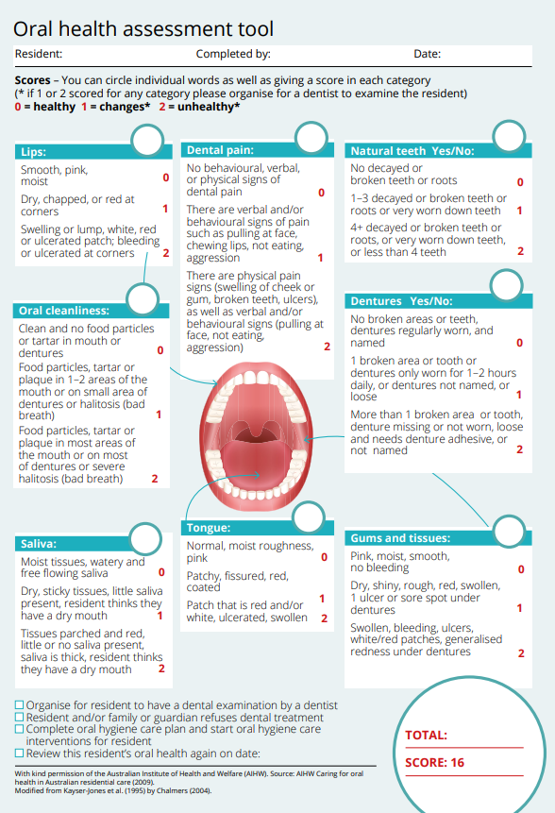
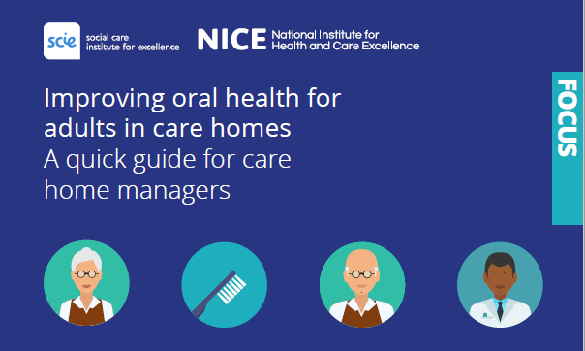
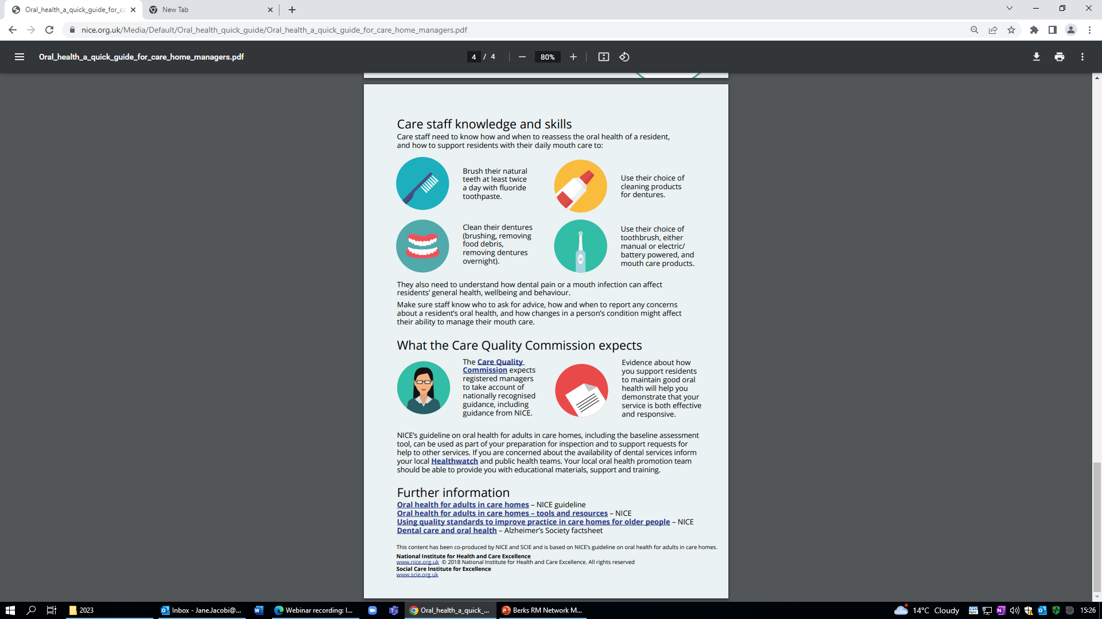
Includes:
Tips to help staff conduct oral health assessment
Handy assessment tool
Understanding how dental pain can affect residents’ general wellbeing
Notes:
Will improve oral health of residents
Can be staff training and development
Can be used for CQC evidence

Slide 10
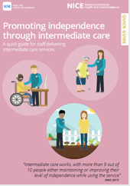

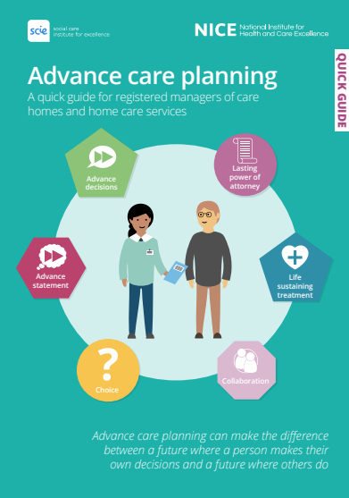
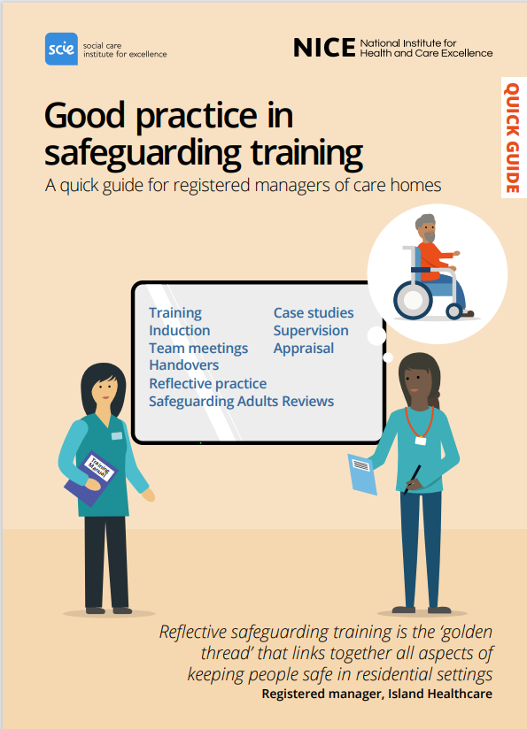





Quick guides: A quick, easy way to access key information from NICE on social care topics
Quick guides to social care topics | Social care | NICE Communities | About | NICE
Notes:
I thought it would be good to flag our very popular quick guides which are based on NICE guidelines and have been developed to give key information for social care topics in as simple, visual format. They have been used in a number of ways to support implementation of NICE and evidence based practice, including in team meetings, staff supervision and as a support tool for staff undertaking assessments e.g oral health in care homes.
Varied topics including:
Safeguarding - creating a safeguarding culture & good practice in training
Promoting positive mental wellbeing for older people
Medicines - giving covertly, effective record keeping and ordering, and discussing & planning medicines support
Advance care planning
Helping to prevent pressure ulcers
Dementia: discussing and planning support after diagnosis
Intermediate care - promoting independence through intermediate care, and understanding intermediate care, including reablement (for people using)
Helping to prevent infection
Moving between hospital and home
Recognising and preventing delirium
Improving oral health for adults in care homes
Better home care for older people
Recognising and responding to domestic violence and abuse
Helping to prevent winter deaths and illnesses associated with cold homes
What to expect during assessment and care planning (for people using adult social care services)
Latest ones published –
Creating a safeguarding culture
Good practice in safeguarding training
Support for unpaid carers’
Developing a positive working culture for supporting disabled children and young people with severe complex needs

Slide 11
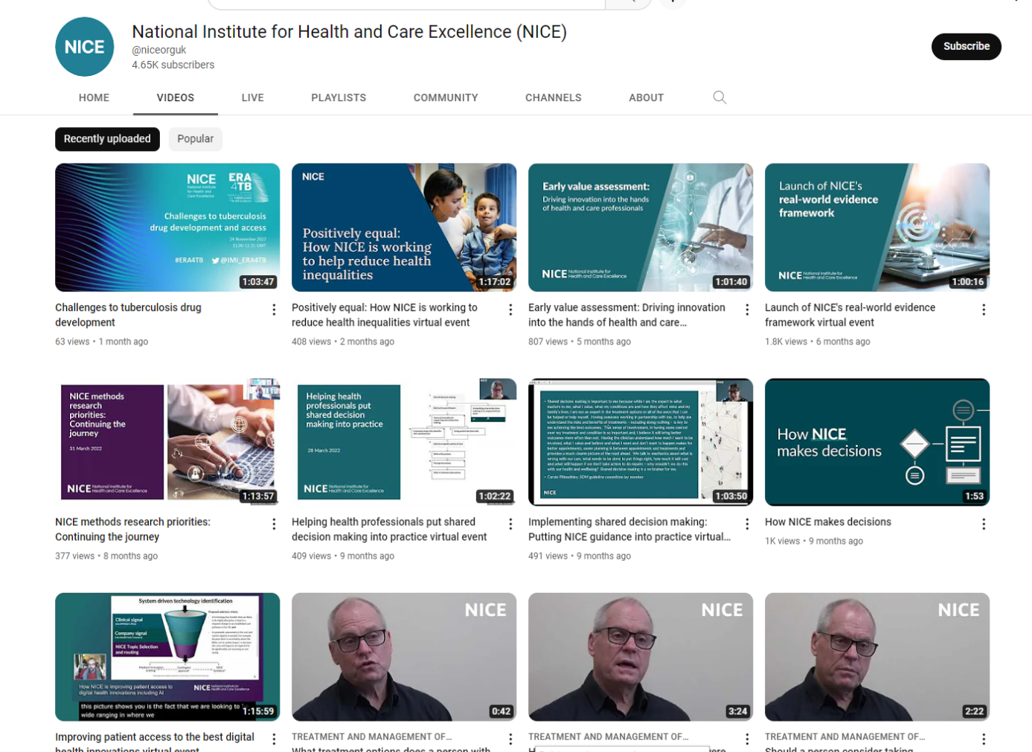






NICE YouTube channel - a collection of 47 videos covering:
NICE events
Conditions and diseases
Shared learning
NICE and what we do
www.youtube.com/user/NICEmedia

Slide 12
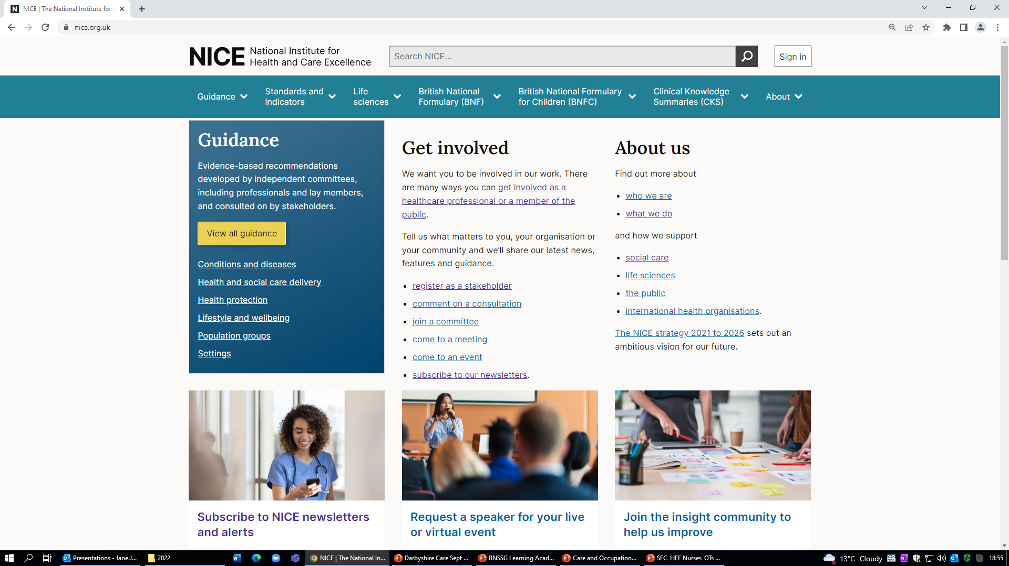
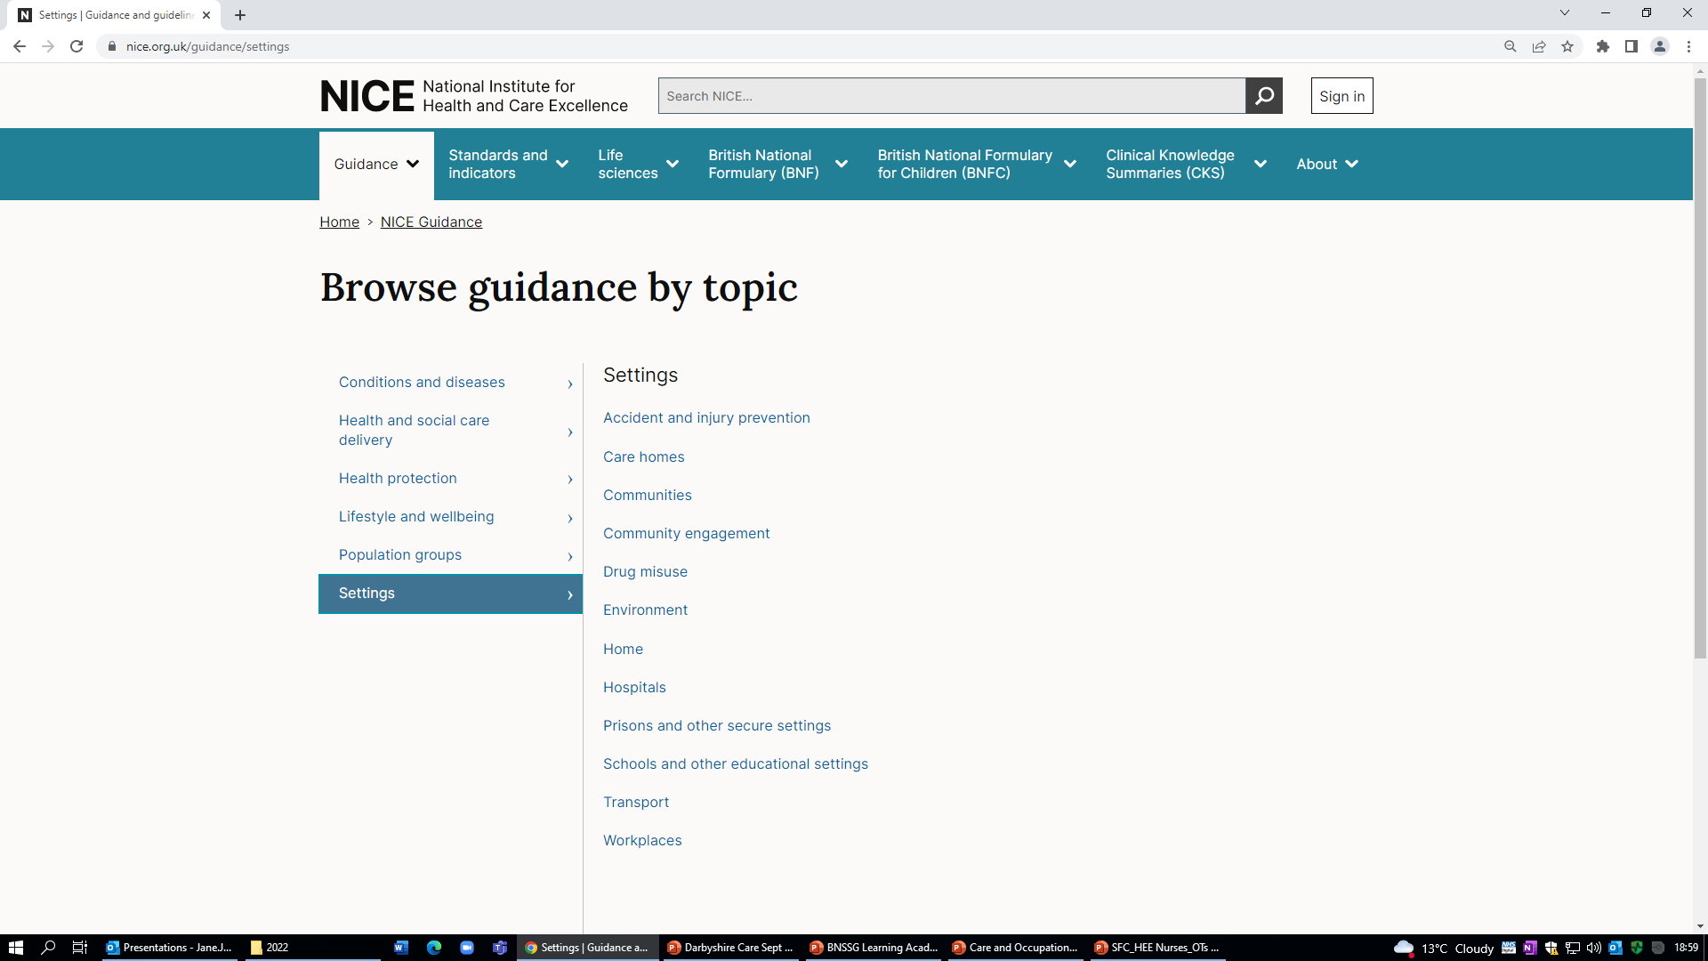
Notes:
This is the NICE homepage – our website. You can search by typing in words to the text box at the top.
You can also browse by area, looking at population groups such as: older people, people with learning disabilities or vulnerable groups. You can also search by setting such as: care homes and home.
If you click on care homes (next slide)…..

Slide 13
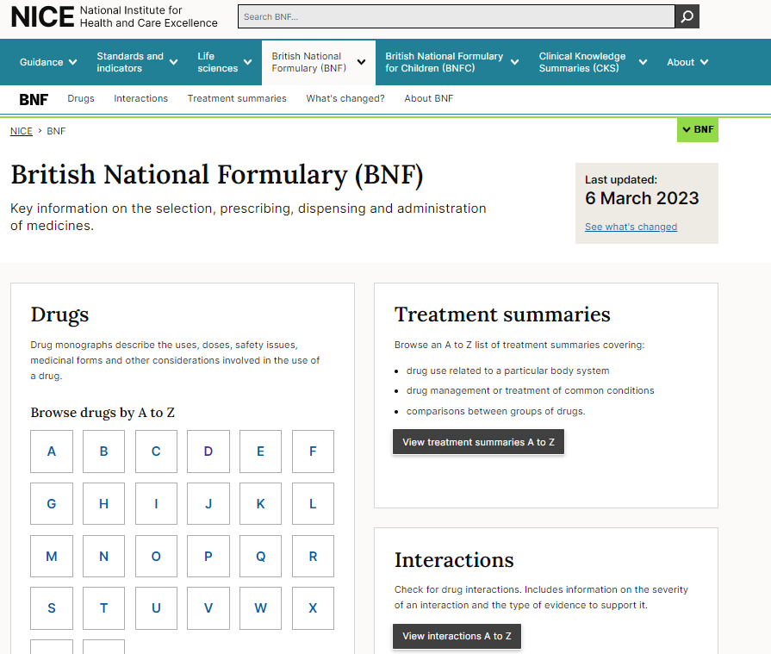
Notes:
This is the NICE homepage – our website. You can search by typing in words to the text box at the top.
You can also browse by area, looking at population groups such as: older people, people with learning disabilities or vulnerable groups. You can also search by setting such as: care homes and home.
If you click on care homes (next slide)…..

Slide 14



Guidelines and standards for medicines optimisation
Managing medicines in care homes (SC1) and Medicines management in care homes (QS85)
Managing medicines for adults receiving social care in the community (NG67), and Medicines management for people receiving social care in the community (QS171)
Medicines optimisation: the safe and effective use of medicines to enable the best possible outcomes (NG5)​
Notes:
An independent organisation, government funded, responsible for providing evidence-based guidance on health and social care.
Our guidance, standards and other resources help health, public health and social care professionals deliver the best possible care within the resources available. We review all the available evidence, publish recommendations to improve care - that reflect safe, effective and cost effective practice.
We work closely with local and national health and social care organisations including NHS England, CQC, Skills for Care and ADASS,. Together we encourage and support a quality and safety focused approach, in which commissioners and providers use NICE guidance and other NICE accredited sources to improve outcomes. Really it’s all about working together, using skills, judgement and evidence to help deliver lives better lived.

Slide 15
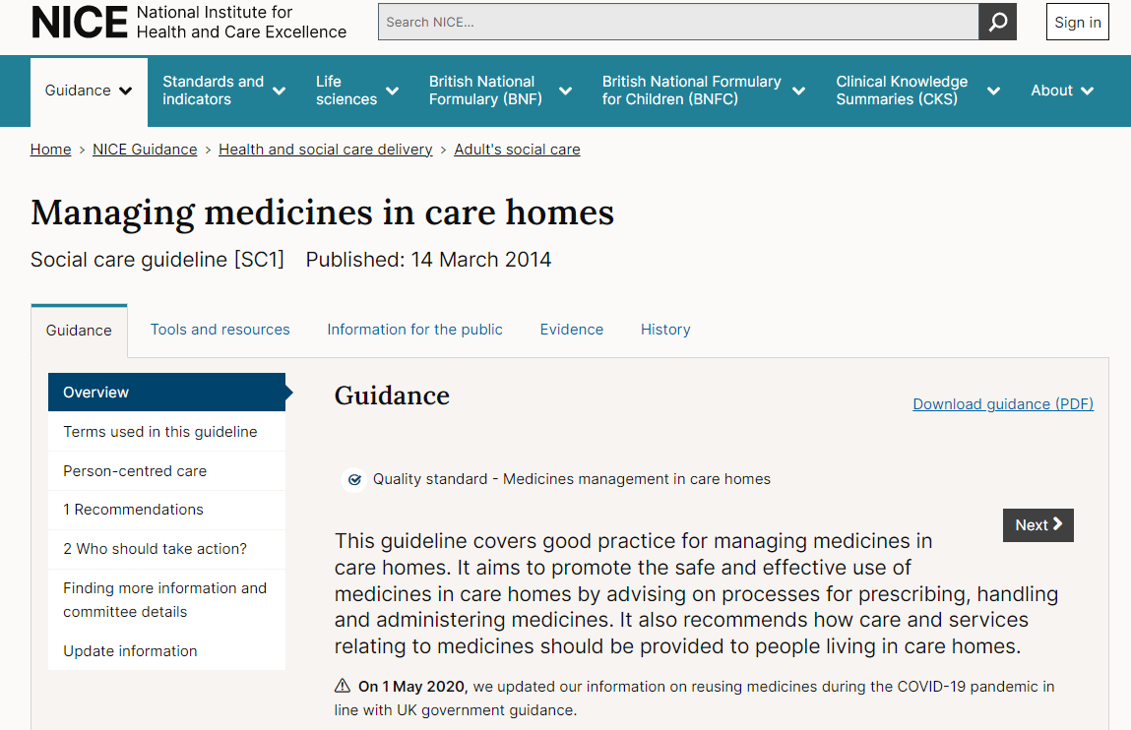

Notes:
Who is it for?
People who provide care in care homes, including care home staff (including nurses employed by the home), GPs, community nursing teams and specialist nurses
People who provide services to care homes, for example supplying pharmacies, GPs, dispensing doctors and appliance contractors
People who commission or monitor how care is provided in care homes, for example, local authorities, the Care Quality Commission (CQC) and the Office for Standards in Education, Children's Services and Skills (Ofsted)
People who live in care homes and their families and carers
Recommendations
This guideline includes recommendations on:
developing and reviewing policies for safe and effective use of medicines
supporting residents to make informed decisions and recording them
sharing information, record-keeping and medicines reconciliation
safeguarding and medicine-related problems
reviewing, prescribing, ordering and dispensing medicines, and receiving, storing and disposing of them
helping residents to take their own medicines
care home staff administering medicines (including covert administration) and non-prescription products
training and competency of care home staff

Slide 16
Managing medicines in care homes (SC1)
Covers good practice for managing medicines in care homes
It aims to promote the safe and effective use of medicines in care homes by advising on processes for prescribing, handling and administering medicines
Also recommends how care and services relating to medicines should be provided to people living in care homes
The starting point for this guideline is that residents should have the same involvement in decisions about their care and treatment, and the right to access appropriate services and support equivalent to those who do not live in care homes
Notes:
Expanding a little…… our guidance is based on the best available evidence and is produced collaboratively by experts, service users, people using services , carers and the wider public. It is subject to consultation and, when necessary challenge.
Covers a wide range of topics, from preventing and managing specific conditions, improving health, and managing medicines in different settings, to providing social care and support to adults and children, and planning broader services and interventions to improve the health of communities.
Our guidance is used to help inform decisions about patient care and also much more widely – for informing commissioning and business planning, health inequalities, specific programmes (for example CVD prevention), and also learning and development.
Very much supporting a shared view of quality across health and care.

Slide 17
Topics covered in the guideline (1)
Developing and reviewing policies for safe and effective use of medicines
Supporting residents to make informed decisions and recording these decisions
Sharing information about a resident's medicines
Ensuring that records are accurate and up to date
Identifying, reporting and reviewing medicines-related problems
Keeping residents safe (safeguarding)
Accurately listing a resident's medicines (medicines reconciliation)
Reviewing medicines (medication review)
Notes:
1.1 Developing and reviewing policies for safe and effective use of medicines
1.2 Supporting residents to make informed decisions and recording these decisions
1.3 Sharing information about a resident's medicines
1.4 Ensuring that records are accurate and up to date
1.5 Identifying, reporting and reviewing medicines-related problems
1.6 Keeping residents safe (safeguarding)
1.7 Accurately listing a resident's medicines (medicines reconciliation)
1.8 Reviewing medicines (medication review)

Slide 18
Topics covered in the guideline (2)
Prescribing medicines
Ordering medicines
Dispensing and supplying medicines
Receiving, storing and disposing of medicines
Helping residents to look after and take their medicines themselves (self-administration)
Care home staff administering medicines to residents
Care home staff giving medicines to residents without their knowledge (covert administration)
Care home staff giving non-prescription and over-the-counter products to residents (homely remedies)
Training and skills (competency) of care home staff
Notes:
1.9 Prescribing medicines
1.10 Ordering medicines
1.11 Dispensing and supplying medicines
1.12 Receiving, storing and disposing of medicines
1.13 Helping residents to look after and take their medicines themselves (self-administration)
1.14 Care home staff administering medicines to residents
1.15 Care home staff giving medicines to residents without their knowledge (covert administration)
1.16 Care home staff giving non-prescription and over-the-counter products to residents (homely remedies)
1.17 Training and skills (competency) of care home staff

Slide 19
Managing medicines in care homes: key points (1)
The recommendations were developed using relevant legislation, guidance, policy and published evidence
When aimed at an individual or organisation this is specified
Arrangements vary:
  Local organisational structures
  How services are commissioned or provided
  What resources are available
Notes:
1.9 Prescribing medicines
1.10 Ordering medicines
1.11 Dispensing and supplying medicines
1.12 Receiving, storing and disposing of medicines
1.13 Helping residents to look after and take their medicines themselves (self-administration)
1.14 Care home staff administering medicines to residents
1.15 Care home staff giving medicines to residents without their knowledge (covert administration)
1.16 Care home staff giving non-prescription and over-the-counter products to residents (homely remedies)
1.17 Training and skills (competency) of care home staff

Slide 20
Managing medicines in care homes: key points (2)
People living in care homes have the same rights as the rest of us
NHS constitution
Treatment and care – based on individual’s needs and preferences
Residents should have the opportunity to make informed decisions about their care
Person-centred care important (safeguarding and mental capacity issues)
Helping residents to look after and take their own medicines
Retain independence
Individual risk assessment (level of support)
Notes:
People living in care homes have the same rights in relation to NHS care as the rest of us, as set out in the NHS Constitution.
Care homes residents should have the opportunity to make informed decisions about their care and treatment.
Person-centred care is important.
Helping residents to look after and take their own medicines helps them retain their independence.
When a person moves into a care home, staff should assume they can manage their own medicines, unless indicated otherwise.
Each resident should have an individual risk assessment to determine the support they need to manage their own medicines.
Care home providers should have a medicines policy which includes written processes for the safe and effective use of medicines
Risk assessment of residents ability to self manage medication might cover;
- resident choice
– whether self‑administration will be a risk to the resident or to other residents
– whether the resident can take the correct dose of their own medicines at the right time and in the right way (for example, do they have the mental capacity and manual dexterity for self-administration?)
– how often the assessment will need to be repeated based upon individual resident need
– how the medicines will be stored
– the responsibilities of the care home staff, which should be written in the resident's care plan (such as reminding the resident to self-administer or assisting residents with certain medicines)?
The process should detail who will be responsible for coordinating, and who will be involved in, risk assessment

Slide 21

Care Home Medicines Policy
Storing and sharing information (including transfers)
Keeping accurate records
Problem identification and reporting
Safeguarding residents
Medicines reconciliation and review
Ordering and disposing of medicines
Stock control of medicines
Administration of medicines (by resident, staff and covertly)
Staff training and competency
Non-prescription medicines (homely remedies)
NICE has published a ‘checklist’ to help you put a local policy in place
Notes:
Recommendations:
1.1.1 Commissioners and providers (organisations that directly provide health or social care services) should review their policies, processes and local governance arrangements, making sure that it is clear who is accountable and responsible for using medicines safely and effectively in care homes.
1.1.2 Care home providers should have a care home medicines policy, which they review to make sure it is up to date, and is based on current legislation and the best available evidence. The policy should include written processes for:
sharing information about a resident's medicines, including when they transfer between care settings
ensuring that records are accurate and up to date
identifying, reporting and reviewing medicines‑related problems
keeping residents safe (safeguarding)
accurately listing a resident's medicines (medicines reconciliation)
reviewing medicines (medication review)
ordering medicines
receiving, storing and disposing of medicines
helping residents to look after and take their medicines themselves (self‑administration)
care home staff administering medicines to residents, including staff training and competence requirements
care home staff giving medicines to residents without their knowledge (covert administration)
care home staff giving non-prescription and over‑the‑counter products to residents (homely remedies), if appropriate.

Slide 22
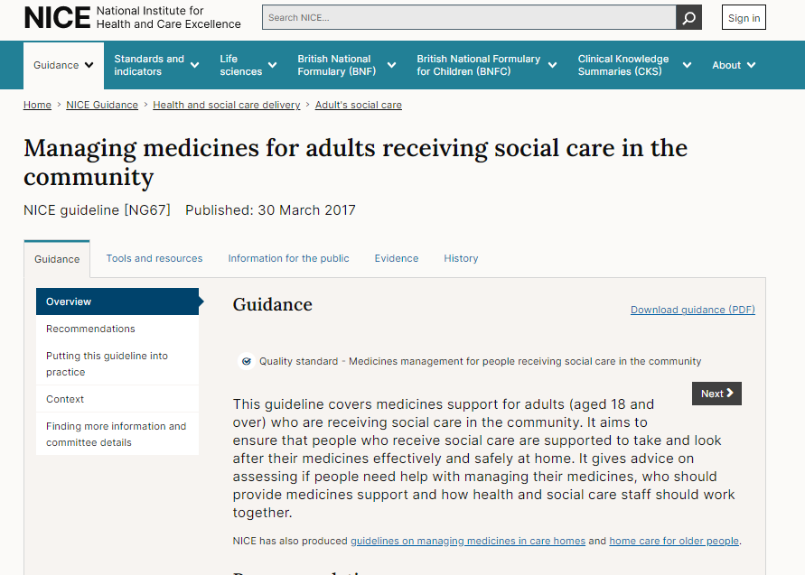

Notes:
Who is it for?
Social care practitioners (including care workers and social workers) providing care for people in the community
Health professionals providing care for people receiving social care in the community, and their support staff
Commissioners and providers of services for people receiving social care in the community
People receiving social care in the community, their families and carers
Recommendations
This guideline includes recommendations on:
governance arrangements and joint working between health and social care
assessing medicines support needs
supporting people to take their medicines, including covert administration and managing concerns
staff training and competency
sharing medicines information and record keeping
safely ordering and supplying medicines and transporting, storing and disposing of medicines

Slide 23

Managing medicines for adults receiving social care in the community (NG67)
Covers medicines support for adults (aged 18 and over) who are receiving social care in the community
It aims to ensure that people who receive social care are supported to take and look after their medicines effectively and safely at home
Gives advice on assessing if people need help with managing their medicines, who should provide medicines support and how health and social care staff should work together
Notes:
Expanding a little…… our guidance is based on the best available evidence and is produced collaboratively by experts, service users, people using services , carers and the wider public. It is subject to consultation and, when necessary challenge.
Covers a wide range of topics, from preventing and managing specific conditions, improving health, and managing medicines in different settings, to providing social care and support to adults and children, and planning broader services and interventions to improve the health of communities.
Our guidance is used to help inform decisions about patient care and also much more widely – for informing commissioning and business planning, health inequalities, specific programmes (for example CVD prevention), and also learning and development.
Very much supporting a shared view of quality across health and care.

Slide 24
Topics covered in the guideline
Governance for managing medicines safely and effectively
Assessing and reviewing a person's medicines support needs
Joint working between health and social care
Sharing information about a person's medicines
Ensuring that records are accurate and up to date
Managing concerns about medicines
Supporting people to take their medicines
Giving medicines to people without their knowledge (covert administration)
Ordering and supplying medicines
Transporting, storing and disposing of medicines
Training and competency
Notes:
1.1 Developing and reviewing policies for safe and effective use of medicines
1.2 Supporting residents to make informed decisions and recording these decisions
1.3 Sharing information about a resident's medicines
1.4 Ensuring that records are accurate and up to date
1.5 Identifying, reporting and reviewing medicines-related problems
1.6 Keeping residents safe (safeguarding)
1.7 Accurately listing a resident's medicines (medicines reconciliation)
1.8 Reviewing medicines (medication review)

Slide 25

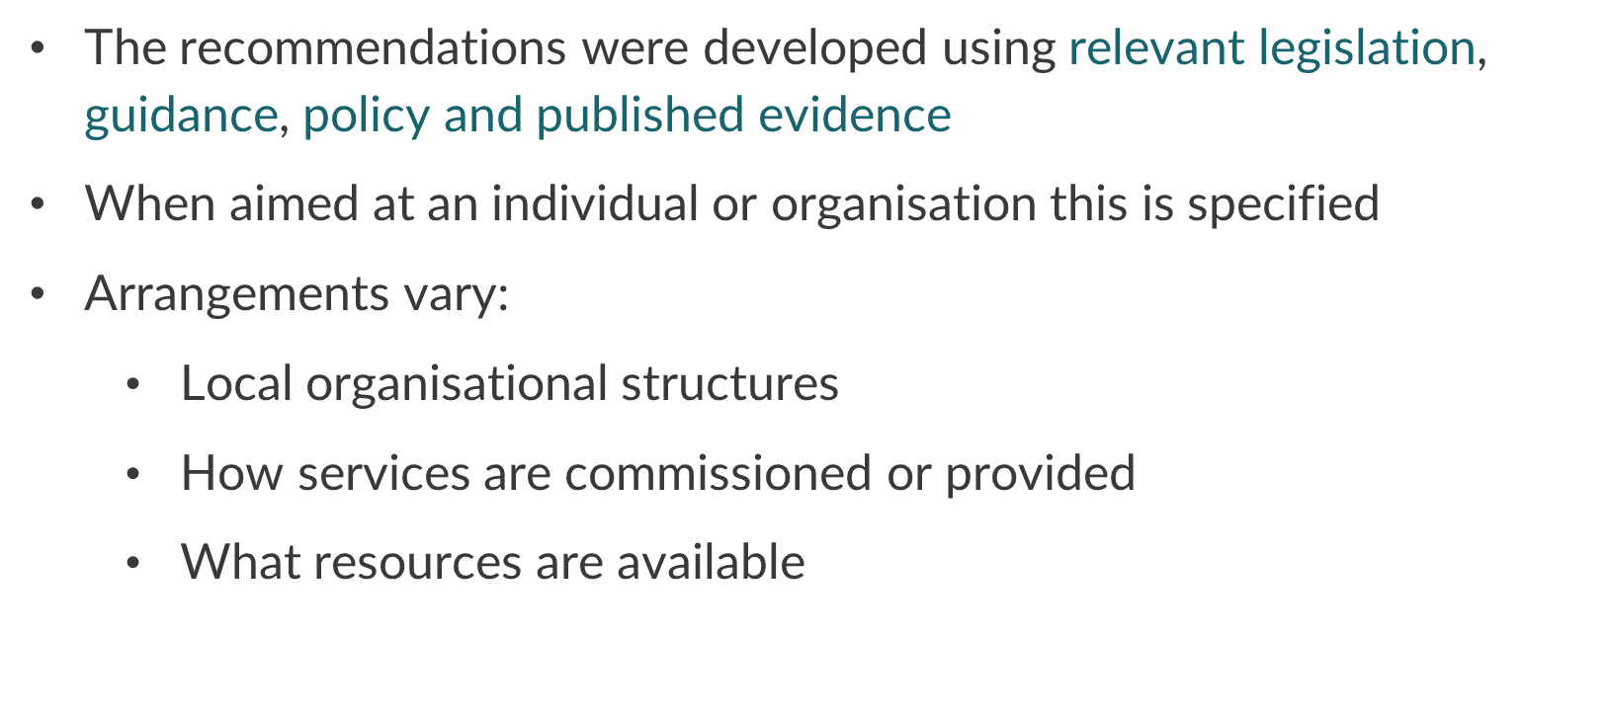
Notes:
1.9 Prescribing medicines
1.10 Ordering medicines
1.11 Dispensing and supplying medicines
1.12 Receiving, storing and disposing of medicines
1.13 Helping residents to look after and take their medicines themselves (self-administration)
1.14 Care home staff administering medicines to residents
1.15 Care home staff giving medicines to residents without their knowledge (covert administration)
1.16 Care home staff giving non-prescription and over-the-counter products to residents (homely remedies)
1.17 Training and skills (competency) of care home staff

Slide 26
Emphasis is on safe systems and processes for managing medicines to minimise the risk of medicines related harm, such as:
  The requirement for joint working between health and social care
  Sharing information about a person’s medicines support including notifying their GP and community pharmacy
Includes recommendations on a ‘person-centred approach’
  Sharing any concerns about a person’s medicines
  Supporting people to take their medicines, for example the 6 rights (‘6Rs’) of administration
Also provides context around relevant legislation
Notes:
People living in care homes have the same rights in relation to NHS care as the rest of us, as set out in the NHS Constitution.
Care homes residents should have the opportunity to make informed decisions about their care and treatment.
Person-centred care is important.
Helping residents to look after and take their own medicines helps them retain their independence.
When a person moves into a care home, staff should assume they can manage their own medicines, unless indicated otherwise.
Each resident should have an individual risk assessment to determine the support they need to manage their own medicines.
Care home providers should have a medicines policy which includes written processes for the safe and effective use of medicines
Risk assessment of residents ability to self manage medication might cover;
- resident choice
– whether self‑administration will be a risk to the resident or to other residents
– whether the resident can take the correct dose of their own medicines at the right time and in the right way (for example, do they have the mental capacity and manual dexterity for self-administration?)
– how often the assessment will need to be repeated based upon individual resident need
– how the medicines will be stored
– the responsibilities of the care home staff, which should be written in the resident's care plan (such as reminding the resident to self-administer or assisting residents with certain medicines)?
The process should detail who will be responsible for coordinating, and who will be involved in, risk assessment

Slide 27
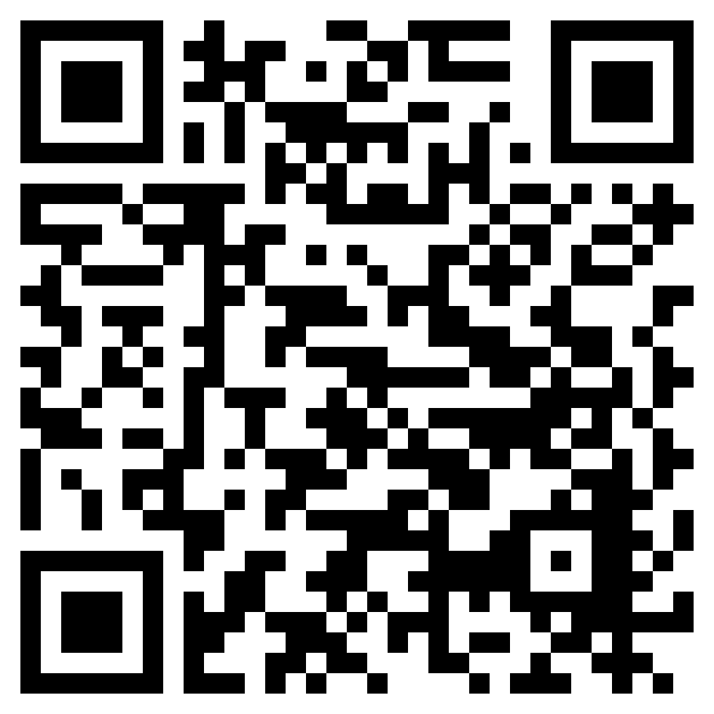





Staying up to date
Visit our website www.nice.org.uk
Sign up for our monthly newsletters using the QR code
Contact our enquiry team nice@nice.org.uk
Contact the field team jane.moore@nice.org.uk
Visit our social channels - Twitter, Facebook, LinkedIn, YouTube and Instagram
27
Notes:
Our field team has extensively delivered bespoke sessions for different audiences across health and social care, often joining up with key partners to do so (e,g NHSE, SfC, CQC, SWE.)
For example –
General introductory sessions about NICE, supporting quality in practice
Registered Manager Networks & Social Care providers – varied topical sessions for example safeguarding, advanced care planning, oral health in care homes, dementia, mental wellbeing of older persons, caring for persons with learning disabilities & autism, supporting CQC preparedness, medicines management & optimisation (linking in with our Medicines Implementation Consultants)
Regulated professionals – NICE supporting CPD, evidence based practice and registration revalidation (social workers, nurses community of practice)

Slide 28






What can I do next?
Reflect on your/team awareness and use of relevant NICE guidelines and standards. Choose one to explore in a team meeting
Sign up to NICE newsletter
Consider how NICE tools and resources can support you in your role
Consider having a NICE champion in your team
Watch some of the videos on the NICE youtube channel
Complete a CPD log to evidence your learning
Notes:
What actions will you take as a result of today’s session?
These are all things you can log as CPD
Please let us know in chat if you are willing to share a case example on how you are using NICE guidance

