Slide 1

Medicines optimisation in Social Care
Simon Hill,
Medicines Manager, CQC
LCAS Forum 22 March 2023

Slide 2
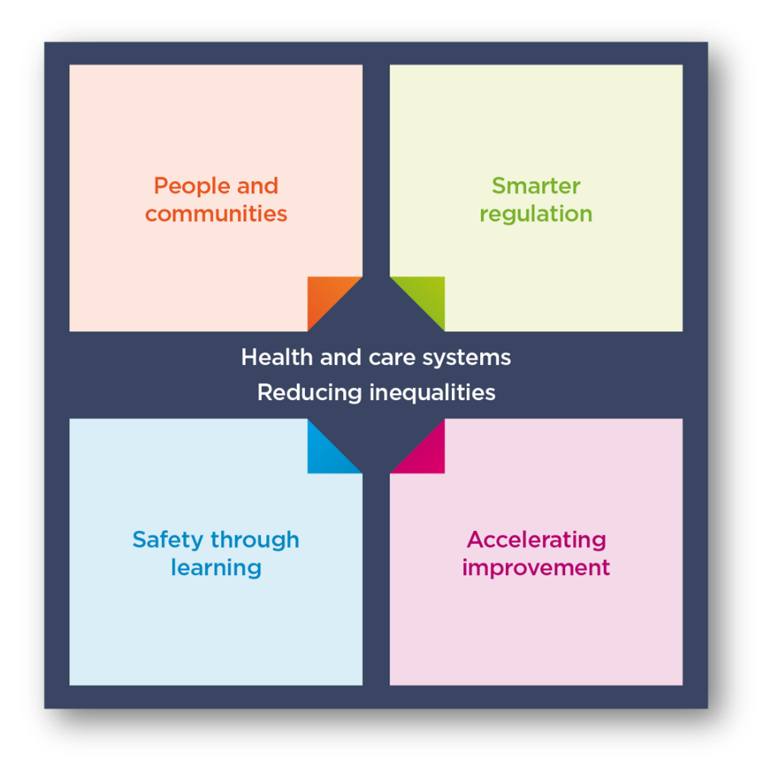
Our new strategy: key themes
We’ll implement our new strategy over the next five years so we can be flexible and adapt to changes in health and care.
Notes:
I am sure all of you are familiar with the CQC and what we do.
For those who are not – we are the independent regulator for health and adult social care in England.
We make sure the health and social care providers provide patients and service users with
Safe, effective, compassionate and high quality care.
And where they do not encourage them to improve.
Our strategy is built on four themes that together determine the changes we want to make. Running through each theme is our ambition to improve people’s care by looking at how well health and care systems are working and how they’re acting to reduce inequalities.
Our aim is to implement our new strategy over the next three to five years. To enable us to be as flexible as possible and adapt to changes in health and care, we’ll review it when we need to.
People and communities
Our regulation should be driven by people’s experiences and what they expect and need from health and care services, rather than how providers want to deliver them.
We want people to always feel listened to, understood, and to know how we’ve acted on what they’re telling us.
We want our information to help people make decisions about care, to enable and empower them to drive change.
We'll identify and call out unwarranted variation and inequalities in health and care.
Smarter regulation
Collecting and sharing information digitally reduce duplication, and make it easier to work with all
Using that information, moving away from relying a set schedule of inspections
Targeting resources to be effective, proportionate and efficient
Learning and improving ourselves to be flexible and responsive, while still keeping more people safe.
Safety through learning
Safety is a key concern as it is consistently the poorest area of performance in our assessments. We want to promote open cultures where the voice of health and care staff and people who use services drives learning and improvement.
Services must promote stronger safety cultures, with people’s safety as their top priority, and minimising avoidable harm
Encouraging services to focus on protecting people by enforcing safety standards and their human rights
Developing solutions to ensure all services have support, leadership, and expertise
Accelerating improvement
The support available to help services improve the quality of their care varies between and within health and care sectors. We will do more with what we know to drive improvements across individual services and systems of care.

Slide 3
A New Regulatory Model
Model: Now
Assessment frameworks (multiple) | Ongoing monitoring but inspections schedule based on previous rating | Inspection: gather evidence using KLOEs (Single point in time) | Develop judgements (offline) Line-up judgements against ratings characteristics | Publish narrative inspection report
Single assessment framework | Ongoing assessment of quality and risk | Not just inspection - variety of options (multiple points in time) – more time spent in higher risk services | Team rating based on evidence found | Ratings updated, short statement published
Process
Model: Future
Notes:
Currently a number of inspection frameworks, detailed and complex - lots of duplication.
Move to a single framework and a single set of expectations and definition of quality across health and social care and systems.
Move away from inspection frequency based on rating to an approach of continual assessment - ability to update ratings and judgements more dynamically to respond quicker to risk and improvement.
Inspection and site visits will always be part of our approach – but with increased monitoring.
Site visits won’t always be required to gather evidence - more for observing care, how staff interact with people, how equipment used, what the environment is like - really get a feel of the service
Move away from long narrative reports to shorter reporting on findings and ratings updated.
Why we’re changing
There are three main reasons why we need to change:
We need to make things simpler so we can focus on what really matters to people.
We need to better reflect how care is actually delivered by different types of service as well as across a local area.
We need one framework that connects our registration activity to our assessments of quality

Slide 4
A single assessment framework
Our framework will assess providers, local authorities and integrated
care systems with a consistent set of key themes, from registration
through to ongoing assessment
5 Key Questions
Quality Statements
Evidence
Specific evidence and quality indicators
Aligned with “I” statements, based on what people expect and need, to bring these questions to life and as a basis for gathering structured feedback​
Expressed as “We” statements; the standards against which we hold providers, LAs and ICSs to account​
People’s experience​, feedback from staff and leaders​, feedback from partners, observation, processes, outcomes
Data and information specific to the scope of assessment, delivery model or population group
Underpinned by best practice standards and guidance​
Notes:
What’s different
We’ve already confirmed that our quality ratings and five key questions will stay central to our approach. But we’re replacing our existing key lines of enquiry (KLOEs) and prompts with new ‘quality statements’. These will reduce the duplication that’s in our four current separate assessment frameworks to allow us to focus on specific topic areas under each key question, and will link to the relevant regulations to make it easier for providers.
We call the quality statements ‘we statements’ as they’re written from a provider’s perspective to help them understand what we expect of them. They draw on previous work developed with Think Local Act Personal (TLAP), National Voices and the Coalition for Collaborative Care on Making it Real. We wanted to maintain that ethos when developing our assessment framework.
Importantly, we’ll base our assessments of quality in all types of services, and at all levels, on this single assessment framework. For local authorities and integrated care systems, we will use a subset of the quality statements being published today.
To make our judgements more structured and consistent, we have also developed six categories for the evidence we collect:
people’s experiences
feedback from staff and leaders
observations of care
feedback from partners
processes
outcomes of care.
We want to be clearer with providers and the public about how we use the information we have about care in a service or local area. So, for each quality statement we’ll state which evidence we will always need to collect and look at. This will vary depending on the type of service. For example, the evidence we can collect for GP practices will be different to what we’ll have available when assessing a home care service. It will also depend on the level at which we’re assessing. For example, the evidence we have when a new service is registering for the first time will be different from a service that has been operating for a while.
To fulfil the ambitions in our strategy, the assessment framework emphasises the need to create cultures that learn and improve, and we set expectations for how services and providers need to work together, and within systems, to plan and deliver safe, person-centred care.

Slide 5
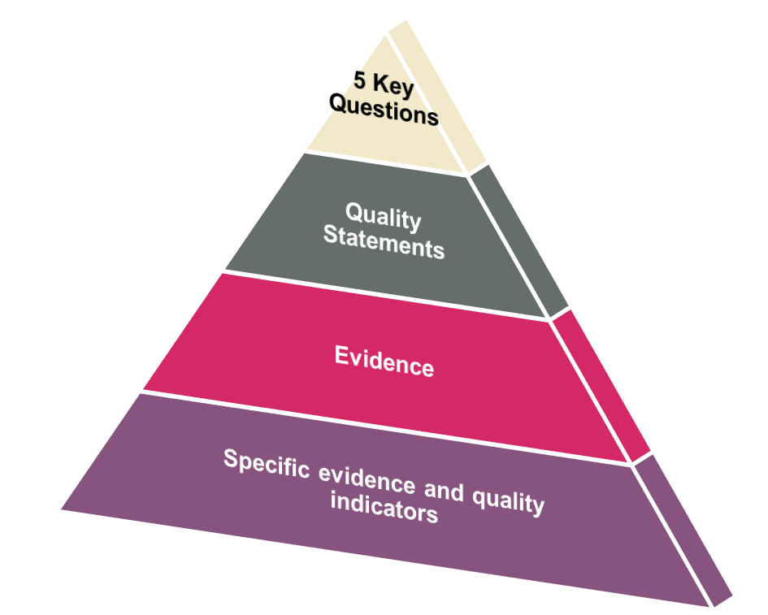
How will we inspect medicines?
Key question: Safe
I feel safe and am supported to understand and manage any risks
Quality statement: Medicines optimisation
We make sure that medicines and treatments are safe and meet people’s needs, capacities and preferences by enabling them to be involved in planning , including when changes happen.
Evidence categories: talking to people and staff, observations of medicines administration, review of medicines records
Specific evidence and quality indicators: refer to best practice guidance NICE SC1 and NG67
Notes:
Key question: Safe
I feel safe and am supported to understand and manage any risks.
Safety is a priority for everyone and leaders embed a culture of openness and collaboration. People are always safe and protected from bullying, harassment, avoidable harm, neglect, abuse and discrimination. Their liberty is protected where this is in their best interests and in line with legislation.
Where people raise concerns about safety and ideas to improve, the primary response is to learn and improve continuously. There is strong awareness of the areas with the greatest safety risks. Solutions to risks are developed collaboratively. Services are planned and organised with people and communities in a way that improves their safety across their care journeys. People are supported to make choices that balance risks of harm with positive choices about their lives. Leaders ensure there are enough skilled people to deliver safe care that promotes choice, control and individual wellbeing.
Quality statements
Learning culture
Safe systems, pathways and transitions
Safeguarding
Involving people to manage risks
Safe environments
Safe and effective staffing
Infection prevention and control
Medicines optimisation: We make sure that medicines and treatments are safe and meet people’s needs, capacities and preferences by enabling them to be involved in planning, including when changes happen.
Related to regulations 9 – person centred care, 12 – safe care and treatment and 11 need for consent
Evidence categories
People’s experience of health and care services - We define people’s experiences as: “a person’s needs, expectations, lived experience and satisfaction with their care, support and treatment. This includes access to and transfers between services”.
Feedback from staff and leaders
Feedback from partners – e.g. commissioners, professional regulators, multi-agency bodies
Observations - We can observe the quality of care either off-site, on-site, or a combination of both. We continue to call on-site visits to gather evidence inspections. Offsite e.g. remote interviews with staff, Healthwatch, using experts by experience to take to people, familes and carers. Onsite via inspection.
Processes – e.g. incidents, notifications, review of care records
Outcomes - focused on the impact of care processes on individuals. They cover how care has affected people’s physical, functional or psychological status.

Slide 6
Health and Social Care Act 2008 (Regulated Activities) Regulations 2014​
Regulations
12 (1)​ Care and treatment must be provided in a safe way for service users​
​12 (2) without limiting paragraph (1) the things which a registered person must do to comply with that paragraph include:​​
12(2) (g) the proper and safe use of medicines​
9: Person-centred care​
10: Dignity and respect​
11: Need for consent​
13: Safeguarding service users from abuse and improper treatment​
14: Meeting nutritional and hydration needs​
17: Good governance​
18: Staffing​
Notes:
So, we are going to spend the next session looking at medicines optimisation quite broadly. And considering why CQC have a medicines team and what we do.
Errors can occur at different stages of the medicines use process and can cause significant harm to people.
This 2017 study from the Policy research unit in economic methods of evaluation in health and social care interventions (EEPRU) found that there are 237 million medicines errors in the NHS in England each year.
Of which 28% cause moderate or serious harm
Causing 712 deaths and contributing to an additional 1700
But his only tells us about the NHS. There is no national data set that collates medicines incidents that occur in social care or any subsets that identify medicines errors in children.
World Health Organisation global patient safety challenge ‘Medication Without Harm’ aims to reduce severe avoidable medication-related harm by 50%, globally in the next 5 years. Launched in March 2017
Medication errors occur when weak medication systems and/or human factors such as fatigue, poor environmental conditions or staff shortages affect prescribing, transcribing, dispensing, administration and monitoring practices, which can then result in severe harm, disability and even death. Medicines optimisation is a framework around which safer medicines practice can be put in place to deliver the best outcome for people.

Slide 7

Medicines errors
Medicines errors can include prescribing, dispensing, administration and monitoring errors.
237 million medicines errors occur in the NHS in England every year
68.3 million errors (28% of total) cause moderate or serious harm
Causing 712 deaths, and contributing to 1,708 deaths
But what about social care services?
?
EEPRU report - PREVALENCE AND ECONOMIC BURDEN OF MEDICATION ERRORS IN THE NHS IN ENGLAND November 2017*
Notes:
So, we are going to spend the next session looking at medicines optimisation quite broadly. And considering why CQC have a medicines team and what we do.
Errors can occur at different stages of the medicines use process and can cause significant harm to people.
This 2017 study from the Policy research unit in economic methods of evaluation in health and social care interventions (EEPRU) found that there are 237 million medicines errors in the NHS in England each year.
Of which 28% cause moderate or serious harm
Causing 712 deaths and contributing to an additional 1700
But his only tells us about the NHS. There is no national data set that collates medicines incidents that occur in social care or any subsets that identify medicines errors in children.
World Health Organisation global patient safety challenge ‘Medication Without Harm’ aims to reduce severe avoidable medication-related harm by 50%, globally in the next 5 years. Launched in March 2017
Medication errors occur when weak medication systems and/or human factors such as fatigue, poor environmental conditions or staff shortages affect prescribing, transcribing, dispensing, administration and monitoring practices, which can then result in severe harm, disability and even death. Medicines optimisation is a framework around which safer medicines practice can be put in place to deliver the best outcome for people.

Slide 8
PIR & Notifications
The provider information return asks:
How many medicines errors have you had in the past 12 months?
Around 44% of responses said ‘zero’
Currently, CQC need to be notified of a medicines error if the cause or effect of a medicine error met the criteria to notify us of one of the following:
A death
An injury
Abuse, or an allegation of abuse
An incident reported to or investigated by the police
Notes:
Recording errors:
Residential 47.2% said 0
Community 38.3% said 0
Administration errors:
Residential 42.9% said 0
Community 39.3% said 0
From a statistical point of view, we appreciate that medicines errors are inevitable, however we are keen to see how ‘leadership within an organisation promotes an open and honest safety culture that supports the safe and secure handling of medicines’. Whilst a single medicines error may result in no harm, a number of the same type of medicines errors being made in quick succession within the same organisation may prompt further investigation / root cause analysis.
From NHS England’s NRLS page guidance:
A ‘low’ reporting rate from an organisation should not be interpreted as a ‘safe’ organisation and may represent under-reporting. Subsequently, a ‘high’ reporting rate should not be interpreted as an ‘unsafe’ organisation and may actually represent a culture of greater openness.
Therefore, providers are encouraged to report medicines errors, unless a clinical / medical review has determined that there has been no harm to the person.

Slide 9
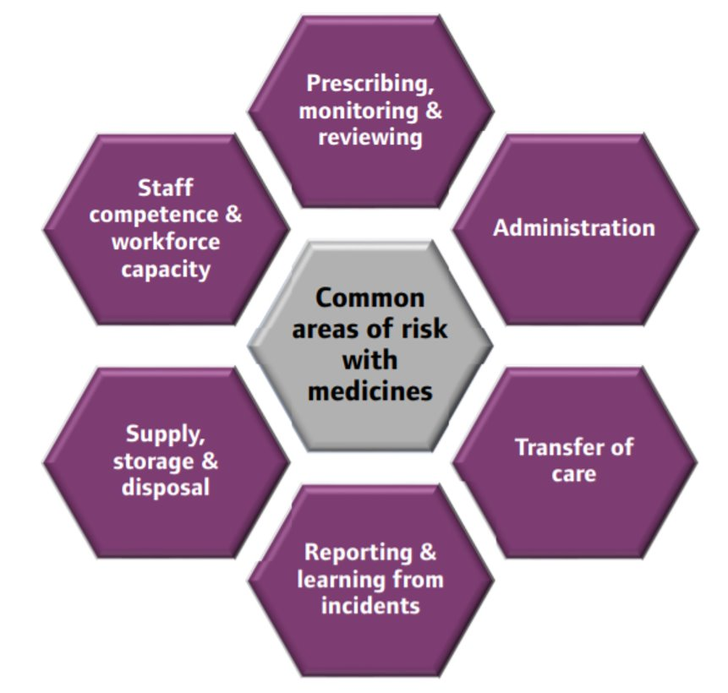
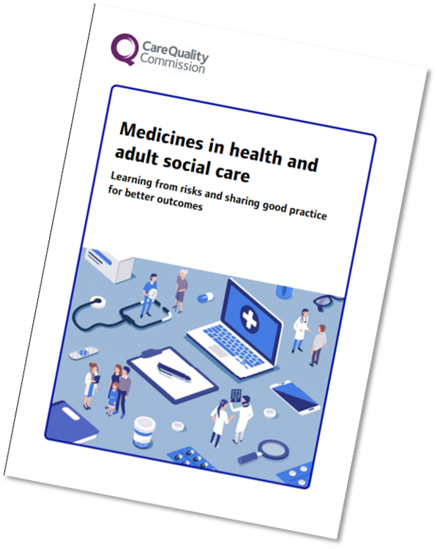
Medicines in health and adult social care
Notes:
Many of the services that CQC regulates have a role in managing medicines. From inspections we have seen that medicines pose a clear risk to people when not used appropriately. Our report on Medicines in health and adult social care raised important issues for everybody involved with medicines in all health and adult social care settings. We found there were six common areas of risk across all health and adult social care settings:
Prescribing, monitoring and reviewing ​
Professionals are responsible for the prescriptions they sign and for their decisions and actions when supplying and administering medicines, or authorising or instructing others to do so.​
Prescribers and pharmacists supplying medicines have a responsibility to keep patients safe and to tell them about any risks in using a medicine. ​
Medicines reviews should be timely​
Monitoring - initial prescribing and over the long term. ​
​
Administration ​
Risks with admin across all sectors. ​
Missed and incorrect doses of medicines (including inadvertent repeated doses) and poorly managed covert and ‘when required’ administration, which results in poorer outcomes. ​
Problems when people self-administered their medicines when not appropriate ​
People not always supported to self-administer when they were able to. ​
Poor record keeping, including incorrectly transcribed medicines administration records and failure to record administration​
​
Transfer of care ​
People use both health and social care services. ​
For best results, local care services should work together to provide joined-up and person-centred care – this varies.​
Medicines should not be considered in isolation, but as an integral part of the person’s pathway, and at each step. ​
​
Reporting and learning from incidents​
Reporting incidents and near misses, and sharing the learning from them, is crucial to reduce the risk of a similar event happening again. ​
Medicines incidents not always recorded, and low recording rates sometimes associated with a culture of fear within organisations about reporting mistakes. ​
Some providers lacked the insight to investigate and share learning within their organisations. ​
​
Supply, storage and disposal ​
Problems with the supply of medicines could be linked to both prescribing and to problems with stock ordering and control. ​
Wide range of medicines not always stored appropriately, including intravenous fluids and controlled drugs. ​
Some medicines not stored at the manufacturer’s recommended temperature, which can compromise their effectiveness and risk patient safety. ​
​
Staff competence and workforce capacity ​
Staff not always trained and assessed as competent in aspects of their roles – across both health and social care settings. ​
E.g. not enough competent staff to administer medicines, examples of staff not competency a

Slide 10
eMAR
Is the system appropriate to the service and does it meet national guidelines for record keeping?
How will you manage the transition from paper records to digital?
Is there continuing access to IT and pharmaceutical support to make sure systems are updated and support is in place for systems failure?
Has the medicines policy updated to reflect the electronic system?
Do systems allow access to the system for appropriate people?
What arrangements are in place if the system or internet goes down?
How is training delivered and how is staff competency to use the system assessed?
Notes:
Recording errors:
Residential 47.2% said 0
Community 38.3% said 0
Administration errors:
Residential 42.9% said 0
Community 39.3% said 0
From a statistical point of view, we appreciate that medicines errors are inevitable, however we are keen to see how ‘leadership within an organisation promotes an open and honest safety culture that supports the safe and secure handling of medicines’. Whilst a single medicines error may result in no harm, a number of the same type of medicines errors being made in quick succession within the same organisation may prompt further investigation / root cause analysis.
From NHS England’s NRLS page guidance:
A ‘low’ reporting rate from an organisation should not be interpreted as a ‘safe’ organisation and may represent under-reporting. Subsequently, a ‘high’ reporting rate should not be interpreted as an ‘unsafe’ organisation and may actually represent a culture of greater openness.
Therefore, providers are encouraged to report medicines errors, unless a clinical / medical review has determined that there has been no harm to the person.

Slide 11
eMAR
How are periods managed where regular staff are not available, and they have to use temporary staff who may be unfamiliar or untrained with the operating system?
How will purchased medicines and homely remedies be managed?
How will staff be trained on how to audit the system and is this carried out regularly?
How are mid-month changes and hospital discharges managed and added to the system safely?
Does the system have safety alerts to prevent medicines being given too close together or at the wrong time?
Does the system meet current data governance and cyber security requirements? For example, compliance with the Data Security and Protection Toolkit (DSPT).
Notes:
Recording errors:
Residential 47.2% said 0
Community 38.3% said 0
Administration errors:
Residential 42.9% said 0
Community 39.3% said 0
From a statistical point of view, we appreciate that medicines errors are inevitable, however we are keen to see how ‘leadership within an organisation promotes an open and honest safety culture that supports the safe and secure handling of medicines’. Whilst a single medicines error may result in no harm, a number of the same type of medicines errors being made in quick succession within the same organisation may prompt further investigation / root cause analysis.
From NHS England’s NRLS page guidance:
A ‘low’ reporting rate from an organisation should not be interpreted as a ‘safe’ organisation and may represent under-reporting. Subsequently, a ‘high’ reporting rate should not be interpreted as an ‘unsafe’ organisation and may actually represent a culture of greater openness.
Therefore, providers are encouraged to report medicines errors, unless a clinical / medical review has determined that there has been no harm to the person.

Slide 12
eMAR
Other records to consider:
There should be systems in place to make sure the following records are accessible and managed safely.
Paper records or other digital records used alongside eMAR records including:
Controlled drugs records
Fluid and thickening fluid charts
Insulin charts
Patch application records
Notes:
Recording errors:
Residential 47.2% said 0
Community 38.3% said 0
Administration errors:
Residential 42.9% said 0
Community 39.3% said 0
From a statistical point of view, we appreciate that medicines errors are inevitable, however we are keen to see how ‘leadership within an organisation promotes an open and honest safety culture that supports the safe and secure handling of medicines’. Whilst a single medicines error may result in no harm, a number of the same type of medicines errors being made in quick succession within the same organisation may prompt further investigation / root cause analysis.
From NHS England’s NRLS page guidance:
A ‘low’ reporting rate from an organisation should not be interpreted as a ‘safe’ organisation and may represent under-reporting. Subsequently, a ‘high’ reporting rate should not be interpreted as an ‘unsafe’ organisation and may actually represent a culture of greater openness.
Therefore, providers are encouraged to report medicines errors, unless a clinical / medical review has determined that there has been no harm to the person.

Slide 13
eMAR
Other records to consider:
When required or PRN guidance
Topical medicines administration records (TMAR) and guidance
Warfarin anticoagulant Record
Covert administration guidance
Enteral feeding and medicines administration guidance
Records of medicines administered by external healthcare professionals
Notes:
Recording errors:
Residential 47.2% said 0
Community 38.3% said 0
Administration errors:
Residential 42.9% said 0
Community 39.3% said 0
From a statistical point of view, we appreciate that medicines errors are inevitable, however we are keen to see how ‘leadership within an organisation promotes an open and honest safety culture that supports the safe and secure handling of medicines’. Whilst a single medicines error may result in no harm, a number of the same type of medicines errors being made in quick succession within the same organisation may prompt further investigation / root cause analysis.
From NHS England’s NRLS page guidance:
A ‘low’ reporting rate from an organisation should not be interpreted as a ‘safe’ organisation and may represent under-reporting. Subsequently, a ‘high’ reporting rate should not be interpreted as an ‘unsafe’ organisation and may actually represent a culture of greater openness.
Therefore, providers are encouraged to report medicines errors, unless a clinical / medical review has determined that there has been no harm to the person.

Slide 14
Compliance aids/dosette boxes
Compliance aids are one of several interventions to support safe administration​
Original packs is preferred option​
Promote independence and reablement​
Medicines review and person centred support​
Use an assessment tool to determine need​
Notes:
Recording errors:
Residential 47.2% said 0
Community 38.3% said 0
Administration errors:
Residential 42.9% said 0
Community 39.3% said 0
From a statistical point of view, we appreciate that medicines errors are inevitable, however we are keen to see how ‘leadership within an organisation promotes an open and honest safety culture that supports the safe and secure handling of medicines’. Whilst a single medicines error may result in no harm, a number of the same type of medicines errors being made in quick succession within the same organisation may prompt further investigation / root cause analysis.
From NHS England’s NRLS page guidance:
A ‘low’ reporting rate from an organisation should not be interpreted as a ‘safe’ organisation and may represent under-reporting. Subsequently, a ‘high’ reporting rate should not be interpreted as an ‘unsafe’ organisation and may actually represent a culture of greater openness.
Therefore, providers are encouraged to report medicines errors, unless a clinical / medical review has determined that there has been no harm to the person.

Slide 15
Medicines audits
Expectations for staff clearly set out within the medicines policy
Opportunity for shared learning
Regular review of systems with records made of any actions required, and a system to ensure that actions are followed up and completed.
A focus on outcomes for people (e.g. gather people’s views, find out how they are getting on with their medicines and if they are happy with them with them etc.)
A mechanism for sharing outcomes to promote improvement for people
Using best practice guidance including tools from NICE, skills for care
Notes:
Recording errors:
Residential 47.2% said 0
Community 38.3% said 0
Administration errors:
Residential 42.9% said 0
Community 39.3% said 0
From a statistical point of view, we appreciate that medicines errors are inevitable, however we are keen to see how ‘leadership within an organisation promotes an open and honest safety culture that supports the safe and secure handling of medicines’. Whilst a single medicines error may result in no harm, a number of the same type of medicines errors being made in quick succession within the same organisation may prompt further investigation / root cause analysis.
From NHS England’s NRLS page guidance:
A ‘low’ reporting rate from an organisation should not be interpreted as a ‘safe’ organisation and may represent under-reporting. Subsequently, a ‘high’ reporting rate should not be interpreted as an ‘unsafe’ organisation and may actually represent a culture of greater openness.
Therefore, providers are encouraged to report medicines errors, unless a clinical / medical review has determined that there has been no harm to the person.

Slide 16
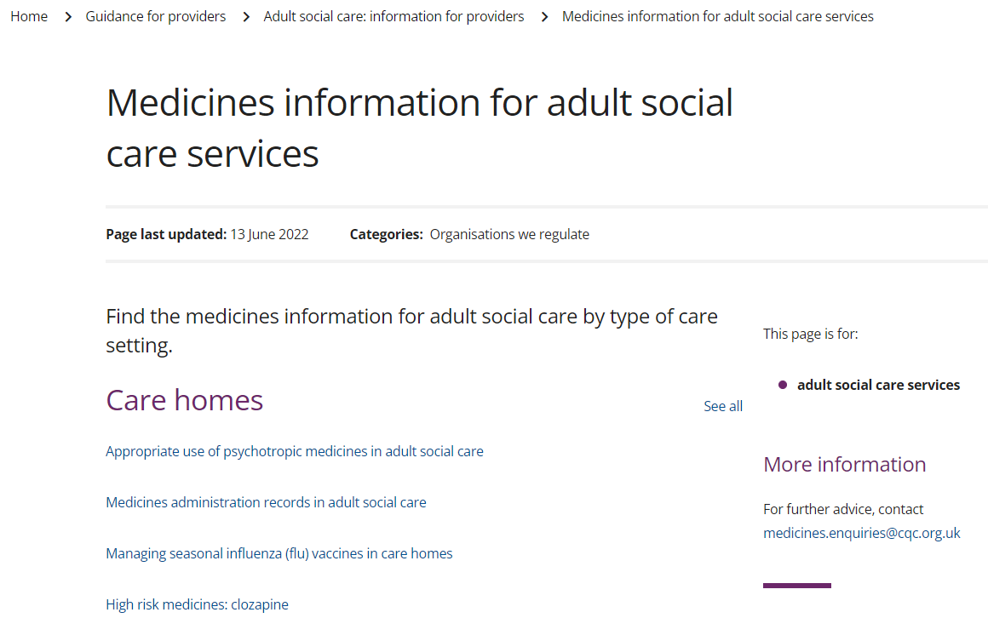
CQC medicines resources
Medicines information for adult social care services - Care Quality Commission (cqc.org.uk)

