Slide 1
LCAS
South West London ICB – Digital Update
Paul Harper - Project Manager
14th February ‘23

Slide 2
Agenda
1.0 Our Baseline
Digital Transformation Fund (DiSC)
Criteria for NHS grant
Baseline data
DSPT
1.1 Progress
Conversion to ‘digital’
2.0 Sensor-based Falls Prevention

Slide 3
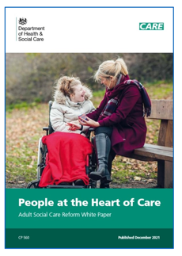
Adult Social Care (ASC)
Digital Transformation Fund
The DTF is designed to accelerate :
The adoption of NHS assured digital social care records.
Sensor-based falls prevention and detection technologies.
Piloting other care technology to build an evidence base for future scaling.
The government’s wider ambitions for reform, the White Paper committed to invest at least £150m in digitising the social care sector.

Slide 4

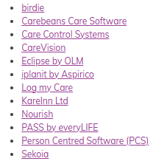
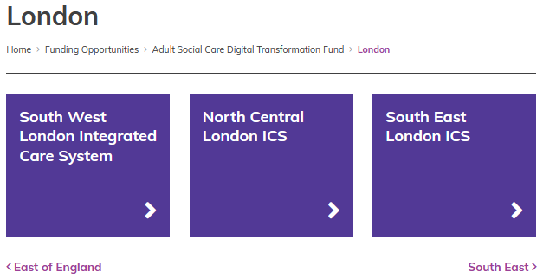
1.0 Digital Social Care Records
SWL ICS - Criteria for NHS Grant Funding
Primarily (but not exclusively) care homes for 2022/23.
Currently ‘paper-based’ (this may change for 2023/24).
Funding to a maximum of £10,000 per service
Purchase from the NHS assured supplier list
Commitment to support ‘benefits realised’.
Commitment to engage with our wider digital offer.
At DSPT ‘Standards Met’, or be working with us to achieve this.
Assured Supplier List - Digital Social Care

Slide 5
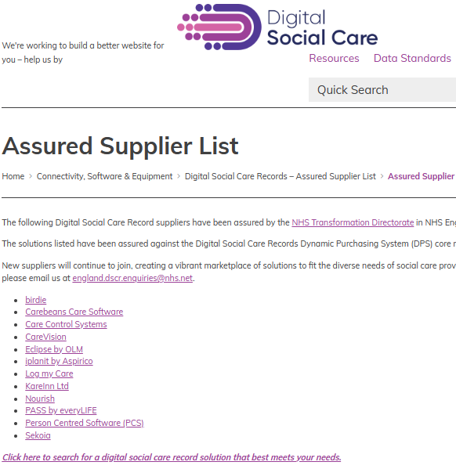
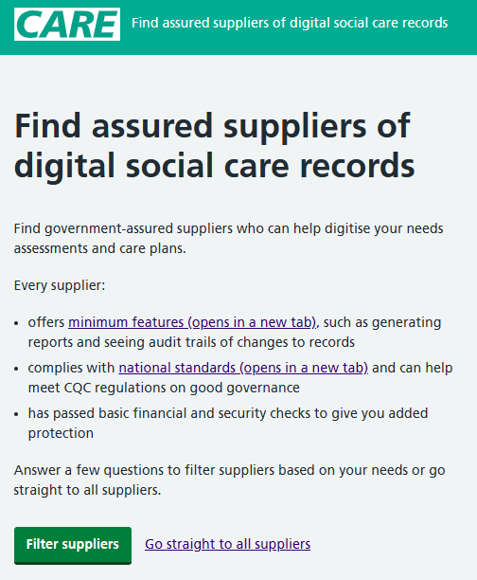

Slide 6
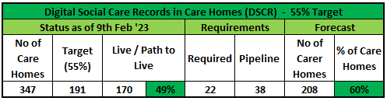
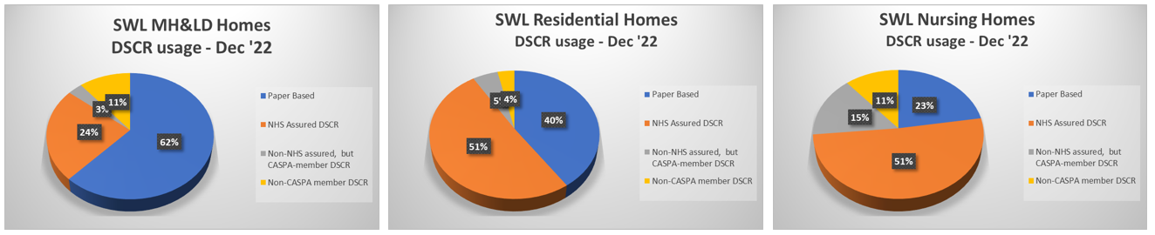
1.1 Progress to Date
March 2022 : 30% of Homes were using an NHS assured or CASPA-member DSCR.

Slide 7
2.0 Feedback from ‘early adopters’ :
‘Using DSCR has saved time and money, increased the amount of time spent with residents, improved information sharing, reduced paper waste and has over the past months improved digital confidence within the whole team.’
‘Though we have only been using it [DSCR} for about a month, we have already seen its benefits. It allows our staff to spend more time with clients than on computers. They log entries while with clients. It also allows the integration of all such risk assessments, support plans, and MARC records into one platform and allows care managers to access it anytime and anywhere.
So far, my experience has been excellent and I will recommend it to any care home providers looking to move into the digital era.
It will not only improve client support but also drastically reduce the cost of printing and paper.’
‘We had one staff member that was anxious about the transition and now they would never want to work with paper ever again.’
‘Because everything is in one location, the time spent on recording has been cut 10-fold. Both for me and my team. I would average that I used to spend at least 1-2 hours a day trawling through paper to find information needed and now, it taken 2 minutes at most. My staff used to spend one hour per shift filling forms, now it is zero because it’s all recorded in real time.’
‘The first obvious cost saving is buying folders, paper and printer consumables such as ink, the drum etc. Saved us at least £500.00 so far this year.’

Slide 8
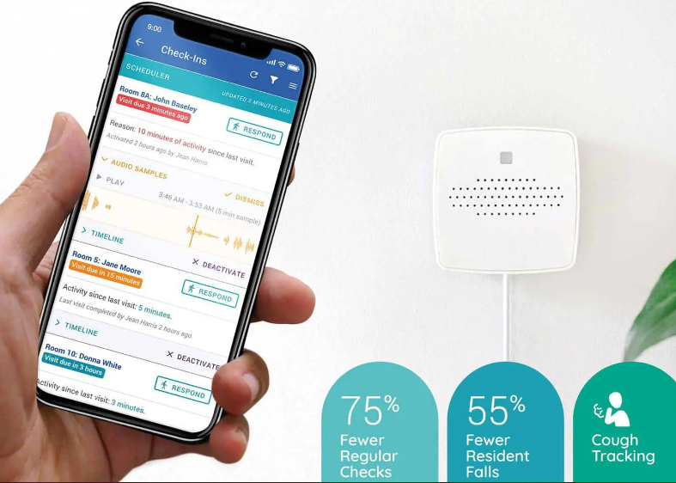
2.0 Sensor-based Falls Prevention (SBFP)
Benefits of SBFP
Residents are disturbed less at night
Staff have more time to spend with residents who need care
Staff gain greater insights into resident’s care needs
Residents receive safer and more responsive care
Fewer routine, physical night-time checks, less night-time disturbance
Fewer night-time falls - fewer hospital attendances and admissions
System | Website
Ally Acoustic Monitoring | Ally Acoustic Monitoring Transforms Night-Time Care (allycares.com)
Vayyar | Vayyar Care: Fall Detection Exclusively with Alexa Together | Vayyar
Adaptive IT and CLB Acoustic Monitoring. | CLB Acoustic Monitoring | Care Home Equipment | Adaptive IT
Eclipse Nurse Call | Eclipse Nursecall Systems - Digital Nursecall & Digital Telecare (ens.im)

Slide 9



Slide 10

What is the eRedBag Pathway?
The eRedBag Pathway is the digital transfer of the electronic versions of the paper documents included in the Hospital Transfer Pathway, more commonly known as ‘Sutton’s Red Bag initiative’.
It has been developed to further improve the information sharing and communication between care homes, ambulance services, hospitals and community teams that the Red Bag documents delivered.
By sending the information in digital format, the eRedBag and eDischarge Summaries are available to staff providing care at a touch of a button.
The eRedBag contains all the original information and more. Since the document is electronic, the eRedBag information is clearly laid out, in colour, can include colour photos and is type written – no longer do people have to try and read people’s handwriting.
The pdf supports easy searching for information required. The actual information in the eRedBag also meets the Professional Records Standards Body’s national standards.
eRedBag Pathway benefits:
Care home resident status and wishes made available to more health & care staff quickly
More timely and appropriate treatment and interventions whilst in hospital
Better and quicker discharges from hospital, and less readmissions to hospital
Care home staff spend less time on administration and paperwork
Less calls from the hospital received by the care home
Reduced risk of lost paperwork and data breaches
Improved assurance for family members, friends and carers

Slide 11
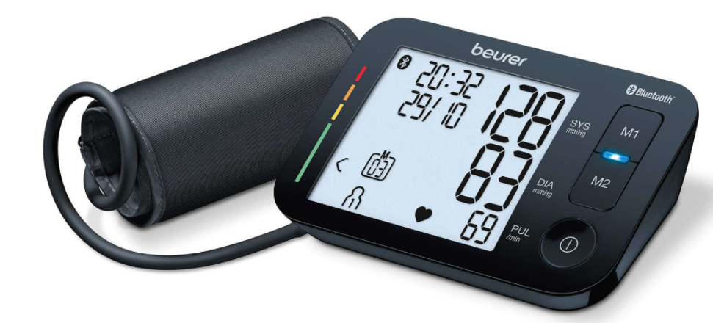
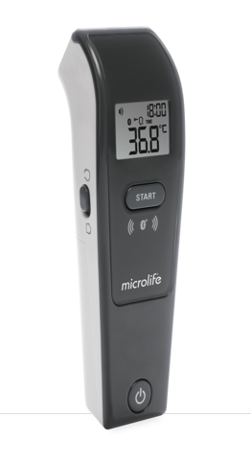
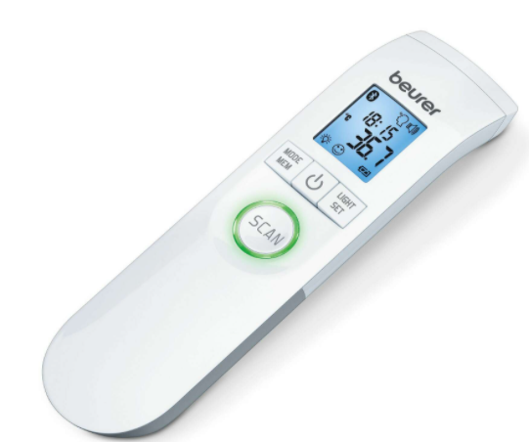




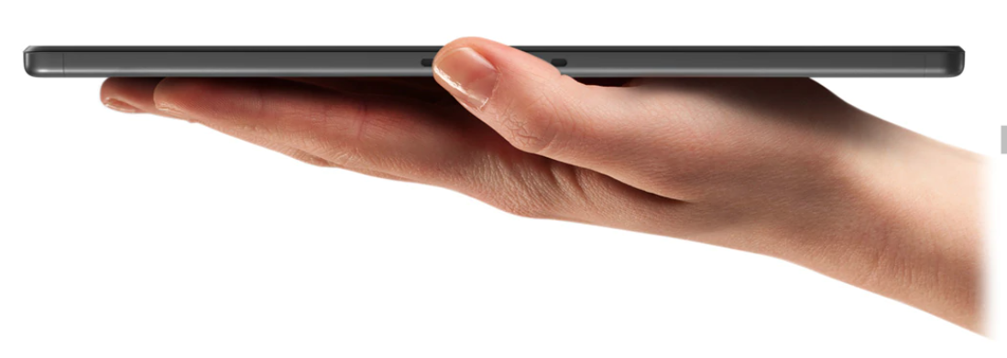
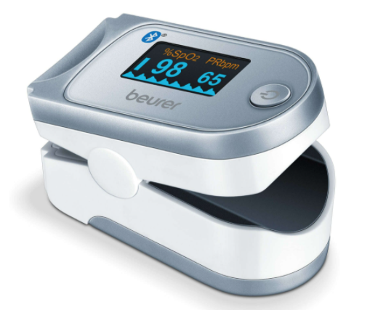
What is the Remote Monitoring Service?
VCare / Whzan will provide you with a set of devices that enable seamless vital sign recording of residents*.
Care home staff and GPs will be able to see the readings in real-time.
Bluetooth-enabled devices mean recordings flow straight into the Remote Monitoring System.
Training will be provided on all devices to help your care home to make the transition.
VCare / Whzan will provide complete end-to-end responsibility of logistics and resolve any device faults.
VCare /Whzan support teams are available 24/7 to resolve any queries and issues
Bluetooth Thermometer
RMS
Bluetooth Blood Pressure Monitor
Bluetooth Pulse Oximeter
Modern Tablet Device
* Number of devices will differ in accordance with specific care home types

Slide 12
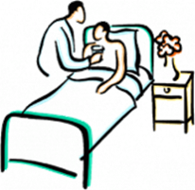
Benefits of Remote Monitoring
The Care Home’s Perspective
Better Care
Administration Time
Staff can provide better care as any changes to a resident's observations can be flagged with the GP, 111 or other services so that action can be taken.
Time is saved making lots of phone calls to GPs as changes to observations can be sent remotely.
Involvement
Proactive Care
It helps residents to feel more involved in their care and less anxious if they are worried about their health.​
Staff can provide proactive care rather than reactive care. This means residents get medical input before their condition worsens.
Your Organisation
Enhanced marketing of your home to future clients since it allows local health professionals to remotely monitor residents (with your permission) and it provides additional evidence to support your answers at your CQC inspection.
Driving improvement through technology - Care Quality Commission (cqc.org.uk)
Communication
It enables staff to communicate meaningful changes in observations to GPs and ambulance services so that they can respond appropriately.

Slide 13
New Care Homes can still sign up to Remote Monitoring
There’s still time to sign up to use Remote Monitoring in your care home. You will get:
✓ Remote Monitoring Bluetooth kit for your care home including a tablet, blood pressure monitor, thermometer and pulse oximeter
✓ Licence to use the kit and the Remote Monitoring System until 31 March 2024.
Please note: The Remote Monitoring offer is currently scheduled to close to new care homes after 31 March 2023.
For more information, please contact Lisa Atik on Lisa.Atik@swlondon.nhs.uk
or email swlcarehomes.admin@swlondon.nhs.uk

Slide 14

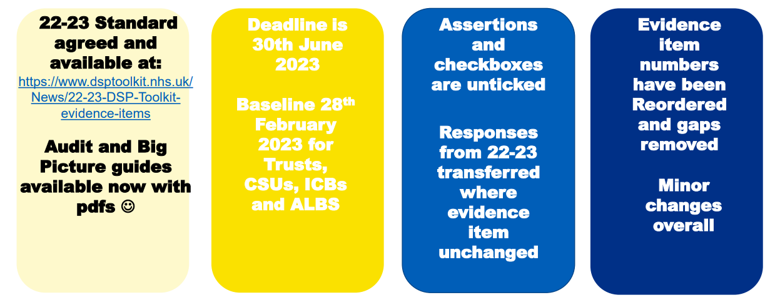
Data and cyber security is important for safe sharing of records – especially with increased use of digital technology during the pandemic
It will help you keep people’s confidential information safe
It will help protect your business from the risk of being fined for a data breach and from the disruption of a cyberattack
The DSPT will demonstrate compliance with legal and CQC requirements
It’s often a contractual requirement from councils and health to complete the DSPT
The DSPT will be your passport to shared care records and other digital innovations with health services, enabling you to be part of a truly joined up care network with the interests of the people you support and care for at the centre
Data Security and Protection Toolkit (dsptoolkit.nhs.uk)

Slide 15
Get in touch ……
swlcarehomes.admin@swlondon.nhs.uk
This mailbox is monitored by the Digital Integration Support and Liaison Officers (DISLO)
Examples of things we can support you with:
DSPT and Information Governance
eRedBag
NHSmail Queries
Remote Monitoring of vital signs
Digital Social Care Records
Sensor-based Falls Prevention
Digital skills
eMAR

Slide 16
Any Questions . . . ?

