Slide 1

Skills for Care updates
18.01.2023

Slide 2
Being Creative about Recruiting
Skills for Care offer Resources to support you to do this!
Recruiting for Values
Finding and keeping workers
Funded initiatives for supporting your recruitment
Safe and Fair Recruitment Guide (includes advice & case studies)
Overseas Recruitment
https://www.skillsforcare.org.uk/Recruitment-support/Recruitment-support.aspx

Slide 3
Safe and Fair Recruitment
https://www.skillsforcare.org.uk/resources/documents/Recruitment-support/Widen-your-talent-pool/Employing-people-with-criminal-records/Safe-and-fair-recruitment-guide.pdf
It’s essential that recruitment practices are fair, effective and robust and focus on the need to safeguard people who need care and support.
We explain how to do this!
Skills for Care has tools to support employers recruit and retain a suitable workforce, including our ‘Good and outstanding care: Safe staffing guide’.

Slide 4
New Resource
New hiring toolkit supports care providers with safer recruitment(link is external). A first-of-its-kind Better Hiring Toolkit has been launched, providing an essential guide for care sector employers to make informed, safer recruitment decisions.
A virtual online session is being held to launch the 'Better Hiring Toolkit' with expert speakers discussing how the social care sector can implement best practice recruitment. This takes place on Thursday 19 January 2023, from 13:00-14:00. Further details can be found here: www.eventbrite.co.uk/e/better-hiring-the-new-industry-standard-in-care-tickets-474128459987(link is external).
The best practice toolkit – which can be accessed for free here(link is external) – provides

Slide 5
International recruitment support
Recruiting internationally is a great way to find skilled and diverse workers, but employers often tell us they have trouble navigating the legalities of recruiting internationally.
Our international recruitment webpage has a range of resources including new guidance on gathering and assessing criminal record information for UK and non-UK nationals, including displaced people, written in partnership with employment experts.
Find out more information on our website
Notes:
https://www.skillsforcare.org.uk/Recruitment-support/Attracting-people/International-recruitment.aspx
New international recruitment support
Recruiting internationally is a great way to find skilled and diverse workers, but employers often tell us they have trouble navigating the legalities of recruiting internationally. Our international recruitment webpage has a range of resources including new guidance on gathering and assessing criminal record information for UK and non-UK nationals, including displaced people, written in partnership with employment experts.

Slide 6
Overseas Recruitment
https://www.skillsforcare.org.uk/Recruitment-support/International-recruitment/International-recruitment.aspx
Overseas recruitment bite-size guide
DHSC and Home Office videos - covering points-based immigration in social care, ethical recruitment and how to apply for a sponsor licence.
Safer recruitment
Other government guidance
Pastoral support
Employer experiences - employer best practice examples across different settings
International recruitment virtual event (2021)
Additional supporting guidance
Blogs and articles on international recruitment

Slide 7
National recruitment campaign ‘Made with Care’
The DHSC has launched the latest phase of the national adult social care recruitment campaign running till March 2023
The campaign will demonstrate the amazing work care workers do, celebrating the way they empower the people they care for and shining a light on the emotional reward of the role.
Advertising will run across radio, video, on demand and digital channels with TV advertising from November 2022 – March 2023.
Campaign will direct job seekers to adultsocialcare.co.uk to find everything they need to research a career and search and apply vacancies near them.
Expert advice, templates and new toolkit of recruitment assets can be found in the campaign resource centre.
Notes:
NEW : NOVEMBER 2022
Adult Social Care: https://www.adultsocialcare.co.uk/home.aspx
Upload a job to DWP ‘Find a Job’ platform: https://www.adultsocialcare.co.uk/include/documents/find-a-job-instructions.pdf
Resource centre: https://www.adultsocialcare.co.uk/recruit.aspx
Campaign newsletter: https://dhsc-mail.co.uk/form/Sx1iaZDJ/zHAb6Zx4x
The campaign will demonstrate the amazing work that care workers do, celebrating the way they empower the people they care for, and shining a light on the emotional reward of the role. It’s designed to support care providers in recruiting the dedicated staff they need by inspiring people with the right values to consider a career in social care.
You can make the most of the awareness the campaign will drive by running local recruitment activity at the same time and uploading your jobs to the DWP ‘Find a Job’ platform. Expert advice, templates and a new toolkit of recruitment assets will also be available from the campaign resource centre in time for the launch of the campaign.

Slide 8

#KeepLearning
Until the end of March, we’re supporting you to #KeepLearning by shining our spotlight on the importance of learning and development.
We know that learning and development is vital not only in supporting a good workplace culture and developing and keeping the people who work in care, but also in providing the best outcomes for people who draw on care and support.
This campaign will support managers and their teams to #KeepLearning by highlighting training and funding opportunities available for social care workers in 2023, and focusing on the real benefits which continual professional development has for people working in social care and the people who they support.
Find out more on our dedicated webpage
Notes:
NEW : JAN 2023
We’ll be publishing blogs and articles and sharing tips and advice to help managers of services to plan for the years’ training and development.
During the campaign we’ll promote apprenticeships and our endorsed providers, as well as our leadership programmes, eLearning and guidance to support with learning. We’ll be reminding leaders and managers of services that funding is still available to pay for learning and development through our Workforce Development Fund.

Slide 9

The Managers Conference
Monday 13 March - Tuesday 14 March 2023 I Leicestershire
Hosted by NCF and Skills for Care and in collaboration with ARC England, the Managers Conference will champion and support the crucial role of managers in adult social care.
It will bring together managers from across the country to share knowledge, ask questions and network with colleagues. Topics include team working, embracing and embedding equality, diversity and inclusion, delivering outstanding care and recruiting potential managers.
An early bird price of £250 +VAT per ticket is available until 3 February 2023 which includes a networking evening with dinner and accommodation followed by breakfast and entry to the conference, with lunch and refreshments.
Book your place and find out more
Notes:
NEW: JAN 2023
https://events.skillsforcare.org.uk/skillsforcare/frontend/reg/thome.csp?pageID=468712&eventID=1488

Slide 10
Workforce Development Fund claims deadline extended
The deadline to submit Workforce Development Fund (WDF) claims has been extended to 31 May 2023.
The fund can be used to support the development of staff at all levels, offering funding for a wide range of qualifications, learning programmes and digital learning modules.
All employers in England have access to the fund, whether it’s claiming via your local partnership, a national partnership or directly from Skills for Care.
Find out more about how to claim and the important dates.
www.skillsforcare.org.uk/wdf
Notes:
AMENDED: DECEMBER 2022
https://www.skillsforcare.org.uk/Funding/Workforce-Development-Fund/Workforce-Development-Fund.aspx
Application deadline
To benefit from the 2022-23 WDF you must:
complete/submit a declaration form before 28 February 2023
ensure your Adult Social Care Workforce Data Set (ASC-WDS) account meets WDF requirements by 31 March 2023
claims must be submitted to Skills for Care by 31 May 2023.
Claims for qualifications
Certificates with a date of issue between 1 January 2022 and 31 May 2023 will be accepted as evidence in support of WDF 2022-23 claims.
Claims for learning programmes
Learners must have started their learning programme by 31 March 2023. The date of issue of the certificate must be between 1 January 2022 and 31 March 2023 to be accepted as evidence in support of WDF 2022-23 claims.
Claims for digital learning modules
Learners must complete digital learning modules by 31 March 2023. The date of issue of the certificate must be between 1 January 2022 and 31 March 2023 to be accepted as evidence in support of WDF 2022-23 claims.

Slide 11

Save the date for our upcoming webinars…
Booking details will be available soon, but in the meantime, you can save the date in your calendars for the following webinars:
How can technology support the delivery of care?
Tuesday 21 February 2023 I 14:00 – 14:45
Providing evidence to the CQC: How do you prepare to have the evidence at hand for CQC assessments, monitoring and inspection?
Wednesday 1 March 2023 | 10:00 – 10:45
New CQC inspection: Practical tools and advice about the new CQC inspection focus and Quality Statements
Tuesday 28 March 2023 | 14:00 – 15:00
Notes:
NEW: JAN 2023
How can technology support the delivery of care?
This webinar will explore the different types of technology currently being utilised in adult social care to support the provision of quality care. It will include a panel of employers and representatives from the sector talking about their experiences and how they made the case for digital in their organisations.
Providing evidence to the CQC
Delivered in partnership with The Outstanding Society, the webinar will provide insight into how other adult social services gather and share evidence with the CQC. From who to involve in this process to how to manage and maintain robust evidence, you’ll hear from other frontline managers on their tried and tested methods.
New CQC inspection
Delivered in partnership with The Outstanding Society, the webinar will provide insight into the new CQC Single Assessment Framework and how to meet their new Quality Statements. You’ll hear from other managers and directors of other services on the bigger changings and what they are doing to be ready, as well as how to access Skills for Care’s latest products shaped around the new inspection focus

Slide 12
Deputy manager networks
These networks are specifically for deputy managers, team leaders and assistant managers
The next Deputy Manager Network for London and the South East is on the 1st of February and will focus on Supervision and how to use coaching techniques to get the best out of sessions with staff.
Find your local deputy manager network:
www.skillsforcare.org.uk/deputymanagers
Notes:
Skills for Care currently supports over 150 registered manager networks, which are recognised as being invaluable by many managers.
We know the benefits these networks provide to managers, so we are setting up a new network specifically for your deputies.
Each network meeting will be virtual and facilitated by a Skills for Care Locality Manager. It will focus on themes including wellbeing and resilience, self-confidence and personal effectiveness, delegation with confidence and dignity, communicating inside and out and making sense of information.
Please note that not every part of the country will be covered by a Deputy Manager Network this year but we will be looking at the success of the first networks to consider wider expansion at a later point. If there is not a network in your area, and you would be interested in joining one in future please email RM.networks@skillsforcare.org.uk.

Slide 13
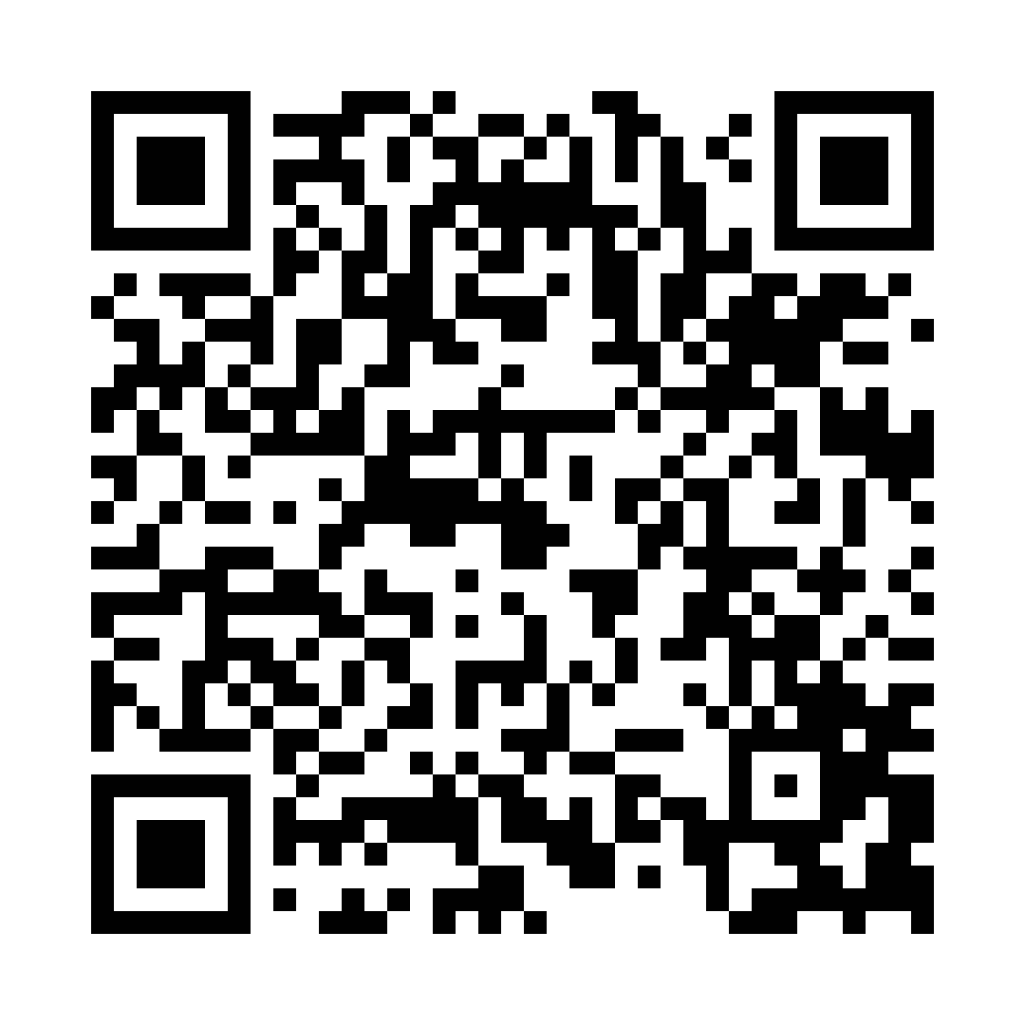
Have you attended a registered manager or deputy manager network? If so, we welcome your feedback!
We are inviting managers who have attended a network to take part in a short survey to help us understand more about the benefits of networks.
We want to understand and gain feedback on:
why managers attend the networks
what benefits managers gain from attending
what improvements they have made to their service as a result of attending the network.
You can access the survey online or
using the QR code
https://online1.snapsurveys.com/sfc-network-survey
Notes:
NEW: NOVEMBER 2022
https://online1.snapsurveys.com/sfc-network-survey
We know how important the registered manager and deputy manager networks are to managers and we want to continue to make them as relevant and useful to you as possible by having the right support in place. Skills for Care supports over 145 networks and they offer a safe space for managers to connect with peers and learn together. The information we gain from the survey will help us to understand more about the benefits of the networks and we will share the findings with the Department of Health and Social Care (DHSC) to demonstrate the value of the networks

Slide 14

ASC-WDS – New feature
You can now download a bespoke ASC-WDS certificate
All care providers using ASC-WDS can now download a bespoke certificate along with an email signature and logo to let everyone know you’re an ASC-WDS contributor.
Your data is invaluable, and you should be proud that you’re using it to make a difference.
Login or create an account
Notes:
NEW: JAN 2023
https://asc-wds.skillsforcare.org.uk/login
Using ASC-WDS means social care providers can contribute to the voice of the sector.
They’re helping the sector by providing crucial data which is used to inform decisions about policy, funding and support for the workforce.
We’re introduced a new feature in ASC-WDS which recognises the important contribution that users are making.
‘Get your ASC-WDS certificate’ allows you to download your tailor made certificate, along with an email signature and logo. You can use them to let everyone know you’re proud that you’re helping the sector.

