Slide 1

Skills for Care update

Slide 2


New recorded webinar
Preparing for the winter pressures ahead
This webinar reflects on what we can expect from the upcoming winter period and how best to prepare for it.
Managers from a range of services talk through how they are developing contingencies for the winter period and practical ways to protect themselves from the impact of staffing challenges.
There are also several bitesize resources to support the webinar including:
Recommendations from other providers
on how to prepare.
Contingency planning checklist.
Example winter plan from a provider.
Watch the webinar now

Slide 3
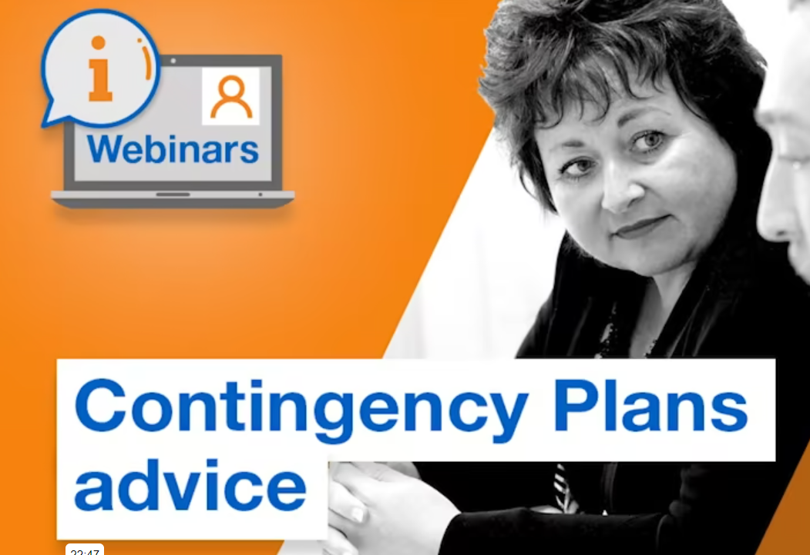
Recorded webinar
Contingency Plans advice
Watch the webinar now
Accompanying resource – guidance on what to include in contingency plans

Slide 4

Trainee Nursing Associate information sessions – SW London
This is your opportunity to find out more if you are thinking of employing a Trainee Nursing Associate or putting an existing employee on a TNA programme
Wednesday 11th January (1pm – 2pm). Book HERE
Tuesday 14th February (1pm – 2pm). Book HERE
Thursday 16th March (1pm – 2pm). Book HERE

Slide 5
Digitising Social Care Engagement event – London
15th Feb (10am – 5pm) at the Coin Street Neighbourhood Centre, SE1
The purpose of the event is to bring care organisations and digital suppliers together
All Digital Social Care Record suppliers on the Assured Provider List have been invited
Find out more and book here

Slide 6
ASC-WDS bulk upload & Workforce Development Funding webinar
12th Jan (1.15pm – 2pm) via MS Teams
During this session we will cover:
- What is ASC-WDS?
- What are the benefits?
- How to set up an account and update information using the bulk upload facility
- Overview of Workforce Development Funding.
Please note this session is for large employers (who have approximately 50 or more staff) only
Please e-mail laura.anthony@skillsforcare.org.uk to book a place

Slide 7
London & SE Nominated Individuals network
We are inviting NIs to join our new network
The first meeting will be on the 25th Jan (10am – 12pm) via Zoom
Agenda:
  CQC: ‘explore the role and responsibilities of nominated individuals and what this entails from a registration and inspection perspective’
  3-times outstanding-rated provider who will talk about the nominated individual role in CQC inspections
Find out more and book at: https://events.skillsforcare.org.uk/londonsoutheastni

Slide 8
Contacts
SW London:
Laura Anthony: 07890 514106 / laura.anthony@skillsforcare.org.uk
NW London:
Selena Docherty: 07825 933674 / selena.docherty@skillsforcare.org.uk
www.skillsforcare.org.uk/register

