Slide 1

Presentation from Dimitra Nikoloudaki
Senior Manager Quality Assurance and Contract Monitoring
London Boroughs of Richmond and Wandsworth
Being Prepared for Christmas and New Year
This Photo by Unknown Author is licensed under CC BY-NC-ND

Slide 2



Advice for all RMs
Roster in advance and have extra staff on call just in case staff call in sick or cannot come in due to emergencies.
Arrange transport for staff during strike days and bank holidays.
Make contact with relatives to know which residents will be spending Christmas with families.
Ensure you know who is on call from Senior Management of your organization in case you need to escalate issues and concerns. Good internal comms are essential with other managers and your staff.
Ensure you print off important information and contacts so they are readily available to staff in case of absence from senior managers and can be located easily in the office.
Be prepared for last minute changes regarding clients and staff and have a contingency in place.
Have enough stock of PPE/tests to last through the holidays.
Update your BCP to have up to date internal contacts and also for the LA you are based, i.e. OOO, duty desk, etc.
Sign up for weather alerts and TFL alerts so you are aware of strike days and adverse weather forecasts.

Slide 3

Care Home Managers
Pre order medication for residents to last you well after the holidays.
Have a list of open pharmacies during the bank holidays in case you run out of medication or in case of emergency.
Update your training on medication just in case other staff need to administer it.
Prepare for nurses and ambulances striking and see what you can provide within the home and what help you can get from the GP or from the Care Home Support Teams.
Ensure you know how many relatives will be visiting during the holidays so the home is not overwhelmed, especially if there is a Covid19 outbreak, and inform everyone if this happens for their safety. Do you need to update the visiting policy to reflect current guidance?
Remember to plan for RedBags and e RedBags for any Residents who are sent from a Care Home to Hospital.
Prepare for an electricity or gas outage. Do you have a generator or electric heaters on storage ready to be used?

Slide 4
Domiciliary Care Managers
Update your training records so you know what competencies each carer has in case of last minute referrals or emergencies.
Have a comms system with carers so you can alert them quickly on weather forecasts, strikes, or other emergencies.
Some ICBs have set up Urgent Community Response teams operating from 8 am to 8 pm where a medical professional can respond within 2 hours. Try to find out what support is available in your borough to get you through the nurses and ambulance striking. Be mindful that ambulances can be called if a person has a heart attack, a stroke, or an accident but not if they’ve had a fall.
Ensure carers know who to contact in the office to escalate issues or concerns and remember to keep families up to date.

Slide 5
Emergency Numbers
………………………………………………………………………………………..
Urgent Community Response Service ( 2 Hour UCR )
Place | Contact | Hours | Provider
Wandsworth * | 0333 300 2350 select option 2 | 8am – 8pm , 7days a week Last referral 18.00 hrs | Central London Community Healthcare NHS Trust
Urgent Community Response Service ( 2 Hour UCR )
Place | Contact | Hours | Provider
Richmond | 0208 714 4060 | 8am - 8pm , 7days a week Last referral 6pm 24/7 Falls pick up over winter | Hounslow and Richmond Community Healthcare NHS Trust

Slide 6
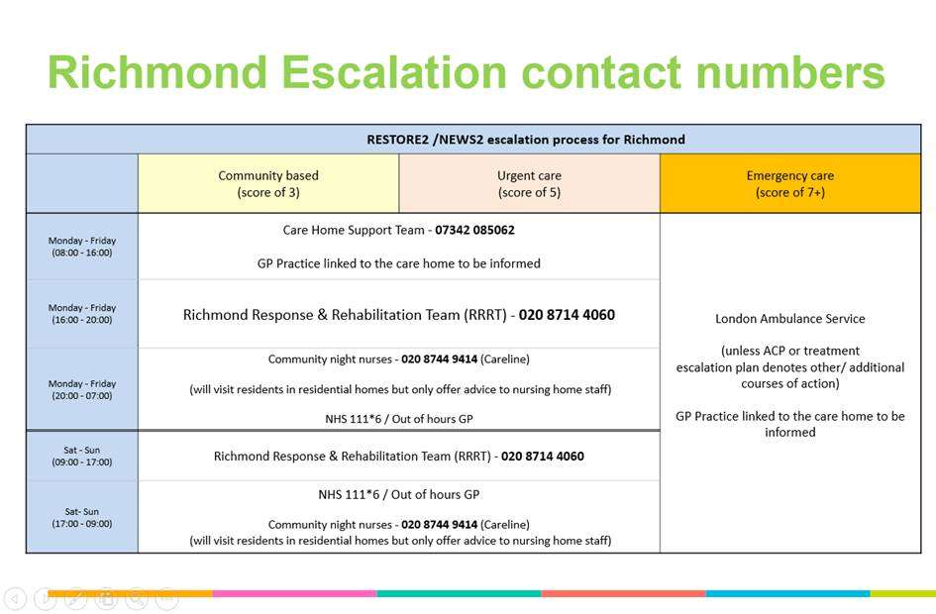
Richmond Contact Numbers
………………………………………………………………………………………..

Slide 7
Wandsworth Contact Numbers
Wandsworth Escalation contact number
………………………………………………………………………………………..
In Hours (8am to 6.30pm)
CLCH Care Home In-Reach Team (Advance Nurse Practitioners) 8am -5pm (Mon to Fri)
Urgent referrals (2 hrs) – Mob: 07990353463/07990353036
Routine referrals (72 hrs) (via SPA) Tel: 0333 300 2350 (Mon to Fri)
Pharmacy support (medication queries): Mob: 07775554233 Tel: 0208 102 4254 VOIP: 8344254 e-fax:0300 008 3201
St George’s Care Home Therapy In-Reach service – support with Physiotherapy, Occupational Therapy, Dietetics; please contact 07827834694; 8am – 2pm (Monday to Friday); response time 72 hours for urgent referrals (routine referrals are seen by Maximising Independence and rehab services with referrals via SPA);
Dietician support response time:
Urgent: (MUST score 4): Patients are seen within 2 weeks.
Routine: patients seen within 4 weeks.
3. GP Practice 8am -6.30pm (Mon to Friday) for routine and urgent referrals
4. CLCH Maximising Independence Team 08.30-16.30 Monday to Friday
Urgent referrals (72 hours) (via SPA) Tel: 0333 300 2350 (Mon to Fri)
Routine referrals (15 days) (via SPA) Tel: 0333 300 2350 (Mon to Fri)
5. Community services via SPA (non-urgent)
Diabetes Specialist Nurses
Heart Failure Nurses
Respiratory Nurse Specialists
Tissue Viability Nurses
Continence Nurses
Routine referrals (via SPA) 0333 300 2350 (lines are manned Monday to Friday from 8am to 8pm and Saturday, Sunday, and Bank Holidays from 8am to 5pm)
End of life
Royal Trinity Hospice - 30 Clapham Common North Side, London, SW4 0RN
Tel: 020 7787 1000
General enquiry email: enquiries@royaltrinityhospice.london
Referral email: rth.referrals@nhs.net
Wandsworth End of life Care Coordination Service (WEoLCCS)
Open 8am-8pm daily including public holidays
Tel: 0300 3000 116
Email: TRIH.Wandsworth-EOLCCC@nhs.net
Out of hours (6.30pm to 8am)
Out of Hours GP
Does your resident have a plan (urgent care plan) that records their wishes? Please alert OOHs GP to record if yes.
Please contact:
your GP practice if a resident does not have a plan (urgent care plan) in place.
Night nurses (via NHS 111 and SPA)
NHS 111*6
End of life out of hours advice - Trinity Hospice; Out of hours advice (patients & carers & clinicians); 020 7787 1062
For a NEWS score from 1 to 6

Slide 8
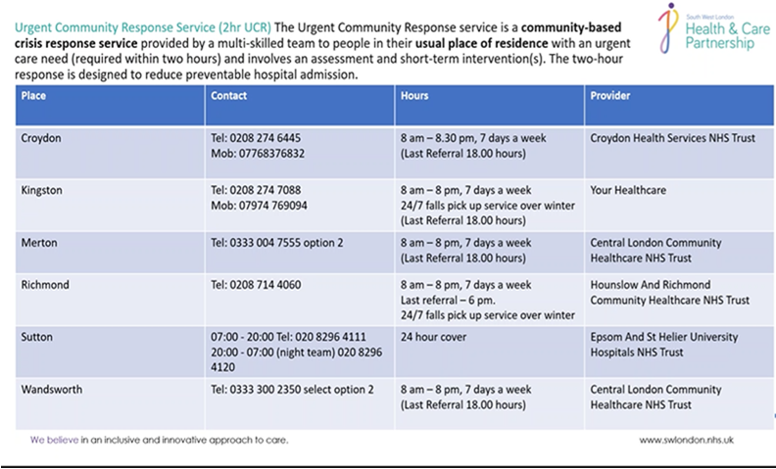
………………………………………………………………………………………..

Slide 9


Any questions?
and

