Slide 1
Understanding the Workforce Development Fund 2022 -2023
LONDON AND SOUTH EAST WORKFORCE DEVELOPMENT FUND DIRECT ACCESS WORKSHOP

Slide 2
Why invest in training your staff?
Our The state of the adult social care sector and workforce in England 2021 has some key figures
Good induction and onboarding can help keep staff for longer
‘A large proportion of staff turnover arose from workers leaving their posts soon after joining. Care workers with less than one year of experience had a much higher turnover rate (36.7%) than those with 10 years or more (12.0%).’
Offering learning and development can help retain staff
‘Care workers who received regular training and those with qualifications were less likely to leave their roles than those who didn’t.’
Improve your CQC scores
‘Establishments with higher levels of staff undertaking learning and development were more likely to receive higher CQC scores (for example, take up of the care certificate, training and qualifications)’.

Slide 3
Two funding streams to draw from
Rapid induction and refresher training | Workforce Development Fund (WDF)
There is funding for inducting and refreshing learning on the key topics of the care certificate. | There is retrospective funding for a range of adult social care qualifications, learning programmes and digital learning modules
These are free to access – you just need an ASC-WDS account with your workplace details. See orange slide | This fund offers money upon completion of a programme from a specified list, and with ASC-WDS eligibility criteria and different claim processes See blue slides

Slide 4
Rapid induction or refresher training
t
Funding now available to ensure ALL workers can perform their duties safely.
Contains the main knowledge elements from the Care certificate:
assisting and moving people
basic life support
fire safety
food safety
health and safety awareness
infection prevention control
medication management and safeguarding.
Employers can select from 11 endorsed providers.
www.skillsforcare.org.uk/EssentialTraining
Free to access – you just need an ASC-WDS account with your workplace details
Notes:
Funding available for the rapid induction training
The fully funded rapid induction programme is now available to ensure new workers can perform their duties safely.
The rapid induction programme covers the following:
assisting and moving people
basic life support
fire safety
food safety
health and safety awareness
infection prevention and control
medication management and safeguarding (specifically around isolation).
The rapid induction also contains the main knowledge elements from the Care Certificate.
Employers can select from 11 endorsed training providers, some of which are new additions this year. These providers have been awarded grants to deliver the rapid induction programme. Please note, all training will be delivered virtually.
Refresher training and the volunteer programme will re-commence when further funding is confirmed in the coming weeks.
http://www.skillsforcare.org.uk/essentialtraining

Slide 5
The Workforce Development Fund
Funding to contribute towards the cost of learning and development, disseminated by Skills for Care on behalf of the Department of Health and Social Care (DHSC).
It supports the delivery of high quality care via the continuing professional development (CPD) of staff across the adult social care sector.
You can claim back money towards the costs of workers completing a broad range of adult social care qualifications, learning programmes and digital learning modules.

Slide 6
WDF Adult social care qualifications, learning programmes and digital learning modules
As the processes for claiming funding for these are different from the Rapid Induction and refresher training, you need to ask yourself 4 key questions.
Do you meet the first essential criteria?
Planning learning and development
How will you claim?
Do/will you have an Adult Social Care Workforce Data Set (ASC-WDS) account?

Slide 7
Ask yourself…
Do you meet the first essential criteria? | Are you an adult social care employer in England? If you aren’t, you won’t be eligible to claim
Planning learning and development | Have you considered what learning and development needs your staff have? Could they be met by undertaking a programme of learning? Are any of the ways of meeting those learning and development needs on the list of WDF eligible qualifications? If so, are you and they aware of the time needed to undertake the learning? Are you and they prepared to commit this? Has, or will your learner, have completed an eligible qualification or programme between 1 January 2022 and 31 March 2023? Is/will your learner’s certificate be dated between 1 January 2022 and 31 March 2023?
Notes:
Adult social care qualifications, learning programmes and digital learning modules

Slide 8
Ask yourself…
How will you claim? | Make contact with your partnership ASAP to let them know you would like to join. They will ask you to complete/submit a declaration form before 28 February 2023. The partnership will process your claims. The final date for submission by the Partnership to Skills for Care is 31 March 2023
Do/will you have an Adult Social Care Workforce Data Set (ASC-WDS) account? | To claim, your ASC-WDS account must meet the requirements. If you have a current ASC-WDS account, you will need to update it according to the requirements. You need to factor in time and who will do this. If you don’t yet have an account, you need to factor in time, and who, will set this up. You must ensure your ASC-WDS account meets WDF requirements by 31 March 2023
If you can meet these 4 requirements, read on!

Slide 9
Criteria for claiming
Open to adult social care employers
Comply with the advertised Adult Social Care Workforce Data Set (ASC-WDS) requirements
Qualifications and learning programmes from a predetermined list
Have certification to show they have taken place in a specified time period.

Slide 10
What can be funded?
You can claim funding towards the cost of listed qualifications, learning programmes and digital learning modules completed between 1 January 2022 and 31 March 2023. This includes money towards the cost of course fees (or employer contributions) and associated costs such as:
employees’ salaries whilst they are undertaking training
coaching and mentoring costs
venue costs for the training

Slide 11
What programmes can be funded and what evidence is required?
There is a list of eligible programmes and qualifications on the website here.
A maximum of £2,000 can be claimed per learner per funding year.
All learning is claimed on completion of a qualification, learning programme or digital module.
Evidenced by a copy of the learner's certificate

Slide 12
Suggestions of programmes and qualifications according to job role.
To make it easier to navigate the list of eligible programmes and qualifications, there are suggestions for various job roles.
These are not prescriptive. They will depend on each service and the needs of the people being supported.
Experienced staff and managers can access programmes or qualifications to refresh their learning.
Shorter programmes duration are highlighted, Where a programme is 4 hours or less, these are indicated by (**)
Notes:
For example-
a manager may ask an experienced care worker with an interest in mental health to become a mental health first aider.
An experienced manager moving between “client” groups may undertake a Level 3 qualification to update their knowledge.
Even though staff and managers may be experienced, they may meet a new situation at work which they need to develop in, where the needs of people being supported change.

Slide 13
For ancillary staff
Chef’s award
Food safety
Nutrition
Range of Level 2 and 3 awards and certificates and diplomas (see Care and Support staff slide)

Slide 14
For care and support staff
Mental Health First Aid (2 days)
Positive behavioural support (NEW)
Care Certificate Assessors (**)
End of Life Care (learning programme-endorsed provider route) (1.5 days)
Forefront digital learning (employees from diverse ethnic backgrounds) (**)
Level 2 (Adult Care Worker) and Level 3 (Lead Adult Care Worker)diploma
Level 2 and 3 apprenticeship + End point assessment
Level 4 Diploma in Adult care
Range of Level 2 and 3 awards and certificates-
Medication
Oral care
Stroke
Clinical skills
Food safety
Nutrition
Mental health
Dementia
Learning disability
Autism
Activity provision
Mental capacity act
Independent advocacy
Social prescribing
Diabetes
End of life
Falls
Assisting and moving people
Notes:
NB people will be required to complete a diploma as part of the apprenticeship programme

Slide 15
Aspiring managers and deputy managers
Positive behavioural support (NEW)
Digital learning for CQC inspection preparation (**)
Lead to Succeed
Introductory modules for managers (NEW) ((**)
Digital learning for managers (**)
Moving up (aimed at employees from diverse ethnic backgrounds)
Learn from Events (**)
Mental Health First Aid (2 days)
Care Certificate Assessors (**)
End of Life Care (learning programme-endorsed provider route) (1.5 days)
Range of Level 2 and 3 awards and certificates (see Frontline staff slide)
Level 4 Diploma in Adult care or Apprenticeship diploma and end point assessment
Level 4 Certificate in principles of leadership and management in adult care
Notes:
NB people will be required to complete a diploma as part of the apprenticeship programme

Slide 16
New managers
Moving up
Digital learning for CQC inspection preparation (**)
Leading Change Improving Care
Well-led
Understanding performance management (1 day)
Understanding self-management skills (1 day)
Understanding workplace culture (1 day)
Introductory modules for managers (NEW) (**)
Digital learning for managers (**)
Learn from Events (**)
Mental Health First Aid (2 days)
Positive behavioural support (NEW)
Care Certificate Assessors (**)
End of Life Care (learning programme-endorsed provider route) (1.5 days)
Range of Level 2 and 3 awards and certificates (see Frontline staff slide)
Level 5 Diploma in Leadership and Management for Adult Care
Level 5 Leadership and Management for Adult Care-apprenticeship + end point assessment
Notes:
NB people will be required to complete a diploma as part of the apprenticeship programme

Slide 17
Experienced managers
Introductory modules for managers (NEW) (**)
Digital learning for CQC inspection preparation (**)
Leading Change Improving Care
Well-led
Understanding performance management (1 day)
Understanding self-management skills (1 day)
Understanding workplace culture (1 day)
Digital learning for managers (**)
Learn from Events (**)
Mental Health First Aid (2 days)
Positive behavioural support (NEW)
Care Certificate Assessors(**)
Level 5 Diploma in Leadership and Management for Adult Care
Level 5 in Leadership and Management for Adult Care-apprenticeship + end point assessment
Notes:
Managers can undertake the Introductory modules as a refresher.
NB people will be required to complete a diploma as part of the apprenticeship programme
Managers may have gaps in their knowledge, depending on their workplaces and if they have moved around services. They may wish to undertake learning to refresh or to fill gaps in their learning or as a refresher, such as
End of Life Care (endorsed provider route)
Range of Level 2 and 3 awards and certificates

Slide 18
Commissioners
Moving up
Level 5 certificate Fundamental Knowledge in Commissioning for Wellbeing-
generic focus
learning disability and autism focus

Slide 19
How much can be claimed
The amount per completed qualification depends on the size of the qualification in terms of the length of time it takes to complete (Total Qualification Time (TQT) hours)
For example-
Leading a person centred service | 45 minutes | £50 claim
Learning from events | 35 minutes | £50 claim
Level 2 award ‘Awareness of end of life’ | 30 hours TQT | £60 claim
Level 2 Award ‘Awareness of dementia’ | 80 hours TQT | £120 claim
Level 2 Certificate ‘Falls prevention’ | 135 hours TQT | £300 claim

Slide 20
How to claim in 2022/23
Direct access to Skills for care
Services in these Local Authority areas can claim by direct access-
North Central London- Barnet, Camden, Enfield, Haringey, Islington
North West London- Brent, Ealing, Hammersmith & Fulham, Harrow, Hillingdon, Hounslow, Kensington & Chelsea, Westminster
North East London -Barking and Dagenham, City of London, Hackney, Havering, Newham, Redbridge, Tower Hamlets, Waltham Forest
Hampshire- Southampton, Hampshire, Isle of Wight, Portsmouth
Please see Guidance for employers accessing WDF directly from Skills for Care
Notes:
The Berkshire, Surrey, Oxfordshire and Buckinghamshire partnership will also accept employers from North London.
Berkshire Workforce Development Funding Partnership
Contact Liz Bailey. berkshirewdf@outlook.com 07977 924354

Slide 21
Understanding the Process to Claiming
Check you are in an area which processes WDF claims via direct access and you meet the eligibility criteria
Awarded Direct Access WDF funding in 2021/22, your circumstances not changed and you have updated your ASC-WDS information in financial year 2022/23?
Yes
Complete or update workplace records and 90% of your staff records on ASC-WDS by 5pm on 31/03/23
No
You don’t need to submit a declaration form
Complete a Direct Access Declaration Form and send to directaccess.wdf@skillsforcare.org.uk by 28th February 2023
This form will be reviewed.
Grant letter sent to you to electronically sign and return (via Echosign) with your grant holder reference
Unique claim form issued with guidance on how to make a claim.
Submit Grant Holder claims form, your claim form and copy of learner certificates to SfC by 5pm Friday 31st March 2023.

Slide 22
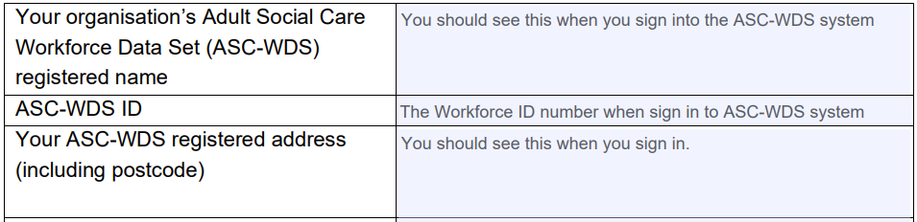
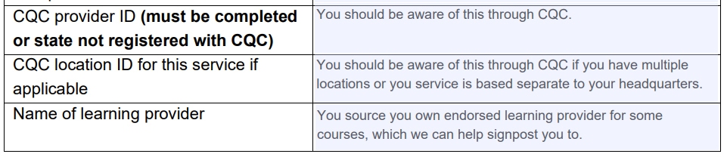
Direct Access Declaration Form
Most areas of the form should be self-explanatory
Some key information that is required includes:
If you have multiple sites you should register for a ‘Parent Account’ which can be registered to one of your service venues or your head office. Parent accounts have a unique ASC-WDS ID along with separate ASC-WDS for each individual location which will need to be included on the final pages of the form.

Slide 23
Adult Social Care
Workforce Data Set
(ASC-WDS)

Slide 24
The Adult Social Care Workforce Data Set
ASC-WDS is a data collection service, commissioned and funded by the Department of Health and Social Care. It is the leading source of intelligence for the adult social care workforce.
It helps you to manage your team and provides crucial information to decision makers.

Slide 25
Benefits to your business
Funding for training your staff – rapid induction & Essential Training in addition to WDF
Safe and free storage of staff records
Manage training and qualification records
Benchmark your workplace
Access the Skills for Care bundle
offer (coming November 2021)
Help the sector by providing key intelligence to decision makers
Can support your workforce planning

Slide 26
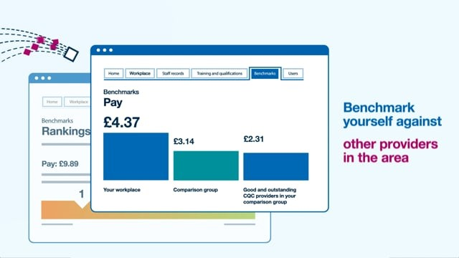
Discover the ASC-WDS
Take a look at the video https://bit.ly/2Q45Ww3

Slide 27
Get started today!
Find out more and create your account at
www.skillsforcare.org.uk/ASCWDS
Or contact our support team for more information
T. 0113 241 0969
E. ascwds-support@skillsforcare.org.uk.

