Slide 1
Tina Stebbings
Business Manager
Fulcrum Care helps nursing and care homes in England to improve
We help you with support and guidance on CQC regulations, management issues and operational matters. Your home will
receive better outcomes from CQC inspections, which will
attract potential residents.

Slide 2
Back to Basics
How have we changed?
CQC have noticed a reduction in quality of the basic, “easy fixes” in Care Home inspections.
Our mock CQC inspections have also picked up on this, even when the inspection is announced.
Care homes who are rated Good are still missing some basics that, in the past would always have been in place.
There seems to be a lack of understanding of the basics
Why? COVID? RM induction?

Slide 3
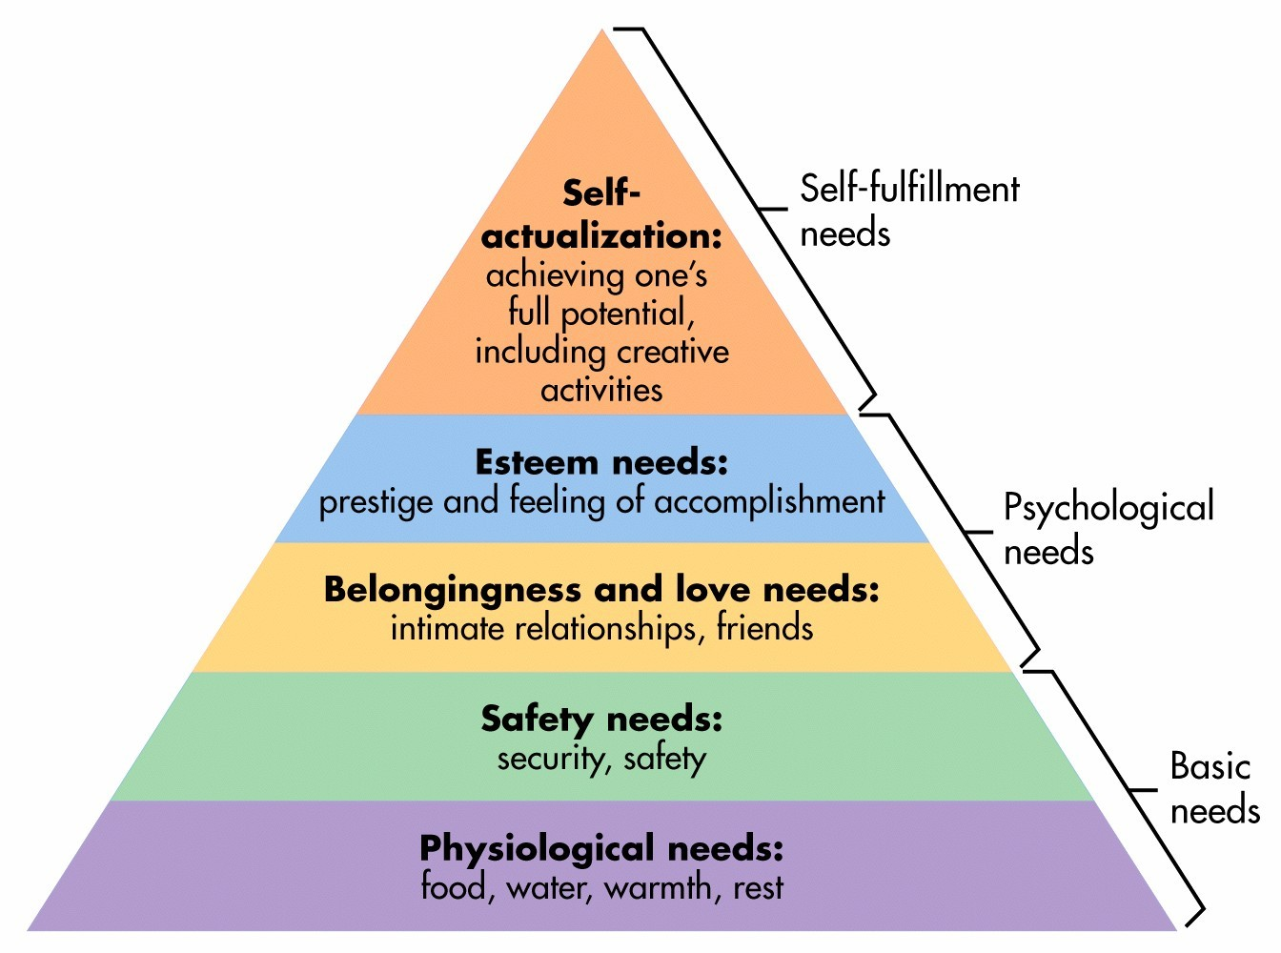
The basic needs of life
Maslow’s pyramid – without the basics in place we can’t build
We can’t move to the next step until we have imbedded the steps beneath
The basic needs are the building blocks to self fulfilment
If the basic needs are taken way the pyramid falls
attract potential residents.

Slide 4
The Basic needs of care home management -Key Lines of enquiry - Safe
S1 How do systems, processes and practices safeguard people from abuse?
S2 How are risks to people assessed and their safety monitored and managed so they are supported to stay safe and their freedom is respected?
S3 How does the service make sure that there are sufficient numbers of suitable staff to support people to stay safe and meet their needs?
S4 How does the provider ensure the proper and safe use of medicines?
S5 How well are people protected by the prevention and control of infection?
S6 Are lessons learned and improvements made when things go wrong?

Slide 5

What are we missing? - Safe
S1 – Issues with the recruitment process
References and DBS not evidenced, Gaps in employment. No PIN tracker
S4 – Medication issues
Lack of oversight, no evidence of audit, competencies, lessons learned from errors
S6- safeguarding
investigations not evidencing lessons learned. Safeguarding alerts raised by externals, not identified internally. CQC notifications not always raised with safeguarding
This Photo by Unknown Author is licensed under CC BY-SA-NC

Slide 6
The Basic needs of care home management -Key Lines of enquiry- Effective
E1 Are people’s needs and choices assessed and care, treatment and support delivered in line with current legislation, standards and evidence-based guidance to achieve effective outcomes?
E2 How does the service make sure that staff have the skills, knowledge and experience to deliver effective care and support?
E3 How are people supported to eat and drink enough to maintain a balanced diet?
E4 How well do staff, teams and services within and across organisations work together to deliver effective care, support and treatment?

Slide 7
The Basic needs of care home management -Key Lines of enquiry- Effective
E5 How are people supported to live healthier lives, have access to healthcare services and receive ongoing healthcare support?
E6 How are people's individual needs met by the adaptation, design and decoration of premises?
E7 Is consent to care and treatment always sought in line with legislation and guidance?

Slide 8

What are we missing? - Effective
E1 – Lack of understanding of MCA
Care plans not built from assessments including MCA
E2 -Training not evidenced effectively
Training needs analysis for staff groups
Matrix kept live
E7 –Consent not evidenced
Evidence in records and in day to day interactions
This Photo by Unknown Author is licensed under CC BY

Slide 9
The Basic needs of care home management -Key Lines of enquiry- Caring
C1 How does the service ensure that people are treated with kindness, respect and compassion, and that they are given emotional support when needed?
C2 How does the service support people to express their views and be actively involved in making decisions about their care, support and treatment as far as possible?
C3 How are people's privacy, dignity and independence respected and promoted?

Slide 10

What are we missing? - Caring
Lack of evidence of the residents being involved in decision making
Decision making and involvement in the running of the home.
Decision making and involvement in their own care planning and showing adaptive ways of supporting this
This Photo by Unknown Author is licensed under CC BY

Slide 11
The Basic needs of care home management -Key Lines of enquiry- Responsive
R1 How do people receive personalised care that is responsive to their needs?
Include Accessible Information Standard
R2 How are people’s concerns and complaints listened and responded to and used to improve the quality of care?
R3 How are people supported at the end of their life to have a comfortable, dignified and pain-free death?

Slide 12

What are we missing? - Responsive
R1- Accessible information standard– not communicating to our residents in a way that they can understand.
Evidence of adaptive ways of passing on information about the Home
R2 – Complaints
Not communicating with residents & relatives before issues become complaints.
Investigations not identifying lessons learned and change in practice

Slide 13
The Basic needs of care home management -Key Lines of enquiry – Well Led
W1 Is there a clear vision and credible strategy to deliver high-quality care and support, and promote a positive culture that is person-centred, open, inclusive and empowering, which achieves good outcomes for people?
W.2 Does the governance framework ensure that responsibilities are clear and that quality performance, risks and regulatory requirements are understood and managed?
How the provider understands and acts on the Duty of Candour, which is their legal responsibility to be open and transparent with people when something goes wrong.

Slide 14
The Basic needs of care home management -Key Lines of enquiry – Well Led
W3 How are the people who use the service, the public and staff engaged and involved?
W4 How does the service continuously learn, improve, innovate and ensure sustainability?
W5 How does the service work in partnership with other agencies?

Slide 15

What are we missing – Well Led
W1 – Share the vision and strategy
Lack of evidence that the whole team understand the organisation vision and strategy. Sometimes this includes senior management
W2 – Governance framework not well managed
Audits not carried out or not in line with policy timescales
Action plans in audits not reviewed and completed.
Audits being treated as stand alone exercise and not way of identifying things that need fixing and fixing them
This Photo by Unknown Author is licensed under CC BY-NC-ND

Slide 16


Get the basics right on the way to the best care service that you can deliver!
This Photo by Unknown Author is licensed under CC BY-ND

Slide 17

Any Questions?

