Slide 1


2022 Quality Assurance

Slide 2



Mick Feather.
Care Business Manager
Getting Inspection ready in 2022!
150 CQC reports… what do they tell us?
What is a safety culture?
Agenda
Workshop/Audience participation
50 CQC reports 2019
50 CQC reports 2020
50 CQC reports 2021
Quality Assurance
Creating a safety culture

Slide 3






Participation time!
What do you do to maintain quality assurance?
How do you know you are maintaining good governance?
What audits do you complete?
Do the audits provide information to improve the service?
Do you document the improvements?

Slide 4

50 CQC reports 2019.
Top 10 areas
Care plans
Risk Assessments
Quality Assurance
Medication Management
Recruitment
Mental Capacity Act
Staff training
Supervisions
Environment
Fire Safety.
August 2019 – December 2019
11 Residential Care
15 Domiciliary Care Agencies
2 Supported Living service
15 Nursing Homes
5 Residential Care (LD)
2 Extra Care service.

Slide 5
50 CQC reports 2020.
August 2020 – December 2020
25 Residential Care
15 Domiciliary Care Agencies
2 Supported Living service
5 Nursing Homes
1 Residential Care (LD)
2 Extra Care service.
Top 10 areas
Care plans
Risk Assessments
Quality Assurance
Infection Control
Medication management
Staff training/supervisions
Recruitment
Consistency of staff (Dom Care)
Mental Capacity Act/consent
Complaints.

Slide 6
50 CQC reports 2021.
September 2021 - December 2021
11 Residential Care
14 Domiciliary Care Agencies
4 Supported Living service
10 Nursing Homes
9 Residential Care (LD)
2 Extra Care service.
Top 10 areas
Quality Assurance
Risk Assessments
Medication management
Care plans
Insufficient staff
Records
Infection Control
Recruitment
Environment
Fire safety – PEEPs.

Slide 7

3. Medication management.
“There was no documentation to support the use of topical medicines. Staff did not have appropriate information to ensure the correct application of these medicines.”
“Protocols for as and when required medicines were not in place to guide staff on how and when to administer these medicines.”
“Medication audits did not identify the lack of recording for PRN and topical medicines that we identified during the inspection.”
“Medicines were not stored in line with safety guidance.”
“Medicines were not disposed of safely. The providers policy for the safe disposal of medicines was not being followed.”
Accurate records were not maintained for controlled medicines.
“Staff were not consistently completing medicines administration records (MAR).”
“The pain patch had not been applied according to these instructions. Sometimes it had been changed too early and sometimes too late. This left people at continued risk of pain and discomfort.”

Slide 8

2. Risk assessments.
“There was a failure to assess, monitor and mitigate risks relating to the health, safety and welfare of people.”
“People's risk assessments and care plans did not always contain detailed information for staff to be able to safely manage risks to people.”
“The provider did not always safely monitor and manage risks to people. Two people continued to lose weight after being referred to the dietician and a plan being put in place.”
“One person was at risk of choking. There was a risk assessment in place. There was guidance in place about how to prevent the person from choking but no guidance around what staff should do if the person started to choke. Staff were able to explain the action they would take. However, there was a risk that not all staff would know what to do if an emergency situation arose.”
“Staff did not always have clear guidance on the actions they should take to protect people from avoidable harm. Risk assessments did not always have the correct information recorded to make sure people received the care and support they needed in the safest way.”

Slide 9

1. Quality assurance.
“Governance processes were not effective in identifying some service shortfalls. There was not an adequate process for assessing and monitoring the quality of the services provided or to ensure that records were accurate and complete.”
“Systems and processes for audit and quality assurance were in place but had not been fully utilised. Areas for improvement had not been fully explored at the time of this inspection.”
“The provider had day to day oversight of the service but lacked robust governance systems which would provide them with assurances that people's care needs were being delivered safely and effectively.”
“Systems to monitor the quality of the service were not robust.”
“Leadership and governance of the service were not effective in identifying some service shortfalls.”
“There was a failure to evidence the outcome of these audits had been used to drive improvements and mitigate further risks to people.”
“There was a lack of effective oversight and monitoring of the service. Strategic governance and quality monitoring processes had failed to ensure compliance with regulations.”
Notes:
There was a lack of provider oversight to the audits in place or ensuring they were in place.
Provider audits or quality assurance checks had not been completed. The registered manager told us the regional manager had not undertaken checks, so the provider was not always sure, improvements had been identified or actions taken.

Slide 10
Four key areas.
Culture
Service users
Staff
Quality Assurance
Quality Assurance
Culture

Slide 11
Definition – Quality Assurance.
Health and Social Care Act 2008 (Regulated Activities) Regulations 2014: Regulation 17
The intention of this regulation is to make sure that providers have systems and processes that ensure that they are able to meet other requirements in this part of the Health and Social Care Act 2008 (Regulated Activities) Regulations 2014 (Regulations 4 to 20A).
To meet this regulation; providers must have effective governance, including assurance and auditing systems or processes. These must assess, monitor and drive improvement in the quality and safety of the services provided, including the quality of the experience for people using the service. The systems and processes must also assess, monitor and mitigate any risks relating the health, safety and welfare of people using services and others. Providers must continually evaluate and seek to improve their governance and auditing practice.
In addition, providers must securely maintain accurate, complete and detailed records in respect of each person using the service and records relating the employment of staff and the overall management of the regulated activity.
As part of their governance, providers must seek and act on feedback from people using the service, those acting on their behalf, staff and other stakeholders, so that they can continually evaluate the service and drive improvement.

Slide 12
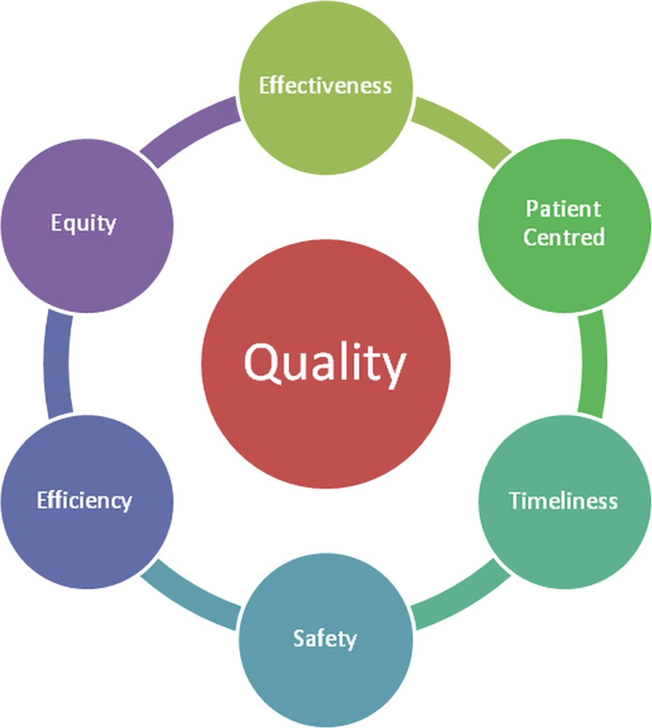
Definition – Quality Assurance.
Defining Quality
QA Triangle
Improving Quality
Measuring Quality
6 Domains of Health Care Quality –Institute of Medicine, Washington
Notes:
Safe: Avoiding harm to patients from the care that is intended to help them.
Effective: Providing services based on scientific knowledge to all who could benefit and refraining from providing services to those not likely to benefit (avoiding underuse and misuse, respectively).
Patient-centered: Providing care that is respectful of and responsive to individual patient preferences, needs, and values and ensuring that patient values guide all clinical decisions.
Timely: Reducing waits and sometimes harmful delays for both those who receive and those who give care.
Efficient: Avoiding waste, including waste of equipment, supplies, ideas, and energy.
Equitable: Providing care that does not vary in quality because of personal characteristics such as gender, ethnicity, geographic location, and socioeconomic status.

Slide 13

Definition – Good Governance.
Well-led
The leadership, management and governance of the organisation assures the delivery of high-quality and person-centred care, supports learning and innovation, and promotes an open and fair culture.
Outstanding
Governance is well-embedded into the running of the service. There is a strong framework of accountability to monitor performance and risk leading to the delivery of demonstrable quality improvements to the service. Leaders and managers see this as a key responsibility.
Good Governance is:
putting processes in place and ensuring that your team do what you say they do. The processes in place should reflect best practice guidelines where they exist. The management team, or provider needs to be able to demonstrate they monitor processes and take action to ensure that what is happening, is what they believe should be happening.
Tip: Consider self–evaluation or self-assessment
How good are we now?
How do we know?
What do we plan to do next?

Slide 14

Create a Safety culture.
Safety culture is a combination of the attitudes, values and perceptions that influence how something is actually done in the workplace, rather than how it should be done.
Poor safety culture has contributed to many major incidents and personal injuries,
and can be just as influential on safety outcomes as an organisation's safety management system itself.
https://www.hsl.gov.uk/what-we-do/safety-culture
Health & Safety Executive
“NHS staff are not supported by sufficient training, and because the complexity of the current patient safety system makes it difficult for staff to ensure, safety is an integral part of everything they do.”
https://www.cqc.org.uk/sites/default/files/20181224_openingthedoor_report.pdf
CQC report 2018
Safety culture is the collection of the beliefs, perceptions and values that employees share in relation to risks within an organisation.
Safety culture is defined as the way in which safety is managed in a workplace.

Slide 15
Safety culture questions.
Care Plans
Are care plans, charts and records up to date and fully completed?
Are all records accurate, complete and maintained?
Are there any care plans, Risk Assessments and staff guidance notes that conflict?
Are electronic systems consistent with paper records?
Risk Assessments
Are all risks to people’s safety assessed and recorded?
Have risks been translated in to practical staff guidance?
Medication management
Is administration and storage of medicines safe?
Are staff trained to carry out administration of medicines?
MAR charts/PRN/Covert/Controlled Drugs
Infection Control
Are infection control processes and procedures followed?

Slide 16
Safety culture questions.
Environment
Is the environment safe?
Is it clean?
Staffing levels
Do staffing levels meet people’s needs?
Does your dependency tool highlight any gaps in staffing levels?
Is it reviewed regularly?
Staff recruitment
Is staff recruitment robust? (DBS / references / gaps in employment history).
Staff training
Are staff trained and competent to carry out their roles?
Are staff supervisions and appraisals completed regularly?
CQC notifications
Are all reportable incidents notified to CQC and Local Authority?
Are safeguarding procedures followed and understood?

Slide 17


Safety culture questions.
Quality Assurance
Do you have effective governance systems?
What works well, what needs improvement?
What has improved?
Culture
Is the culture open, inclusive and positive?
Are equality characteristics fully considered?
Is it reviewed regularly?
Surveys
Have you completed a recent survey of residents/clients, staff and family/friends?

Slide 18

Questions.
Feedback.

Slide 19


Thank you!
© The contents of this presentation are copyright of Citation Professional Solutions and may not be reproduced or copied in any form without written consent.
Version 1 Updated 14 February 2022.

