Slide 1

Meeting CQC requirements - support from Skills for Care
Laura Anthony, Locality Manager – SW London

Slide 2
Skills for Care resources – Preparing for CQC inspection
Understanding what the CQC expects from regulated providers can help you be prepared for inspection and demonstrate that you are delivering Good and Outstanding care
Preparing for your CQC inspection checklist – this is based on recommendations from frontline managers and helps you reflect on what you will need to evidence
Preparing for CQC inspection action plan - This template can be used to document your activity and goals in preparing for inspection
Download HERE

Slide 3
Improving your CQC rating
Improving your CQC rating checklist – This checklist enables you to reflect about how you can improve and establish the building blocks for continuous improvement
Improving your CQC rating action plan - This template can be used to document your goals, ambitions and plans of how improvements are going to be measured and managed within clear timeframes
Guide to Improvement - a comprehensive resource developed in consultation with a range of different regulated care providers with one thing in common; they have all fallen below the CQC standards and successfully improved
Download HERE

Slide 4
Outstanding care
Striving for outstanding checklist – This checklist can be used to reflect on whether your service is ready to evidence you are delivering outstanding levels of care. It can help you to reflect on what additionally may be needed to achieve this rating from the CQC.
Striving for outstanding action plan - Document your goals, ambitions and plans of how improvements are going to be measured and managed within clear timeframes, as well as recording progress.
Case study videos – find out what outstanding-rated providers do to achieve and maintain their rating
Download HERE

Slide 5
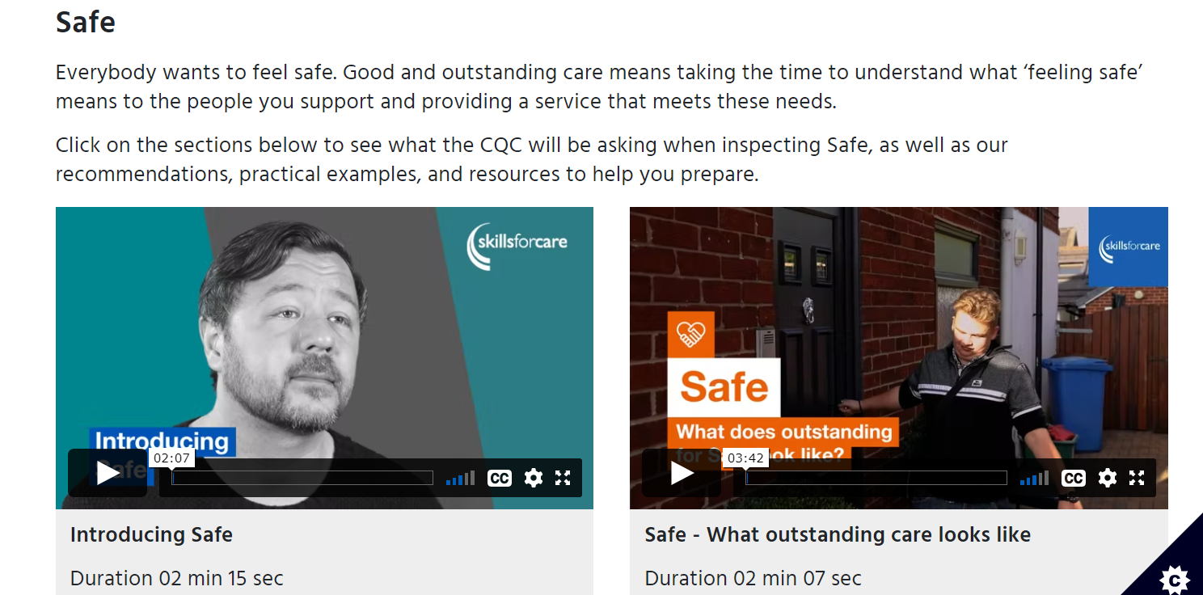
Inspection toolkit
The toolkit includes exercises, examples, recommendations and resources to help you understand CQC expectations:
Access HERE

Slide 6
Virtual learning modules
Being prepared for CQC inspection
Improving your CQC rating
Striving for Outstanding – coming soon
Modules cost £10 each to access (or £9 if your organisation uses the Adult Social Care Workforce Data Set) BUT you can claim back £50 for each module from the Workforce Development Fund. This funding contributes towards the cost of the digital learning, the employees’ time required to complete the module, and the time taken to apply and embed the learning within their organisation.

Slide 7
Online seminars
Being prepared for CQC inspection
Improving your CQC rating
Striving for Outstanding – coming soon
These provide information, activities and an opportunity to network with other providers facing similar issues
October dates have now sold out, but dates for early 2023 will be announced soon – keep an eye on our events page: www.skillsforcare.org.uk/events

Slide 8
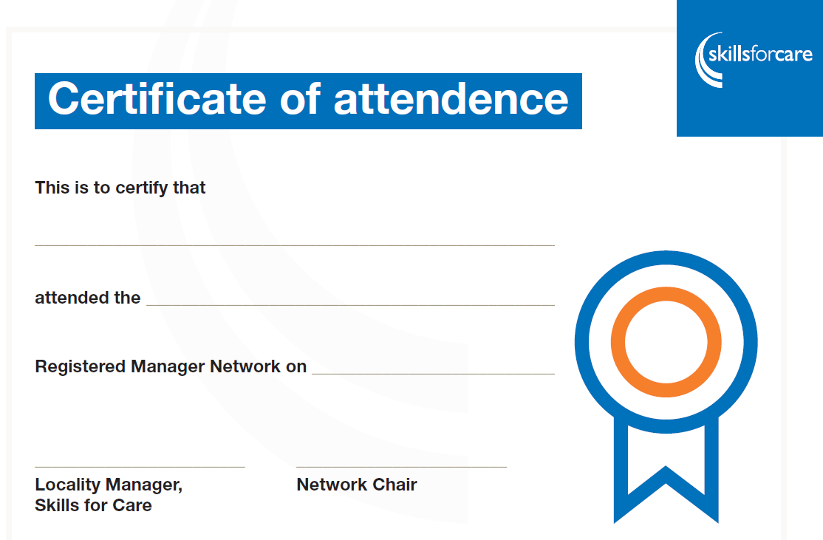
Attendance Certificates

Slide 9
Contact details
Laura Anthony
Skills for Care Locality Manager – SW London
07890 514106
laura.anthony@skillsforcare.org.uk
www.skillsforcare.org.uk/register

