Slide 1
Helping you get #RecruitmentReady
Recruiting new workers can be challenging at any time, but the impact of the COVID-19 pandemic has made this challenge even greater.
We can provide support to help you find and keep the right people. From our research and work with employers across the sector we know what has worked well for others.

Slide 2
Recruitment tips
Speak to your local Jobcentre Plus to find out about current initiatives i.e. Sector-Based Work Academy Programmes; Kickstart. Also – send them detailed information about your current vacancies
Speak to your local authority – some are running recruitment programmes
Get in touch with local colleges and universities – students who have recently completed courses may be looking for work
The Prince’s Trust is working to support young people into the sector and is looking for employers with vacancies
Look into widening the pools you recruit from – Seeing Potential resources; Skills for Care guidance on recruiting from different demographic groups

Slide 3
Recruitment tips cont…
Link with other care providers to ensure we keep those interested in social care – for example dom care services might not be able to take people on because they can’t drive
Speak to local employment services i.e. Croydon Works
Use free jobs boards i.e. DWP’s Find a Job; Nextdoor – two free business posts a month
Link with local voluntary sector organisations – they may know of volunteers looking to move into paid work
Speak to your Locality Manager to find out about local initiatives i.e. Proud to Care London
Attend some sessions to boost your ideas:
  Skills for Care Values Based Recruitment & Retention Workshops

Slide 4
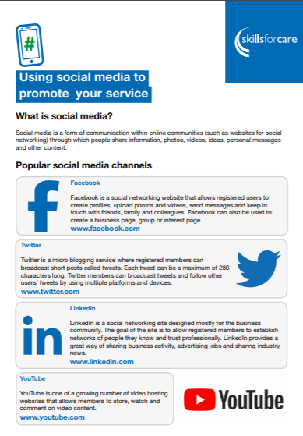
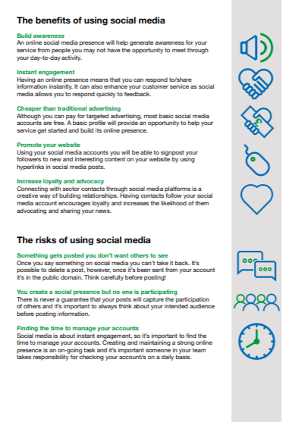
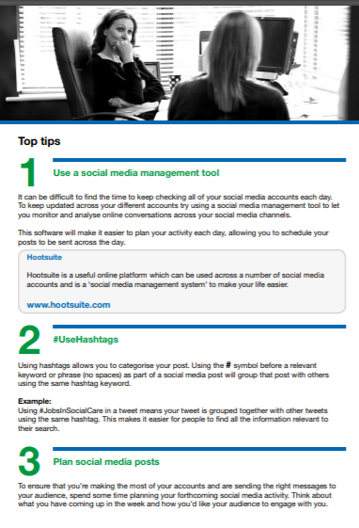
Using social media to support your service
Skills for Care has developed some guidance to support employers to use social media to promote their service, particularly in relation to recruitment activity.
www.skillsforcare.org.uk/SocialMediaTips

Slide 5
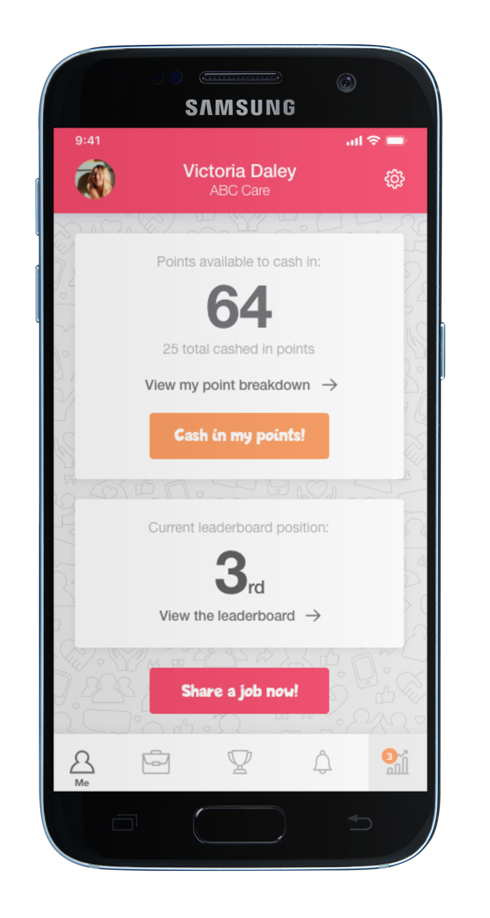

Care Friends – the employee referral app for social care
Since its launch in June 2020, over 11,000 care workers have downloaded the app, there have been 160,313 job shares and 9,292 candidates have been generated.
How does it work?
Add job vacancies from the Care Friends portal
Employees see job vacancies in app and share with their friends and contacts
Track progress of candidates through portal.
For more information visit: www.carefriends.co.uk

Slide 6
Recruitment: How do we attract more and better quality applications which progress to employment?
  Promote what your organisation does well
  Be clear about the job - and benefits of working for you (training, structured inductions, flexibility, progression)
  Think about your job titles – do they really reflect the work people do?
  Enhance your approach to Values-Based Recruitment
  Think about whether you’re ruling applicants out unnecessarily by asking for qualifications and previous experience
  Sharpen up your recruitment message and adverts
  Be responsive and professional with applicants, explain the process and timelines
  Revisit application forms – reduce length; look into whether applications can be made via mobile phone

Slide 7
Recruitment resources
Skills for Care Website
https://www.skillsforcare.org.uk/Recruitment-support/Attracting-people/International-recruitment.aspx
On this link you will find:
Recruitment planning
Attracting People
Application and selection process
Retaining your workforce
Workshops and seminars

Slide 8
ASC-WDS Benefits Bundle – new discounts added
The ASC-WDS Benefits Bundle is available to all new and existing users of the service, and it offers access to special offers and discounts across our products.
The first of our Skills for Care endorsed training providers have added their support to the Benefits Bundle with offers that will allow care providers to save on training for their staff.
Coleman Training and Consultancy,
The National Activity Providers Association (NAPA)
The Medication Training Company.
To find out more about the Benefits Bundle, learn more about the ASC-WDS service or create an account, visit our dedicated webpage
www.skillsforcare.org.uk/ASCWDS

Slide 9

#HappyHealthyWorkplace
Throughout May and June, Skills for Care will be focusing on creating a happy and healthy workplace
A happy and healthy team is a productive team, a team who will go above and beyond to deliver the highest quality of care to people who draw on support.
While the events of the past two years have undoubtably impacted the wellbeing of the people working in social care, we’ve also seen examples of fantastic creativity and understanding for the ways that we look after ourselves, as well as one another.
We have lots of resources which can help you with creating and maintaining a happy and healthy workplace and we will be publishing blogs and articles that share advice and real life examples.
Find out more information on our website

Slide 10
Good and outstanding care (GO) resources and support
Preparing for your CQC inspection
An introductory virtual learning module, practical checklist and opportunities to commission in further experience.
Inspection toolkit
This toolkit includes recommendations, examples and resources to help you understand expectations.
Improving your CQC rating
Resources to help services improve their rating including a practical checklist, Action Plan resource, full guide and virtual learning module.
Outstanding care
Resource to help you achieve Outstanding including a checklist, Action Plan resource and films. Virtual learning module due summer 2022

Slide 11
Launch of Liberty Protection Safeguards (LPS) consultation
The Government has launched a public consultation on proposed changes to the Mental Capacity Act (MCA) Code of Practice for England and Wales, which includes guidance on the new LPS system. As part of the consultation, the Government are asking for feedback on a consultation document and a Code of Practice via an online survey.
The proposed changes include significant new responsibilities for many adult social care settings and roles, including services supporting children aged 16-18 and services providing support to people in their own homes.
We’re encouraging all adult social care providers and those with an interest in the training and development of the sector to get involved with the consultation. The closing date is Thursday 7 July 2022.
Get involved with the consultation

Slide 12
New programme: Forefront
Forefront is a new programme designed to help those working directly with people drawing on care and support to start their leadership journey and provide an understanding of what they need to do to develop their career.
While designed specifically to meet the needs of workers from a minority ethnic background, we also recognise the value for workers from wider backgrounds in supporting equality, diversity and inclusion within their organisations. All topics covered within the programme will form part of an action plan for the participant to use within their own role.
Employers can claim £50 per participant, per module from the
Workforce Development Fund.
www.skillsforcare.org.uk/forefront

Slide 13

Universal Principles for Advance Care Planning (ACP)
NHS E&I have developed these principles working with Skills for Care and partners across health and social care.
The six high level principles for advance care planning set out clearly a personalised approach for individuals and families and all those who support them on their end of life journey
This work has been in response to the CQC report ‘Protect, Connect, Respect – decisions about living and dying well’ (2021).
Download the document

Slide 14
What learning and development opportunities do the care sector need?
Skills for Care wants to ensure that we continue to support the sector and are responsive to its learning and development needs
We’re running some small events to understand more about what people working in the sector think about the learning and development opportunities available to them. Come along and have your say…
Events for providers with less than 250 employees
Wednesday 18 May 2022 | 10:30 – 12:00
Events for learners
Thursday 19 May 2022 |10:30 – 12:00
Find out more www.skillsforcare.org.uk/TellUs

Slide 15
Social media masterclasses for recruitment
Skills for Care is working with marketing strategist Paul Ince of marketing agency LikeMind Media to deliver a series of masterclasses to support social care recruiters in using social media to find and keep staff.
Each masterclass is free and open to anyone currently working for an adult social care provider organisation who is involved in recruitment, employee engagement, and workforce planning.
Tuesday 14 June | 10:00 -11.30 | Using Twitter to boost your recruitment and retention
Tuesday 5 July | 10:00 - 11.30 | Using LinkedIn
Tuesday 2 August | 10:00 -11.30 | Using TikTok
Find out more

Slide 16
Modern Slavery: Awareness information for social care providers
The National Care Forum and Skills for Care are offering an online workshop for those interested in understanding more about modern slavery in the UK today and helping to identify when someone might be a victim.
Attendees will gain a wider knowledge of the dynamics at play in modern slavery situations, help in identifying red flags and how to signpost to the relevant services.
Tuesday 7 June 2022 | 13:30 - 15:00 - book now

Slide 17

Upcoming webinar…
Take a virtual tour of the Adult Social Care Workforce Data Set (ASC-WDS)
Tuesday 21 June 2022 I 10:00 – 10:45
This session is designed to give social care providers who do not yet have an ASC-WDS account a demonstration of how the service works. It will be a practical demonstration of the service and will show you first-hand the key features which are already being used by over 20,000 care providers.
Benefits of an ASC-WDS account include:
Eligibility to claim from the Workforce Development Fund.
Record key information about your staff.
Access exclusive discounts and offers with the ASC-WDS Benefits Bundle.
Register for the webinar

Slide 18
New recorded webinar…
Wellbeing leadership – what does good look like?
In our latest recorded 30-minute webinar, we focus on wellbeing leadership, what good looks like and best practice with practical tips, tools and ideas.
The webinar talks about compassionate leadership and psychological safety, as well as exploring courageous conversations about wellbeing.
You’ll also hear from others how they create a wellbeing
culture.
View the webinar

Slide 19
Deputy manager networks
These networks are specifically for deputy managers, team leaders and assistant managers
Virtual meetings facilitated by a Skills for Care Locality Manager.
Great opportunity for deputies to meet the challenges they face in their day-to-day work.
Opportunity to build connections and a peer supportive network.
Facilitate the sharing of best practice and learning.
The next DM network for your area is
13th July 10-12
www.skillsforcare.org.uk/deputymanagers

Slide 20

Advice line for managers
If you are a social care manager, we can help you to recruit and retain staff, develop your team, strengthen leadership, and meet CQC expectations around quality of care.
Our team can help you with:
resources
wellbeing
online learning
funding
latest guidance and advice
Call
0113 241 1260
Email
RMAdvice@skillsforcare.org.uk

