Slide 1
Aghileh Hatami
Registered Manager
I am an Iranian qualified nurse and have been working in both the clinical and community setting since 1997, and currently, I am the Registered Manager of the company.

Slide 2
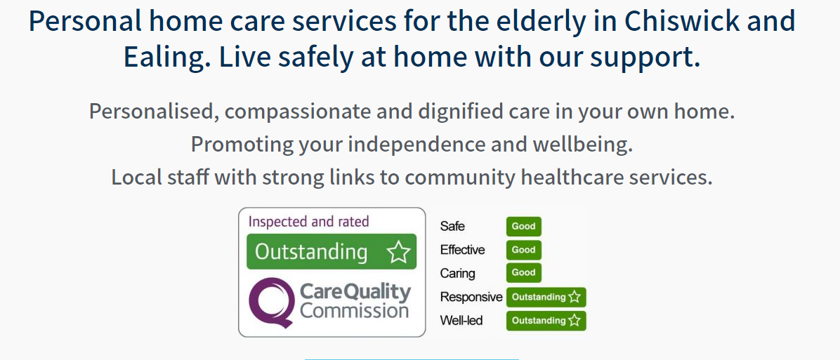
Care Concern Homecare Ltd
Care Concern was founded in 1993. The company has seen the implementation of regulations and seen them evolve to where we are today. During this time, we had to keep improving and continuously develop our skills and knowledge, but ultimately the foundation of our care provision has always rested in getting the fundamental part right. What this means is putting the client at the center of care and responding to their care needs efficiently, promptly, and competently.

Slide 3
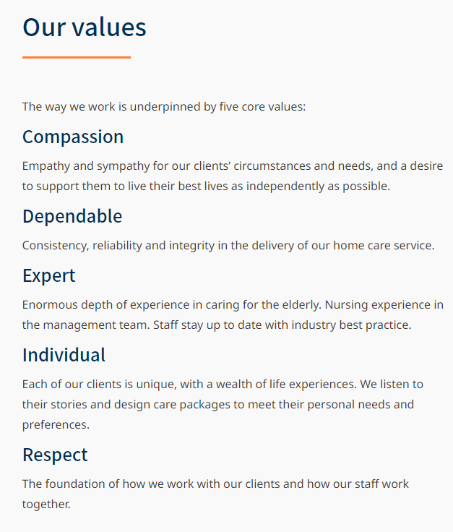
Our values

Slide 4
How we managed to maintain our Outstanding Rating

Slide 5
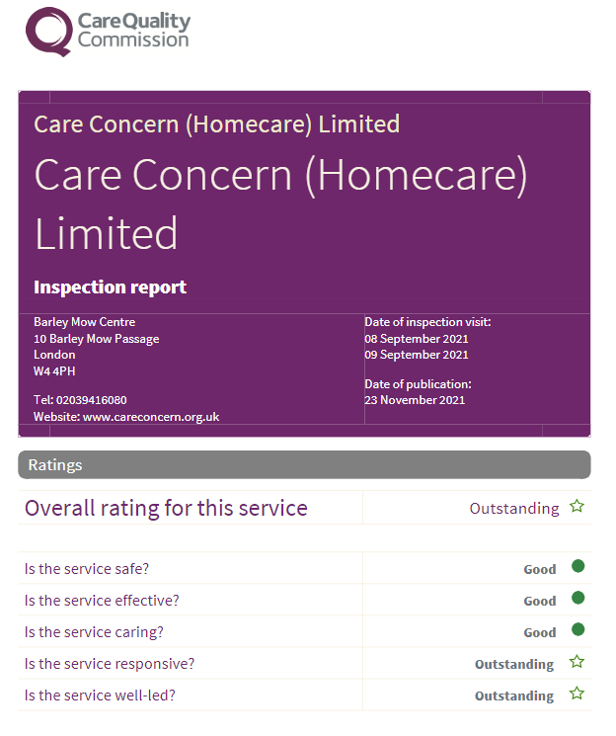
Our key to success
Communication & Prompt Information Sharing
Time Management & Prioritizing
Staffing & Training
Group Discussion & Decision Making
Staff support, Peer support, Phone calls
Digital system, Innovation & Virtual meetings
Keeping up to date & right PPE
Communicating with our CQC inspector
Working efficiently with other professionals
Reflecting & Learning from mistakes
Personal Development & Building Personal skills (resilience & empathy)

Slide 6
What we have learnt
The first thing we learnt was that there was never an end to our learning
We had to continue learning especially while dealing with an unprecedented situation/current pandemic
Being available to speak to staff whenever they need support or when they have a concern plays an incredible role in strengthening the relationships
Not avoiding difficult conversations; These conversation are to clarify and avoid assumptions
Being transparent with staff and clients (considering GDPR guidelines): showing them that you are a human with feeling not just a manager with some rigid instructions
Continuously reviewing our policies and procedures
Networking and attending Skills for care, Homecare Association, CQC and other relevant webinars have been invaluable
"We learnt that we too deserve a pat on the back, and celebrate our achievements"

Slide 7
Any questions?

Slide 8
Check our website:
https://careconcern.co.uk/
Contact number: 02039416080

