Slide 1
Digital Update
- DSPT
- DSCR
Paul Harper - Project Manager
Care Home Digital Integration paul.harper@swlondon.nhs.uk
16th March ‘22

Slide 2

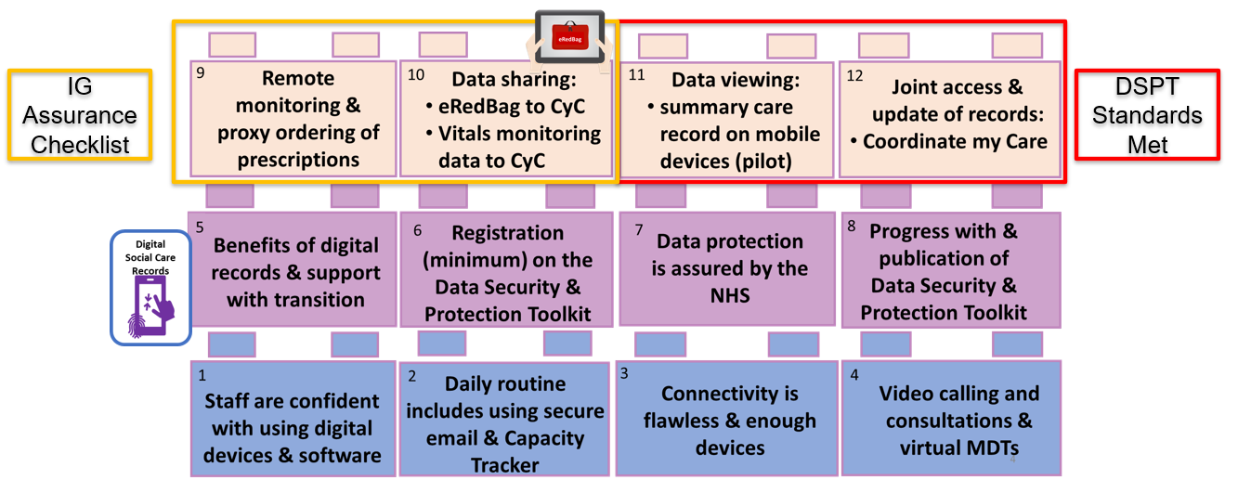
SWL’s current ‘digital’ offer for Care Homes :

Slide 3


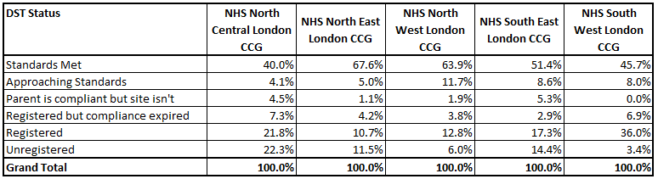
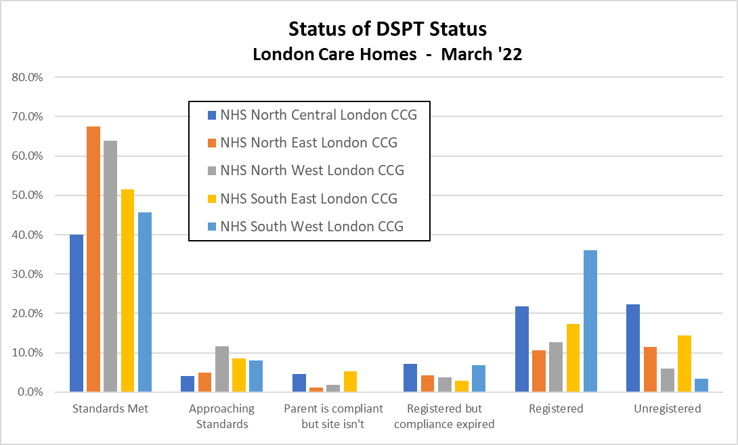
Update - March ‘22
How can SWLCCG Help ?
Daily 1:1 sessions available, with specialists, supporting IG Assurance Checklist and DSPT. Bookable through : swlcarehomes.admin@swlondon.nhs.uk

Slide 4
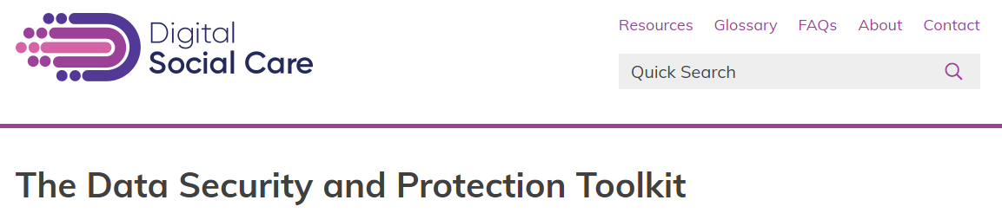

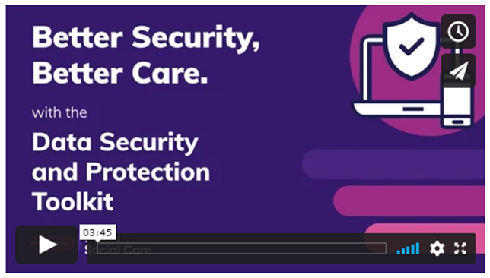
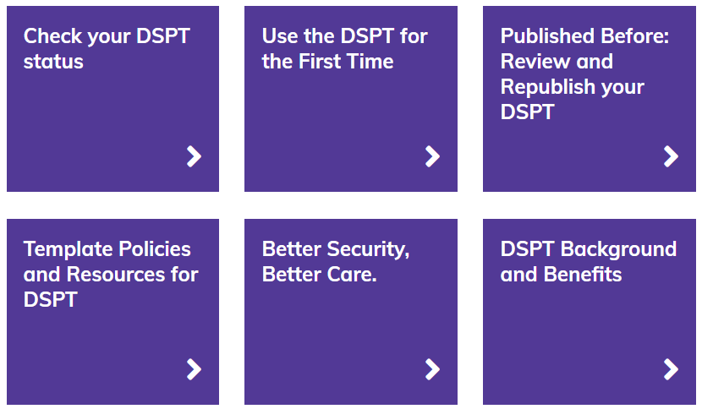

Top level navigation on the DSPT pages is now as follows :
Why not sign up to the Digital Social Care Newsletter :
Newsletter Signup - Digital Social Care
Digital Skills & Training - Digital Social Care
https://www.digitalsocialcare.co.uk/data-security-protecting-my-information/data-security-and-protection-toolkit/

Slide 5

Adult social care digital transformation
Enabling the adult social care system to make best use of digital tools and technology to deliver improved outcomes for people
Alongside the adoption of care technology, the NHS are supporting providers through the Digitising Social Care Records (DSCR) programme, aiming for 80% CQC-registered adult social care providers to have access to a digital social care record that can interoperate with a local Shared Care Record by March 2024.
A Digital Social Care Record (DSCR) allows the digital recording of care information and care received by an individual, within a social care setting, replacing traditional paper records. DSCRs are person-centred and enable information to be shared securely and in real-time with authorised individuals across the health and care sector.
DSCR will play an important role in joining up care across social care and the NHS, freeing up time spent by care workers and managers on administrative tasks whilst equipping them with the information they need to deliver care. They are the platform on which other remote care tools can integrate and can enable the greater personalisation of care planning that focuses on the individual.

Slide 6

Digitising Social Care Records
- why move from paper ?
The benefits of digital social care records include:
More relevant and timely data available to those supporting closer monitoring of people.
Improving efficiencies in process (digital records avoids manual input)
Improved staff retention (less time-consuming paperwork - means staff can focus on resident activities) and utilisation of staff resources
Improved readiness in social care providers for regulatory inspection (LA and CQC)
Improved experiences of staff taking part in MDTs as shared data is more comprehensive and up to date
Greater understanding of resources required to be fully digital social care provider with falls prevention abilities
Supporting new ways of working to help break down the barriers between social and health care (improved data flow to help optimise care planning and outcomes)
Less reliance on hand-writing and English skills as many systems have predictive text, voice to text and icon-based activities.
Reduced use of paper and print

Slide 7

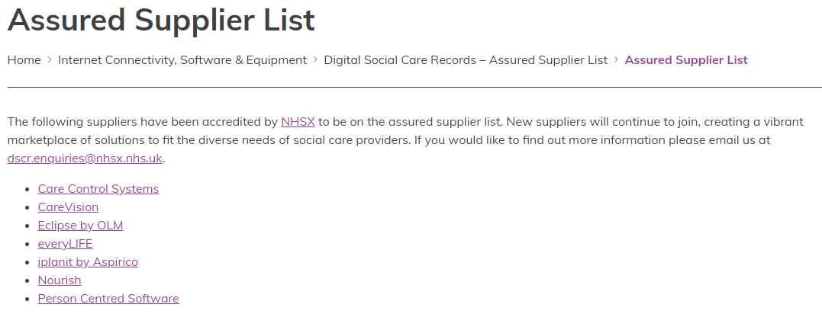
Digitising Social Care Records
NHSx Accredited Suppliers
You can watch short demo videos, read about what their software does and speak to suppliers
Assured Supplier List - Digital Social Care

Slide 8

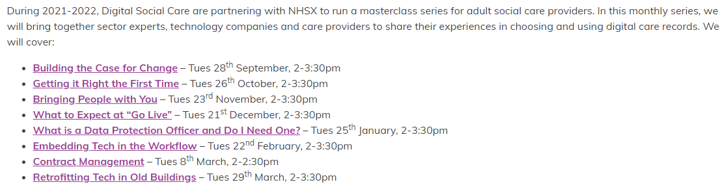
Adopting Digital Care Records - Masterclass Series
Digitising Social Care Records (DSCR)
Note : Please book early to avoid disappointment.
Recordings are available for events which have already taken place.
Adopting Digital Care Records - Masterclass Series - Digital Social Care

